Slide 1
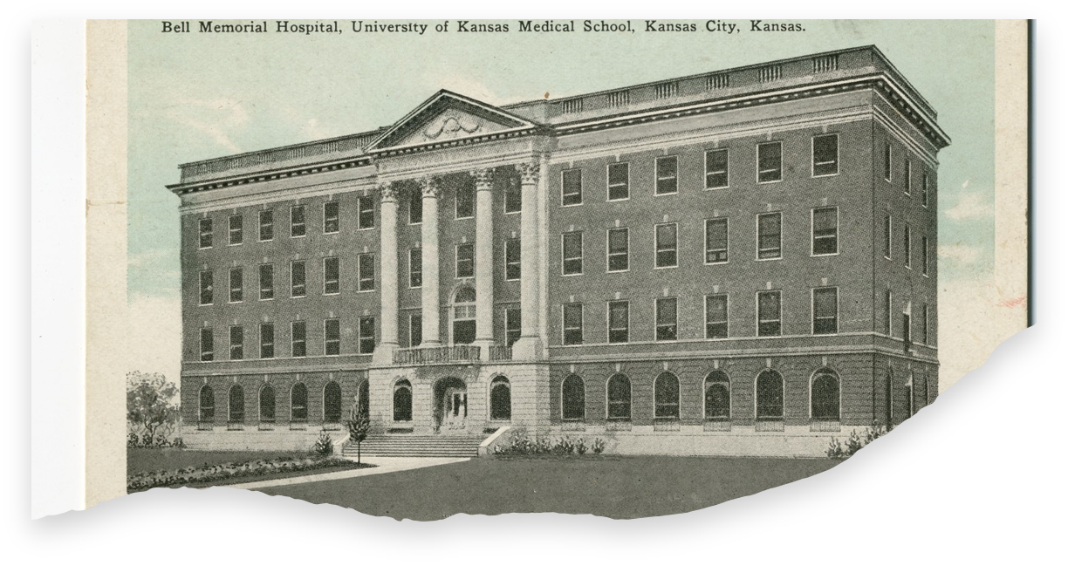
What’s New in TBI Rehabilitation 2026?
Brad Steinle, MD
Clinical Associate Professor
Department of Physical Medicine and Rehabilitation Medicine
University of Kansas School of Medicine

Slide 2
What’s New in TBI Rehabilitation 2026?
Disclosure of Relationships with Commercial Interests
Financial Relationships: In accordance with the Accreditation Council for Continuing Medical Education (ACCME) Standards for Integrity and Independence in Accredited Continuing Education, I disclose the following relevant financial relationships with commercial interests within the past 24 months:
I have no relevant financial relationships to disclose.

Slide 3
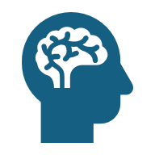
What’s New in TBI Rehabilitation 2026?
In 2021, there were an estimated 20.84 million new cases and 37.93 million prevalent cases of TBI globally, accounting for 5.48 million years lived with disability (YLDs)

Slide 4
What’s New in TBI Rehabilitation 2026?
The mechanism of TBI is two-fold: the acute phase, occurring immediately after the injury, and the chronic phase, involving complex cellular and molecular changes manifesting over many years.
PRIMARY INJURY
💥 Mechanical Damage • Skull fractures • Contusions • Lacerations • Diffuse axonal injury • Hemorrhage: - Epidural - Subdural - Subarachnoid
SECONDARY DAMAGE
⚠️ Cellular Cascade • Ischemia • Excitotoxicity (↑ glutamate) • Ca²⁺ influx • Mitochondrial failure • Free radicals • Inflammation • BBB breakdown

Slide 5
What's new in TBI Rehabilitation 2026
The core principles of TBI rehabilitation center on individualized, interdisciplinary care that is patient-centered, comprehensive, and accessible throughout the recovery continuum.
Rehabilitation services must be matched to the needs, strengths, and capacities of each person with TBI and modified as those needs change over time.
Core disciplines include physical therapy, occupational therapy, speech-language pathology, neuropsychology, physiatry, neurology, and behavioral health.
Persons with TBI and their families should have the opportunity to play an integral role in planning and designing their individualized rehabilitation programs.
Rehabilitation must include cognitive and behavioral assessment and intervention as core components.
Persons with TBI should have access to rehabilitation services through the entire course of recovery, which may last for many years after the injury.
Community-based, nonmedical services should be components of extended care and rehabilitation, including supported employment programs, formal education programs, day programs for social skill development, supported living programs, independent living centers, case management, and peer support programs.

Slide 6
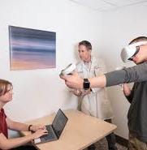
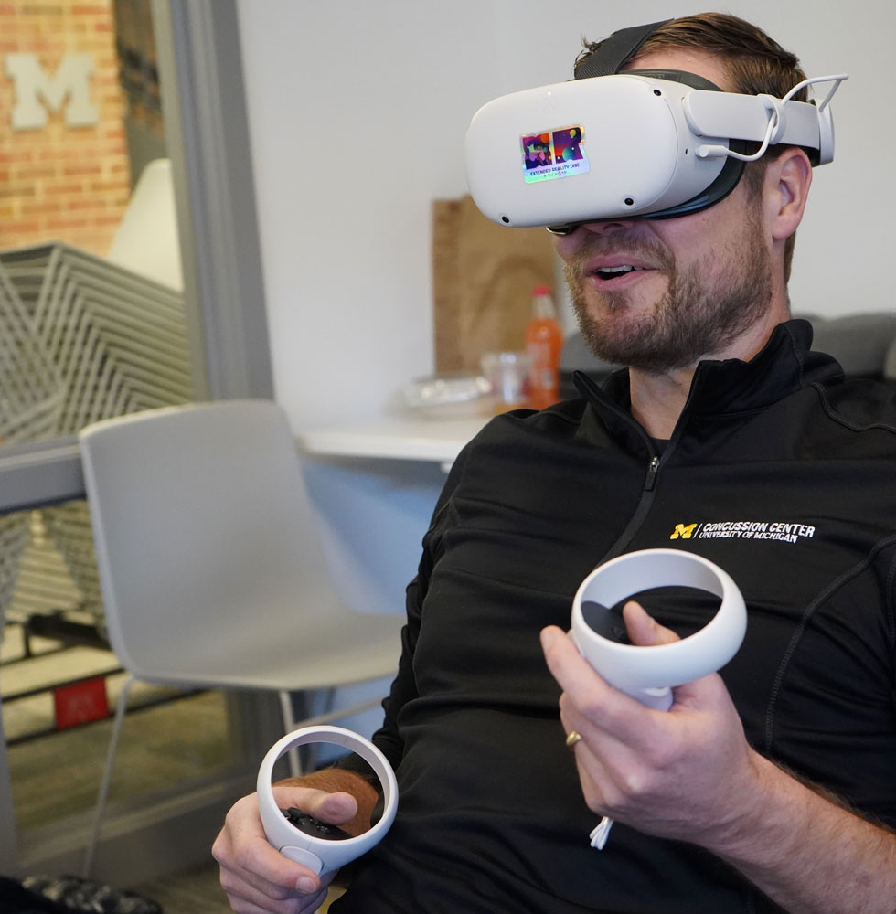
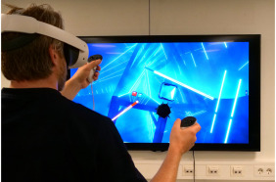
What's new in TBI Rehabilitation 2026
Virtual reality (VR) and robotics are expanding access to immersive, adaptable rehabilitation environments that improve cognitive performance, motor function, and patient engagement.

Slide 7
What's new in TBI Rehabilitation 2026?
Virtual Reality:
Systematic reviews suggest an effective treatment protocol of 10-12 sessions, 20-40 minutes in duration, 2-4 sessions per week for cognitive improvements in memory, executive function, and attention.
Alashram AR, Annino G, Padua E, Romagnoli C, Mercuri NB. Cognitive rehabilitation post traumatic brain injury: A systematic review for emerging use of virtual reality technology. J Clin Neurosci. 2019 Aug;66:209-219.

Slide 8
What's new in TBI Rehabilitation 2026?
Virtual Reality:
A 2025 meta-analysis found VR-based interventions more effective than traditional cognitive therapy, with significant improvements in global cognitive function (SMD: 0.64), executive function (SMD: 0.32), attention (SMD: 0.40), and social cognitive function (SMD: 0.46).
Chi K, Chen J, Zhou S, Han Z. The effectiveness of digital cognitive intervention in patients with traumatic brain injury: systematic review and meta-analysis. Front Neurol. 2025 Oct 7;16:1651443.

Slide 9
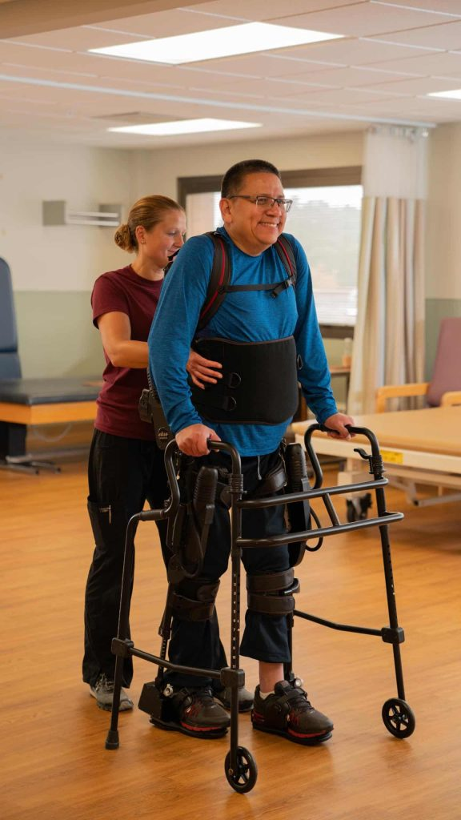
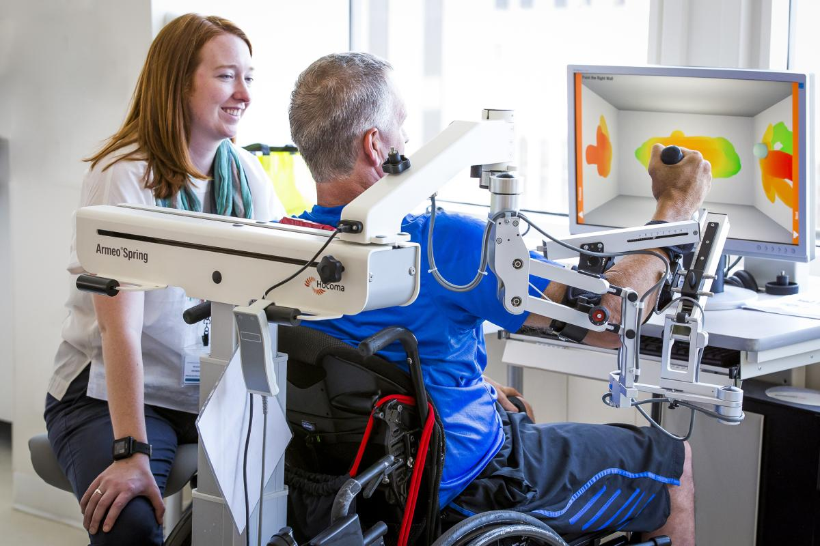
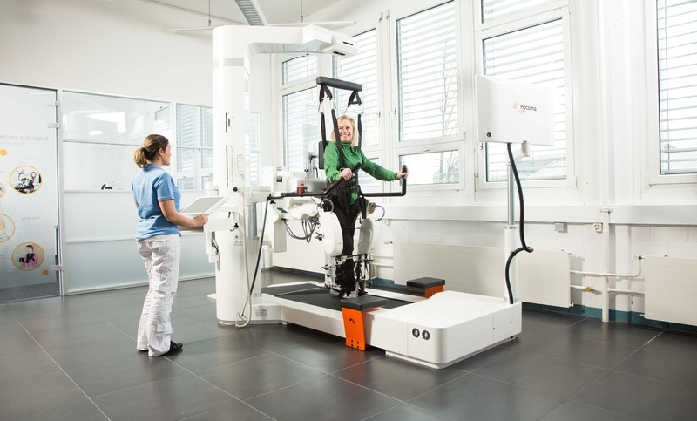
What's new in TBI Rehabilitation 2026?
Robotics:
Robotic rehabilitation in TBI encompasses technologies that provide repetitive, high-intensity, task-specific training to improve motor function, gait, and cognition through exoskeletons, end-effector devices, and humanoid robots. These systems facilitate neuroplastic changes by delivering consistent, measurable therapy that can reduce staffing requirements while maintaining or improving outcomes compared to conventional approaches.
Shen Y, Jiang L, Lai J, Hu J, Liang F, Zhang X, Ma F. A comprehensive review of rehabilitation approaches for traumatic brain injury: efficacy and outcomes. Front Neurol. 2025 Jun 13;16:1608645

Slide 10
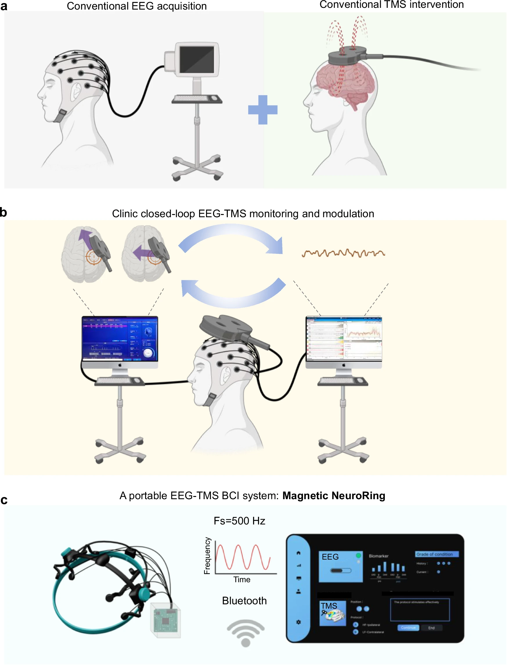
What's new in TBI Rehabilitation 2026?
Brain-computer interfaces and tele-rehabilitation platforms are enhancing remote delivery of care, addressing barriers related to geography and access.

Slide 11
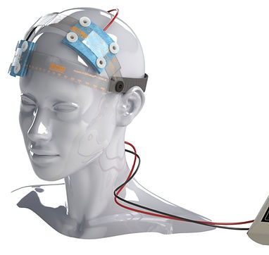
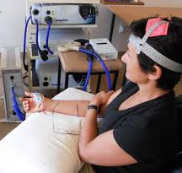
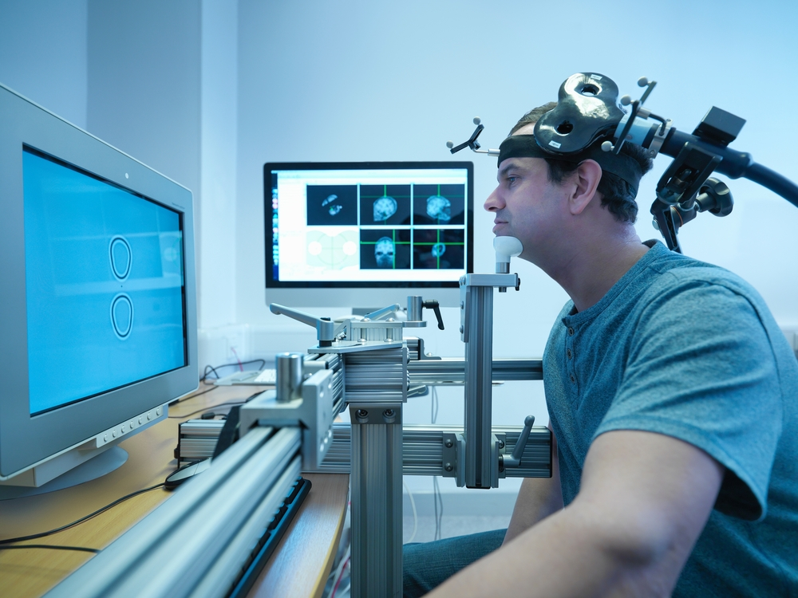
What's new in TBI Rehabilitation 2026?
Noninvasive brain stimulation techniques, including transcranial direct current stimulation (tDCS) and transcranial magnetic stimulation (rTMS), show promise in modulating cortical networks and augmenting neuroplasticity, though evidence during the acute period remains limited.

Slide 12
What's new in TBI Rehabilitation 2026?
Repetitive TMS (rTMS) delivers repeated magnetic pulses through a coil placed on the scalp, inducing electrical currents in targeted cortical areas. The technique aims to modulate aberrant neuronal activity patterns following TBI and augment adaptive neuroplasticity. [2-3] Different frequencies produce distinct effects: high-frequency stimulation (≥5 Hz) increases cortical excitability, while low-frequency stimulation (≤1 Hz) decreases it.

Slide 13
What's new in TBI Rehabilitation 2026?
Transcranial direct current stimulation (tDCS) is a non-invasive brain stimulation technique that delivers weak direct electrical current (typically 1-2 mA) through electrodes placed on the scalp to modulate cortical excitability and promote neuroplasticity. [1-2] The technique is inexpensive, portable, and well-tolerated compared to other neuromodulation approaches.

Slide 14
What's new in TBI Rehabilitation 2026?
Comparative Effectiveness
Meta-analysis comparing both techniques found modest overall effects for both modalities, with no clear superiority of one over the other. Both showed significant effects for anxiety (0.195, p=0.020) and headache (0.354, p=0.040), but effect sizes were small, suggesting subtle rather than dramatic improvements.
Galimberti A, Tik M, Pellegrino G, Schuler AL. Effectiveness of rTMS and tDCS treatment for chronic TBI symptoms: A systematic review and meta-analysis. Prog Neuropsychopharmacol Biol Psychiatry. 2024 Jan 10;128:110863.

Slide 15
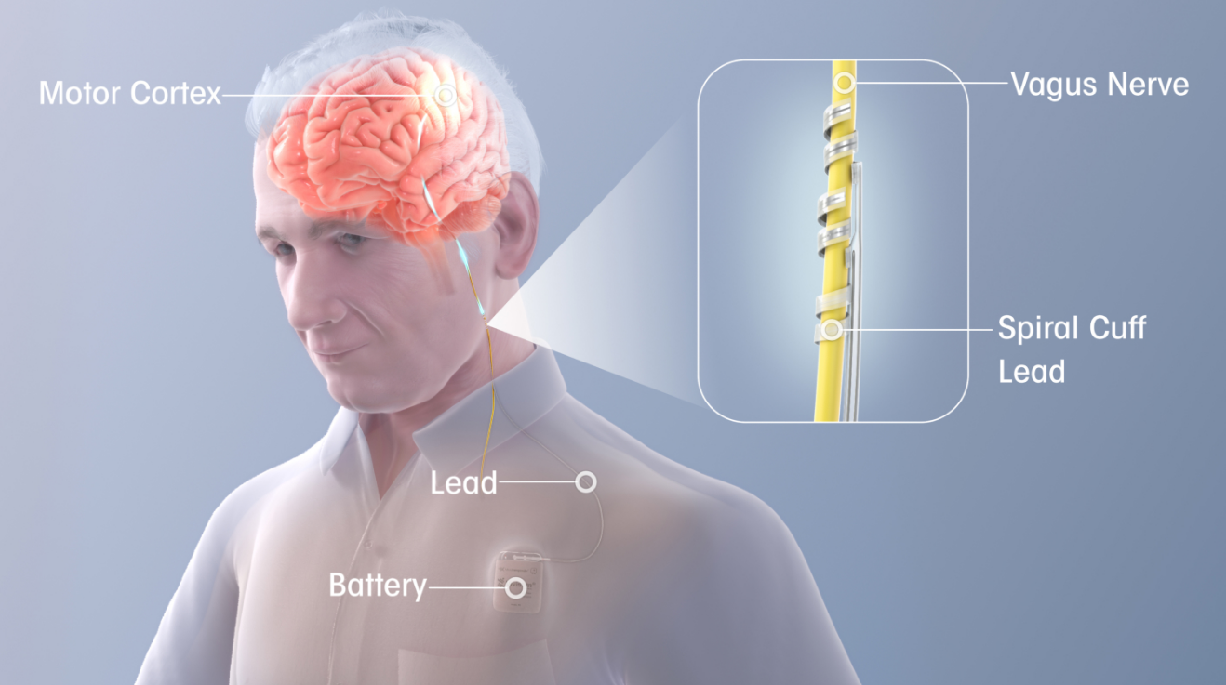
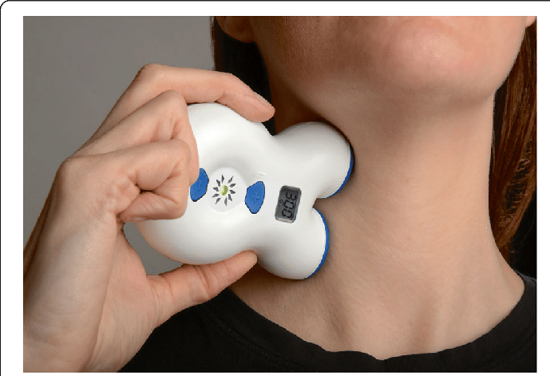
What's new in TBI Rehabilitation 2026?
Vagus nerve stimulation
Vagus nerve stimulation (VNS) is an emerging neuromodulation therapy for TBI rehabilitation that shows promise in both preclinical and early clinical studies for improving cognitive, motor, and behavioral outcomes. The evidence base is strongest in animal models, with limited but growing human data supporting its safety and potential efficacy.

Slide 16
What's new in TBI Rehabilitation 2026?
Vagus nerve stimulation
A recent observational study of 102 patients with mild TBI receiving non-invasive VNS (nVNS) demonstrated significant improvements across multiple symptom domains after approximately 3 months of treatment. [1] The most notable reductions were in post-traumatic headache, difficulty concentrating, dizziness, and depression, with 16 of 22 symptom domains showing significant improvement. Approximately 34% of patients achieved clinically meaningful response (≥30% reduction in at least half of assessed symptoms), with no device-related adverse events reported.
Ament M, Leonard E, Staats PS, Ingram NT. Non-invasive vagus nerve stimulation is associated with the reduction in persistent post-concussion symptoms: an observational study. Front Neurol. 2025 Aug 26;16:1642034. doi: 10.3389/fneur.2025.1642034. PMID: 40937177; PMCID: PMC12420837.

Slide 17
What's new in TBI Rehabilitation 2026?
Vagus nerve stimulation
A small feasibility study using transcutaneous cervical vagus nerve magnetic stimulation in 10 TBI patients found the intervention safe and feasible, with improvements in cognitive function observed in 8 patients after 10 days of treatment.
Zhang H, Zhao Y, Qu Y, Du J, Peng Y. Transcutaneous Cervical Vagus Nerve Magnetic Stimulation in Patients With Traumatic Brain Injury: A Feasibility Study. Neuromodulation. 2024 Jun;27(4):672-680.

Slide 18
What's new in TBI Rehabilitation 2026?
Vagus nerve stimulation
VNS appears to promote TBI recovery through multiple neuroprotective pathways:
Anti-inflammatory effects: VNS reduces neuroinflammation by decreasing pro-inflammatory cytokines (IL-1β, IL-6, TNF-α) and inhibiting pyroptosis through the OX-A/NLRP3/caspase-1/GSDMD signaling pathway.
Neuroplasticity enhancement: VNS activates neuromodulatory networks (noradrenergic, cholinergic, serotonergic systems) that promote synaptic plasticity and cortical reorganization. [7] Local activation of α2 adrenergic receptors in the motor cortex appears critical for VNS-induced plasticity.
Neuroprotection: VNS attenuates blood-brain barrier breakdown, reduces cerebral edema, decreases oxidative stress, and may limit secondary brain injury. [
Neurotrophic support: VNS increases expression of brain-derived neurotrophic factor (BDNF) and other growth factors that support neuronal survival and plasticity.

Slide 19
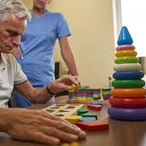
What's new in TBI Rehabilitation 2026?
Neuropharmacology:
Methylphenidate: improved executive memory, baseline speed, inhibitory control, and variability in responding.A 2024 meta-analysis of 41 studies (4,434 patients) found that methylphenidate showed a small but significant positive effect on cognitive functioning in TBI patients (effect size d = 0.34, 95% CI: 0.12-0.56, P = 0.003).
Donepezil: the cholinergic agent demonstrated a large effect size (d = 1.68, P = 0.03), though this was based on only 3 studies and requires further validation
N-acetyl cysteine: administered in mild TBI within 24 hours demonstrated faster symptom resolution compared to placebo in an RCT of 81 adults.

Slide 20
What's new in TBI Rehabilitation 2026?
Nutritional Support and Supplementation:
Omega-3 fatty acids, play a crucial role in neuronal integrity and function, aiding TBI recovery by reducing oxidative stress and inflammation.
Curcumin, known for its antioxidant and anti-inflammatory properties, reduces oxidative stress, increases brain-derived neurotrophic factor (BDNF), and suppresses inflammatory markers, enhancing cognitive recovery in TBI models.
Fisetin, a flavonoid, reduces oxidative damage and inflammation by upregulating Nrf2 pathways and suppressing NF-kB, showing potential in TBI models.
Vitamin D supplementation improves cognitive function, reduces inflammation, and correlates with better recovery outcomes in TBI patients.

Slide 21
What's new in TBI Rehabilitation 2026?
Nutritional Support and Supplementation:
B vitamins, especially B2, 3, and 6, exhibit neuroprotective properties by reducing lesion volume, oxidative stress, and neuronal damage post-TBI.
Vitamin E, anantioxidant, protects against TBI-induced oxidative stress and improves neurocognitive outcomes. Thes eagents modulate various pro- and anti-inflammatory pathways to abrogate neuroinflammation, stabilize mitochondria, decrease oxidative stress, and promote neuronal recovery.
Creatine, Coenzyme Q10,magnesium, and zinc also show promise in reducing inflammation, and enhancing recovery in TBI models, although further clinical research is needed.

Slide 22
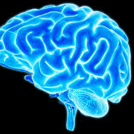
What's new in TBI Rehabilitation 2026?
Stem cell transplantation
Stem cell therapy for traumatic brain injury (TBI) is an emerging investigational treatment that has shown promising results in clinical trials, with evidence demonstrating safety and improvements in motor function, though it remains largely experimental and not yet FDA-approved for routine clinical use.

Slide 23
What's new in TBI Rehabilitation 2026?
Stem cell transplantation
The most robust clinical data comes from the STEMTRA trial, a phase 2 randomized, double-blind, sham-controlled study that evaluated stereotactic intracranial implantation of modified bone marrow-derived mesenchymal stromal cells (SB623) in patients with chronic motor deficits from TBI. The trial demonstrated that SB623-treated patients achieved significant improvement in Fugl-Meyer Motor Scale scores at 24 weeks (8.3 points vs 2.3 points in controls, p=0.04), with sustained improvement at 48 weeks.
Okonkwo DO, McAllister P, Achrol AS, Karasawa Y, Kawabori M, Cramer SC, Lai A, Kesari S, Frishberg BM, Groysman LI, Kim AS, Schwartz NE, Chen JW, Imai H, Yasuhara T, Chida D, Nejadnik B, Bates D, Stonehouse AH, Richardson RM, Steinberg GK, Poggio EC, Weintraub AH. Mesenchymal Stromal Cell Implants for Chronic Motor Deficits After Traumatic Brain Injury: Post Hoc Analysis of a Randomized Trial. Neurology. 2024 Oct 8;103(7):e209797.

Slide 24
What's new in TBI Rehabilitation 2026?
Stem cell transplantation
A systematic review of clinical trials from 2013-2023 identified 11 studies involving 402 patients (249 receiving stem cells, 153 controls). All studies reported improvements in clinical, radiologic, or biochemical markers after transplantation, with no serious adverse events reported.
Saboori M, Riazi A, Taji M, Yadegarfar G. Traumatic brain injury and stem cell treatments: A review of recent 10 years clinical trials. Clin Neurol Neurosurg. 2024 Apr;239:108219.

Slide 25
What's new in TBI Rehabilitation 2026?
Stem cell transplantation
Intrathecal transplantation (via lumbar puncture) was the preferred route of administration in most clinical trials, though stereotactic intracranial implantation has been used successfully in the STEMTRA trial.
The therapeutic benefits appear to derive primarily from immunomodulation and paracrine effects rather than direct cell engraftment and replacement of damaged neurons.
MSCs reduce neuroinflammation, decrease oxidative stress, promote neurogenesis and angiogenesis, and modulate the inflammatory response through secreted factors.

Slide 26


Slide 27
References
Zarmer L, Khan MS, Islat G, Alameddin H, Massey M, Kazui S, Chaudhry R. Traumatic Brain Injury: Advances in Diagnostic Techniques and Treatment Modalities. J Clin Med. 2025 Oct 10;14(20):7145.
Tang, Y., Wang, Y., Zhang, W. et al. Magnetic NeuroRing: a portable adaptive brain-computer interface for real-time transcranial magnetic stimulation in post-stroke motor rehabilitation. npj Biomed. Innov. 3 (2026).
Galimberti A, Tik M, Pellegrino G, Schuler AL. Effectiveness of rTMS and tDCS treatment for chronic TBI symptoms: A systematic review and meta-analysis. Prog Neuropsychopharmacol Biol Psychiatry. 2024 Jan 10;128:110863. doi: 10.1016/j.pnpbp.2023.110863. Epub 2023 Sep 12. PMID: 37709126.
Tsai PY, Chen YC, Wang JY, Chung KH, Lai CH. Effect of repetitive transcranial magnetic stimulation on depression and cognition in individuals with traumatic brain injury: a systematic review and meta-analysis. Sci Rep. 2021 Aug 20;11(1):16940. doi: 10.1038/s41598-021-95838-2. PMID: 34417481; PMCID: PMC8379199.
Johansen T, Matre M, Løvstad M, Olsen A, Lund A, Martinsen AT, Becker F, Brunborg C, Rizzo A, Spikman JM, Neumann D, Ponsford J, Tornås S. Virtual Reality in Training of Sustained Attention, Processing Speed, and Working Memory After Traumatic Brain Injury: A Randomized Controlled Trial. Arch Phys Med Rehabil. 2026 Jan;107(1):21-31. doi: 10.1016/j.apmr.2025.07.005. Epub 2025 Jul 24. PMID: 40714041.
Lucke-Wold B, Zasler ND, Ruchika F, Weisman S, Le D, Brunicardi J, Kong I, Ghumman H, Persad S, Mahan D, Delawan M, Shah S, Aghili-Mehrizi S. Supplement and nutraceutical therapy in traumatic brain injury. Nutr Neurosci. 2025 Jun;28(6):709-743. doi: 10.1080/1028415X.2024.2404782. Epub 2024 Dec 30. PMID: 40440029.
Feinberg C, Carr C, Zemek R, et al. Association of Pharmacological Interventions With Symptom Burden Reduction in Patients With Mild Traumatic Brain Injury: A Systematic Review. JAMA Neurol. 2021;78(5):596–608. doi:10.1001/jamaneurol.2020.5079.
van der Veen, R., Königs, M., Bakker, S., van Iperen, A., Peerdeman, S., Bet, P.M. and Oosterlaan, J. (2024), Pharmacotherapy to Improve Cognitive Functioning After Acquired Brain Injury: A Meta-Analysis and Meta-Regression. Clin Pharmacol Ther, 115: 971-987. https://doi.org/10.1002/cpt.3186.
Shen Y, Jiang L, Lai J, Hu J, Liang F, Zhang X, Ma F. A comprehensive review of rehabilitation approaches for traumatic brain injury: efficacy and outcomes. Front Neurol. 2025 Jun 13;16:1608645. doi: 10.3389/fneur.2025.1608645. Erratum in: Front Neurol. 2025 Jul 08;16:1651979. doi: 10.3389/fneur.2025.1651979. PMID: 40584523; PMCID: PMC12202449.
Management and Rehabilitation of Post-Acute Mild Traumatic Brain Injury (mTBI) (2021). Department of Veterans Affairs. 2021. Maj Thomas J. Bayuk DO, Amy O. Bowles MD, Lt Col Andrew W. Bursaw DO, et al.

Slide 28
References
Zhang H, Zhao Y, Qu Y, Du J, Peng Y. Transcutaneous Cervical Vagus Nerve Magnetic Stimulation in Patients With Traumatic Brain Injury: A Feasibility Study. Neuromodulation. 2024 Jun;27(4):672-680.
Ament M, Leonard E, Staats PS, Ingram NT. Non-invasive vagus nerve stimulation is associated with the reduction in persistent post-concussion symptoms: an observational study. Front Neurol. 2025 Aug 26;16:1642034. doi: 10.3389/fneur.2025.1642034. PMID: 40937177; PMCID: PMC12420837.
Kang J, Ren B, Wang J, Tang Y, Dong X. Vagus nerve stimulation: a promising strategy to combat pyroptosis and inflammation in traumatic brain injury through the OX-A/NLRP3/caspase-1/GSDMD signaling pathway. Eur J Med Res. 2025 Jul 7;30(1):586.
Tseng CT, Gaulding SJ, Dancel CLE, Thorn CA. Local activation of α2 adrenergic receptors is required for vagus nerve stimulation induced motor cortical plasticity. Sci Rep. 2021 Nov 4;11(1):21645.
Everard G, Saragih IDaryanti, Dawson J, Tarihoran DE, Advani SM, Tzeng HM, Lee BO, Bekkering GE. Vagus nerve stimulation to improve post‐stroke motor function and activity. Cochrane Database of Systematic Reviews 2026, Issue 3. Art. No.: CD015859.
Tseng CT, Gaulding SJ, Dancel CLE, Thorn CA. Local activation of α2 adrenergic receptors is required for vagus nerve stimulation induced motor cortical plasticity. Sci Rep. 2021 Nov 4;11(1):21645. Okonkwo DO, McAllister P, Achrol AS, Karasawa Y, Kawabori M, Cramer SC, Lai A, Kesari S, Frishberg BM, Groysman LI, Kim AS, Schwartz NE, Chen JW, Imai H, Yasuhara T, Chida D, Nejadnik B, Bates D, Stonehouse AH, Richardson RM, Steinberg GK, Poggio EC, Weintraub AH. Mesenchymal Stromal Cell Implants for Chronic Motor Deficits After Traumatic Brain Injury: Post Hoc Analysis of a Randomized Trial. Neurology. 2024 Oct 8;103(7):e209797.
Saboori M, Riazi A, Taji M, Yadegarfar G. Traumatic brain injury and stem cell treatments: A review of recent 10 years clinical trials. Clin Neurol Neurosurg. 2024 Apr;239:108219.
Cozene B, Sadanandan N, Farooq J, Kingsbury C, Park YJ, Wang ZJ, Moscatello A, Saft M, Cho J, Gonzales-Portillo B, Borlongan CV. Mesenchymal Stem Cell-Induced Anti-Neuroinflammation Against Traumatic Brain Injury. Cell Transplant. 2021 Jan-Dec;30:9636897211035715.

