Slide 1
“Let it begin with me”
Emily Ptacek, M.S. CCC/SLP Brain Injury Survivor
Notes:
Hello everyone, It’s truly a pleasure to be here today. I’ll try not to sound like a robot reading a script! But without my prepared words I would talk all day about absolutely nothing- so I promise to stick to my script.

Slide 2
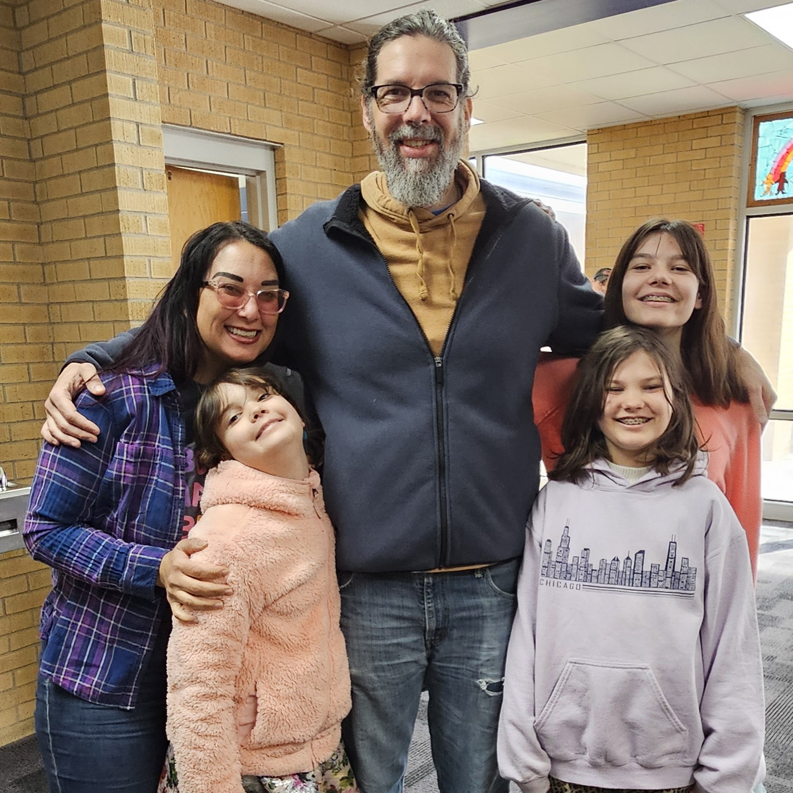
Introduction Many people in this room understand brain injury.
You may be:
Living with a brain injury
Caring for someone who has one
A professional helping survivors regain independence
Today I’d like to share part of my journey.
Notes:
Brain injury has touched each of our lives in some way. Some of you are survivors. Some of you are caregivers. Some of you are professionals who dedicate your careers to helping people with brain injuries regain independence. No matter which group you fall into, we’re all here because we care about this community.

Slide 3
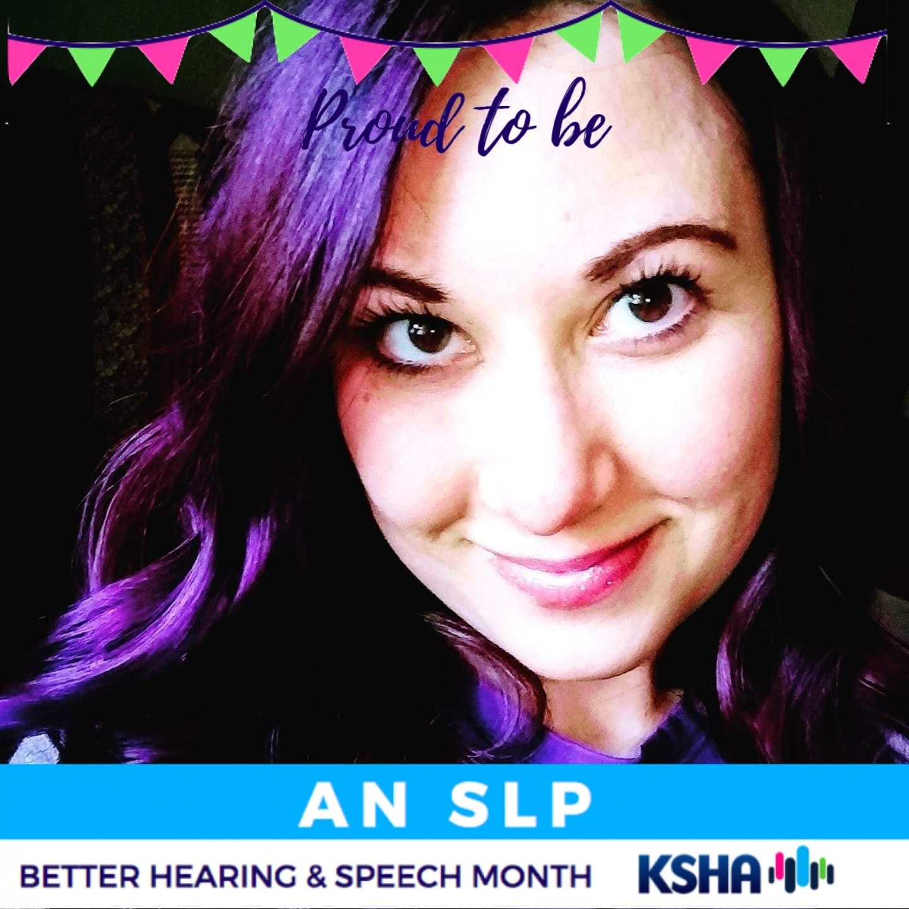
Who I Am
Before my accident I was:
A young mom
Working full-time at a job I loved
A wife to my husband, Will
I expected to spend the next 40 years living that life.
But the universe had other plans
Notes:
I am a brain injury survivor. Before my accident I was a young mom to three beautiful little girls. I worked full time at a job that I loved as a speech language pathologist. I was a wife to my husband Will. I completely expected to spend the next 40 years living that life. But the universe had other plans.

Slide 4
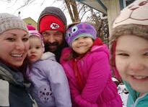
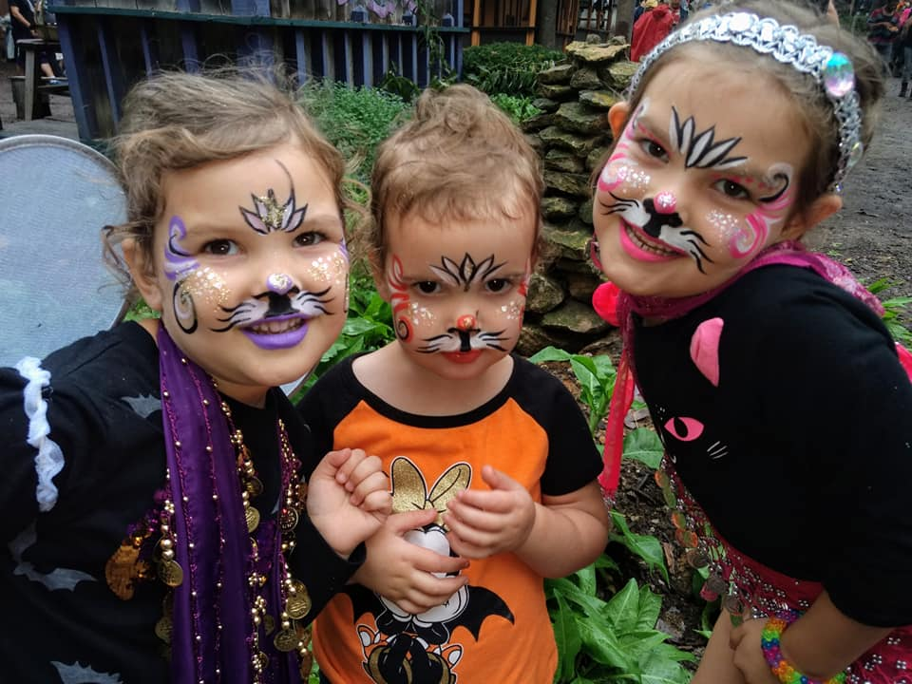
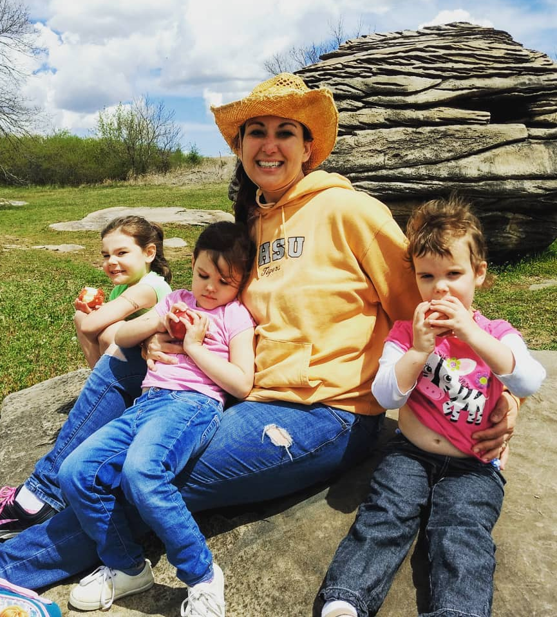
My Life Before
Notes:
My girls were 3, 5 and 6 –almost 7 at the time of my injury. My youngest has no memory of the person I used to be and that’s ok. Now they are 8, 10 and 12 going on 30!

Slide 5
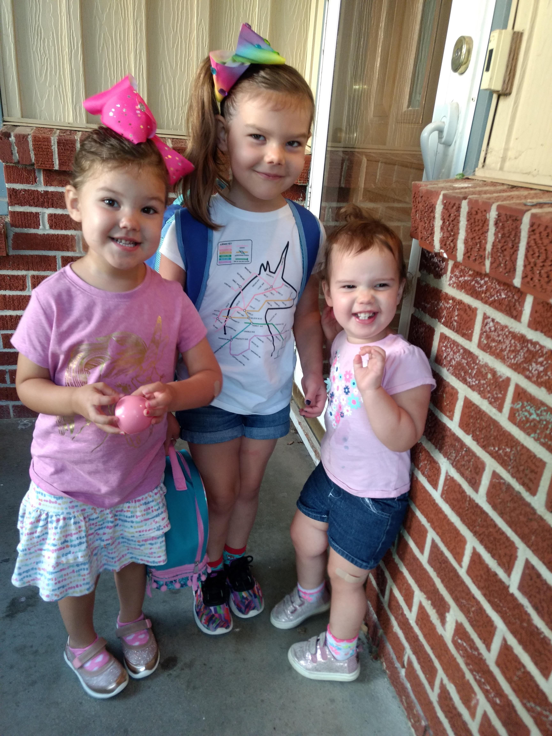
November 6, 2020
November 6, 2020 started like a normal day.
Took my girls to school and daycare
Went to work
Saw patients
Planned a quiet weekend with my family
But that afternoon…
I was involved in a motor vehicle accident.
Notes:
On November 6th, 2020 my day started like any other day. I woke up, took my girls to school and daycare, and went to work. I saw outpatients, worked on the inpatient rehabilitation unit, did a modified barium swallow study , inhaled a salad for lunch, and was heading out to see a home health patient. I fully expected to pick up my girls after work and have a relaxing weekend together. But that day changed everything. I was involved in a motor vehicle accident and was life-flighted to Wesley Hospital in Wichita. After being stabilized there, I was transferred to Madonna rehabilitation cent in Lincoln, Nebraska. Eventually I was able to return home in time for my daughter’s 7th birthday – 35 days after the accident.

Slide 6
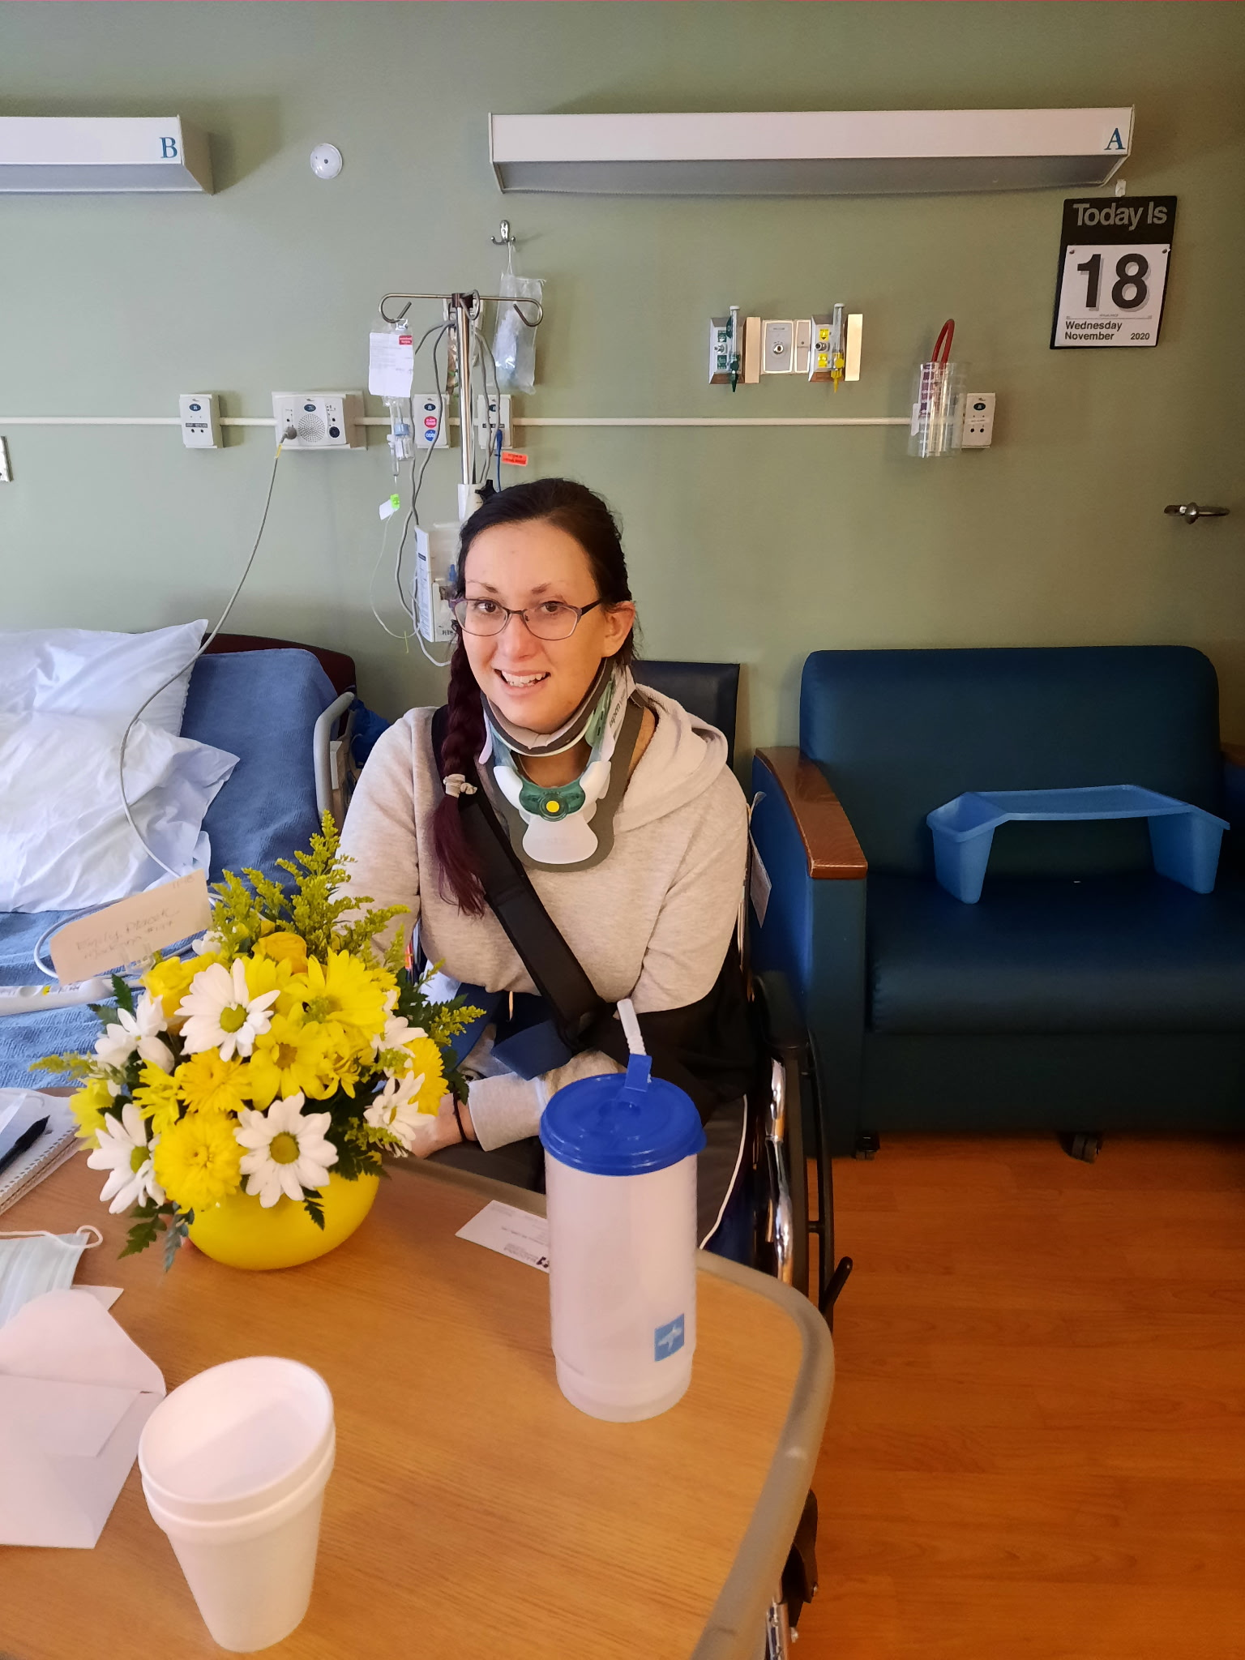
The First Five Weeks
After the accident:
LifeFlight to Wesley Hospital in Wichita
Stabilized and transferred to Madonna Rehabilitation Center in Lincoln, Nebraska
Five intense weeks of recovery.
Notes:
I just summarized about 5 weeks of my life into one slide. I’m not going to go into the full details of my recovery today because many of you already know how that process goes.

Slide 7
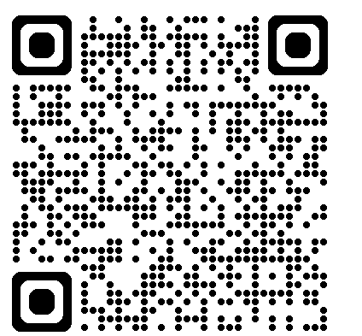
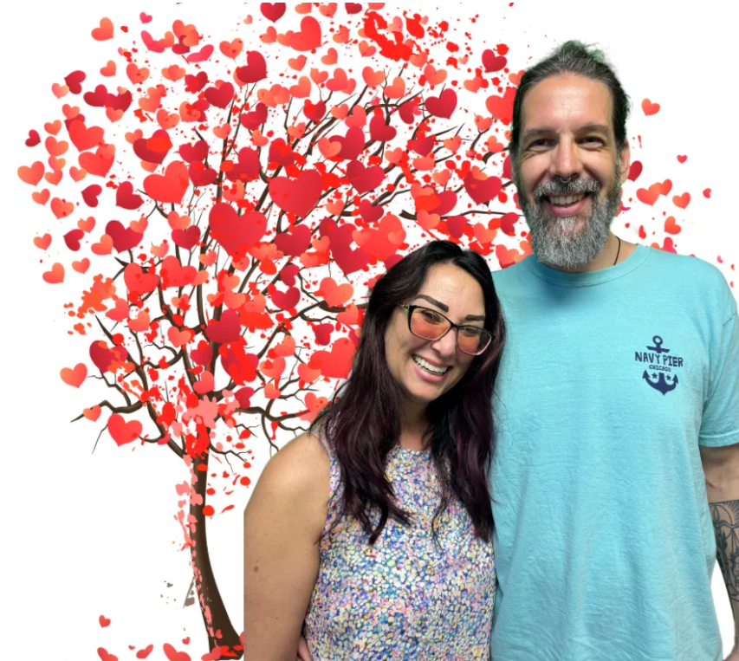
“That Podcast In Hutch”
By Jason Probst
Notes:
But if you’re curious and want to hear more about that journey take your phone and scan the QR to listen to an episode of That Podcast in Hutch with Jason Probst. We are talk more in depth about my recovery and about the role my husband and family played during that time. What I will say is that I had many people helping guide my recovery.

Slide 8
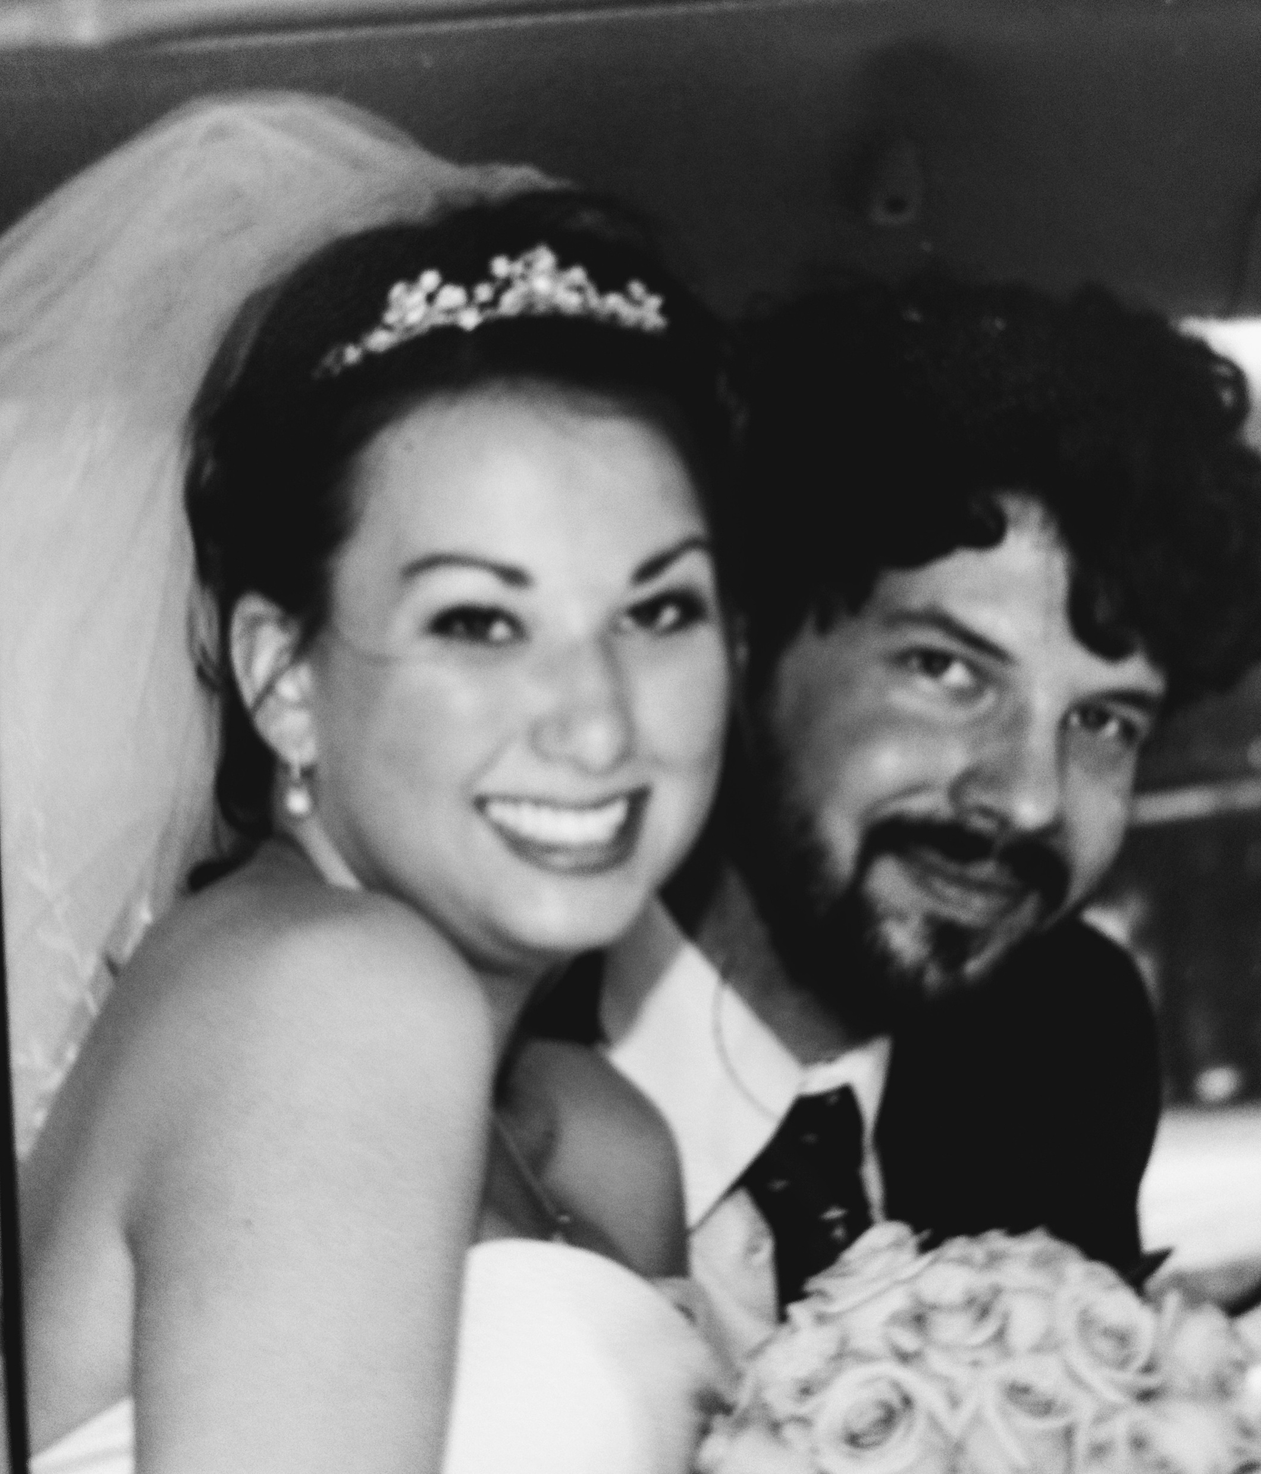
My Husband
This year we celebrate 16 years of marriage
After my accident our roles changed.
He stepped in to manage:
Finances
Meals
Appointments
The girls’ schedules
Notes:
My husband and I will celebrate our 16th wedding anniversary this year. Our life has had many bumps along the way, but we’ve bother chosen to grow and adapt together. Before my accident, I was the one who managed everything. Finances. Meals. Appointments. Kid schedules. After the accident, I was suddenly pulled out of that life. My husband stepped in and picked up the pieces. He has become even closer with our girls because of it. He’s helping them learn how to navigate the world and recognize moment when someone might need extra help- like their mom sometimes does. I have a deep appreciation and connection with him. He’s my person.

Slide 9
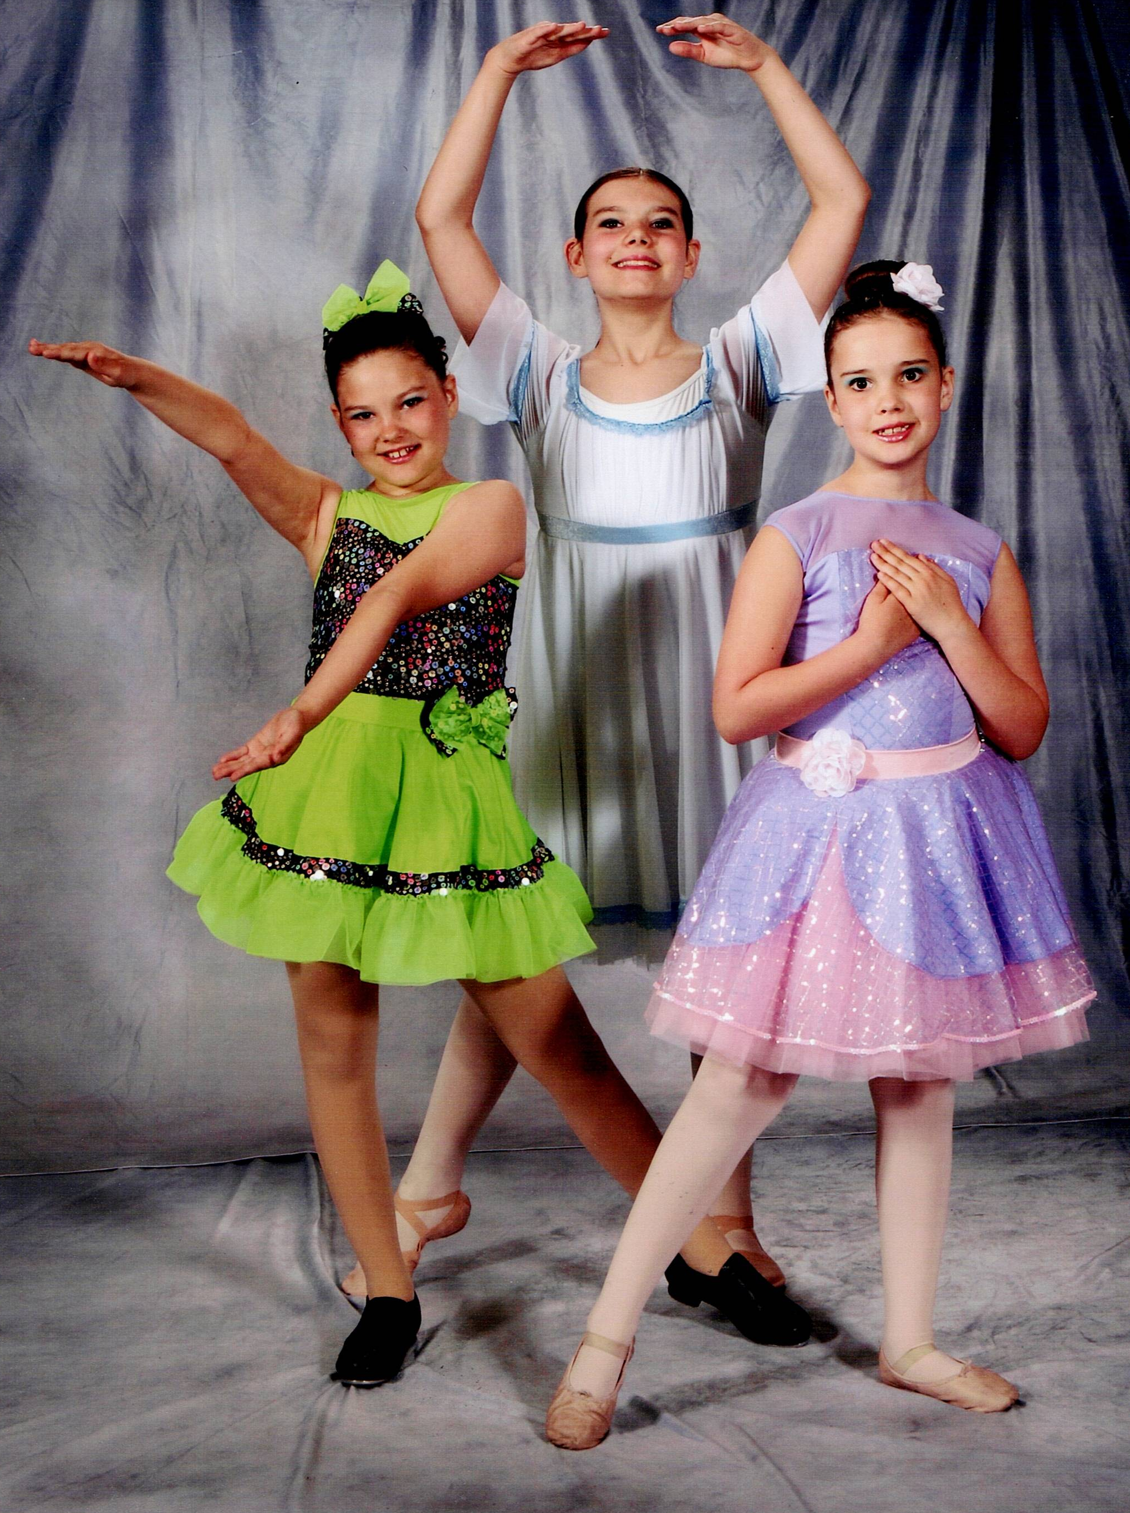
He became even closer with our daughters.
He’s my person.
He’s OUR person.
Notes:
In fact, he is performing the ultimate Dad duty by doing the girls’ hair and makeup for recital pictures later today. Like I said, he is my person- OUR person

Slide 10
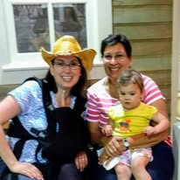
My Mom
My Mom- Carol
With me at Wesley Hospital
With me at Madonna Rehab
Helped with appointments
Advocate for my care
Support like this makes recovery possible.
Notes:
I also want to thank my mom Carol. After 34 years, she probably thought she was finished with the hands-on care of her child. But life had other plans. She was with me at Wesley Hospital and stayed with me during the week at Madonna Rehab. She went to doctor’s appointment and therapies with me. Early on especially, it was incredibly helpful to have someone else in those appointments. She would notice things I missed, ask questions I hadn’t thought of, and help explain things to my husband later when my brain was exhausted. She continues to advocate for me today- and even chauffeured me here this morning.

Slide 11
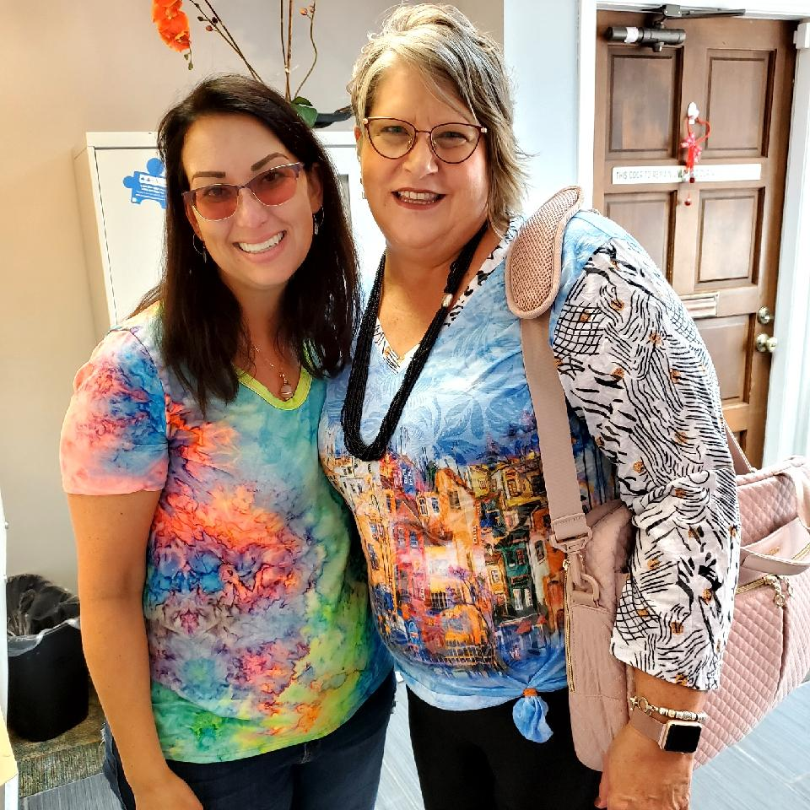
The “Gold Standard”
The “Gold Standard” of Care
Nurse case manager
Coordinated appointments
Transportational support
Tracking recovery
But many survivors do NOT get this.
Notes:
During my recovery I had a full team of therapists, and I also had something called a nurse case manager. Her name was Joni. She scheduled my appointments, made sure I had transportation, attended appointments with me, and recorded everything. Then she would report back to the care team about my progress. This is the type of support every brain injury survivor deserves. But many people don’t get it. The reason I had this level of care is because my accident happened while I was working. That realization opened my eyes to how many survivors struggle without that support. Many people fall through the cracks of our healthcare system. Some end up facing poverty, homelessness, addiction, or worse. I feel incredibly lucky – and I also feel a responsibility to advocate for change.

Slide 12
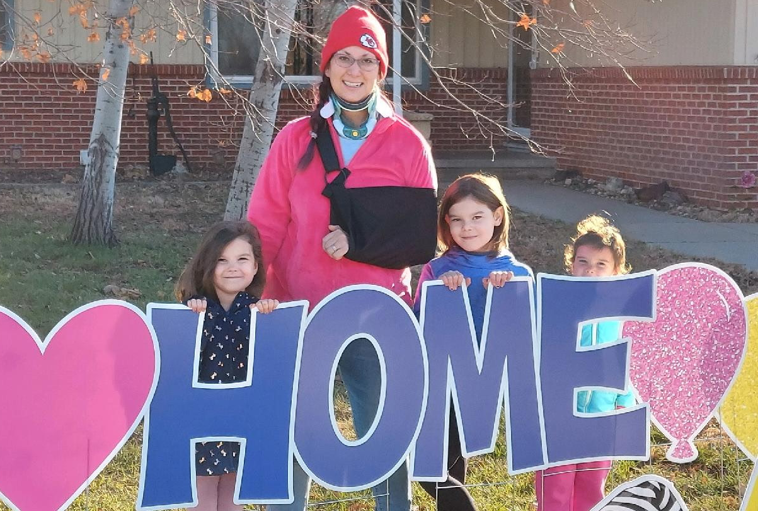
The Hardest Parts
Some of the hardest challenges:
Fatigue
Memory struggles
Loss of independence
Depression and anxiety
Recovery is not only physical.
Notes:
People with brain injuries may look fine on the outside, but internally we are struggling to do our best. Our best may be someone else’s worst. Prior to my injury I had struggled a bit with depression and anxiety, however, my coping skills were useless after the accident and I needed help. I met with a mental health therapist to unravel these emotions.

Slide 13
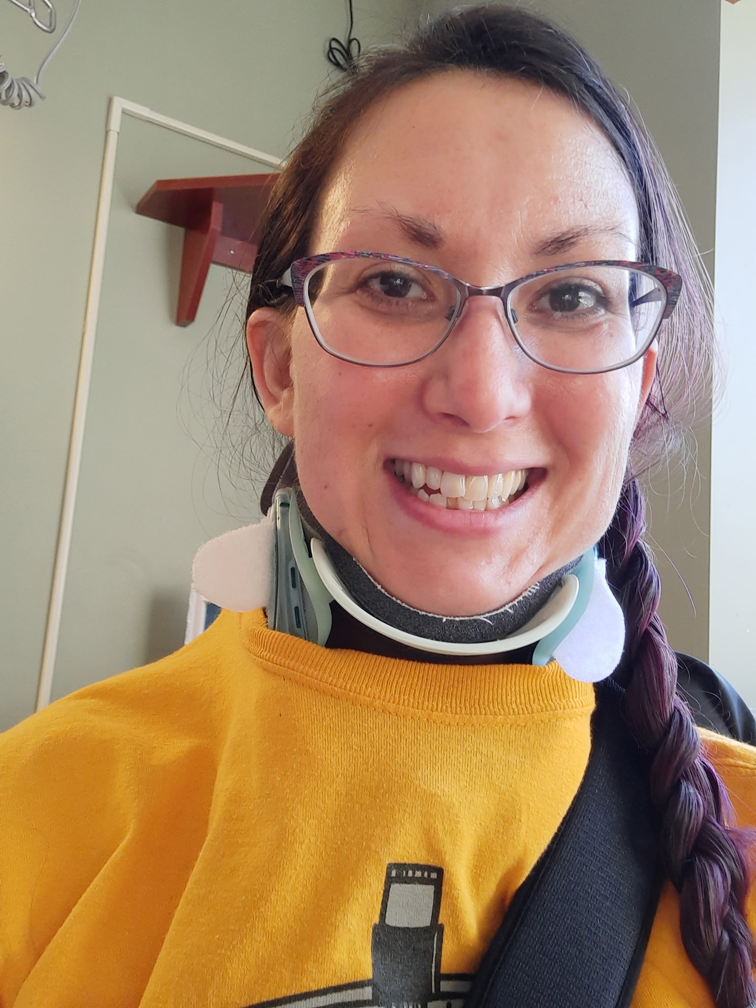
A Turning Point
A therapist suggested I attend a brain injury support group.
But the only on available did not fit my schedule
So……
I started one.
Notes:
My therapist suggested I try attending a brain injury support group. This was just after COVID when many things were still reopening. But the only support group available didn’t fit my schedule. So instead of giving up… I started one.

Slide 14
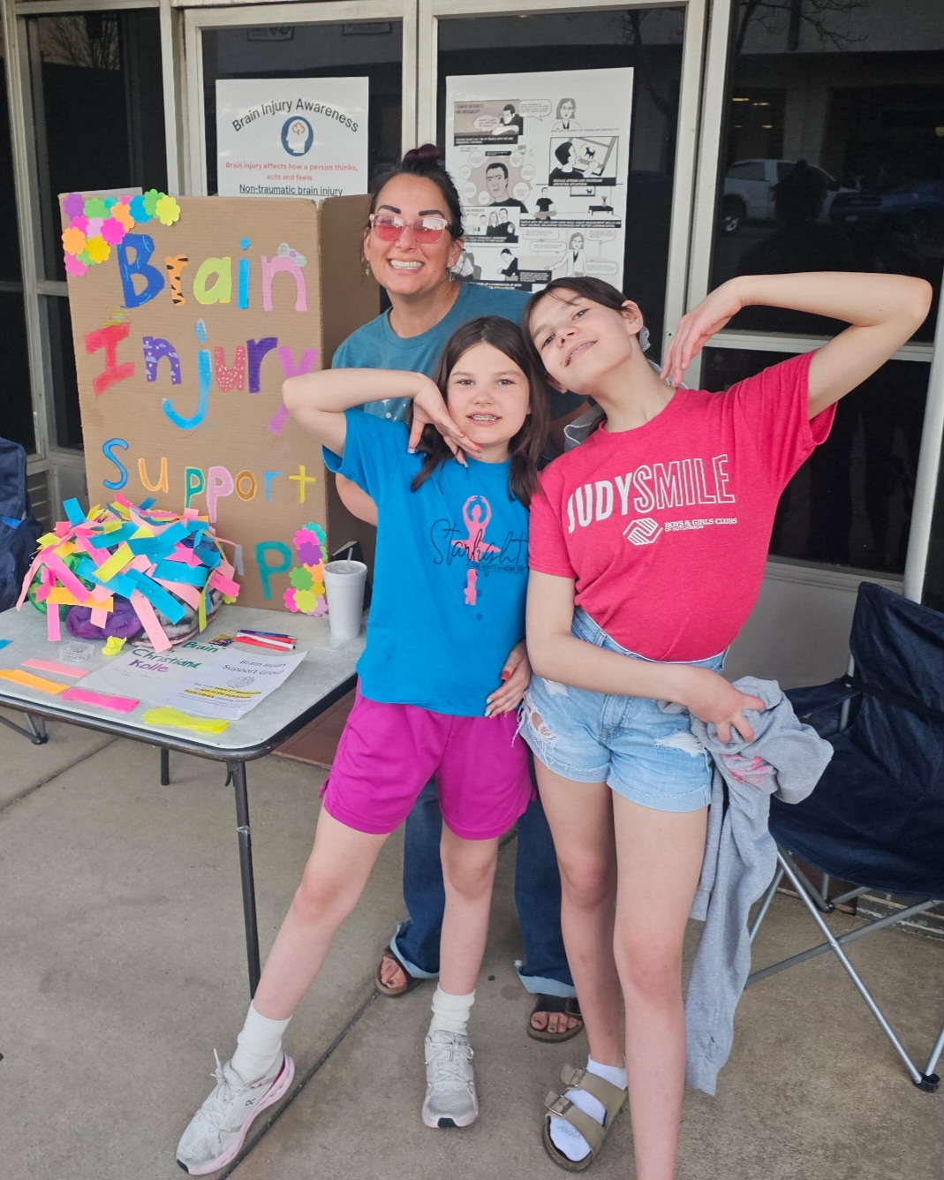
Let’s make it official!
Contacted the Kansas Brain Injury Association and they listed our group on the website
Notes:
My first step was contacting the Brain Injury Association of Kansas and visiting with Bev Jacobson. She helped me get our meeting listed on the website, so that people could find us with a quick internet search!

Slide 15
Our First Meeting
Our First Meeting- August 2023
Hutchinson Regional Medical Center
Our first meeting was in August of 2023.
Attendance:
My mom
My mother in-law
Notes:
Our first meeting was in August of 2023. It took place in a conference room at Hutchinson Regional Medical Center. Attendance that afternoon? My mom. My mother in-law. That was it. But every group has to start somewhere. After that meeting I started spreading the word.

Slide 16
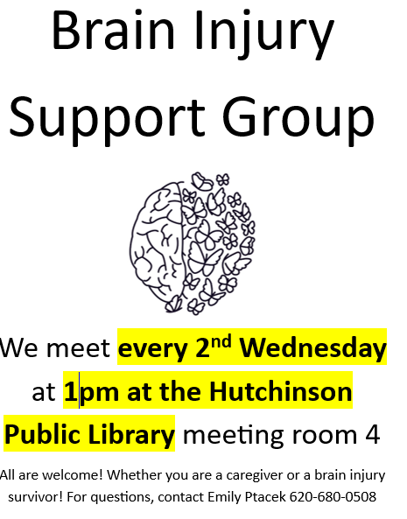
Spreading the Word
To find members I:
Made flyers
Posted them around town
Shared them at clinics and therapy offices
Talked to anyone who would listen
Sometimes you just have to start small.
Notes:
I made flyers and carried them with me at all times, so I could hand them out and leave them with any businesses that I visited. Sometimes you just have to start small.

Slide 17
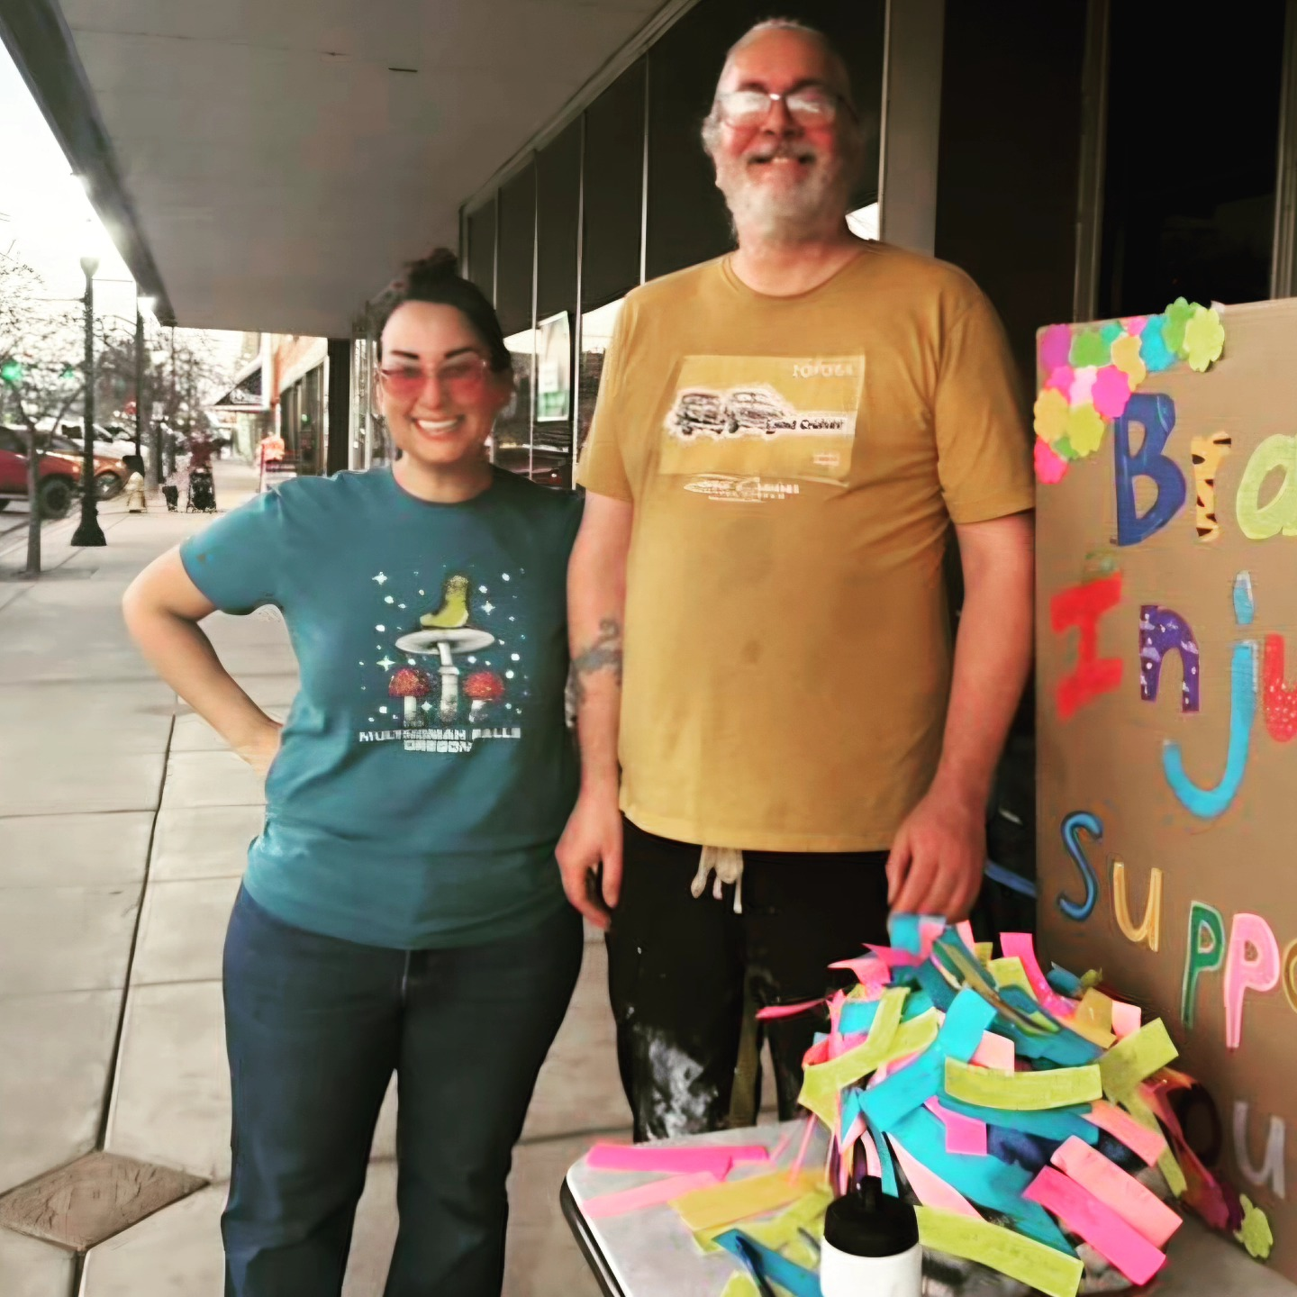
Christian Found Us!
Notes:
That December my husband and I went to a movie event. I sat in front and my husband was in the back with all of the tall people. He chatted with the guy next to him and told him about my injury after he had checked on me. The guy said, “You know, there’s a brain injury support group around here, and I keep meaning to go but I forget.”. Will told him that it was my group and introduced us. Christian has been coming ever since- and I set alarms to remind him or give him a ride.

Slide 18
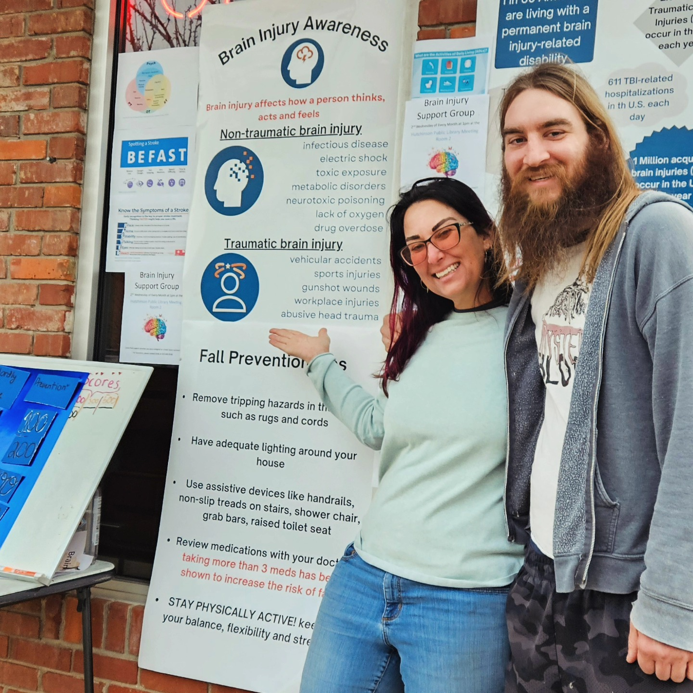
Community Outreach
We hosted a booth at Hutchinson’s Third Thursday event the past two years.
Posters
Brain games
Community
conversations
Notes:
We also set up a booth at Hutchinson’s “Third Thursday” event. A free monthly event initiated by the Hutchinson Recreation Commission. My family helped me create posters and brain games for people to try. We met many people and had great conversations. It was a fun way to raise awareness about brain injury and abut our support group. This is a picture of my little brother and I, he lives in Hutch too and another person that I couldn't do without!

Slide 19
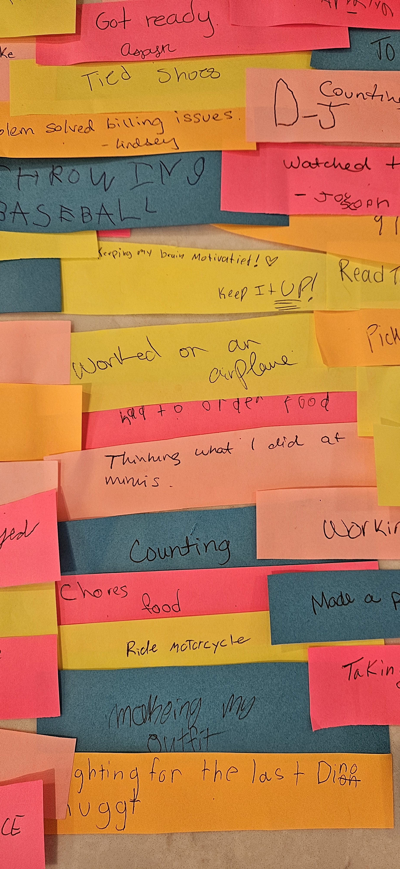
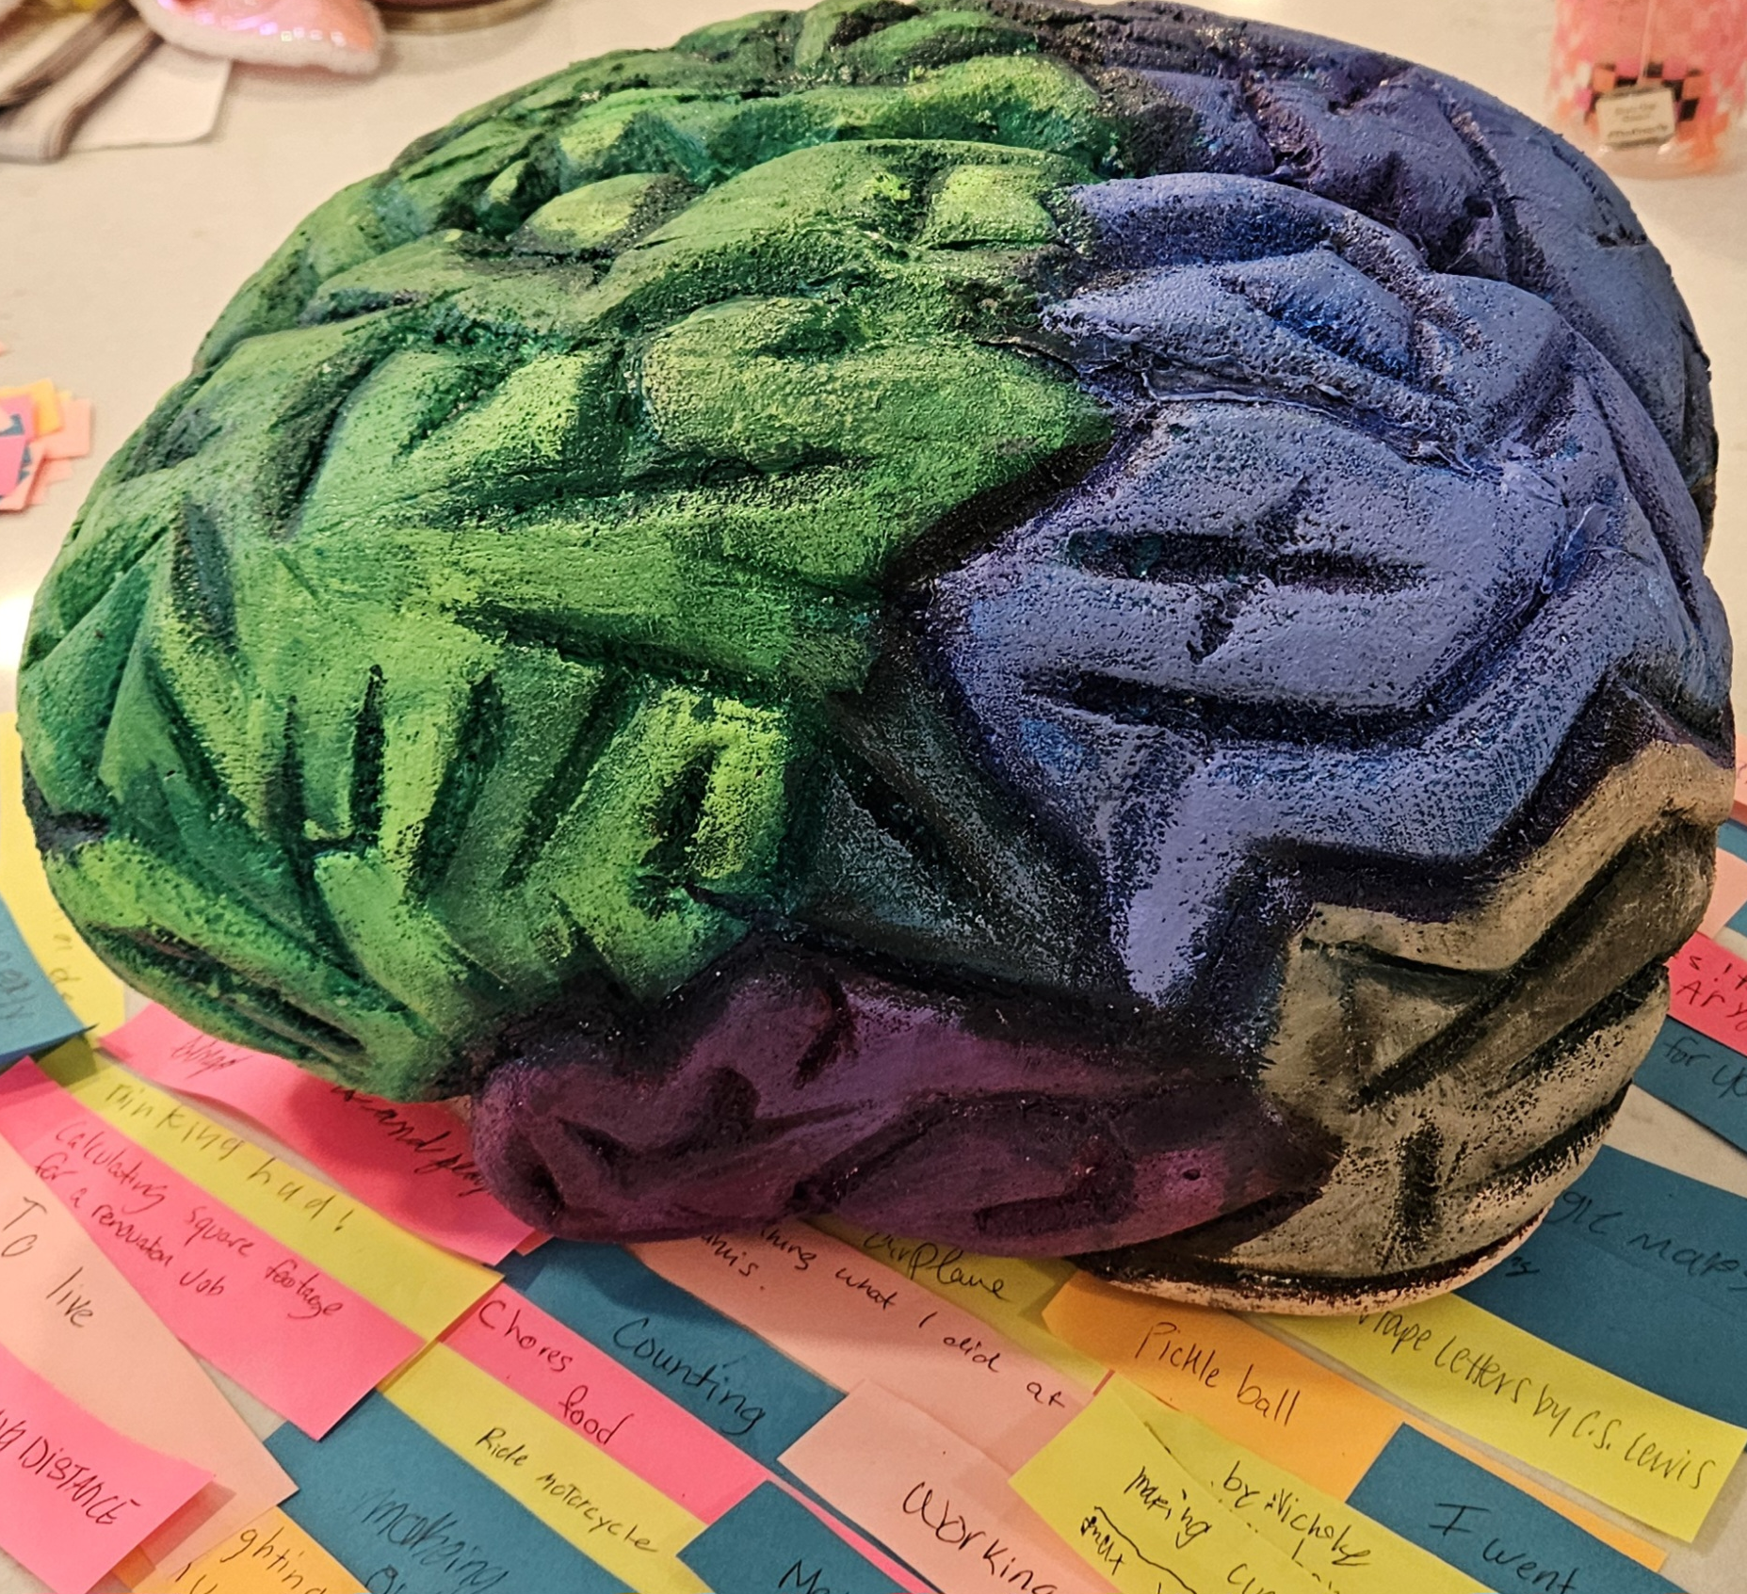
“How have I used my brain
today??”
Notes:
At our last Third Thursday event, Christian sculpted a brain from Styrofoam and we asked people passing by to write down an answer to the question, “how have you used your brain today?” and then pin the responses to the brain. We got 87 responses! My favorite was ‘fighting for the last Dino nugget”

Slide 20
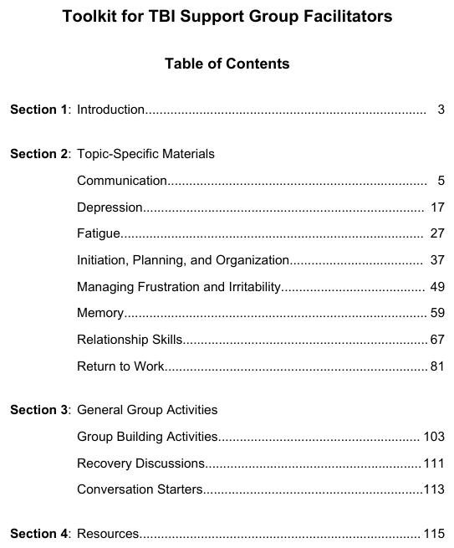
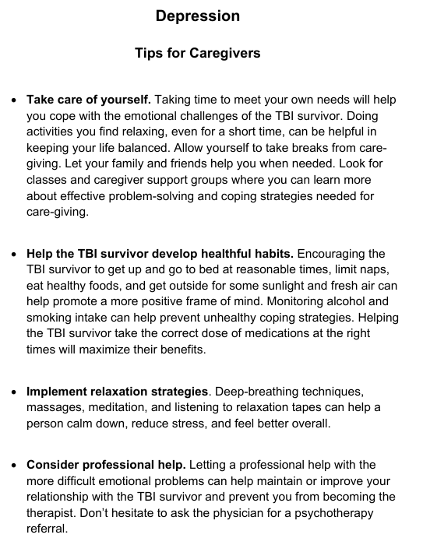
BrainInjuryMatters.org
Notes:
My internet search started with the Brain Injury Association of America and led to the discovery of BrainInjuryMatters.org. This website had a ‘Toolkit for TBI Support Group Facilitators’. I was so excited to find a book with directions on how to lead a support group and bonus points for being free! This toolkit was extremely helpful as it contained information on a variety of topics like Communication, Depression, Fatigue, Memory and more. Each topic gave facts and suggestions for both the person with the brain injury and the caregiver. As well as discussion questions and a brief group activity.

Slide 21
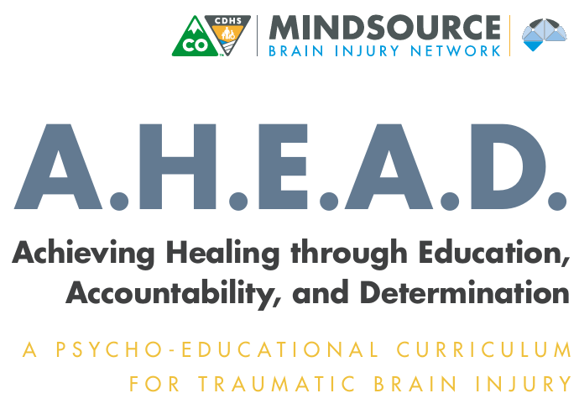
Mindsourececolorado.org
Notes:
I stumbled upon the AHEAD program from one of the books that I’ll share about later. This program stands for ‘Achieving Healing through Education, Accountability and Determination’ and was developed in Colorado and has different exercises as well as homework tasks and a take home Symptom Recognition log.

Slide 22
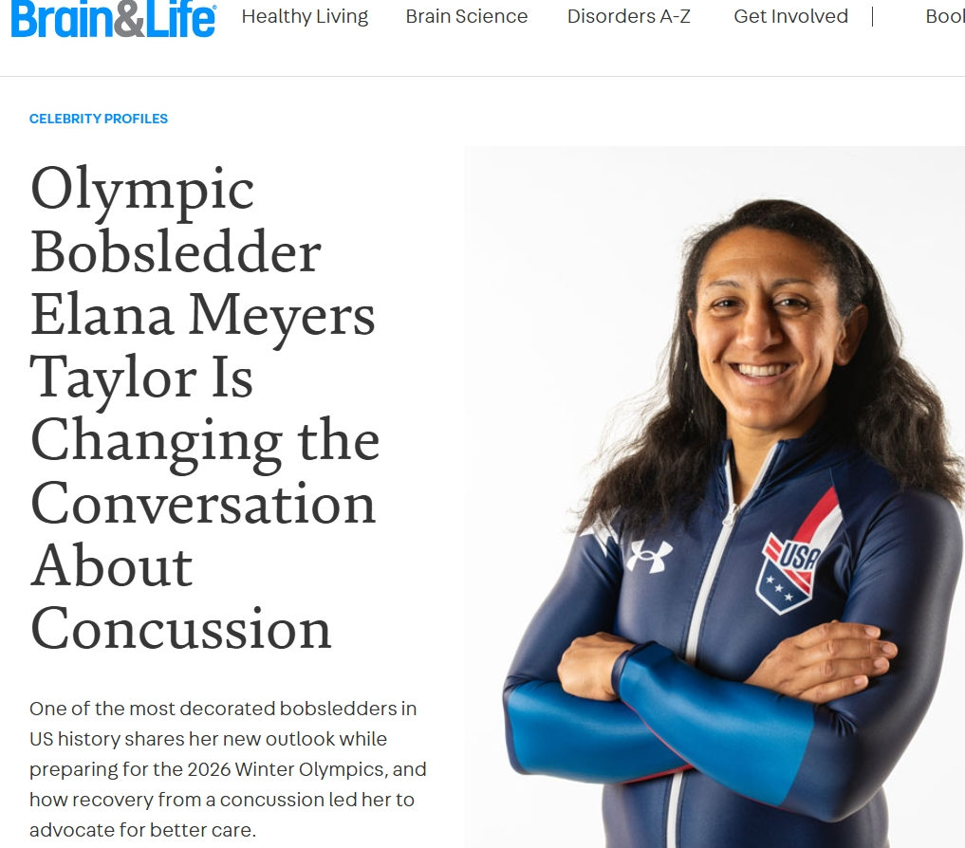
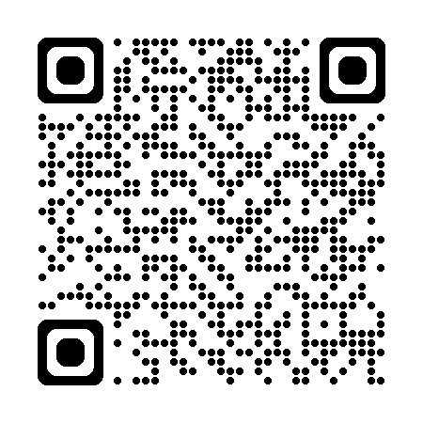
Brain&Life Magazine
It’s FREE!!
Notes:
My neurologist introduced me to this free resource. I encourage all of the group members to subscribe to the Brain&Life Magazine. I really enjoy the stories and learning about the newest research for brain injury and neurological disorders. They recently switched to completely online and I don’t have to wait for the mail but I do miss the paper form.

Slide 23
Books by Brain Injury Survivors
“I’ll Carry the Fork: Recovering a Life After Brain Injury” by Kara Swanson
“Brain Injury Rewiring for Survivors: A Lifeline to New Connections” by Carolyn Dolen
“Headstrong: Surviving a Traumatic Brain Injury without Losing My Mind” by Donna Valentino
“Finding True Purpose: Life Beyond the Castle” by Terri Mongait
“Sex with a brain injury: On concussion and recovery” by Annie Liontas
“Where is the Mango Princess: A journey back from brain injury” by Cathy Crimmins
“Left Neglected” by Lisa Genova
Notes:
After my injury, my mom immediately got on thriftbooks.com and searched out some of these titles, which she eventually shared with me and my mother in-law. These are a few of those titles and some others that I found helpful. This list of books is by or about brain injury survivors…

Slide 24
Educational Books about Brain Injury
“The Traumatized Brain” by Vani Rao, MBBS, MD and Sandeep Vaishnavi, MD, PhD
“Brain Injury Rewiring for Survivors” by Carolyn E. Dolen, MA
“The Mind Electric: A Neurologist on the Strangeness and Wonder of our Brains” by Pria Anand
“Head Cases: Stories of Brain Injury and It’s Aftermath” by Michael Paul Mason
“The Hilarious World of Depression” by John Moe
“The Mini ADHD Coach” by Alice Grendron
Notes:
This list is from the scientific neurologist/therapist point of view. Which I found really interesting as a speech language pathologist and it was a good review and helped me make sense of my own injuries.

Slide 25
Podcasts
“Hope Survives” Christabelle Braden
“Model Systems Knowledge Translation Center” msktc.org
“Brain Injury Speaks The Podcast” OntarioBIA
Neuro Pathways: A Cleveland Clinic Podcast for Medical Progessionals
“Depresh Mode with John Moe”
“ADHD for Smart Ass Women with Tracy Otsuka”
Notes:
And my constant reading led to the discovery of some podcasts, which also led to finding some topics for group discussion, and the introduction of some speakers.

Slide 26

Speaker
Jennifer Vaughn, SLP and Regional Director of “Minds Matter”
Notes:
Our first speaker was with Jennifere Vaughn from mind matter. She brought a crew and they presented abut the brain injury waiver program and the various ways in which they can assist our population with recovery.

Slide 27
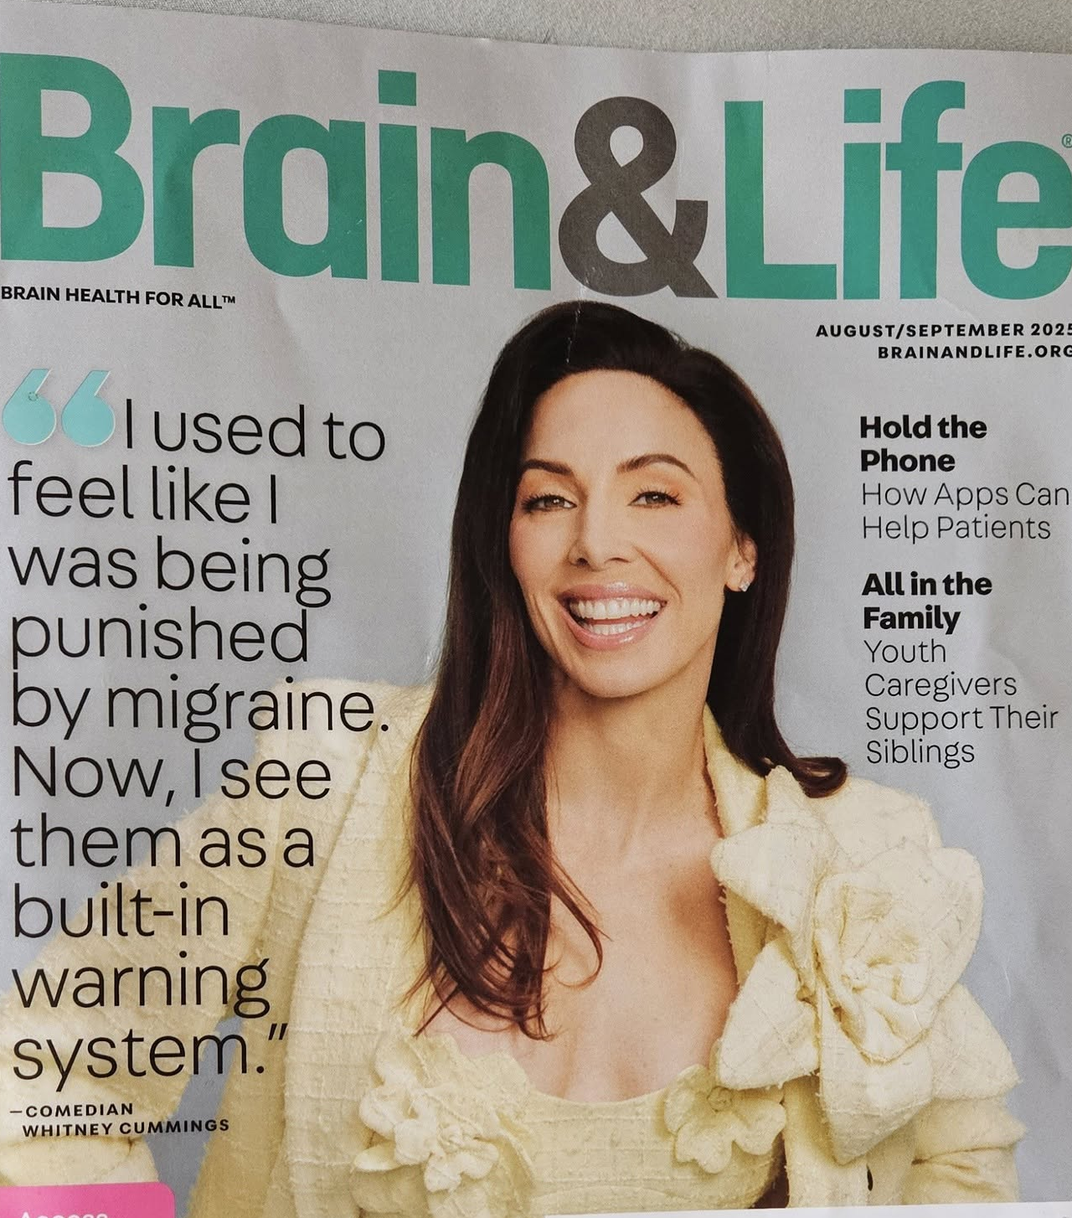
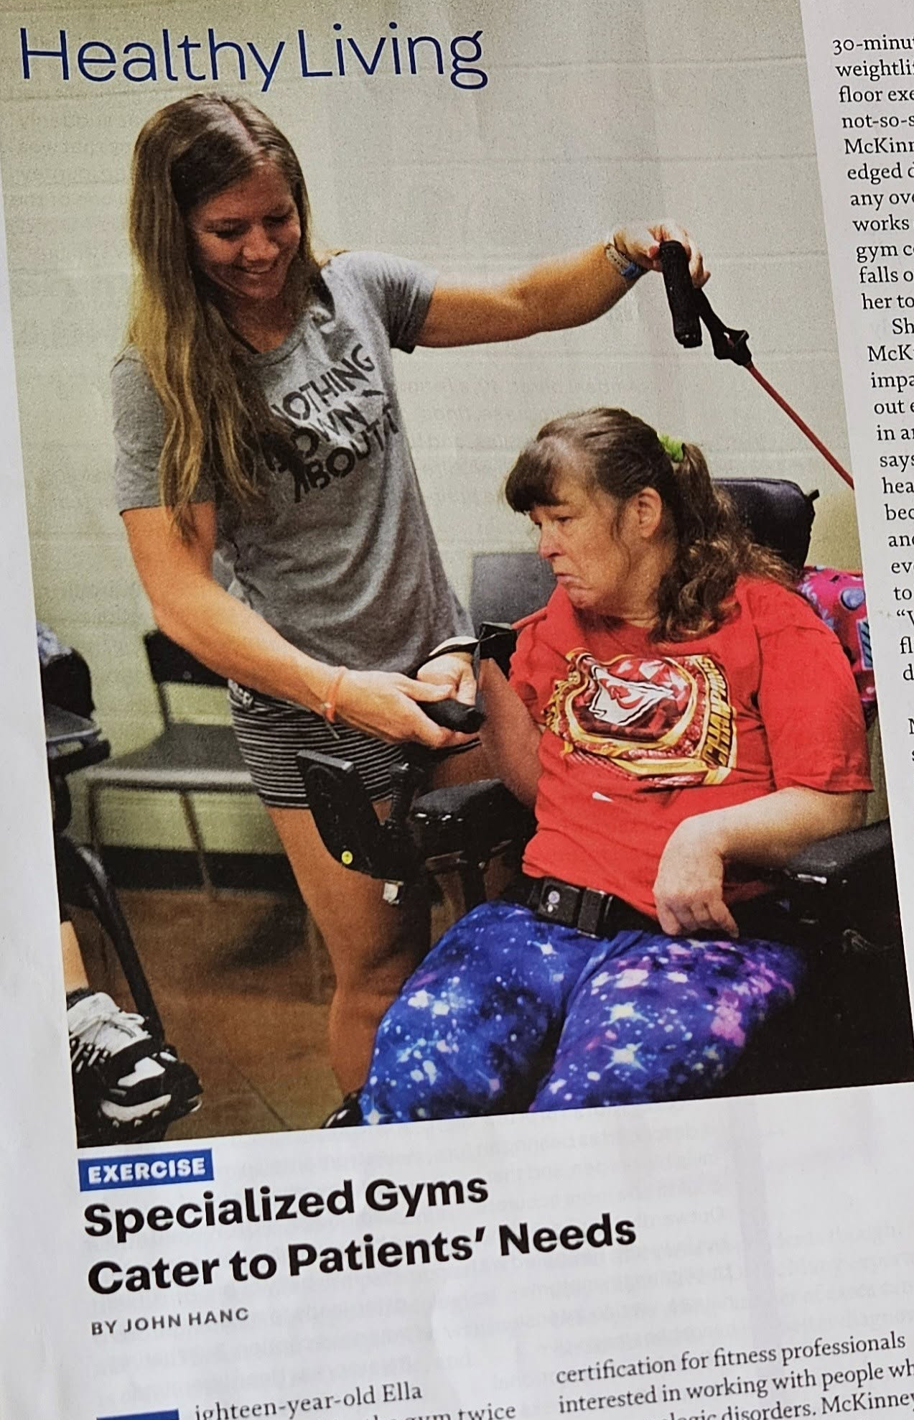
Anna Woods,
ACE Certified Personal Trainer and Aging Specialist and Crossfit Level 1 Coach SheStrength”
Notes:
We also had our local celebrity, Anna Woods come. She was featured in the August/September 2025 issue of Brain&Life magazine that I previously talked about. I was already a member of her gym ‘SheStrength’ but hadn’t realized she was specialized in adaptive fitness. This explains why I felt so comfortable with her gym. She talked to our group about the importance of fitness and her work in developing an adaptive fitness certification program to help bridge the gap for success from therapy to home. She stressed that this is an area that patients often lack support with and professionals are unaware of the existence of such certifications.

Slide 28
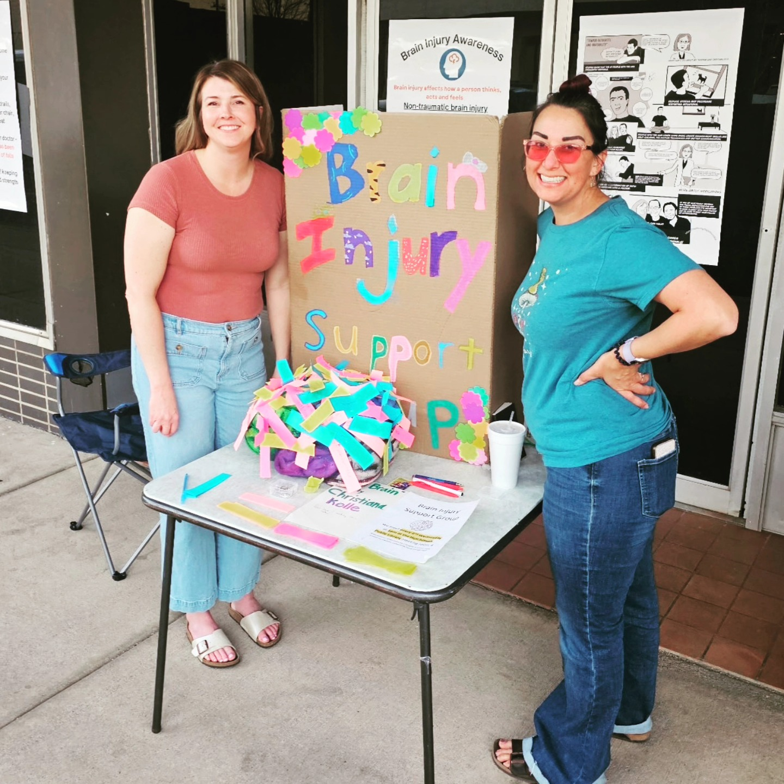

Lindsey Henry
M.A., CCC-SLP “Abundance Speech Therapy”
Notes:
My lawyer friend sent me an email one day, telling me about this amazing speech language pathologist that they had met at a convention and ‘did I know her?” I reached out to Lindsey Henry- turns out she knew of me from working at the hospital, our paths missed intersecting by just a few months! She started a private practice in Hutchinson, specializing in brain injury with adults. Our group learned so much from her visit and she helped out at our Third Thursday event last month! I am in aw of another individual who saw a need in our community and is filling it!

Slide 29
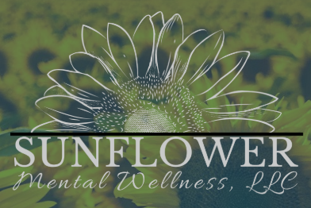
Mindy Manning, Psychiatric/Mental Health Nurse- “Sunflower Mental Wellness”
Notes:
I receive services from Sunfower Mental Wellness – a small business in Hutchinson. That gave me the idea to ask my provider Mindy Manning to come speak to our group about the various mental health challenges that often result from a brain injury.

Slide 30
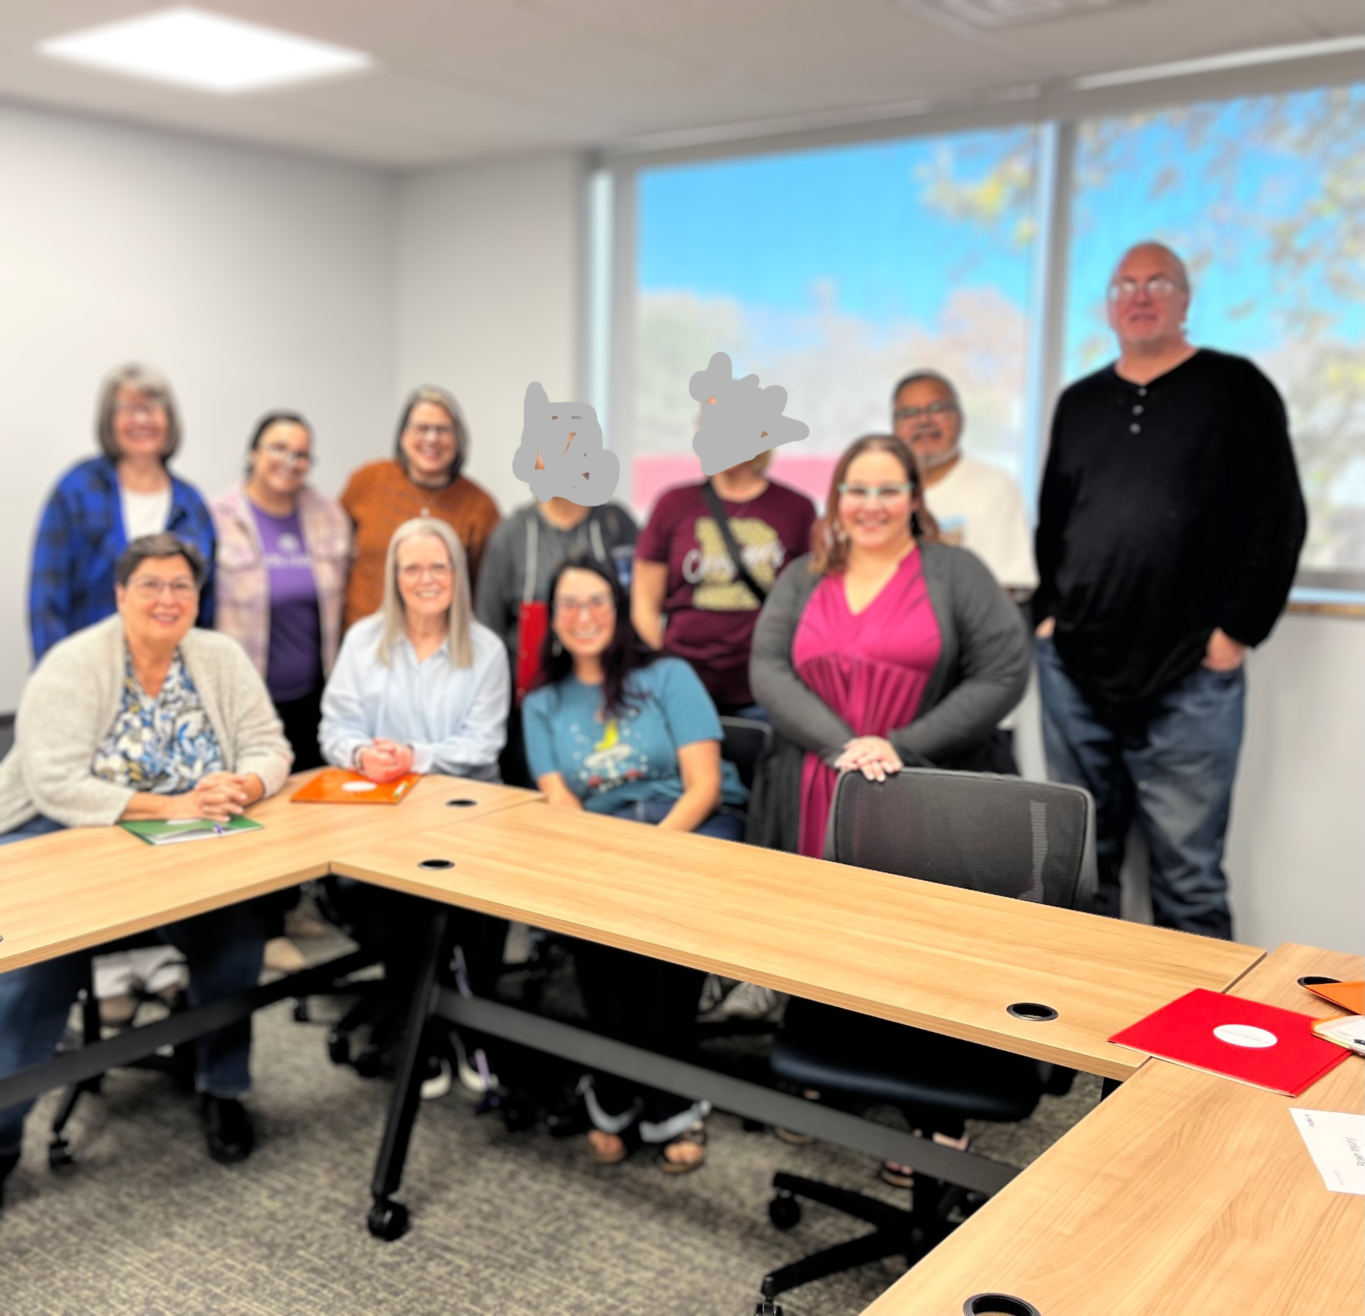
This is Our Group
Future Topics & Speakers
Therapy· Mental Health· Fitness · Resources
This is OUR group.
Notes:
We continue to look for new topics and speakers. But the most important thing is that this is our group, not just mine. The members help decide what we talk about and what we learn next. This is a picture that I snagged when the gals from Minds Matter visited. Some of the faces a blurred and edited to protect the members’ privacy.

Slide 31
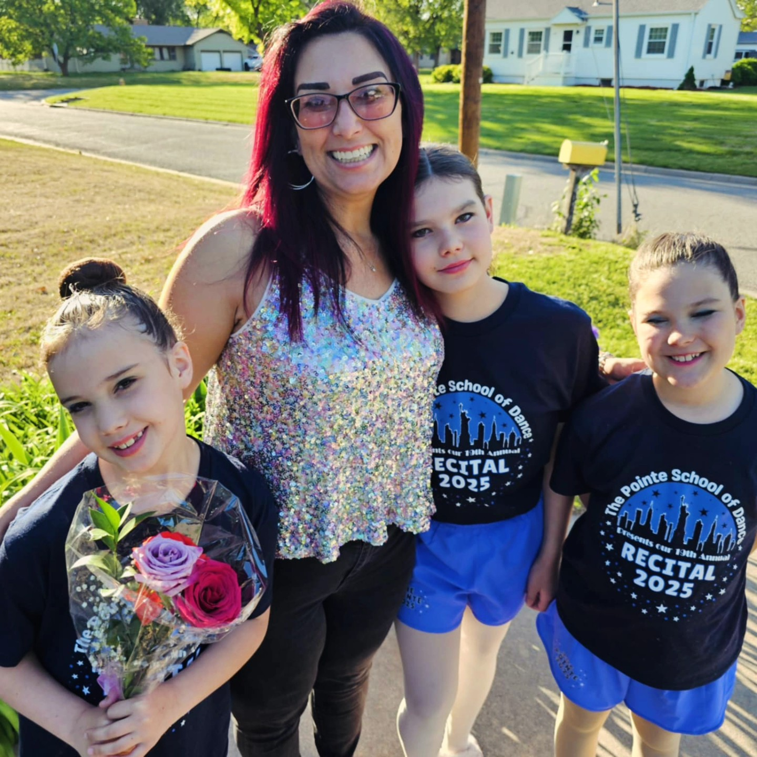
Recovery vs Improvement
Brain Injury Survivors Can Improve
Notes:
I often say that brain injury survivors can improve. I don’t usually use the word recover. To me, that implies that someday I’ll become the same person I was before the accident. And that’s not realistic. But Improvement is real. Growth is real. And life after brain injury can still be meaningful.

Slide 32
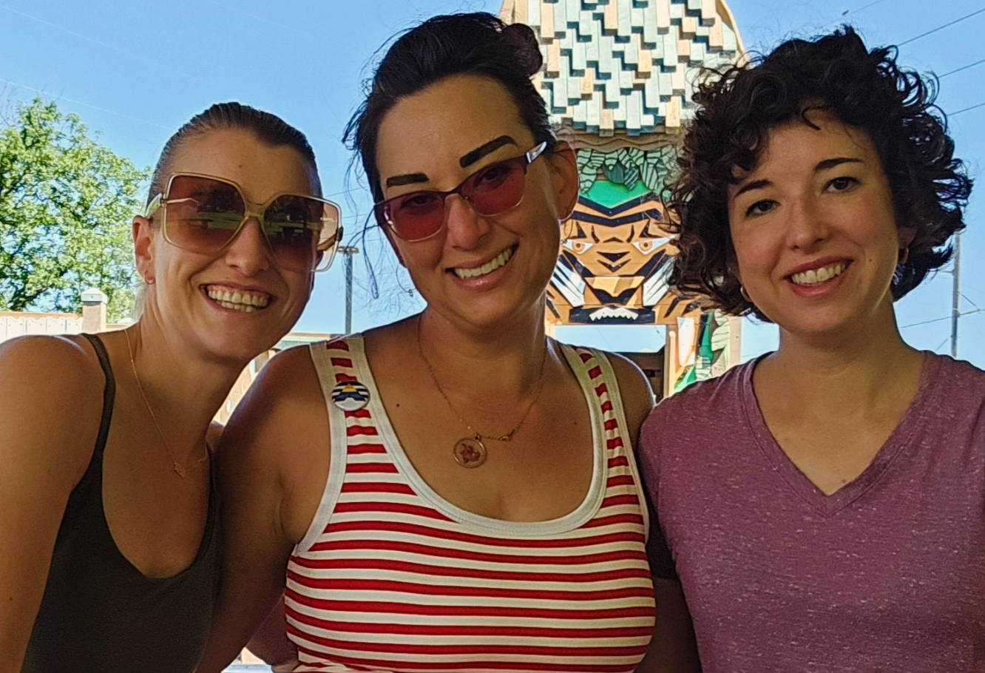
Why Support Groups Matter
Support groups provide:
Understanding
Shared experience
Practical advice
Hope
Notes:
Brain injuries can be incredibly isolating. But when people come together and share their experiences, something powerful happens. People realize they’re not alone. They learn from each other. And they find hope again. This is a picture of myself and two of my sisters. One is an occupational therapist and the other a lawyer, I’m very lucky to have sisters in the helping professions! My injury has affected them too, and I know they are even better at their jobs because they have been a part of this experience.

Slide 33
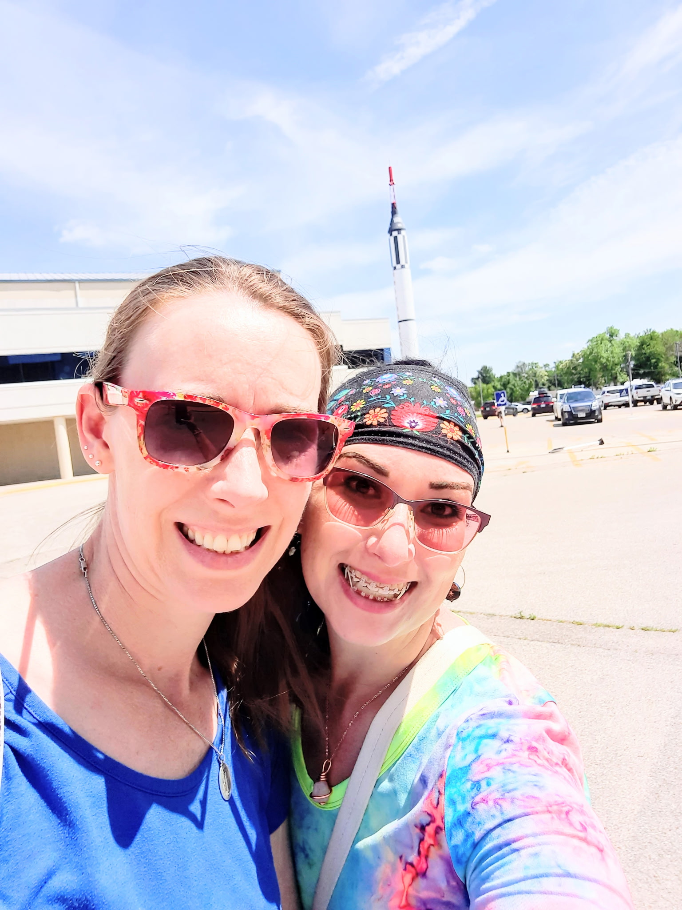
Find or Start a Group
Find a Support Group
Biaks.org
If you don’t find one…..
Notes:
If you’re looking for a brain injury support group near you, I encourage you to visit the brain Injury Association of Kansas website. They list both in-person and virtual support groups. This is a picture of my oldest sister, who is also a speech language pathologist, she is my sounding bored for potential group ideas and encouragement. Without my family support I never would have started a group. SO, get on the website and find a group today! And if you can’t find one that works for you…

Slide 34
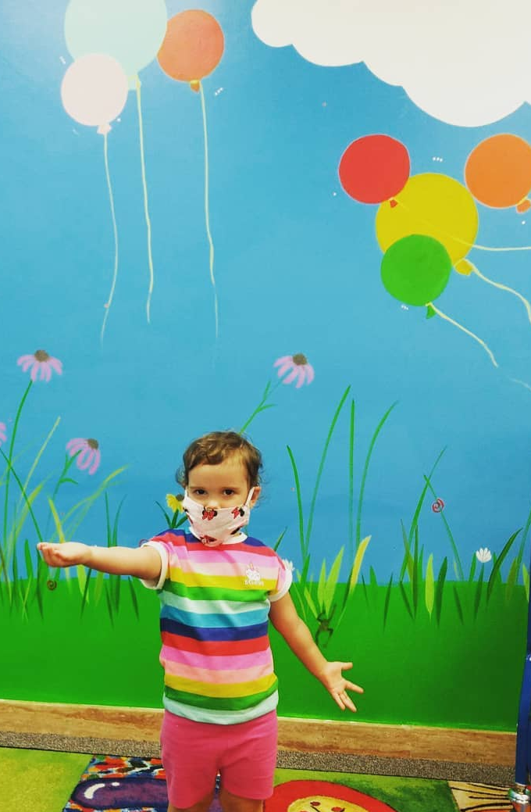
Let it begin with……
YOU!!
Thank You! Emily Ptacek
Emily.ptacek0348@gmail.com
Notes:
Maybe it’s time to start one. That’s exactly how our group began. Each of you MATTER. Thank you all for being here today.

