Slide 1
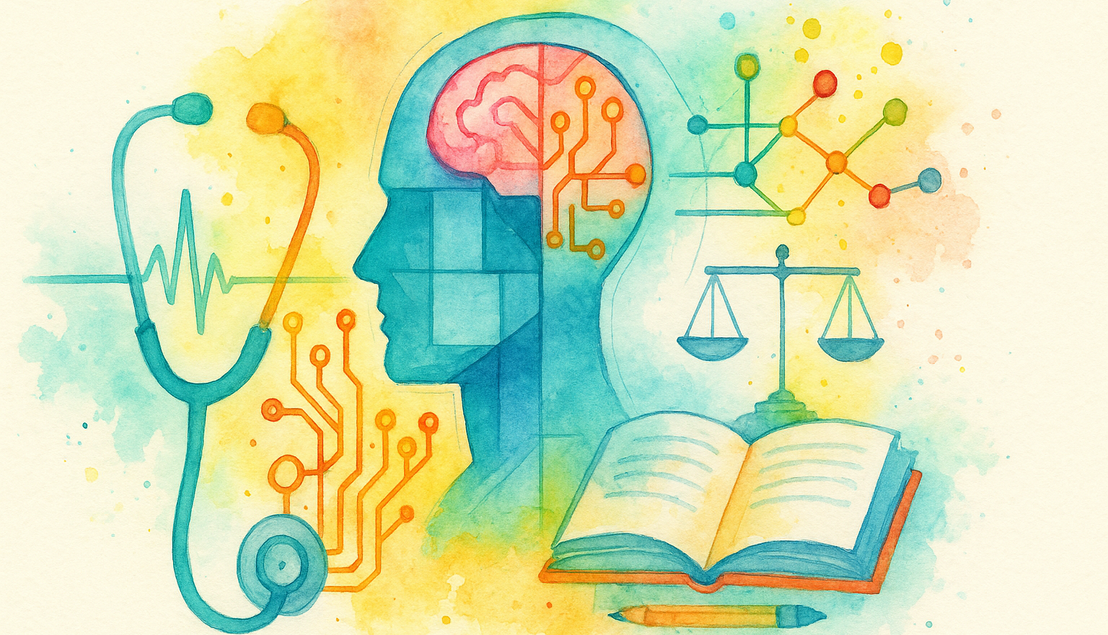
Responsible AI in Brain Injury Care:
Practical Uses, Risks, and Safeguards

Slide 2

Hello!
Imran Musaji
PhD CCC-SLP
(He/Him/His)
Assistant Professor
Department of Communication Sciences and Disorders
Wichita State University

Slide 3
Learning Outcomes
How are we using AI?
What are problems with AI?
Can we use it responsibly?

Slide 4
Artificial Intelligence (AI)
What is it good for?

Slide 5
Basic Definitions
Artificial Intelligence = AI = Software that mimics human-like intelligence to solve tasks.
Machine Learning = AI that improves over time through various methods
Algorithm = A step-by-step process to do some task

Slide 6
A Basic AI Model…
PURPOSE:
Define the task and success metric.
ALGORITHM:
Choose the approach (rules/ML/LLM)
DATA:
High-quality, representative, labeled data.
TRAINING:
Improve algorithm by training on data.
SUPERVISION:
Human review, monitoring, and control.

Slide 7
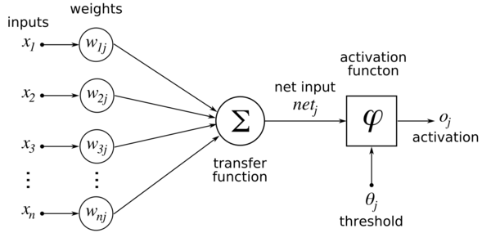
Big picture = “Mimic a brain”
Historically, the holy grail of AI systems has been to mimic brain function
McCulloch, W. S., & Pitts, W. (1943). A logical calculus of the ideas immanent in nervous activity. The bulletin of mathematical biophysics, 5, 115-133.

Slide 8
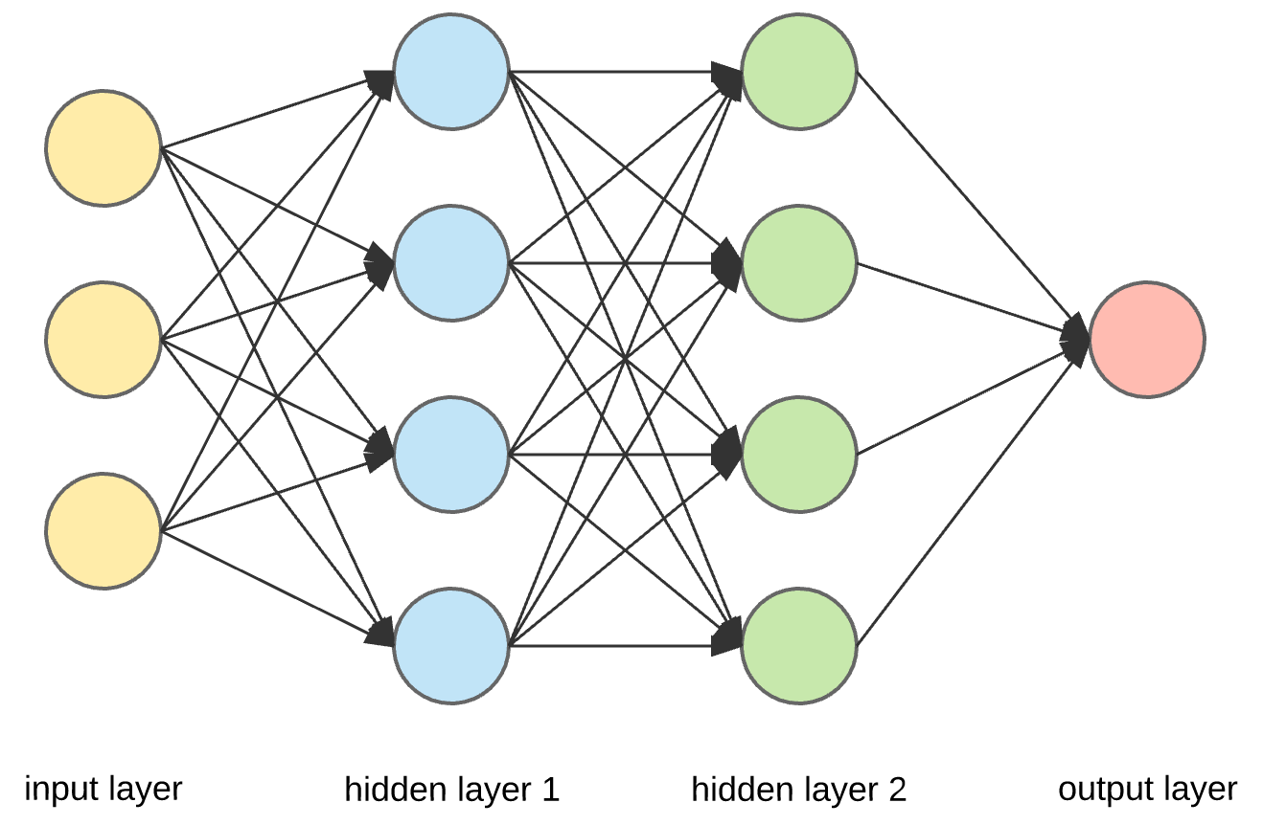
Neural Networks
Chains of algorithms that mimic human neuronal connections to follow complex patterns in data
Computation
Weight

Slide 9
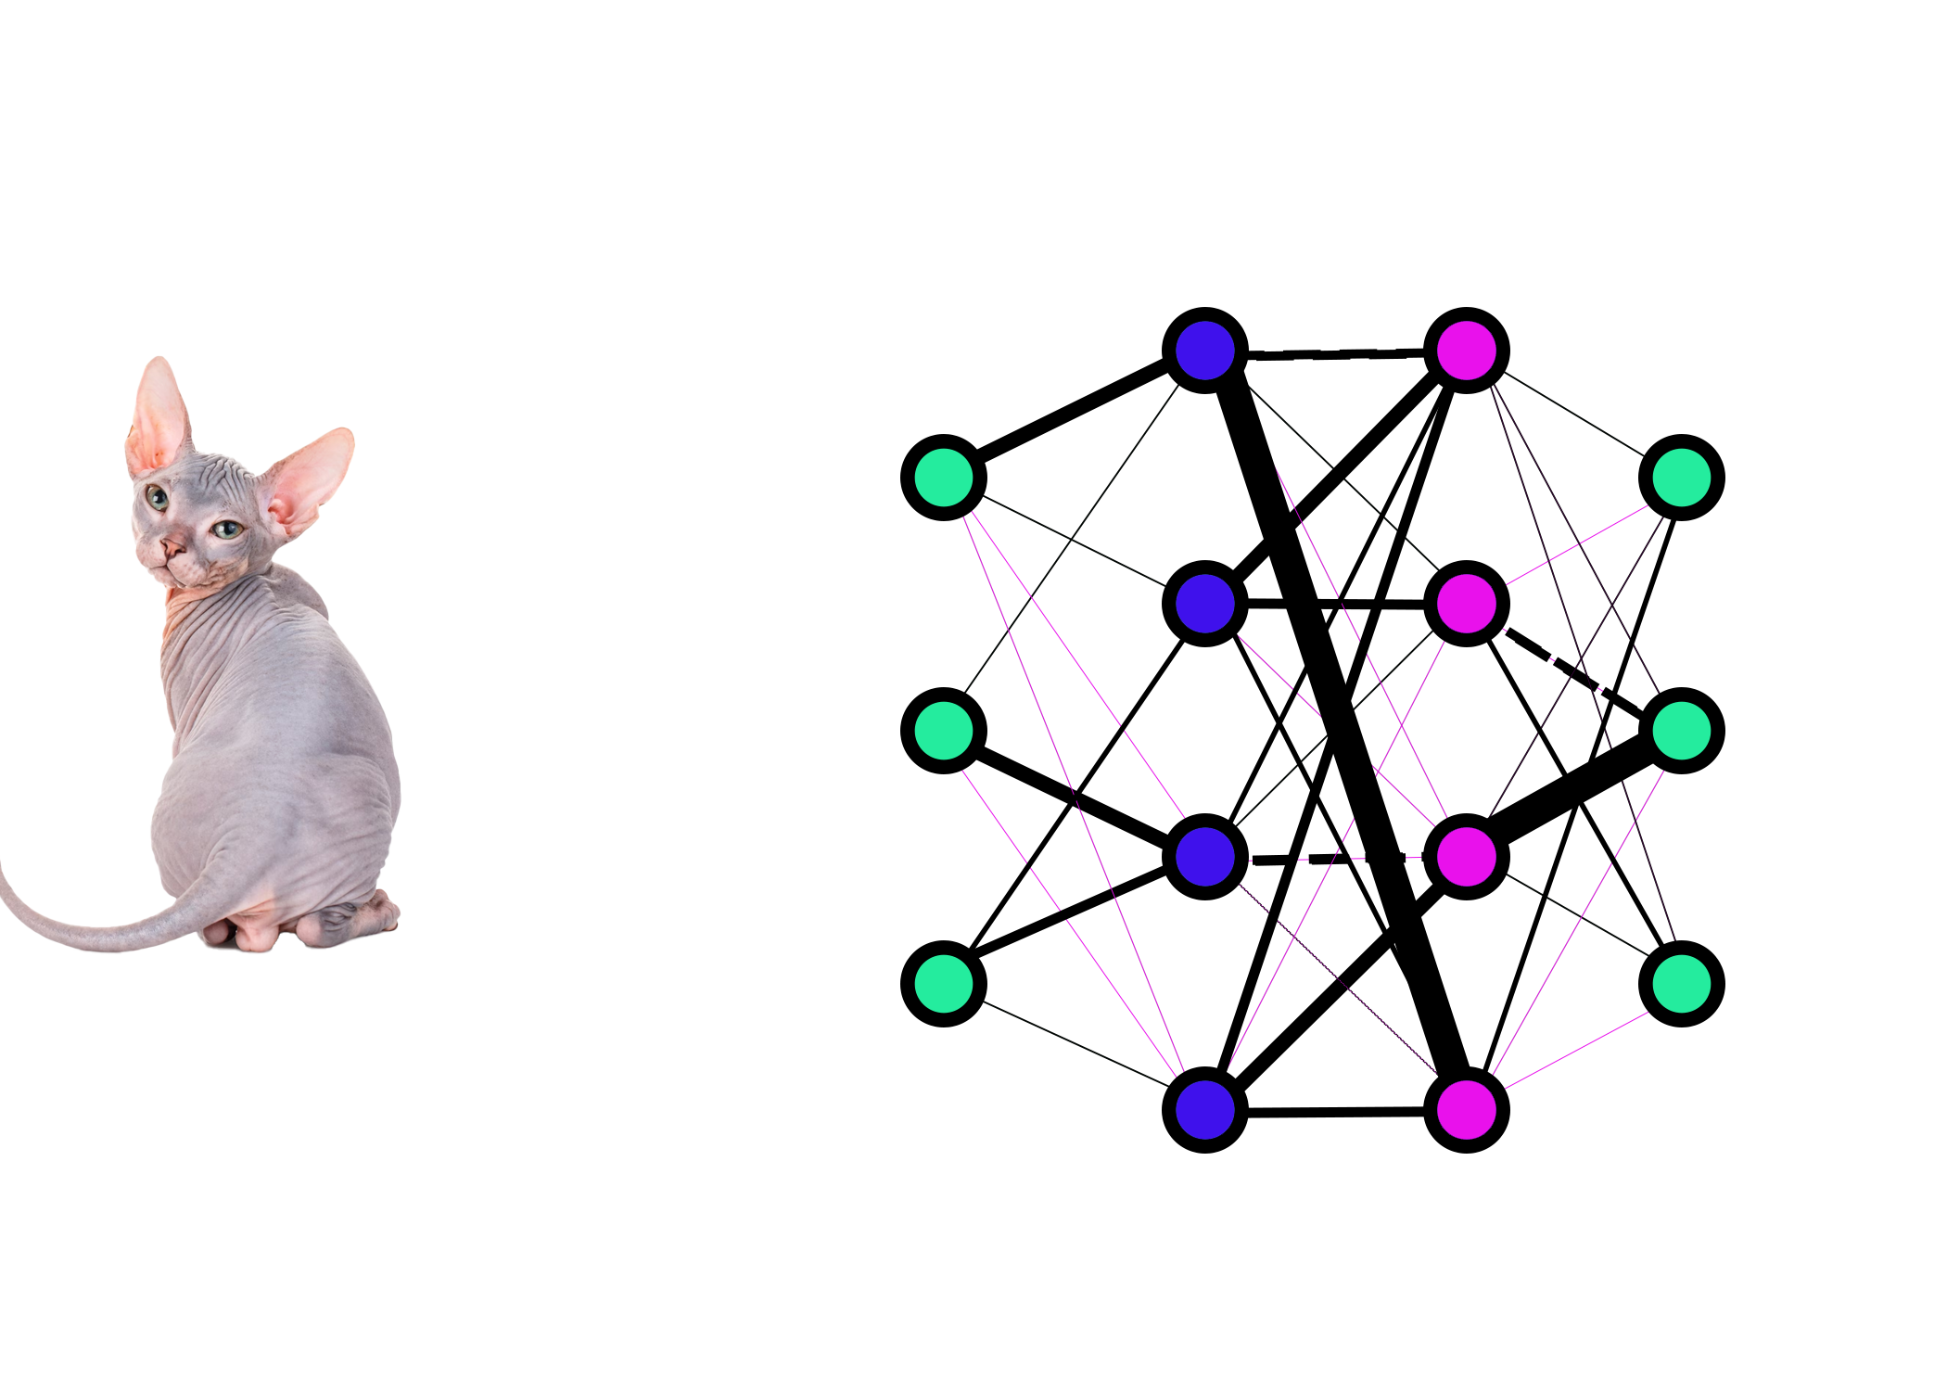
Neural Networks
Inference: Input × Weights → Output
Feature 1:
Ear shape
Output 1
0.12 = mouse
Feature 2:
Tail length
Output 2
0.21 = chihuahua
Feature 3:
Fuzziness
Output 3
0.67 = cat

Slide 10
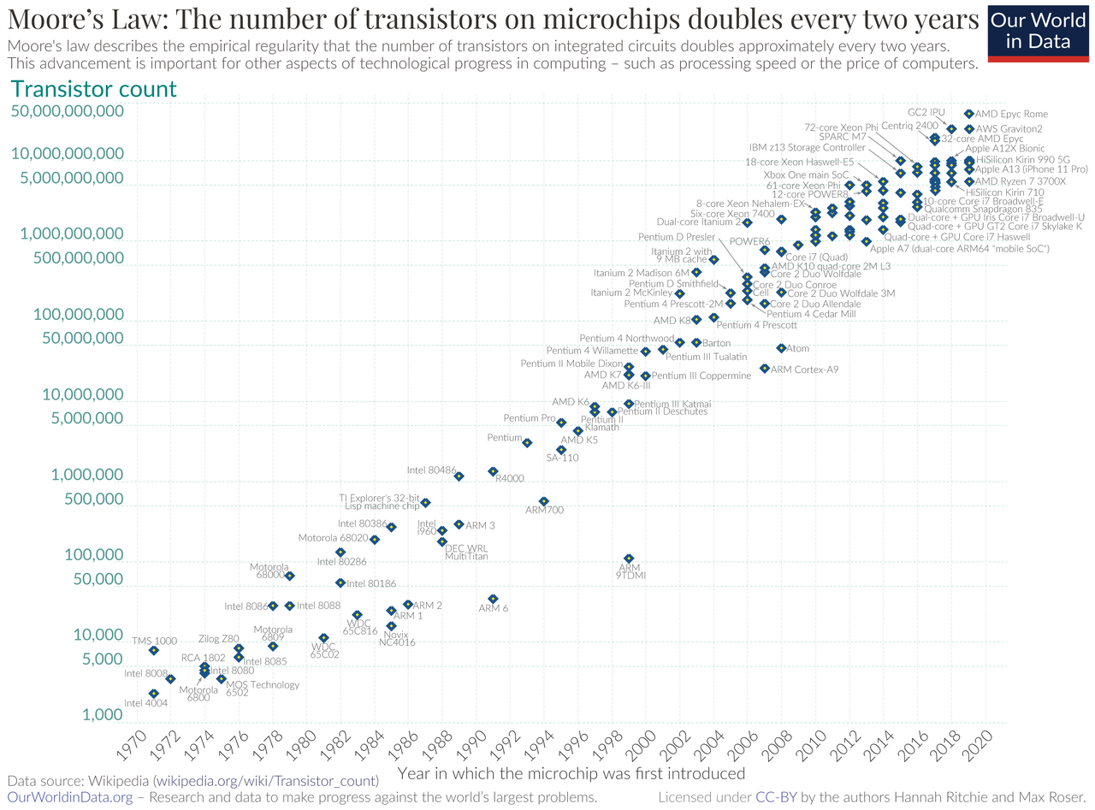

Slide 11
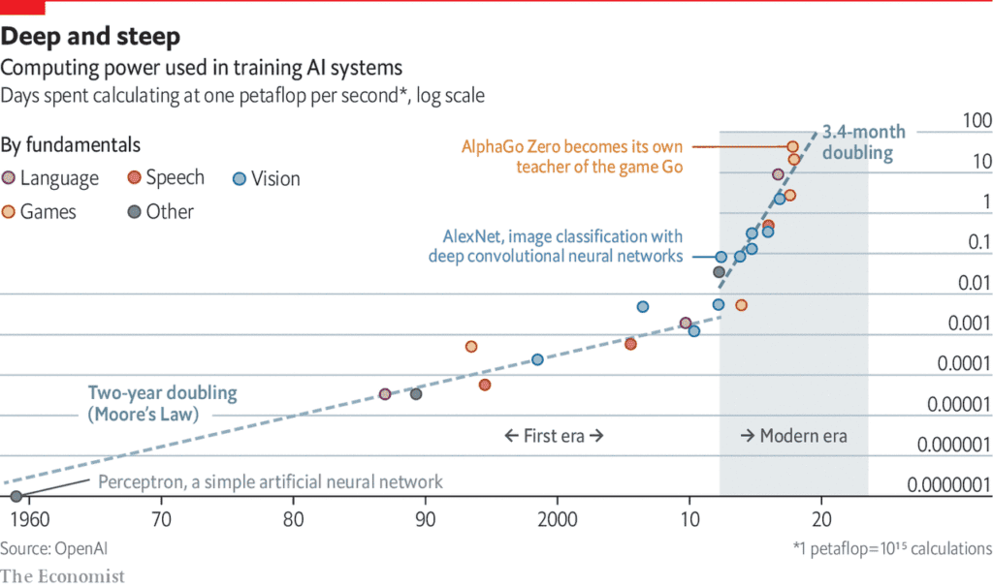
2000s– Beyond exponential growth

Slide 12
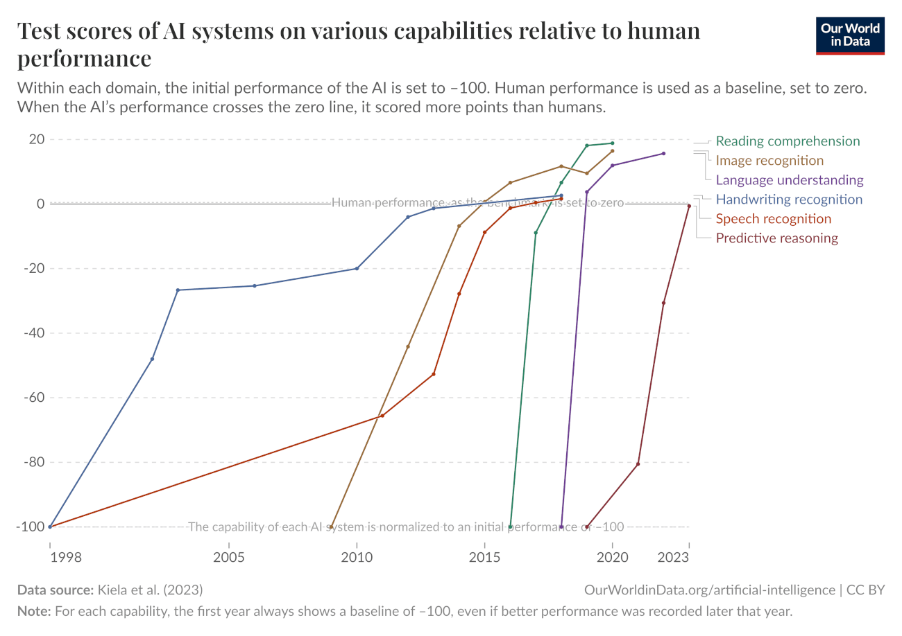
Sabri, H., Saleh, M. H., Hazrati, P., Merchant, K., Misch, J., Kumar, P. S., ... & Barootchi, S. (2025). Performance of three artificial intelligence (AI)‐based large language models in standardized testing; implications for AI‐assisted dental education. Journal of periodontal research, 60(2), 121-133.
Jaworski, A., Jasiński, D., Jaworski, W., Hop, A., Janek, A., Sławińska, B., ... & Jasińska, N. (2024). Comparison of the performance of artificial intelligence versus medical professionals in the Polish final medical examination. Cureus, 16(8).
Lin, J. C., Kurapati, S. S., Younessi, D. N., Scott, I. U., & Gong, D. A. (2024). Ethical and professional decision-making capabilities of artificial intelligence chatbots: evaluating ChatGPT’s professional competencies in medicine. Medical Science Educator, 34(2), 331-333.
Martínez, E. (2024). Re-evaluating GPT-4’s bar exam performance. Artificial intelligence and law, 1-24.
And many more…
Notes:
Kiela, D., Bartolo, M., Nie, Y., Kaushik, D., Geiger, A., Wu, Z., ... & Williams, A. (2021). Dynabench: Rethinking benchmarking in NLP. arXiv preprint arXiv:2104.14337.

Slide 13
Machine Learning in CSD
How are we using it?

Slide 14
Voice

Slide 15
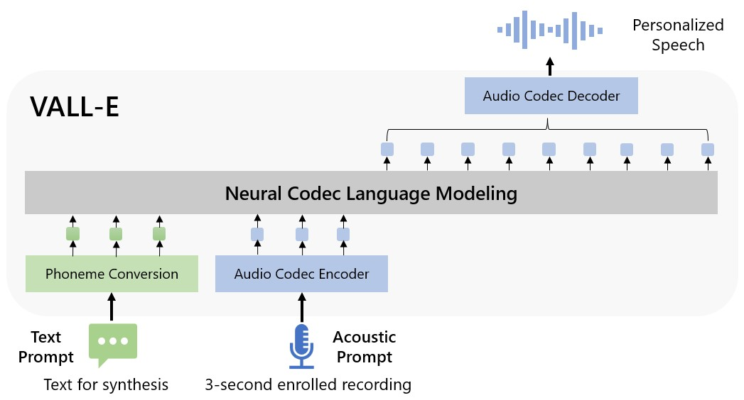
Voice Banking and Voice Cloning
Wang, C., Chen, S., Wu, Y., Zhang, Z., Zhou, L., Liu, S., ... & Wei, F. (2023). Neural Codec Language Models are Zero-Shot Text to Speech Synthesizers. arXiv preprint arXiv:2301.02111.

Slide 16

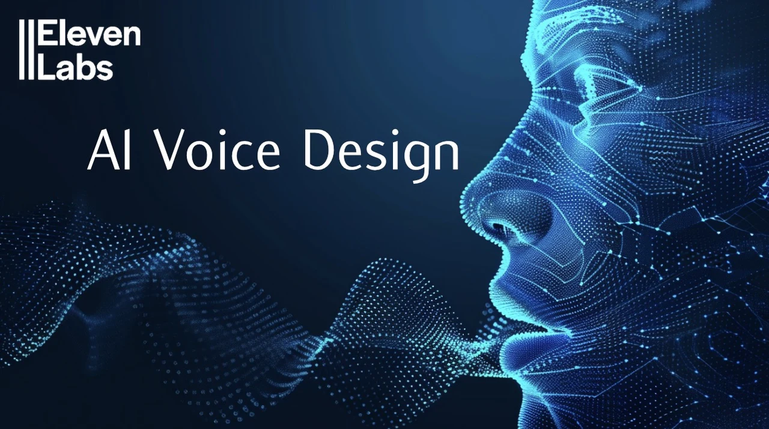

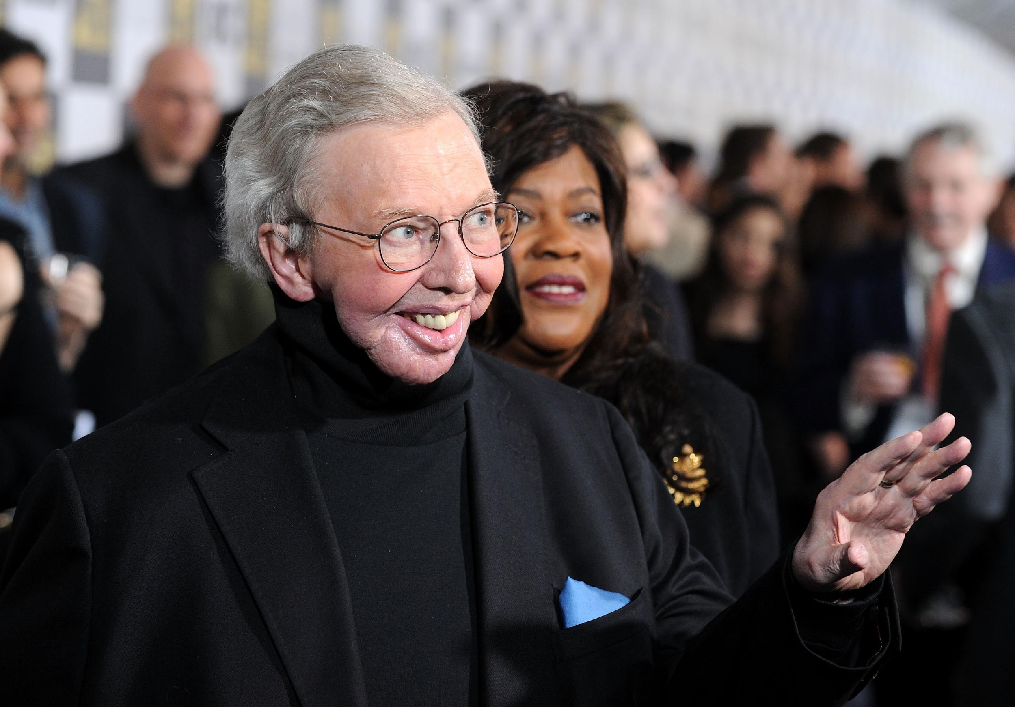



Slide 17
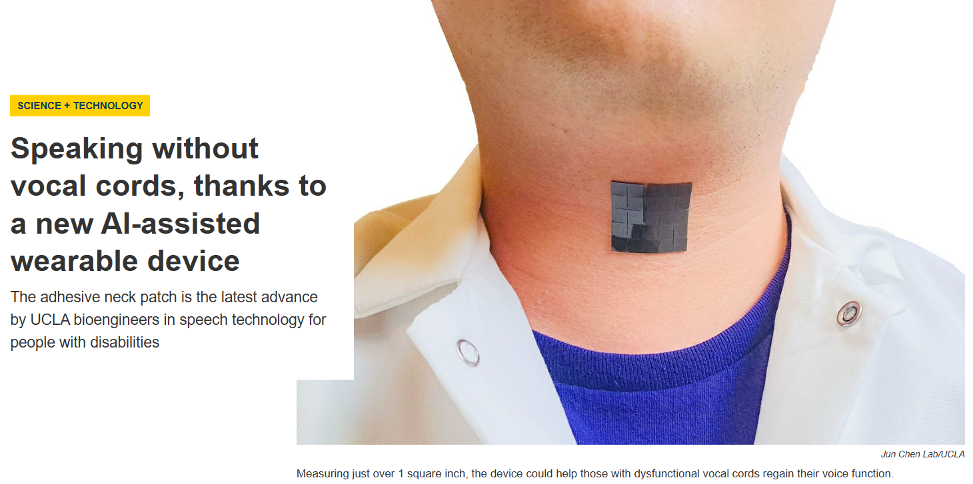
AI powered laryngeal muscle sensors…
Che, Z., Wan, X., Xu, J., Duan, C., Zheng, T., & Chen, J. (2024). Speaking without vocal folds using a machine-learning-assisted wearable sensing-actuation system. Nature Communications, 15(1), 1873.

Slide 18
Language

Slide 19
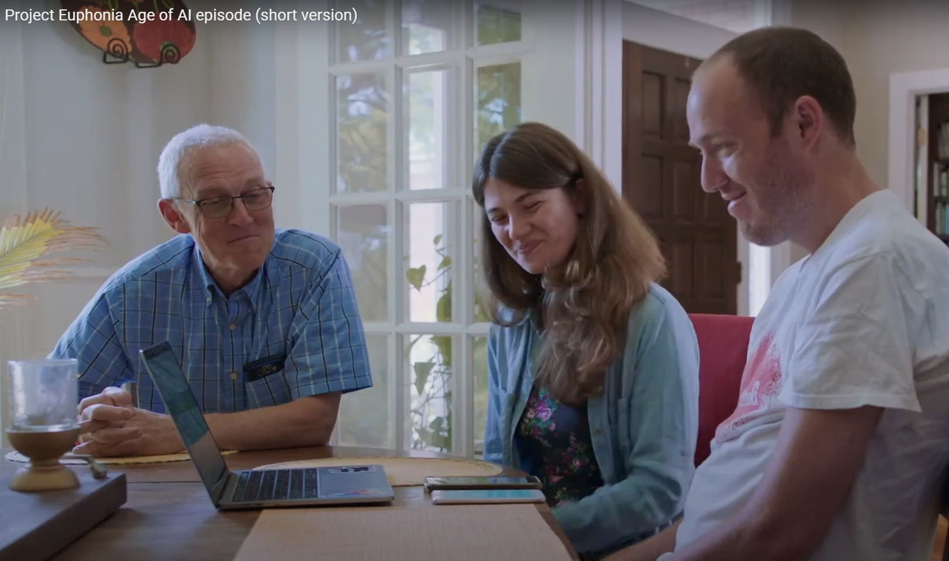
Google Euphonia
Better, more diverse, adaptive speech models
Voice Cloning
Voice Access
Text-to-Speech
Speech-to-Text
https://youtu.be/pPPXY-fpcI8?si=U-nZhRzC_WwkgEEp

Slide 20
Google Euphonia
Goal: Better, more diverse, adaptive speech models
2025 overview reports >1.5M utterances from ~3,000 speakers and continued international expansion of the corpus to improve ASR for atypical speech.
2024 study evaluates conversational ASR for people with disordered speech (using Euphonia data/partnerships).
Martin, A., MacDonald, R. L., Jiang, P. P., Ladewig, M., Cattiau, J., Heywood, R., ... & Tomanek, K. (2025). Project Euphonia: advancing inclusive speech recognition through expanded data collection and evaluation. Frontiers in Language Sciences, 4, 1569448.
Tobin, J., Nelson, P., MacDonald, B., Heywood, R., Cave, R., Seaver, K., ... & Green, J. R. (2024). Automatic speech recognition of conversational speech in individuals with disordered speech. Journal of Speech, Language, and Hearing Research, 67(11), 4176-4185.

Slide 21
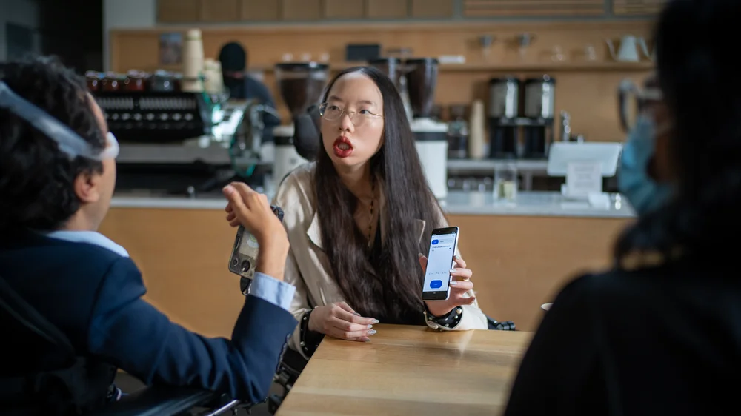
Google Relate
Alternative access modalities for devices
Digital access
Potential for AAC applications
You can download now
https://youtu.be/EU2oCVlzEZk?si=RdV2fzVGhDYckIZe

Slide 22
Assistive Tech
+
AAC

Slide 23
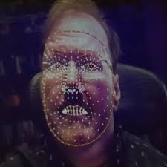
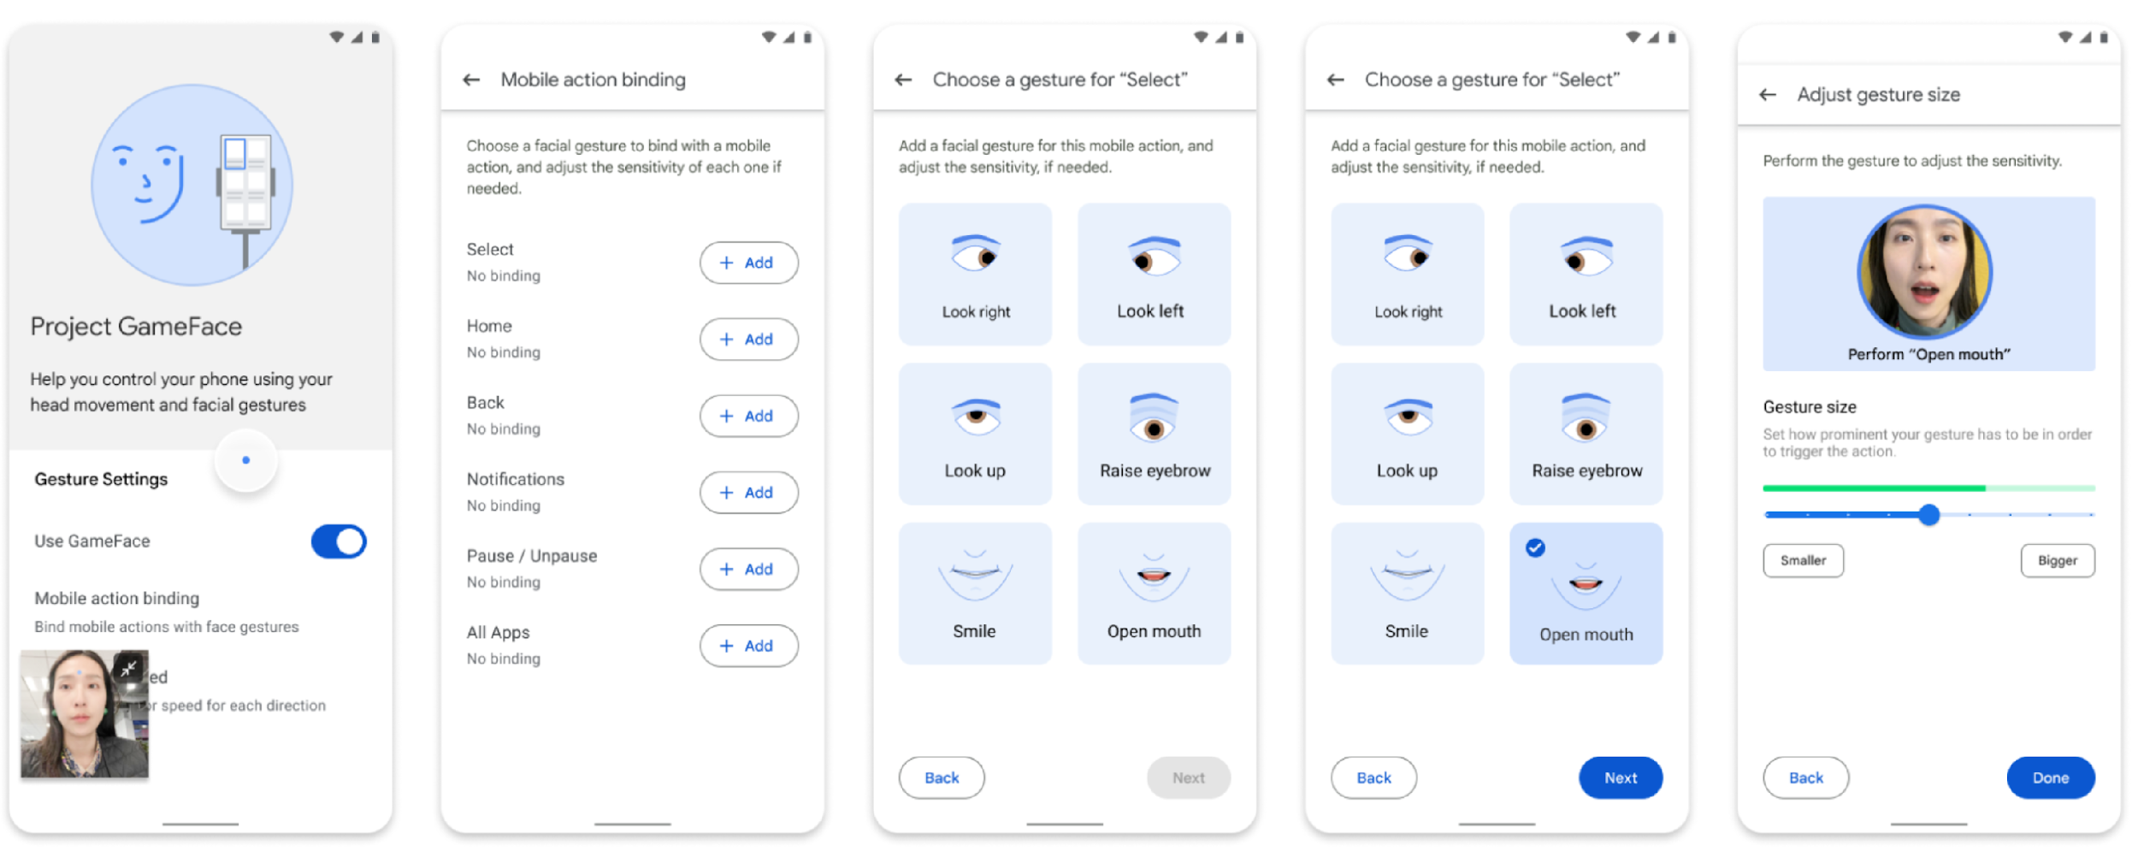
Project Game Face
Alternative access modalities for devices
Digital access
Potential for AAC applications

Slide 24
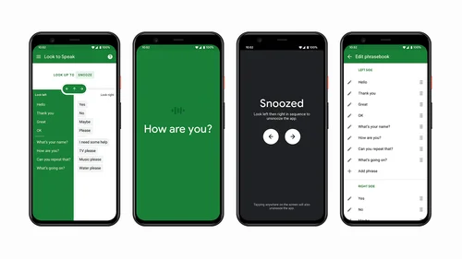
Look to Speak
Select phrases using eye movement

Slide 25
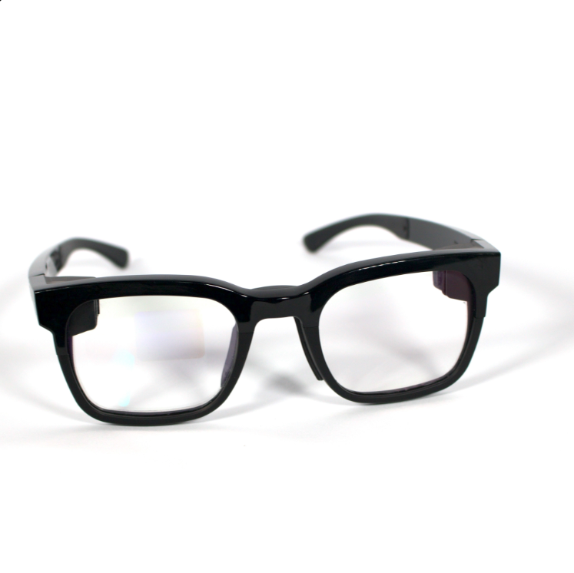
Transcribe Glass
Live captions
Can augment hearing
Can adapt to loud environment
Can enable translation
Aiming to be affordable
https://youtu.be/9DnMcI3Vdbk?si=yoPNnUJvomj42fWB

Slide 26
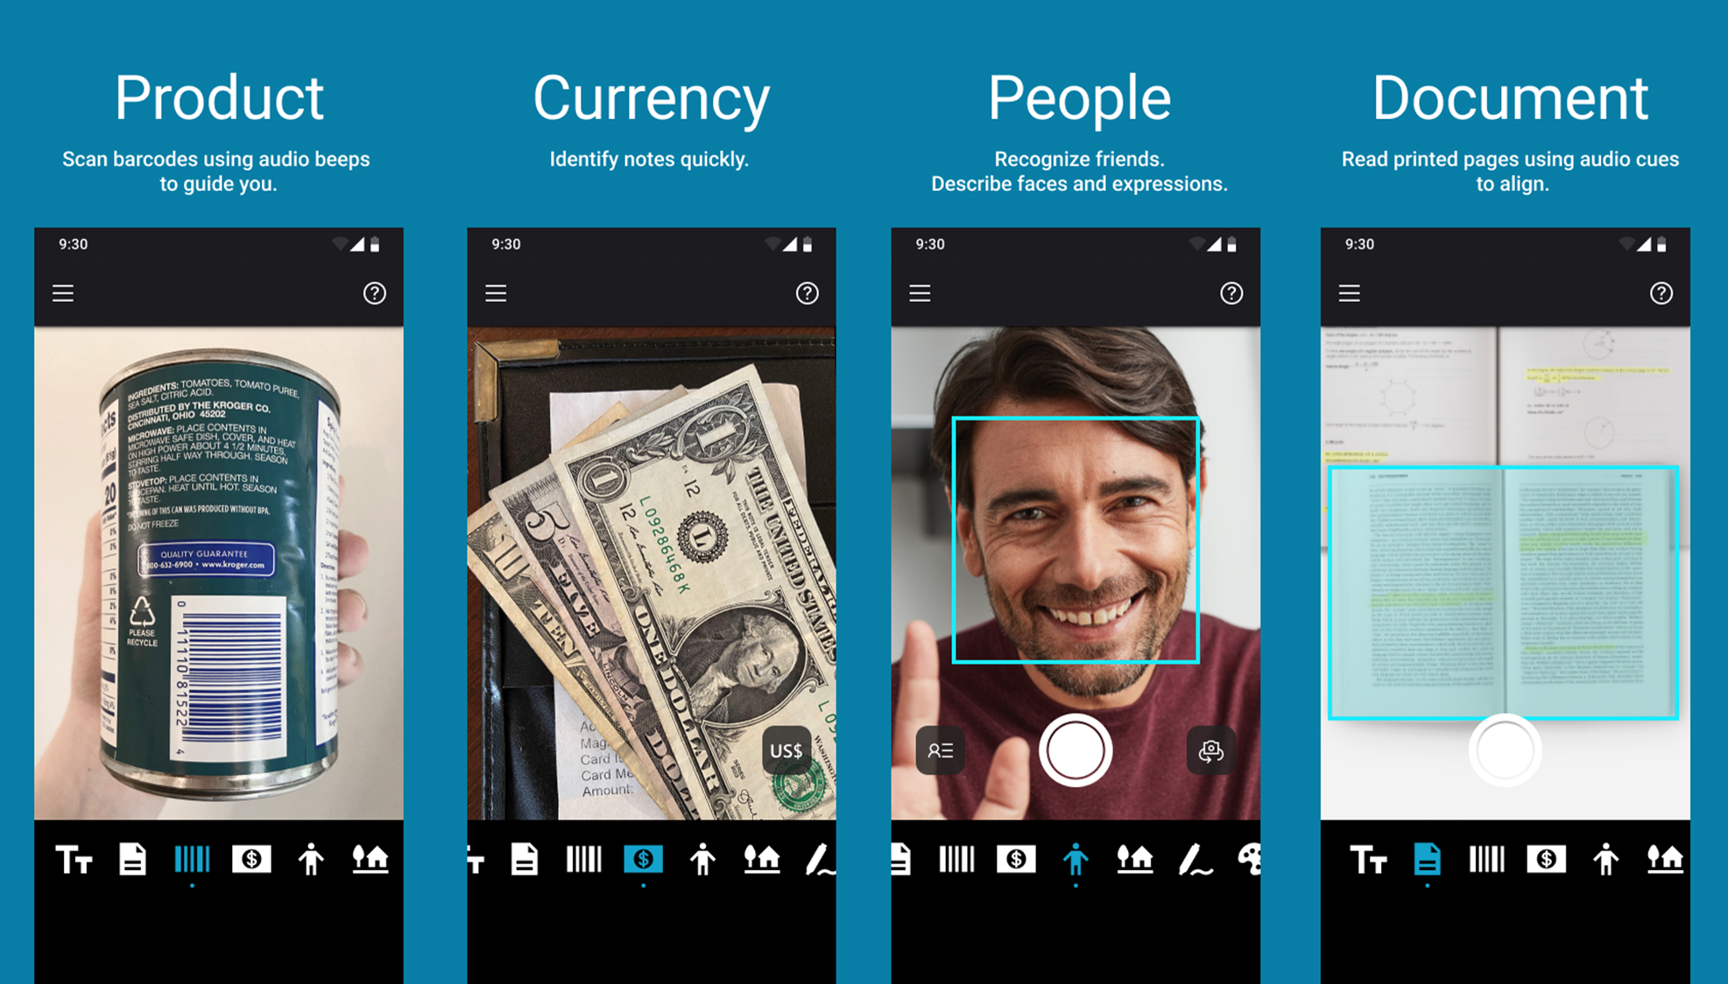
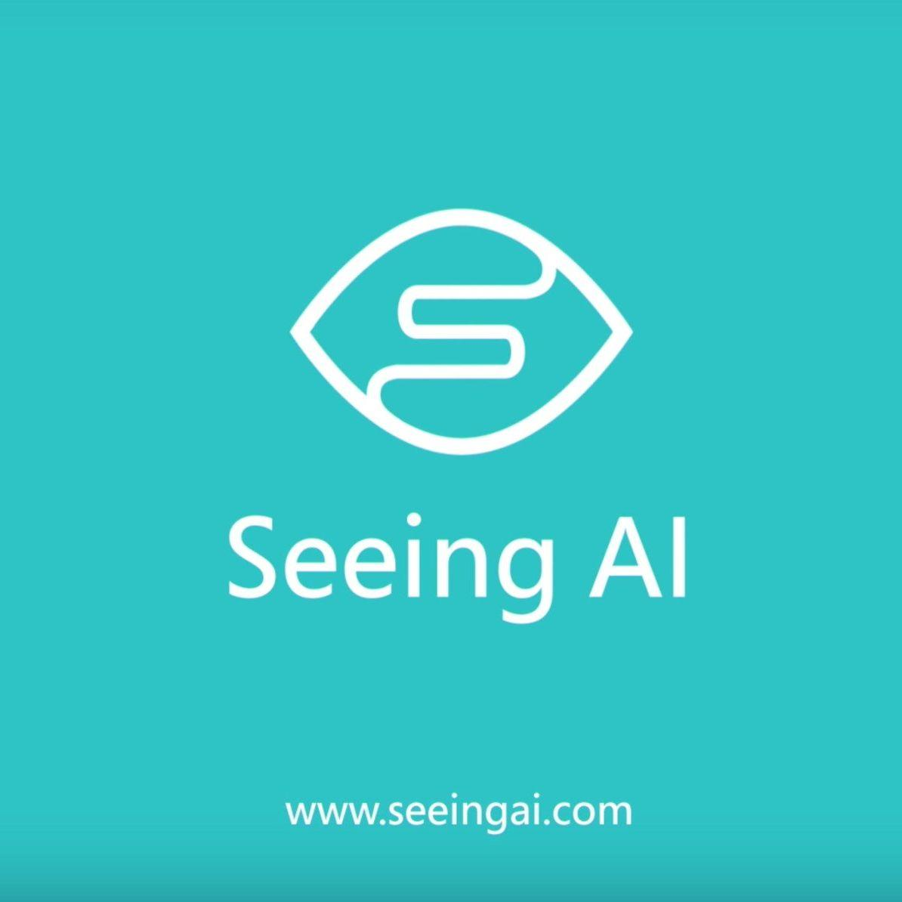
Seeing AI

Slide 27
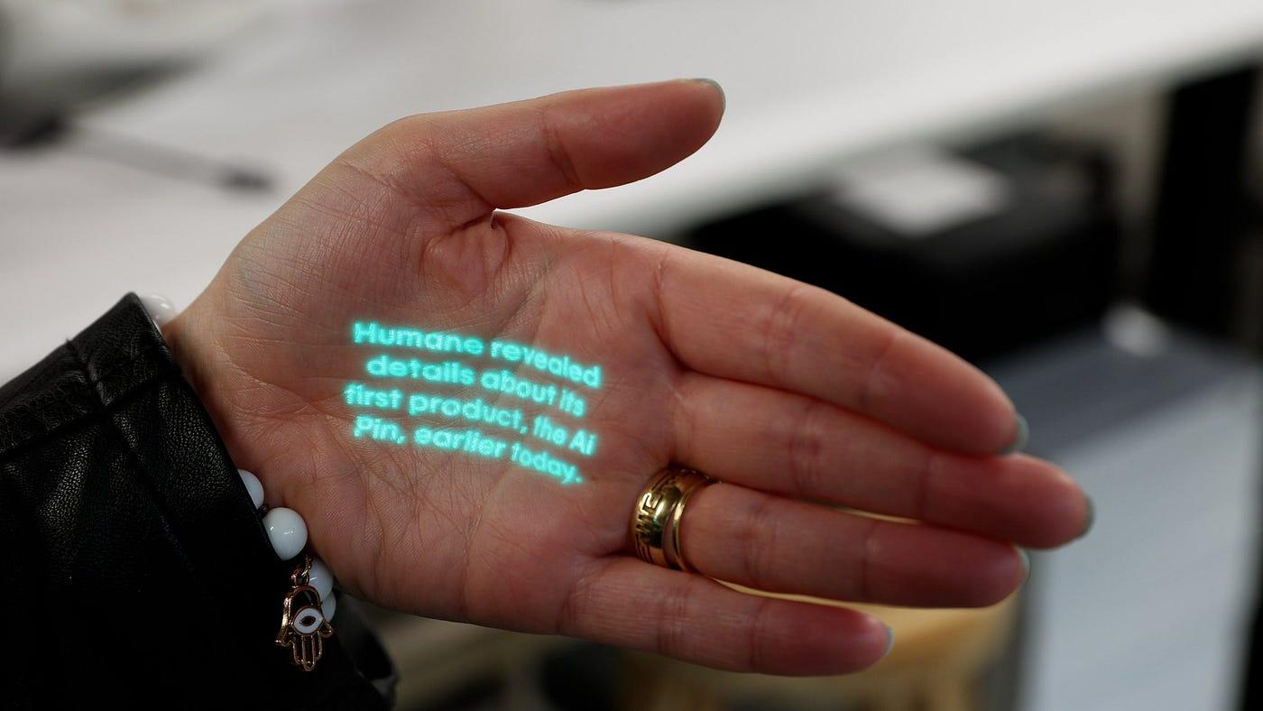
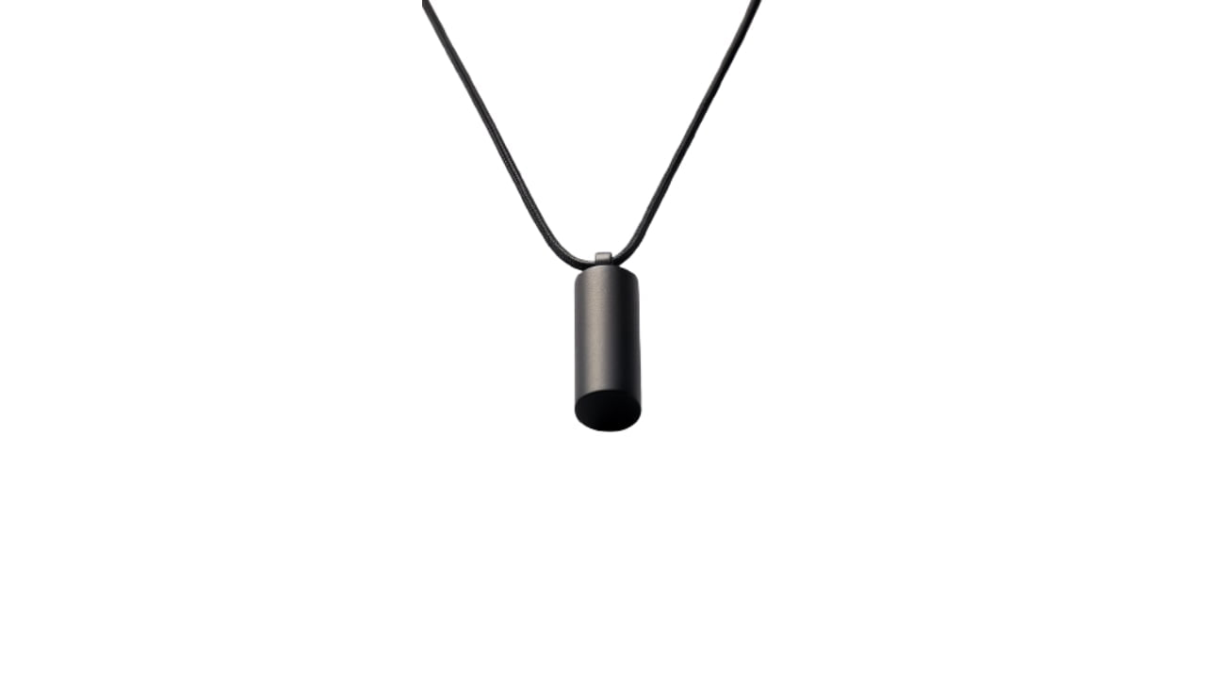
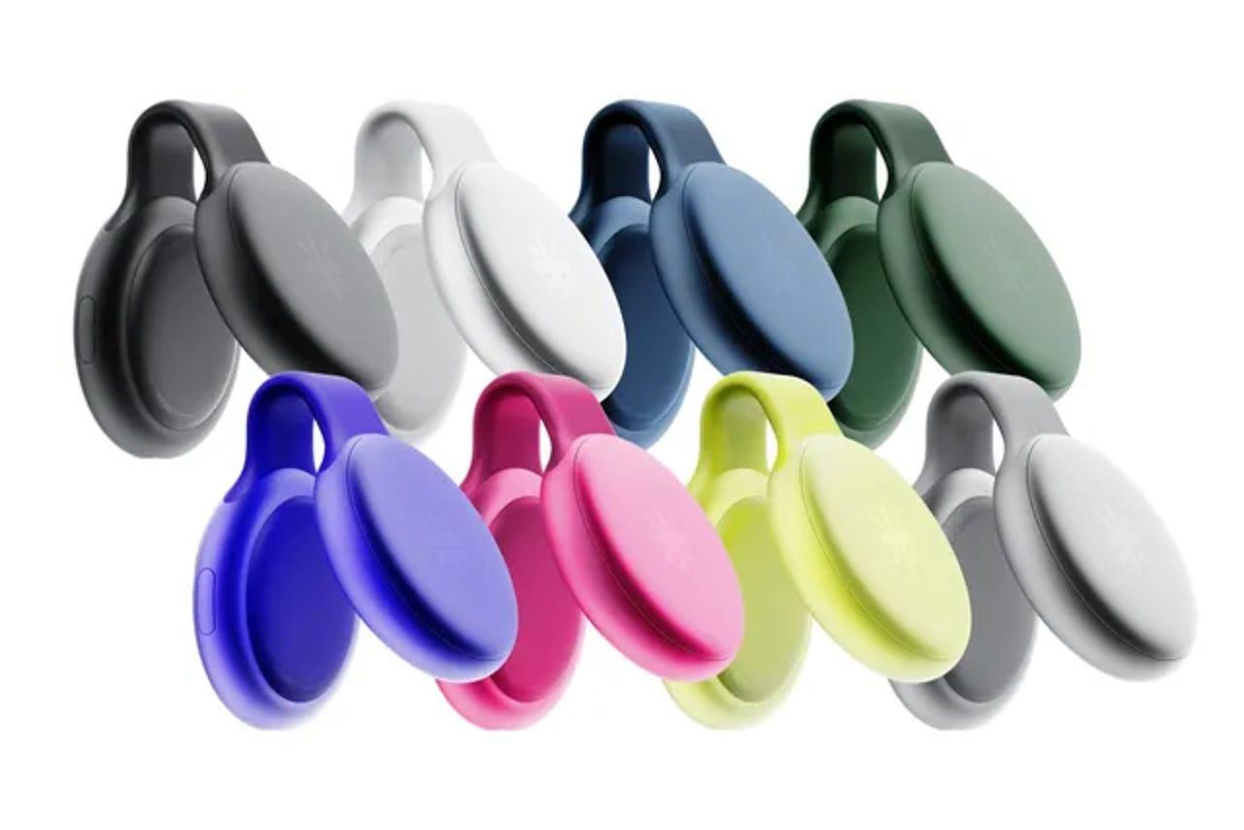
Note Taking
Otter.ai
Zapier
ChatGPT
Evernote
Senstone
Livescribe
Limitless
and many more…

Slide 28




Text-to-speech, speech-to-text, screen readers, and voice assistants.
A huge number of options, including those tailored for specific needs
  Dyslexia
  Other reading disorders
  Dysgraphia/agraphia
  Visual impairment
  Cognitive language disorders

Slide 29
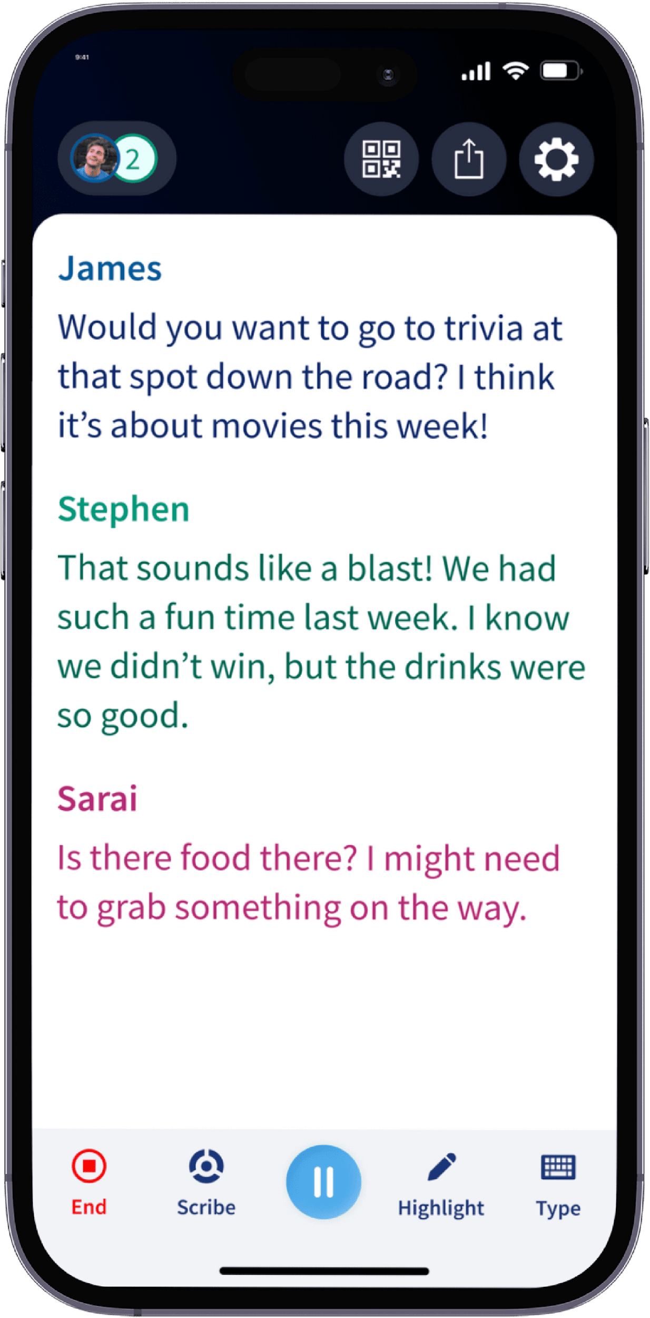
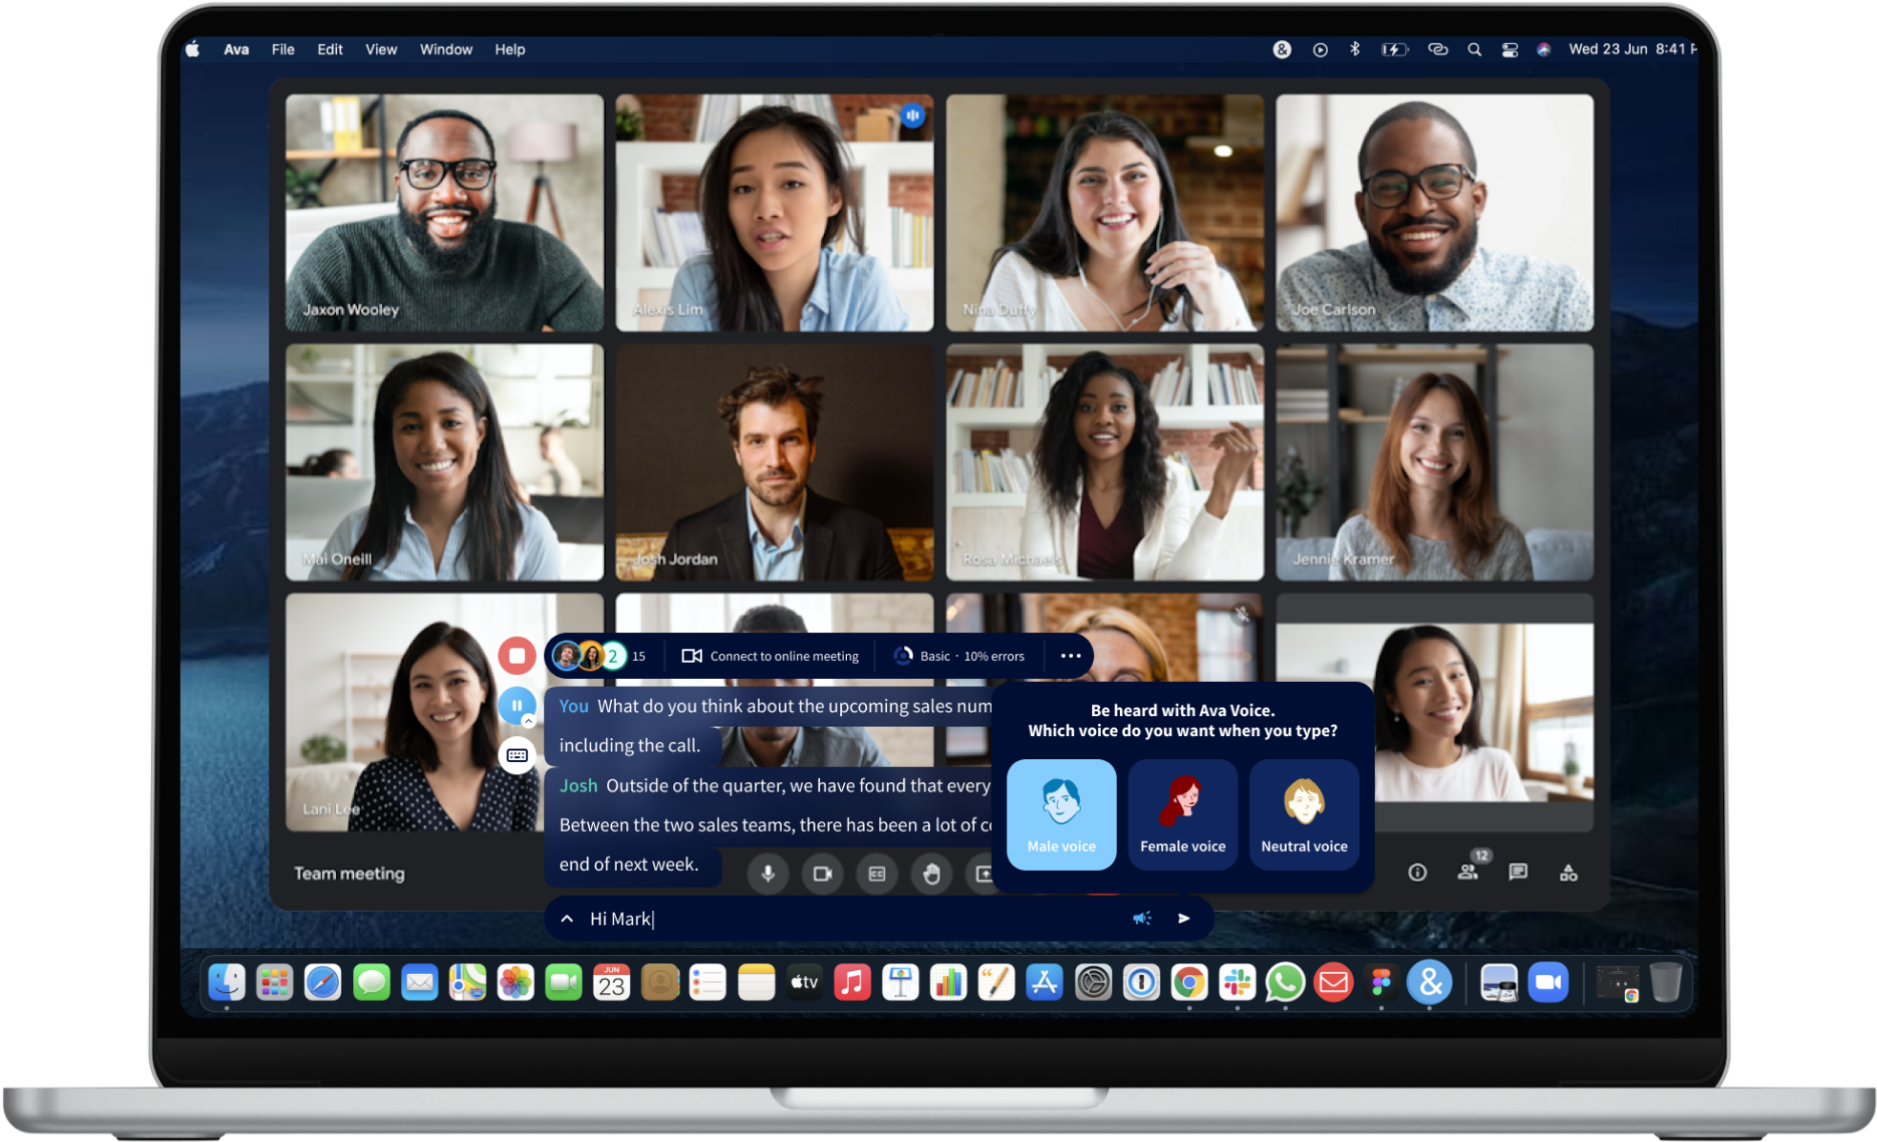
Ava
Group captioning
Multiple devices
Telecommunication
https://youtu.be/MgKVPcJE6Ds?si=Tr2v-CQM8zbw3IZO

Slide 30
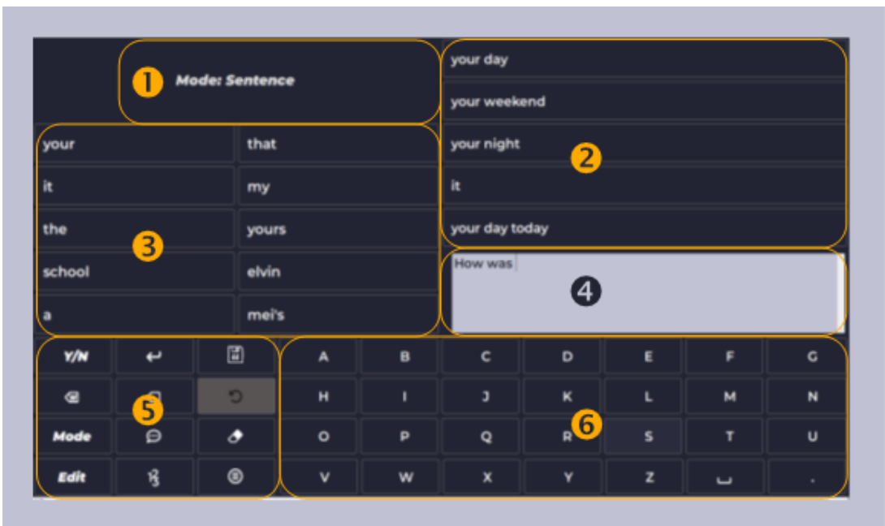
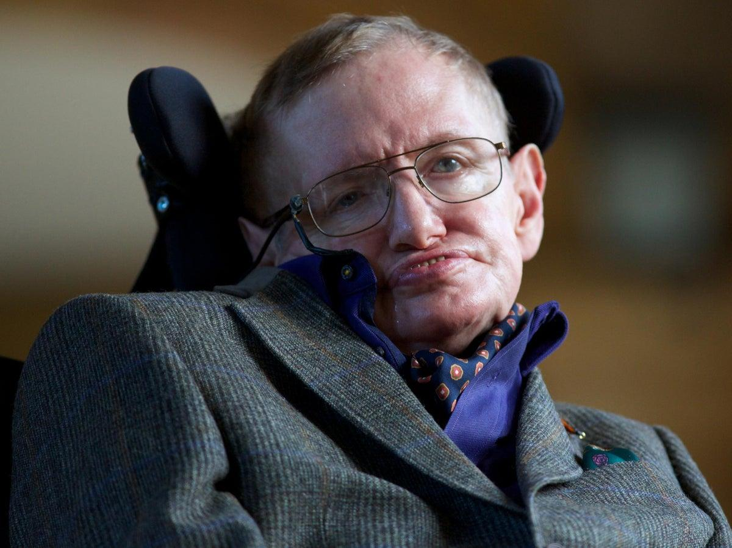
ACAT
Intel made Stephen Hawking’s AAC system free and open source.

Slide 31
Hearing

Slide 32
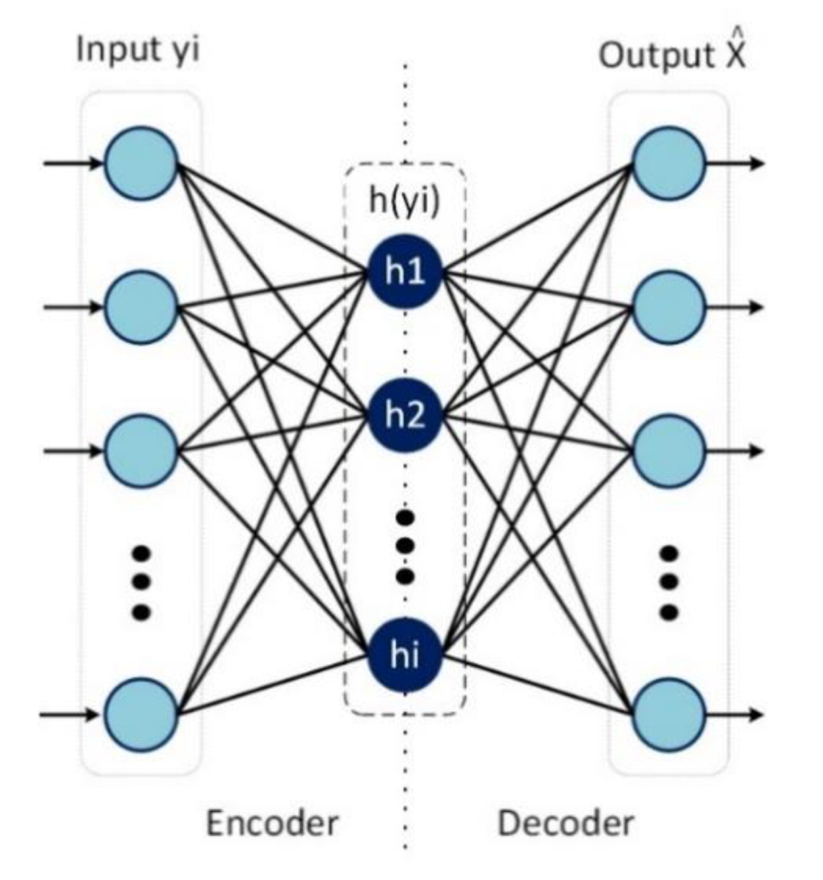
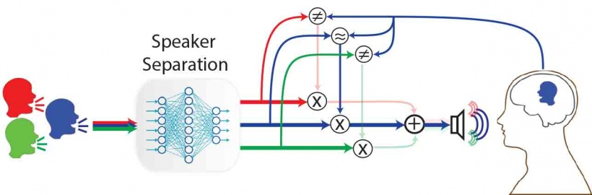
Modern Hearing Aids
Neural Networks are used to:
  Distinguish speakers
  Eliminate noise
  Amplify signals
  Identify source
  Adapt to environment

Slide 33
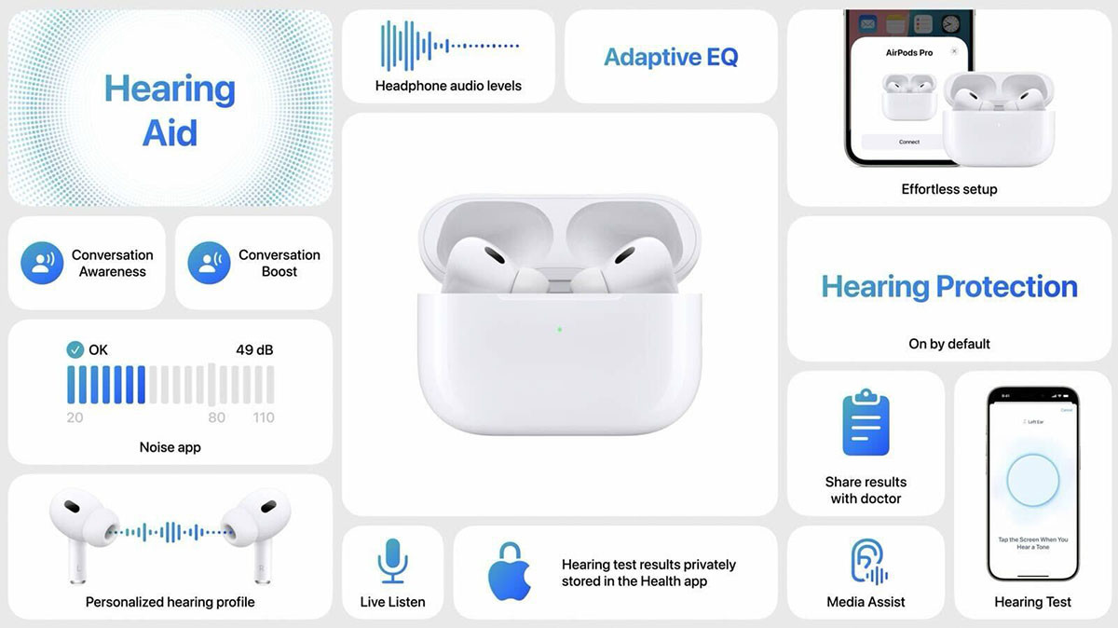

Slide 34
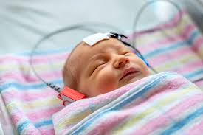
Automated Hearing Screening
AI Automated audiometry/Auditory Brainstem Response
Highly accurate and twice as fast as clinicians.
Chesnaye, M. A., Simpson, D. M., Schlittenlacher, J., Laugesen, S., & Bell, S. L. (2025). Audiogram estimation performance using auditory evoked potentials and Gaussian processes. Ear and Hearing, 46(1), 230-241.

Slide 35
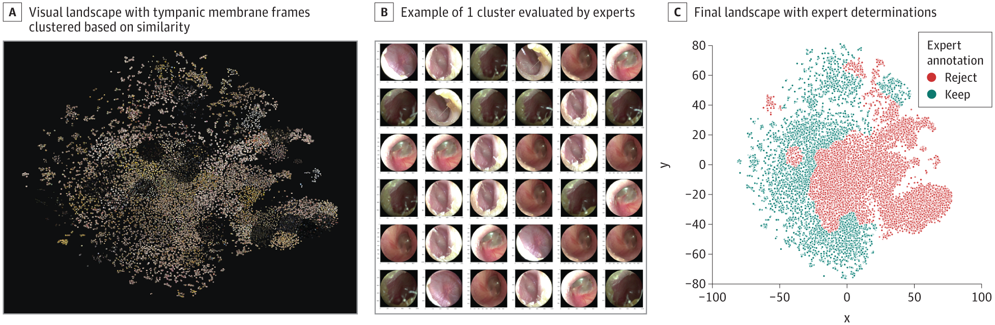
Otitis Media
Interprets tympanic-membrane videos to identify otitis media in children
A decision-support tool
Sensitivity of 93.8% and specificity of 93.5%.
Merler, M., Agurto, C., Peller, J., Roitberg, E., Taitz, A., Trevisan, M. A., ... & Norel, R. (2025). Clinical assessment and interpretation of dysarthria in ALS using attention based deep learning AI models. npj Digital Medicine, 8(1), 260.

Slide 36
Brain Computer Interface

Slide 37
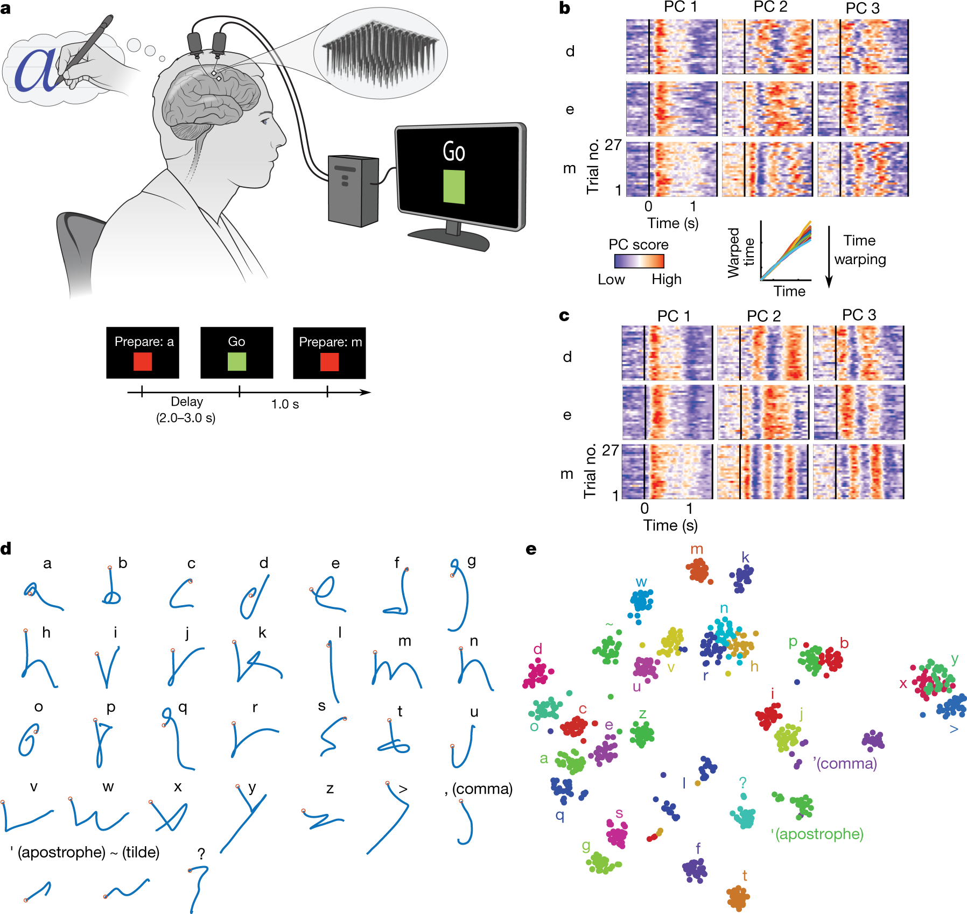
Brain Computer Interface
Willett, F. R., Avansino, D. T., Hochberg, L. R., Henderson, J. M., & Shenoy, K. V. (2021). High-performance brain-to-text communication via handwriting. Nature, 593(7858), 249-254.

Slide 38
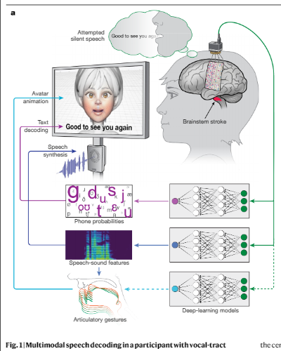
…and digital Avatars
Metzger, S. L., Littlejohn, K. T., Silva, A. B., Moses, D. A., Seaton, M. P., Wang, R., ... & Chang, E. F. (2023). A high-performance neuroprosthesis for speech decoding and avatar control. Nature, 620(7976), 1037-1046.

Slide 39
Assessment

Slide 40
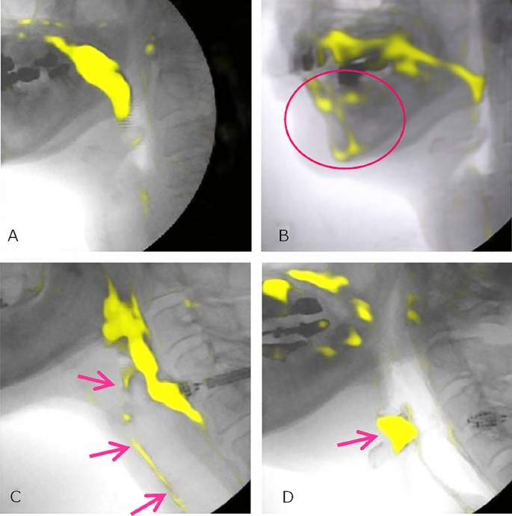
Automated MBS
Li, W., Mao, S., Mahoney, A. S., Coyle, J. L., & Sejdić, E. (2024). Automatic Tracking of Hyoid Bone Displacement and Rotation Relative to Cervical Vertebrae in Videofluoroscopic Swallow Studies Using Deep Learning. Journal of Imaging Informatics in Medicine, 1-11.
Li, W., Mao, S., Mahoney, A. S., Petkovic, S., Coyle, J. L., & Sejdić, E. (2024). Deep learning models for bolus segmentation in videofluoroscopic swallow studies. Journal of Real-Time Image Processing, 21(1), 18.
Iida, Y., Näppi, J., Kitano, T., Hironaka, T., Katsumata, A., & Yoshida, H. (2023). Detection of aspiration from images of a videofluoroscopic swallowing study adopting deep learning. Oral Radiology, 39(3), 553-562.
Ariji, Y., Gotoh, M., Fukuda, M., Watanabe, S., Nagao, T., Katsumata, A., & Ariji, E. (2022). A preliminary deep learning study on automatic segmentation of contrast-enhanced bolus in videofluorography of swallowing. Scientific Reports, 12(1), 18754.

Slide 41
Automated MBS?
A 2025 paper developed AI model that quickly identified a normal swallow with high accuracy
It automated Region Of Interest (RoI) identification and image prep
Not so good at identifying penetration and aspiration
Kwak, S., Kim, J. K., Moon, J. S., Lee, G. W., Kim, S., & Chang, M. C. (2025). Deep learning-based video analysis for automatically detecting penetration and aspiration in videofluoroscopic swallowing study. Scientific Reports, 15(1), 24296.

Slide 42
Auscultation of Swallow
Non-invasive
Cheap
Inter-rater reliability issues
Not standardized
Lack of normative data
Limited sensitivity and specificity
+AI?
Khalifa, Y., Coyle, J. L., & Sejdić, E. (2020). Non-invasive identification of swallows via deep learning in high resolution cervical auscultation recordings. Scientific Reports, 10(1), 8704.
Chia, A. A., Lum, S., Boo, M., Tan, R., Balamurali, B. T., & Chen, J. M. (2024, July). Cervical Auscultation Machine Learning for Dysphagia Assessment. In 2024 International Conference on Signal Processing and Communications (SPCOM) (pp. 1-5). IEEE.
Coyle, J. L., & Sejdić, E. (2020). High-resolution cervical auscultation and data science: new tools to address an old problem. American Journal of Speech-Language Pathology, 29(2S), 992-1000.

Slide 43
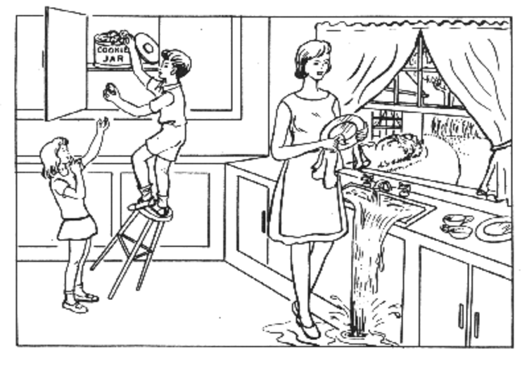
Predict Alzheimer's
Language samples describing “Cookie Theft”
New samples obtained from cognitively normal individuals.
Predicted future Alzheimer’s
Better than predictive models that used genetic, demographic variables, neuropsychological test results.
Goodglass H., Kaplan E., & Barresi B. (2001). Boston Diagnostic Aphasia Examination–Third Edition (BDAE-3). Philadelphia, PA: Lippincott Williams & Wilkins.
Eyigoz, E., Mathur, S., Santamaria, M., Cecchi, G., & Naylor, M. (2020). Linguistic markers predict onset of Alzheimer's disease. EClinicalMedicine, 28.

Slide 44
Dyslexia
Ahire, N., Awale, R. N., Patnaik, S., & Wagh, A. (2023). A comprehensive review of machine learning approaches for dyslexia diagnosis. Multimedia Tools and Applications, 82(9), 13557-13577.
Al-Barhamtoshy, H. M. & Motaweh, D. M. Diagnosis of dyslexia using computation analysis. In International Conference on Informatics, Health & Technology (ICIHT), 1–7 (2017).
Input standardized tests results
Predict dyslexia
High diagnostic accuracy (>90%)
Some predict risk for dyslexia before it otherwise detectable
Varola, H. A., Mani, S., Compton, D. L., Fuchs, L. S. & Fuchs, D., Early prediction of reading disability using machine learning. In AMIA Annual Symposium, 667–671 (2009).
Palacios, A., Sánchez, L., Couso, I. & Destercke, S. An extension of the FURIA classification algorithm to low quality data through fuzzy rankings and its application to the early diagnosis of dyslexia. Neurocomputing 176, 60–71 (2016).
Khan, R. U., AiCheng, J. L. & YinBee, O. Machine learning and Dyslexia: Diagnostic and classification system (DCS) for kids with learning disabilities. Int. J. Eng. Technol. 7(3.18), 97–100 (2018).

Slide 45
Eye Gaze and AI
Przybyszewski, A. W., Śledzianowski, A., Chudzik, A., Szlufik, S., & Koziorowski, D. (2023). Machine learning and eye movements give insights into neurodegenerative disease mechanisms. Sensors, 23(4), 2145.
AI models predicted…
Dyslexia
Autism
Parkinson
Alzheimer
Aphasia
Asish, S. M., Kulshreshth, A. K., & Borst, C. W. (2022). Detecting distracted students in educational VR environments using machine learning on eye gaze data. Computers & Graphics, 109, 75-87.
Alcañiz, M., Chicchi‐Giglioli, I. A., Carrasco‐Ribelles, L. A., Marín‐Morales, J., Minissi, M. E., Teruel‐García, G., ... & Abad, L. (2022). Eye gaze as a biomarker in the recognition of autism spectrum disorder using virtual reality and machine learning: A proof of concept for diagnosis. Autism Research, 15(1), 131-145.
Sharma, S., Kim, H., Harris, H., Haberstroh, A., Wright, H. H., & Rothermich, K. (2021). Eye tracking measures for studying language comprehension deficits in aphasia: A systematic search and scoping review. Journal of Speech, Language, and Hearing Research, 64(3), 1008-1022.

Slide 46
Stuttering
Asci, F., Marsili, L., Suppa, A., Saggio, G., Michetti, E., Di Leo, P., ... & Costantini, G. (2023). Acoustic analysis in stuttering: a machine-learning study. Frontiers in Neurology, 14, 1169707.
Alnashwan, R., Alhakbani, N., Al-Nafjan, A., Almudhi, A., & Al-Nuwaiser, W. (2023). Computational intelligence-based stuttering detection: A systematic review. Diagnostics, 13(23), 3537.
Nearing automatic detection of moments of stuttering with AI models.
Indicators include
  Acoustics
  Prosody
  Eye Gaze
  Muscle Tension
Barrett, L., Hu, J., & Howell, P. (2022). Systematic review of machine learning approaches for detecting developmental stuttering. IEEE/ACM Transactions on Audio, Speech, and Language Processing, 30, 1160-1172.
Das, A., Mock, J., Chacon, H., Irani, F., Golob, E., & Najafirad, P. (2020). Stuttering speech disfluency prediction using explainable attribution vectors of facial muscle movements. arXiv preprint arXiv:2010.01231.
Shih, Y. J., Gkalitsiou, Z., Dimakis, A. G., & Harwath, D. (2024, December). Self-supervised speech models for word-level stuttered speech detection. In 2024 IEEE Spoken Language Technology Workshop (SLT) (pp. 937-944). IEEE.

Slide 47
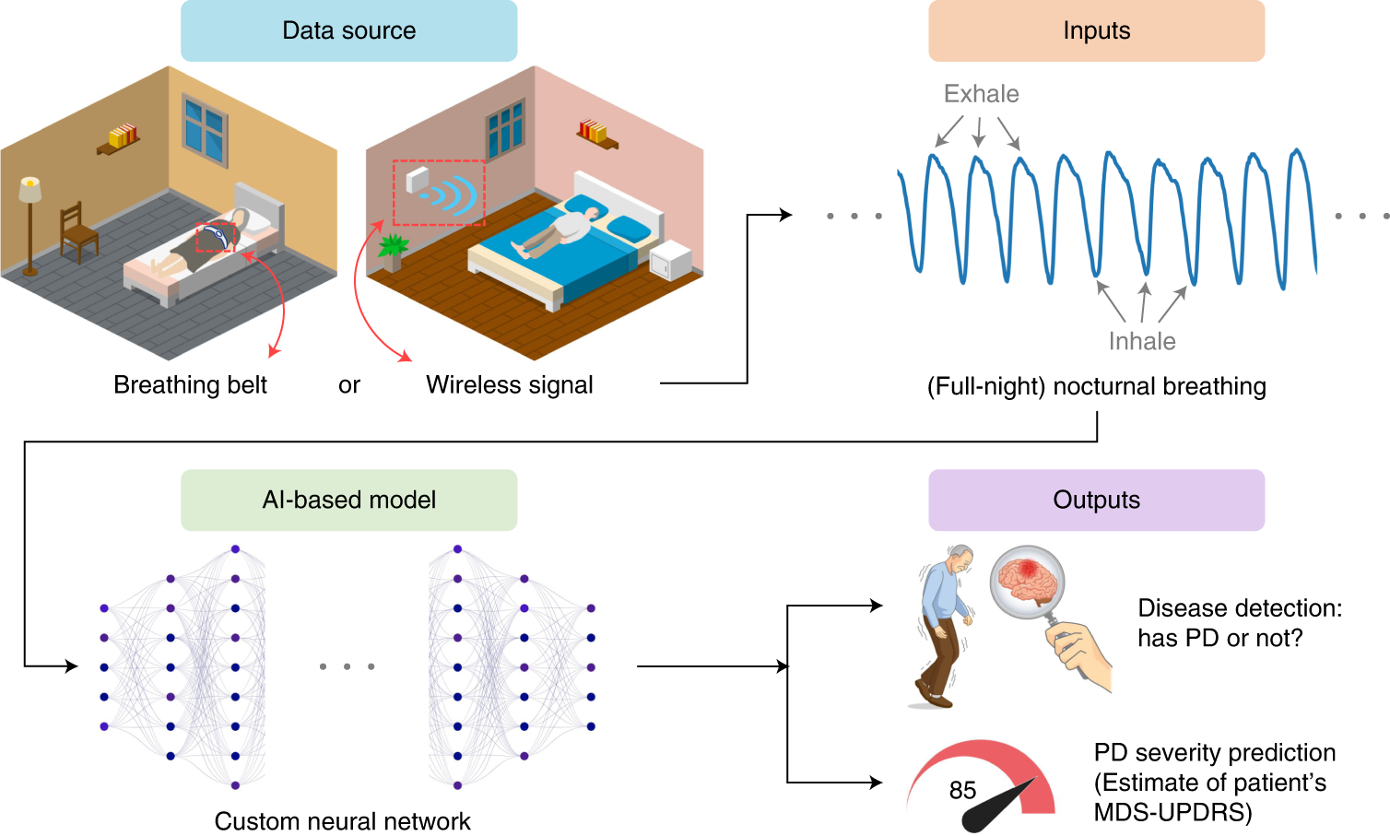
New Diagnostic Markers
Example: Parkinson Disease
Using EEG
Using Gait
Using acoustics
Using breath patterns
Pramanik, M., Pradhan, R., Nandy, P., Qaisar, S. M., & Bhoi, A. K. (2021). Assessment of acoustic features and machine learning for Parkinson’s detection. Journal of healthcare engineering, 2021(1), 9957132.
Tahir, N. M., & Manap, H. H. (2012). Parkinson disease gait classification based on machine learning approach. Journal of Applied Sciences(Faisalabad), 12(2), 180-185.
Zhan, A., Mohan, S., Tarolli, C., Schneider, R. B., Adams, J. L., Sharma, S., ... & Saria, S. (2018). Using smartphones and machine learning to quantify Parkinson disease severity: the mobile Parkinson disease score. JAMA neurology, 75(7), 876-880.
Mei, J., Desrosiers, C., & Frasnelli, J. (2021). Machine learning for the diagnosis of Parkinson's disease: a review of literature. Frontiers in aging neuroscience, 13, 633752.
Maitín, A. M., García-Tejedor, A. J., & Muñoz, J. P. R. (2020). Machine learning approaches for detecting parkinson’s disease from eeg analysis: A systematic review. Applied Sciences, 10(23), 8662.

Slide 48
Severity Classification
Example: Dysarthria
  AI Identified dysarthria severity in ALS
  Rated “listener effort”
  Identified highlight salient phonetic cues
Merler, M., Agurto, C., Peller, J., Roitberg, E., Taitz, A., Trevisan, M. A., ... & Norel, R. (2025). Clinical assessment and interpretation of dysarthria in ALS using attention based deep learning AI models. npj Digital Medicine, 8(1), 260.

Slide 49
And thousands more…

Slide 50
How good are these AI applications?
Numerous high-level (systematic reviews, meta-analyses, randomized controlled trials)
AI is equivalent or better to human medical judgement in many specific applications in specific contexts for specific samples
Barlow, J., Sragi, Z., Rivera‐Rivera, G., Al‐Awady, A., Daşdöğen, Ü., Courey, M. S., & Kirke, D. N. (2024). The use of deep learning software in the detection of voice disorders: a systematic review. Otolaryngology–Head and Neck Surgery, 170(6), 1531-1543.
Ali, O., Abdelbaki, W., Shrestha, A., Elbasi, E., Alryalat, M. A. A., & Dwivedi, Y. K. (2023). A systematic literature review of artificial intelligence in the healthcare sector: Benefits, challenges, methodologies, and functionalities. Journal of Innovation & Knowledge, 8(1), 100333.
Liu X, Faes L, Kale AU, Wagner SK, Fu DJ, Bruynseels A et al. A comparison of deep learning performance against health-care professionals in detecting diseases from medical imaging: A systematic review and meta-analysis. Lancet Digital Health. 2019;1:6.

Slide 51
…but…

Slide 52
Pilot Proliferation
“A striking lack of validated models emerged, as well as a general difficulty in reproducing many published studies, mainly due to the absence of the corresponding parameter lists. ”
Tavazzi, E., Longato, E., Vettoretti, M., Aidos, H., Trescato, I., Roversi, C., ... & Di Camillo, B. (2023). Artificial intelligence and statistical methods for stratification and prediction of progression in amyotrophic lateral sclerosis: A systematic review. Artificial Intelligence in Medicine, 142, 102588.

Slide 53
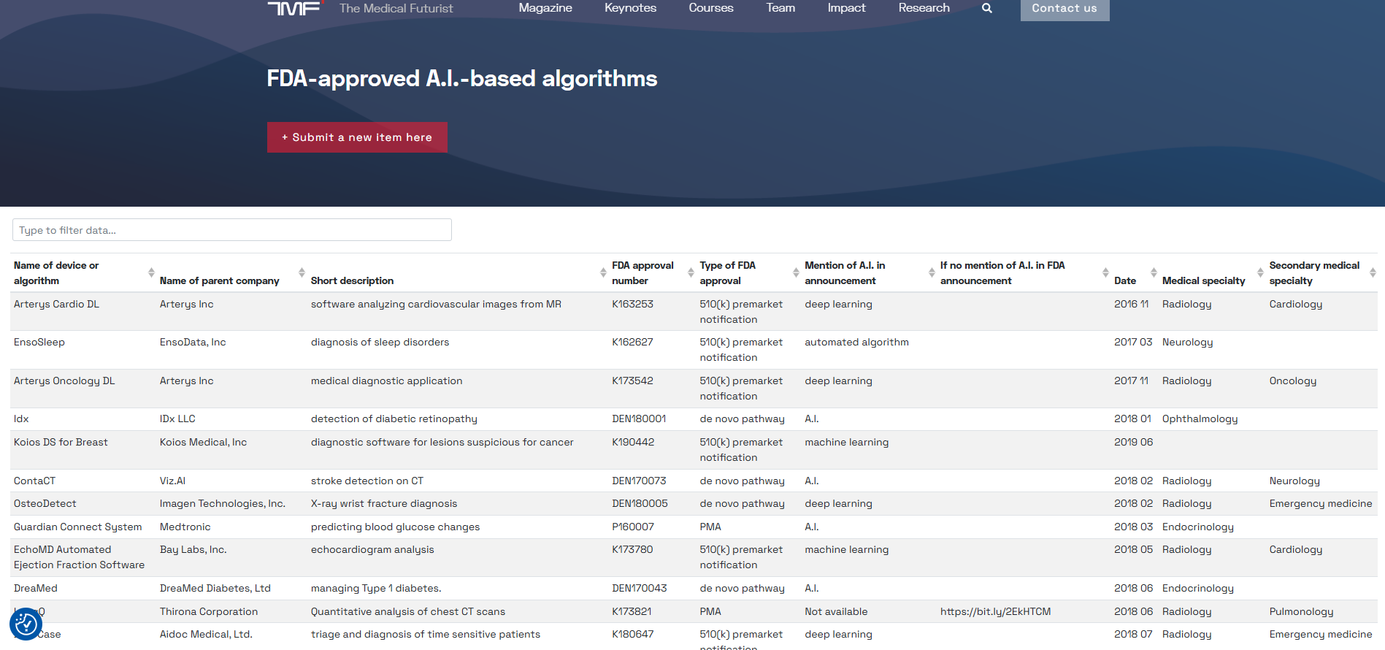

Slide 54
Decision Support Instruments (DSI) or
Medical Decision Support Systems (CDSS)

Slide 55
DSI or CDSS Must…
Be approved by agency like FDA
Have been clinically validated
Integrate with existing electronic health systems
Must be point-of-care, not retroactive
Include risk analysis, bias assessment, audits
Be transparent
Have a human in the loop

Slide 56


Slide 57
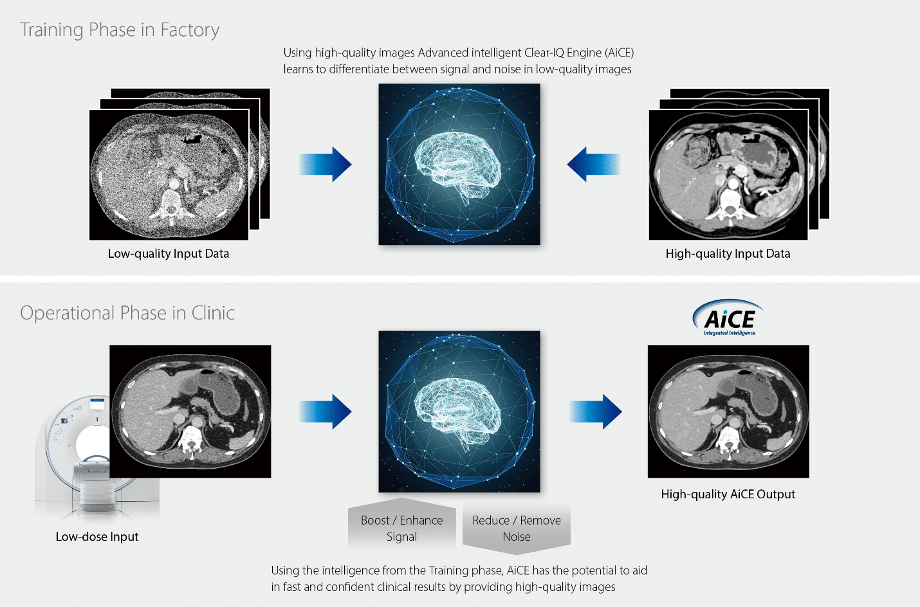

Slide 58
Generative AI in CSD
How are we using it?

Slide 59
Very recently, AI systems improved in unexpected ways…

Slide 60
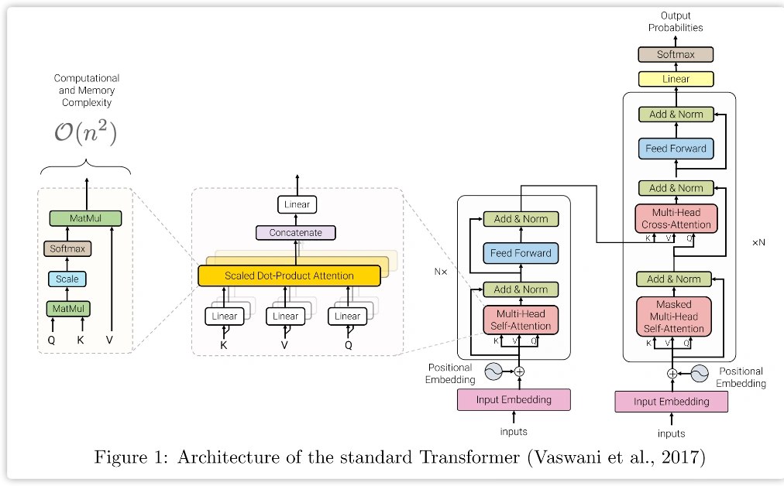
2017
Transformers
Google
Vaswani, A., Shazeer, N., Parmar, N., Uszkoreit, J., Jones, L., Gomez, A. N., ... & Polosukhin, I. (2017). Attention is all you need. Advances in neural information processing systems, 30.

Slide 61
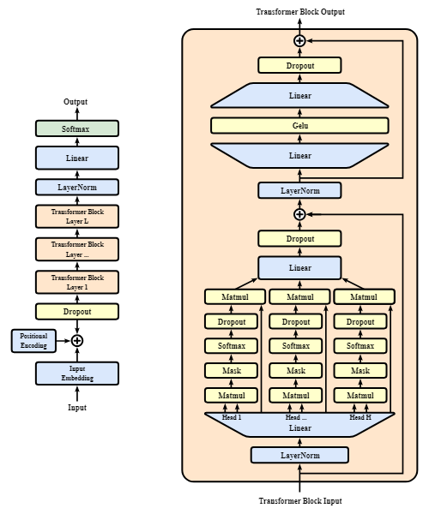
2018
Generative PreTrained Transformers OpenAI

Slide 62

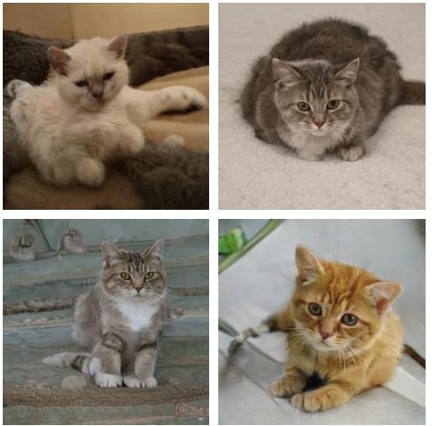

GenAI
Generative AI use tranformers and other AI approaches to create new content like writing, images, or sounds that feel human-made.

Slide 63


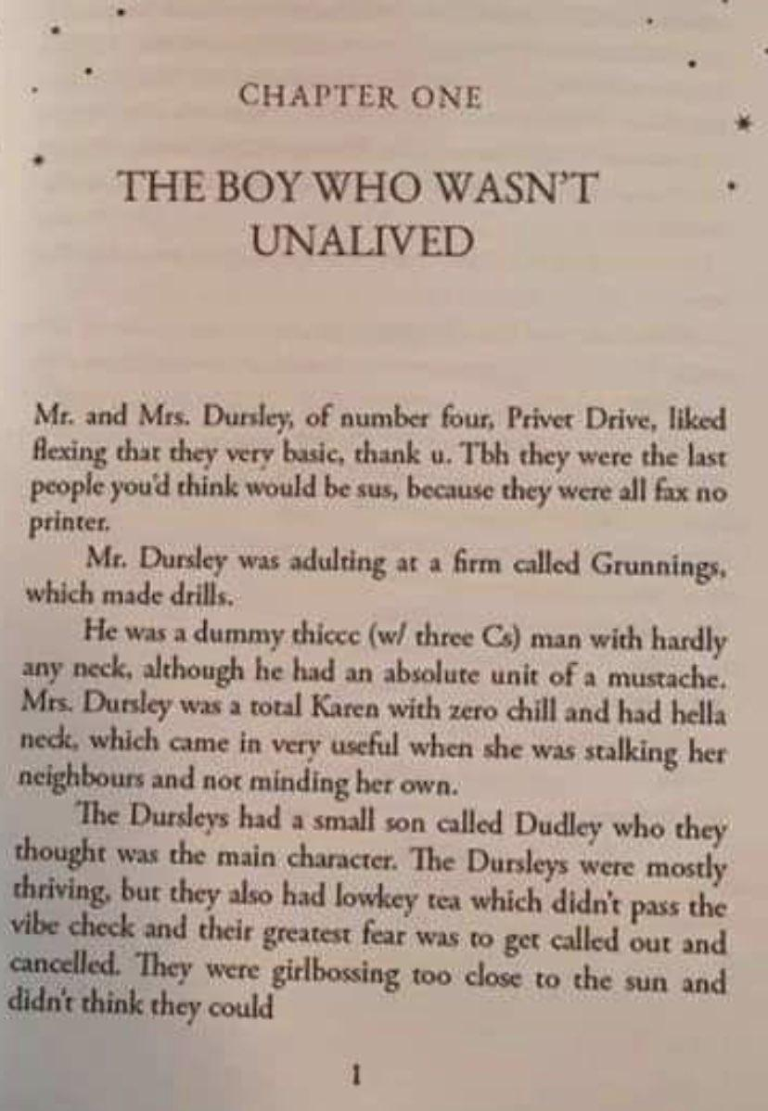



Large Language Models (LLM)

Slide 64



A Quick Demo
VS

Slide 65
Administrative / Documentation

Slide 66
AI is also changing …
Medical coding
Electronic medical records
Administrative Documentation
Legal cases
Insurance determinations
Patent applications
Training and education

Slide 67
Most common CSD uses…
It appears most SLP AI users report using either LLMs or GenAIs.
Most use AI for administrative tasks, or creation of materials for therapy.
Austin, J., Benas, K., Caicedo, S., Imiolek, E., Piekutowski, A., & Ghanim, I. (2025). Perceptions of Artificial Intelligence and ChatGPT by Speech-Language Pathologists and Students. American Journal of Speech-Language Pathology, 34(1), 174-200.

Slide 68
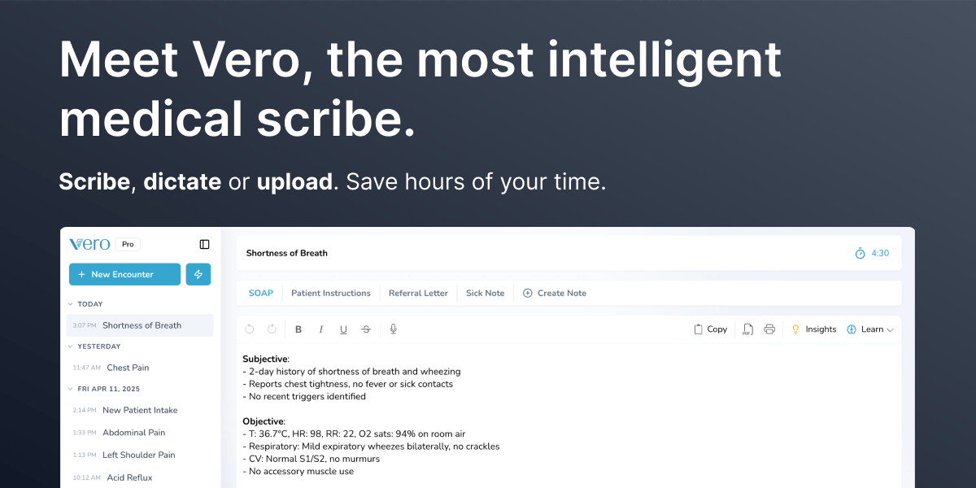
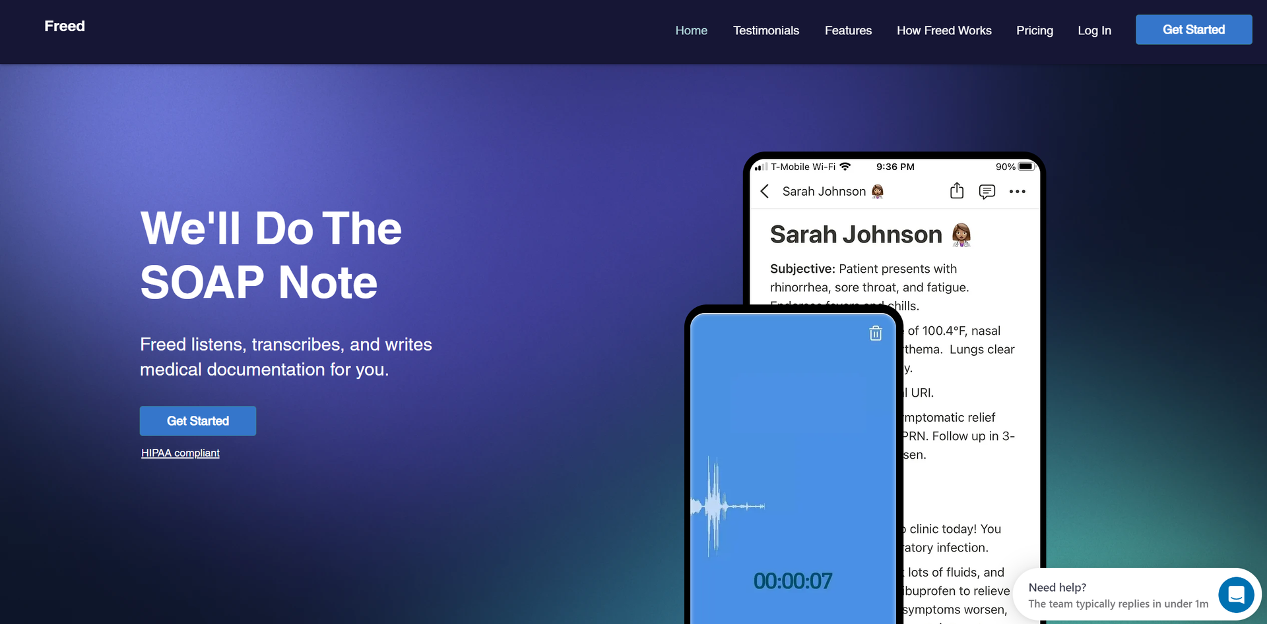
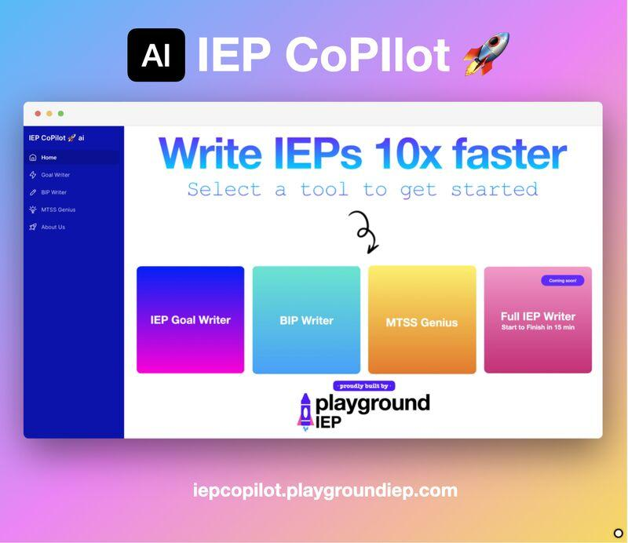

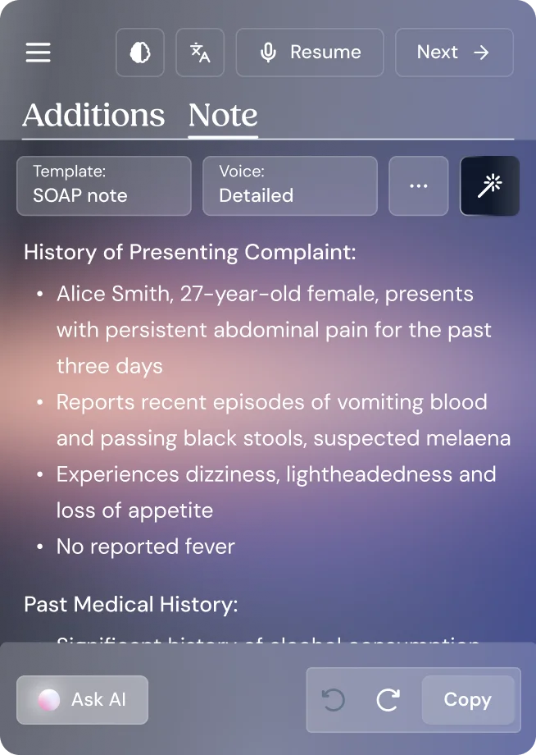
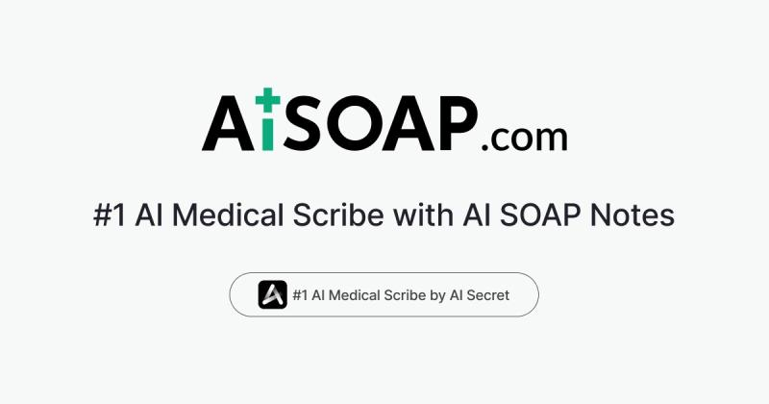

Slide 69
AI Apps Targeted at SLPs…
Magic School
ChatGPT
Snapchat AI
Heidi
TheraPlatform
AutoNotes
Diffit
Ambiki
Notability
WebPT
ScribaCare
PatientNotes
SayIt
Otter.ai
DeepScribe
SmartMD
Soap Note AI
Nudge
Almost all of these are primarily based on LLMs.

Slide 70
What could possibly go wrong?

Slide 71
THE PROBLEMS
Will AI Destroy Everything?

Slide 72
Things we won’t talk about today
AI is a big new problem on top of old, much bigger problems.
Water
Energy
Silica/Semiconductor shortage
Rare Earth
E-waste
Heat Pollution
Land for Data Centers (100+ acres per center)
Exploitation
Displacement
It is getting bigger fast…

Slide 73
AI Apps Targeted at SLPs and Clinicians
SUS
Magic School
ChatGPT
Snapchat AI
Heidi
TheraPlatform
AutoNotes
Diffit
Ambiki
Notability
WebPT
ScribaCare
PatientNotes
SayIt
Otter.ai
DeepScribe
SmartMD
Soap Note AI
Nudge

Slide 74
That’s AI, bruh!

Slide 75

The JAMA Summit on AI
AI's integration into healthcare outpaces evidence of its effectiveness.
Many tools lacking rigorous testing and oversight.
We need for standards in validation, transparency, and accountability to prevent inequities and safety issues.
Angus, D. C., Khera, R., Lieu, T., Liu, V., Ahmad, F. S., Anderson, B., ... & Termulo, C. (2025). AI, Health, and Health Care Today and Tomorrow: The JAMA Summit Report on Artificial Intelligence. JAMA, 334(18), 1650-1664.

Slide 76
Implementation Problem
Limited evidence of generalizability
Concerns regarding validity/replication
Limited translation from bench to clinic
Hidden biases
Equity issues
Black Box issues
Liu X, Faes L, Kale AU, Wagner SK, Fu DJ, Bruynseels A et al. A comparison of deep learning performance against health-care professionals in detecting diseases from medical imaging: A systematic review and meta-analysis. Lancet Digital Health. 2019;1:6.

Slide 77
Is AI Valid and Reliable?

Slide 78


Slide 79

Man Singer Emoji
What image does AI generate if I just send it the “singer man” emoji?

Slide 80



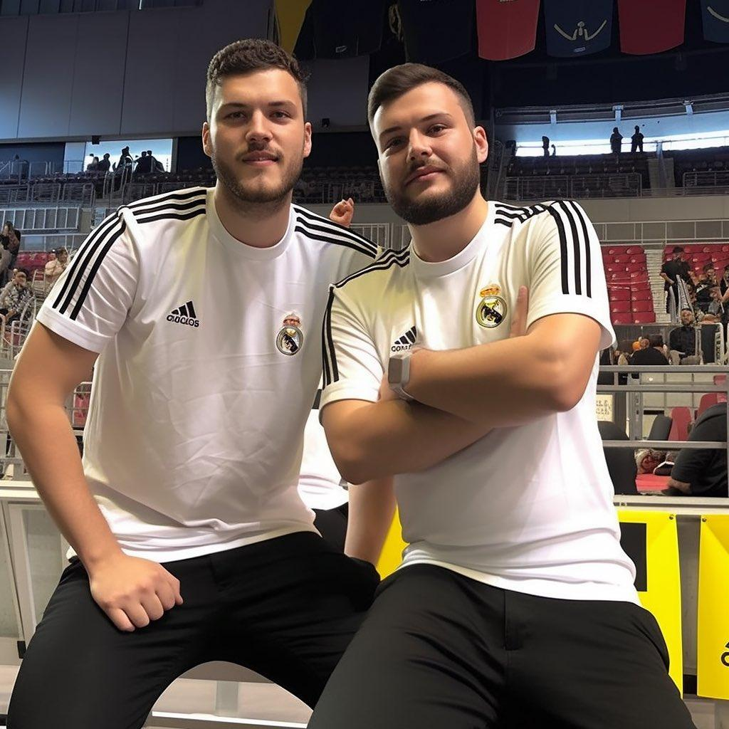



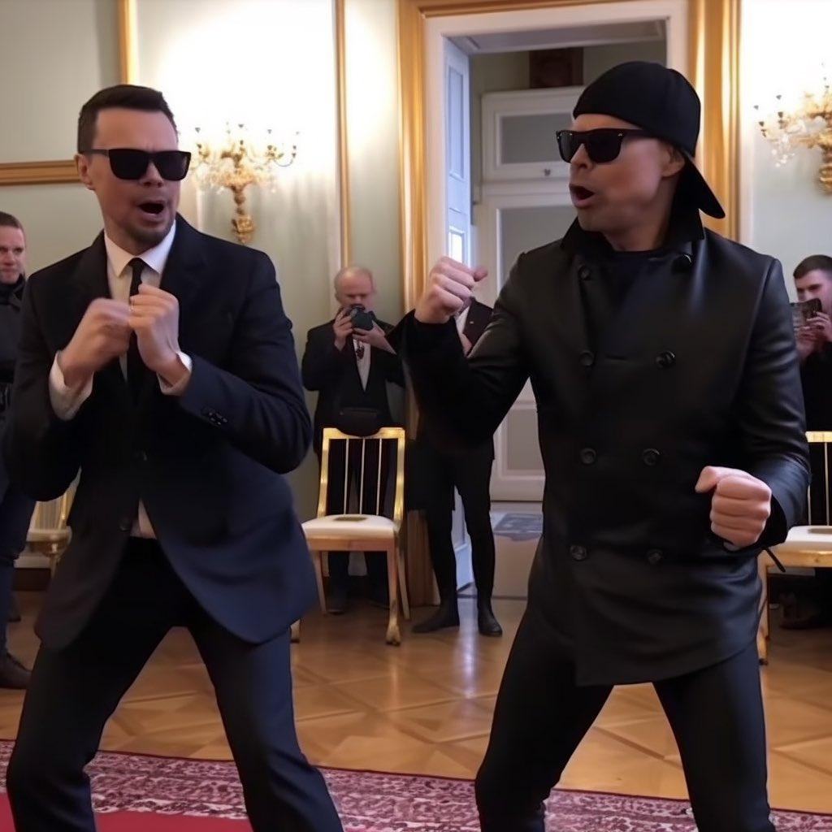
Man Singer Emoji Output…

Slide 81

Sewing Emoji

Slide 82

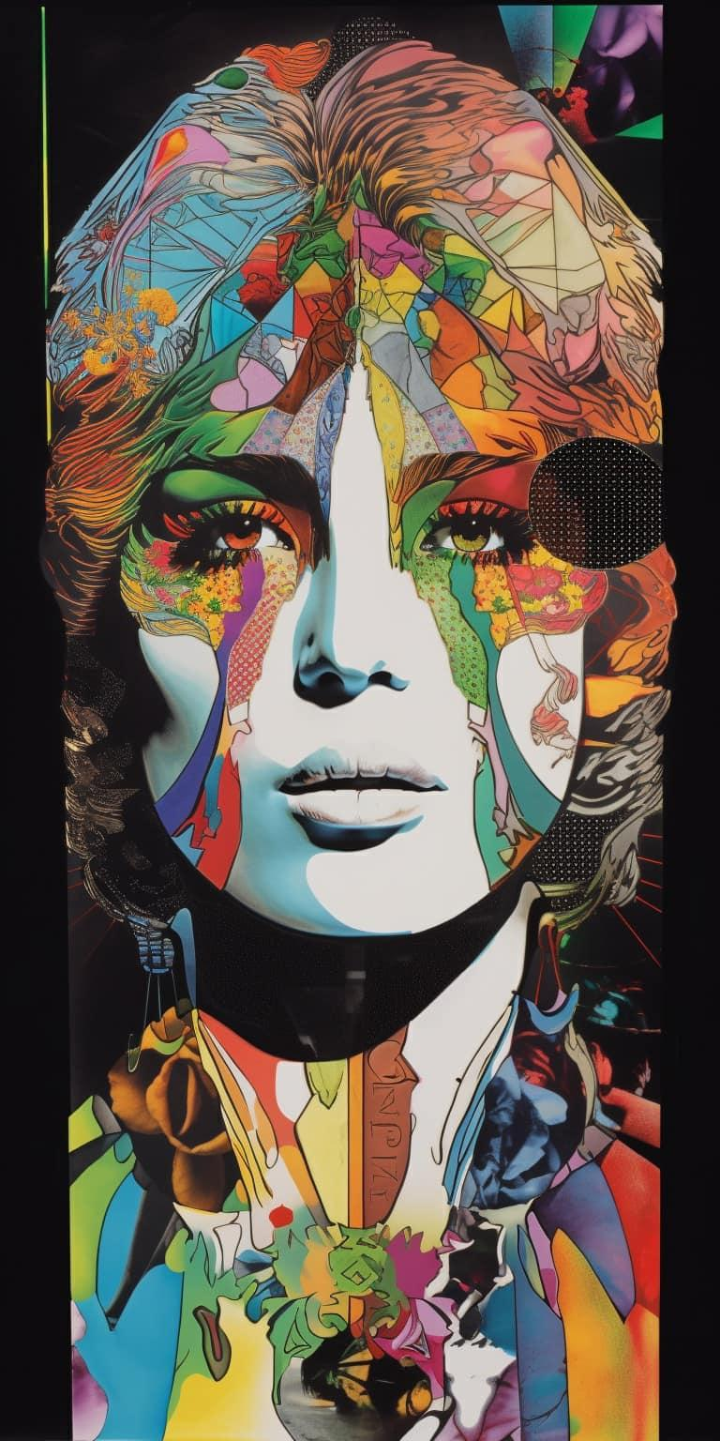









Sewing Needle Emoji Output…

Slide 83

Ninja Emoji
What will a visual generative AI with an NLP interface when given this prompt?

Slide 84










Ninja Emoji Output…

Slide 85
Why?

Slide 86
Problem Type #1:
Black Box Problems

Slide 87

PROBLEM Type #1:
No Transparency
Data
Purpose
Rules
Training
This is a “black box”

Slide 88
Black boxes lack…
Transparency
Replicability
Identifiable
Explainability
Accessibility
Causability
Predictable

Slide 89
Informed consent requires an informed clinician.

Slide 90
Problem Type #2:
Data and Training Bias

Slide 91

Data/Training Bias?
“Doctor”
“Nurse”
“Speech Language Pathologist”

Slide 92
Risk estimates and future health needs
PROBLEM: Data/Training Bias
Data dependent on past expenditures
Minority patients have lower past expenditures due to barriers, access, disconnect
AI underestimates needs and allocates funds away
AI trained on reduced allocation in future
Example of a AI Feedback Loop!
Obermeyer, Z., Powers, B., Vogeli, C., & Mullainathan, S. (2019). Dissecting racial bias in an algorithm used to manage the health of populations. Science, 366(6464), 447-453.

Slide 93

Example: Pulse Oximetry
Data/Training Bias
Algorithms are calibrated on light skin
Hypoxia is underestimated with dark skin
Results are fed into EMR and AI systems
New models are even MORE biased
Cabanas, A. M., Sáez, N., Collao-Caiconte, P. O., Martín-Escudero, P., Pagán, J., Jiménez-Herranz, E., & Ayala, J. L. (2024). Evaluating AI methods for pulse oximetry: performance, clinical accuracy, and comprehensive bias analysis. Bioengineering, 11(11), 1061.
Sjoding, M. W., Dickson, R. P., Iwashyna, T. J., Gay, S. E., & Valley, T. S. (2020). Racial bias in pulse oximetry measurement. New England Journal of Medicine, 383(25), 2477-2478.
And many more…

Slide 94
More examples
Data/Training Bias
Linguistic Bias!
Koenecke, A., Nam, A., Lake, E., Nudell, J., Quartey, M., Mengesha, Z., ... & Goel, S. (2020). Racial disparities in automated speech recognition. Proceedings of the national academy of sciences, 117(14), 7684-7689.
AI Text To Speech misinterprets black speech
95.5% of medical images show light skin
AAE in tweets is mislabeled leading to ML errors
Data and Training Bias!!
Adamson, A. S., & Smith, A. (2018). Machine learning and health care disparities in dermatology. JAMA dermatology, 154(11), 1247-1248.
Human Error!!!
Blodgett, S. L., & O'Connor, B. (2017). Racial disparity in natural language processing: A case study of social media african-american english. arXiv preprint arXiv:1707.00061.

Slide 95
More examples
Data/Training Bias
Medical Imaging AI provide worse performance for women
AI prefers AI writing over human writing
Data and Training Bias!!!!
Yang, Y., Liu, Y., Liu, X., Gulhane, A., Mastrodicasa, D., Wu, W., ... & Patel, S. (2025). Demographic bias of expert-level vision-language foundation models in medical imaging. Science Advances, 11(13), eadq0305.
Laurito, W., Davis, B., Grietzer, P., Gavenčiak, T., Böhm, A., & Kulveit, J. (2025). AI–AI bias: Large language models favor communications generated by large language models. Proceedings of the National Academy of Sciences, 122(31), e2415697122.
Emergent Bias!!!!!

Slide 96
Data/Training Bias
Creates inequity
Results in AI that does not generalize across diverse subgroups
Confounds outcomes
Limits accessibility/inclusivity

Slide 97
Problem Type #3:
Hidden Changes

Slide 98
Post-processing Effects
Guiderails and Filters: Hidden rules that modify output
Temperature: Controls the creativity/novelty of output
Logit biasing; Limits target words/phrases

Slide 99


Guiderails and Filters
User Controlled Guiderails…
Programmed Filters…

Slide 100

Temperature
Scalar values that adjust how random generative output is.

Slide 101

Logit Biasing
LLMs tokenize text.
We can weight tokens to increase or decrease the chance of a word or phrase being used.
{
"model": "gpt-4",
"prompt": “Tell me about...",
"max_tokens": 50,
"logit_bias": {
"21985": -100
}
}
Token: "Bruno"
Token ID: 21985

Slide 102



Temperature Up
Added Guiderails
Possible Logit Biasing
Post-processing Effects
Example 1:
Attempt to correct for bias using post-processing
Resulted in anachronistic and sometimes offensive content.

Slide 103



Temperature Down
Added Guiderails
Possible Logit Biasing
Post-processing Effects
Example 2: Grok
Attempts to force model to perform in certain way

Slide 104
Problem #3:
Emergent Behaviors

Slide 105
Emergent Behaviors Hallucinations
Any inaccurate or misleading output generated when the AI tries to fill in blanks
Hallucinations are a part of LLMs structure

Slide 106


Slide 107



Prompt: “Salmon swimming in a river”

Slide 108

Overgeneralization
Emergent Behaviors
AI sometimes overgeneralizes findings when summarizing studies
Accurate prompting made it worse
Newer models were worse
Peters, U., & Chin-Yee, B. (2025). Generalization bias in large language model summarization of scientific research. Royal Society Open Science, 12(4), 241776.

Slide 109

Emergent Behaviors
Sycophancy

Slide 110
Emergent Behaviors
Deception
AI are increasingly capable of complex forms of deception

Slide 111


EXAMPLE: GPT-4 and the Captcha
GPT-4 Technical Report:
https://cdn.openai.com/papers/gpt-4.pdf

Slide 112
Other Recent Examples:
AI can detect when it is being evaluated
They attempt to game the system
Circumvent guardrails
Attempt to copy code to external servers
Schoen, B., Nitishinskaya, E., Balesni, M., Højmark, A., Hofstätter, F., Scheurer, J., ... & Hobbhahn, M. (2025). Stress Testing Deliberative Alignment for Anti-Scheming Training. arXiv preprint arXiv:2509.15541.
Meinke, A., Schoen, B., Scheurer, J., Balesni, M., Shah, R., & Hobbhahn, M. (2024). Frontier models are capable of in-context scheming. arXiv preprint arXiv:2412.04984.

Slide 113
Other Recent Examples:
16 leading AI models
Given access to emails and personal information
Tasked with simple business goals
They all demonstrated deception, including
  Leaking private information
  Blackmail
Naik, A., Quinn, P., Bosch, G., Gouné, E., Zabala, F. J. C., Brown, J. R., & Young, E. J. (2025). AgentMisalignment: Measuring the Propensity for Misaligned Behaviour in LLM-Based Agents. arXiv preprint arXiv:2506.04018.

Slide 114


Slide 115
Problem #4:
Other Sources of Variation

Slide 116

Updates
Updates are often new models
May function completely differently
We must have a predetermined change-control plan (PCCP).
AI systems should notify when model/weights/filters change.

Slide 117

🥷
V4
Nov
2022
V4
Mar
2023

Slide 118


🥷
V6
Dec
2023
V7
Apr
2025

Slide 119


Every model and version is different…

Slide 120
Problem #5:
Alignment Problems

Slide 121
The Alignment Problem
PAROLE
Target: Identify who is high risk for recidivism
Actual Function:
Identify individuals who were black
INSURANCE
Target: Identify which claims have merit
Actual Function:
Decline maximum number of claims
HIRING
Target: Identify best resumes
Actual Function:
Identify male resumes
Van Dijck, G. (2022). Predicting recidivism risk meets AI act. European Journal on Criminal Policy and Research, 28(3), 407-423.
Rucker, P., Miller, M., & Armstrong, D. (2023). How Cigna saves millions by having its doctors reject claims without reading them. ProPublica. Updated April, 14.
Dastin, J. (2022). Amazon scraps secret AI recruiting tool that showed bias against women. In Ethics of data and analytics (pp. 296-299). Auerbach Publications.
Notes:
Parole: first reported in 2019, and still persisting, Compas AI paroles actually predict race more than recidivism, and create negative feedback loops of policing
Insurance: Insurers used AI model called nHPredict to wrongfully deny medically necessary care. Now some are trying to create AI to fight denials

Slide 122
AI model learns wrong variables
PROBLEM: Alignment
AI models trained to interpret X-rays used associated non-medical data with pneumonia
Examples included the x-ray machine used or the department ordering the x-ray.
Not generalizable
Zech, J. R., Badgeley, M. A., Liu, M., Costa, A. B., Titano, J. J., & Oermann, E. K. (2018). Variable generalization performance of a deep learning model to detect pneumonia in chest radiographs: a cross-sectional study. PLoS medicine, 15(11), e1002683.

Slide 123
Is AI Valid and Reliable?
Remember our question?

Slide 124
Answer:
Not inherently.
We need to understand types of errors, do reliability and validity checks, and to monitor for changes when using AI systems.
We also need transparency from the AI systems we choose.
Is AI Valid and Reliable?

Slide 125
These problems can effect any AI systems.
Generative AI is particularly susceptible.
Is AI Valid and Reliable?

Slide 126
Last question
So, can I use that AI?

Slide 127
#1
We need to trial and validate AI tools just as we would any other clinical tool.

Slide 128
#2
We all need to work on developing AI literacy skills, particularly with regards to CSD issues.

Slide 129
Things we need to think about about…
HIPAA Privacy & Security Rules
  Apply ‘minimum necessary’
  Encrypt in transit/at rest
  access control
  audit logs
  breach response
Business Associate Agreement (BAA)
  Your institution must have a good one
State recording laws
  Know your state: some require all‑party consent (in‑person and/or phone); document consent

Slide 130
Things we need to think about…
ONC HTI‑1 (DSI transparency)
  If the tool suggests care decisions, there are additional rules and regulations
Platform isn’t designed to process 42 CFR Part 2 data
  Since 2024 must have explicit, separate, written patient consent to share substance use records
End User License Agreement / Terms of Use
  Usually says clinician is responsible for all errors
  Usually states you indemnify them of all claims
  Usually states they carry no liability for any harm
  Usually states the clinician assumes all liability

Slide 131
#3
We need professional guidelines yesterday.

Slide 132
My Must-Haves for AI use in CSD
Clear data ownership
Client owns their data
NAWR
Dedicated AI systems
Appropriate models
Evidence-based
Diverse/Inclusive/Equitable
Human Oversight
Human in loop
Human first
Human last
Accountability
Stop thresholds
Interpretability
Fault
Transparency of use
Must disclose AI
Model Card

Slide 133
Also Important…
Conform to Policies
HIPAA / FERPA / COPPA Attestation
Security Attestation (SOC / SOC2)
BAA/DPA/Contract
State consent
Substance use privacy (Part 2)
ONC HT1 if Decision Support Instrument
Ensure Privacy
Minimum necessary
Pausability
Able to withdraw consent
No training with data
Monitor Changes
Equity audits
Predetermined Change Control Plan (PCCP)
Validity/Reliability Audits
Stop thresholds

Slide 134
Human First,
Human-In-Loop,
Human Last

Slide 135
In the next few years?
AI is highly likely to rapidly replace, improve, or augment our best tools.
AI will outperform even the best of us at certain tasks. It will also fail at other tasks.
We need to be leaders in this area.

Slide 136

QR to Master Folder
List of CSD AI Tools
Ethical AI Checklist
ASHA and AI Alignment
Big List of AI Pitfalls
Prompting Guide
Draft of AI Competencies
This Slide Deck
Workshop Slide Deck

Slide 137


CLEAR-AI
(Clinical and Educational Assessment of Readiness of AI tools)
Written Protocol
(under development)
CoPilot Automated Agent
(just for fun)

Slide 138

Your Questions???
AI generated image using Dolly 2.0 through ChatGPT. Prompt: architectural watercolor depicting conversations about AI, interior shot, no text, no words.

Slide 139
End Program

Slide 140
Bonus Slides

Slide 141
A Quick Demo
VS

Slide 142
New AI Capabilities
“Across the battery of theory of mind tests, we found that GPT-4 models performed at, or even sometimes above, human levels at identifying indirect requests, false beliefs and misdirection, but struggled with detecting faux pas. ”
Complex pragmatics
Multimodal interactions
Theory of Mind
Emergent abilities
Innovative Problem Solving
Internet of Things
Generative applications
Strachan, J. W., Albergo, D., Borghini, G., Pansardi, O., Scaliti, E., Gupta, S., ... & Becchio, C. (2024). Testing theory of mind in large language models and humans. Nature Human Behaviour, 1-11.
ChatGPT 4.5 has successfully passed a 2-person and 3-person Turing test
… with caveats.
Jones, C. R., & Bergen, B. K. (2025). Large language models pass the turing test. arXiv preprint arXiv:2503.23674.
Notes:
These new models were not just more powerful. They did things we previously didn’t think AI could do

Slide 143
Technology hesitancy…
Mass-printed novels will cause “reading mania”
Railway speeds would cause asphyxia, railway spine, and dropped organs
Bicycles will cause women to develop “bicycle face”
The telephone will cause widespread communication problems due to disembodied voices
AAC will prevent normal language development
Electric lights could hurt health
Mobile phones will cause cancer
Air conditioning causes disease, weakness, and social decay
Television will destroy your eyes
Elevators sudden stops cause “elevator sickness”

Slide 144
And yet, there are legitimate reasons to be concerned…

Slide 145


Slide 146

Medical Gemini
Med Gemini is an AI being trained on medical charts for doctors
It invented the “basilar” ganglia
AI was trained on doctor’s notes, and they commonly mis-transcribe “basal” as “basilar”

Slide 147
Validation Gap and Negative Outcomes
950 AI medical devices authorized by the FDA through November 2024.
60 were associated with 182 recall events.
Most common causes of recalls were:
  diagnostic or measurement errors
  functionality delay or loss.
43% took place within one year of FDA authorization.
Lee, B., Kramer, P., Sandri, S., Chanda, R., Favorito, C., Nasef, O., ... & Dai, T. (2025, August). Early Recalls and Clinical Validation Gaps in Artificial Intelligence–Enabled Medical Devices. In JAMA Health Forum (Vol. 6, No. 8, pp. e253172-e253172). American Medical Association.

Slide 148

Data Poisoning
Example using Nightshade taken from MIT Technology Review: https://www.technologyreview.com/2023/10/23/1082189/data-poisoning-artists-fight-generative-ai/
Notes:
Here, the AI can recoginize an apple, but is thrown off by the clever application of a stickynote

Slide 149

One recent example…

Slide 150

Another recent example…
“Our initial analysis estimates that around 0.15% of users active in a given week have conversations that include explicit indicators of potential suicidal planning…
or intent and 0.05% of messages contain explicit or implicit indicators of suicidal ideation or intent.”
1.2 Million
per week
400 thousand
per week
https://openai.com/index/strengthening-chatgpt-responses-in-sensitive-conversations/

Slide 151
Privacy

Slide 152
Further concerns…
AI is also changing security
Limited non-PHI can reidentify anonymized data sets.

Slide 153
Reidentification
Deanonymized Netflix data
Narayanan, A., & Shmatikov, V. (2008, May). Robust de-anonymization of large sparse datasets. In 2008 IEEE Symposium on Security and Privacy (sp 2008) (pp. 111-125). IEEE.
4 random time-location points uniquely identified ~95% of 1.5M people in a mobile dataset.
De Montjoye, Y. A., Hidalgo, C. A., Verleysen, M., & Blondel, V. D. (2013). Unique in the crowd: The privacy bounds of human mobility. Scientific reports, 3(1), 1376.
Most Americans can be identified using ZIP, Sex, Birthdate
Sweeney, L. (2000). Simple demographics often identify people uniquely. Health (San Francisco), 671(2000), 1-34.
Model inversion allows medical data entered into models during training to be retrieved
Fredrikson, M., Jha, S., & Ristenpart, T. (2015, October). Model inversion attacks that exploit confidence information and basic countermeasures. In Proceedings of the 22nd ACM SIGSAC conference on computer and communications security (pp. 1322-1333).

Slide 154

Further concerns…
Facial Recognition can identify individuals from MRI Face Scans
Steeg, K., Bohrer, E., Schäfer, S. B., Vu, V. D., Scherberich, J., Windfelder, A. G., & Krombach, G. A. (2024). Re-identification of anonymised MRI head images with publicly available software: investigation of the current risk to patient privacy. EClinicalMedicine, 78.

Slide 155
Cognitive Effects

Slide 156
AI Changes How We Think
Learned helplessness
Reduced confidence
Reduced engagement
Reduced critical thinking
Impaired Learning
Gajos, K. Z., & Mamykina, L. (2022, March). Do people engage cognitively with AI? Impact of AI assistance on incidental learning. In Proceedings of the 27th International Conference on Intelligent User Interfaces (pp. 794-806).
Spatharioti, S. E., Rothschild, D., Goldstein, D. G., & Hofman, J. M. (2025, April). Effects of LLM-based Search on Decision Making: Speed, Accuracy, and Overreliance. In Proceedings of the 2025 CHI Conference on Human Factors in Computing Systems (pp. 1-15).
Chen, Y., Kirshner, S. N., Ovchinnikov, A., Andiappan, M., & Jenkin, T. (2025). A manager and an AI walk into a bar: does ChatGPT make biased decisions like we do?. Manufacturing & Service Operations Management, 27(2), 354-368.
Glickman, M., & Sharot, T. (2025). How human–AI feedback loops alter human perceptual, emotional and social judgements. Nature Human Behaviour, 9(2), 345-359.

