Slide 1
Inpatient Rehabilitation of the Pediatric Brain Injury: Interventions and Education for Improved Outcomes after Discharge
Presented by Elizabeth Pierce, DPT &
Quincey Carroll, OTR/L
Notes:
Introduce ourselves then EP can introduce the presentation

Slide 2
Objectives
Attendees will understand how to better tailor interventions to a pediatric population.
Attendees will learn about dry needling and its implications for improved outcomes in the inpatient rehabilitation setting.
Attendees will understand the process of caregiver education to promote the family’s readiness for discharge.
Attendees will learn how the pediatric inpatient rehabilitation team coordinates a comprehensive discharge plan for patients and their families.
Notes:
QC can talk about the first 2 objectives
EP can talk about the second 2 objectives

Slide 3
What happens before a rehab admission?
Therapies start working with patients as soon as medically appropriate
Internal inpatient rehab admits vs. outside referrals
To be admitted to CMH Inpatient Rehab Program:
Patient must be stable
Patient must be able to tolerate 3 hours of therapy each day
Disorders of Consciousness considerations
Notes:
-Therapy begins often in ICU (early mobility – positioning, PRAFOs, splints if needed)
Outside referrals come to us ready for rehab (based on notes from hospital) and are expected to meet our rehab inclusion criteria

Slide 4
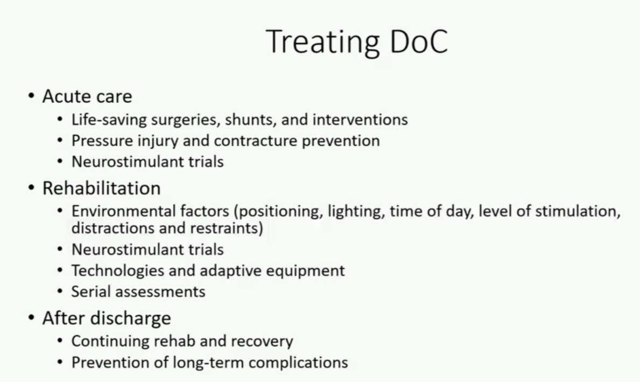
Notes:
Currently doing CRS-R assessment (same examiner, when possible, similar times of day)
Patterned change, not single events
-eye opening/visual fixation, consistent command following, improved initiation or responsiveness,
Distinguish: reflex vs purposeful
Random vs reproducible

Slide 5
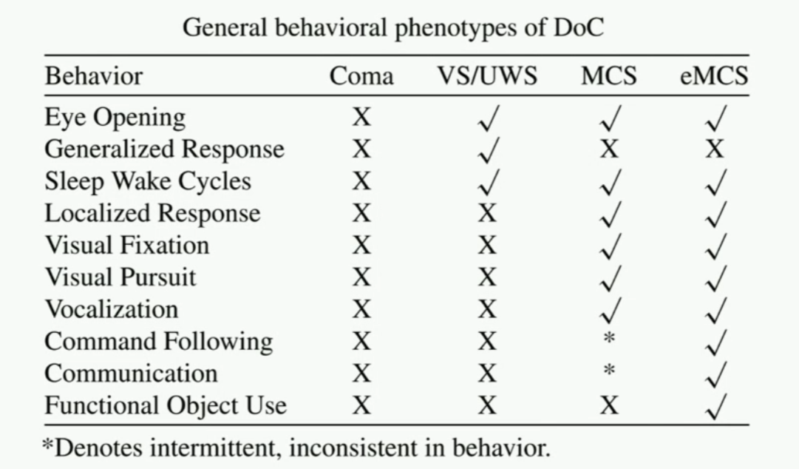
Notes:
Vegetative state/unresponsive wakefulness syndrome
MCS- minimally conscious state
eMCS- Emergence from minimally conscious state

Slide 6
Interventions

Slide 7
Salience
Several studies have proven the importance of relevance to the success of recovery when considering intervention strategies
For our pediatric population, this typically means play!
We work closely with family/caregivers to determine what activities will be most motivating for our patients.
Notes:
EP will talk about this slide
Just took a course through Shirley Ryan on TBI rehab and they spoke about the importance of salience throughout the 10 total presentations that made up the course
Things to consider: research has demonstrated the importance of salience but what does that look like in a pediatric population? What does a pediatric day look like and how do we make our interventions relevant

Slide 8




Kids love games!
Notes:
Problem solving, recalling sequences, positioning, weightshifting, balance, error augmentation, FM –environmental modifications
Vision**
PT ways to use games: to encourage reps without feeling like reps; to distract while working on challenging positions; exercise uno; weight shifting, balance

Slide 9

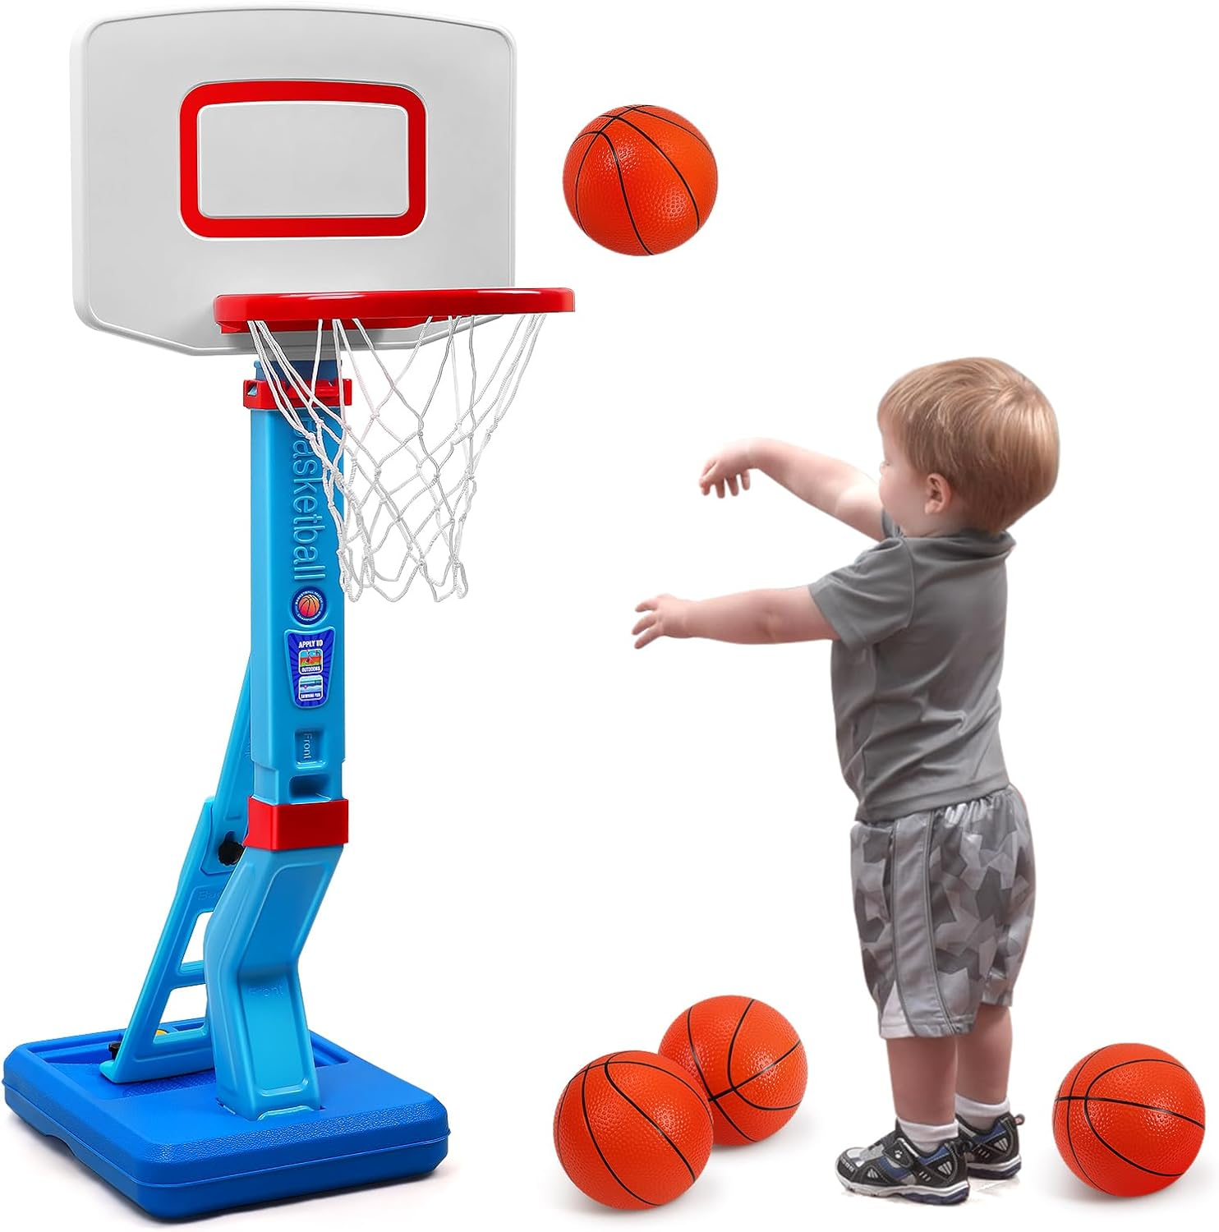

How can we incorporate these into therapy?
Notes:
Cars: position changes (squat and recover); static standing; reaching across midline
Bubbles: dynamic balance
Basketball: strengthening, balance

Slide 10

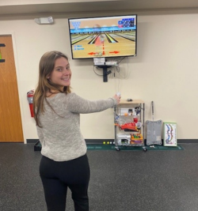

Notes:
Stomp and catch: balance, strength, coordination
Squigz: balance, fine motor/grip strength, weight shifting, core strength with stability when removing from support surface
Wii: strength (adding weights), balance, coordination
*Can always combine to make an obstacle course

Slide 11
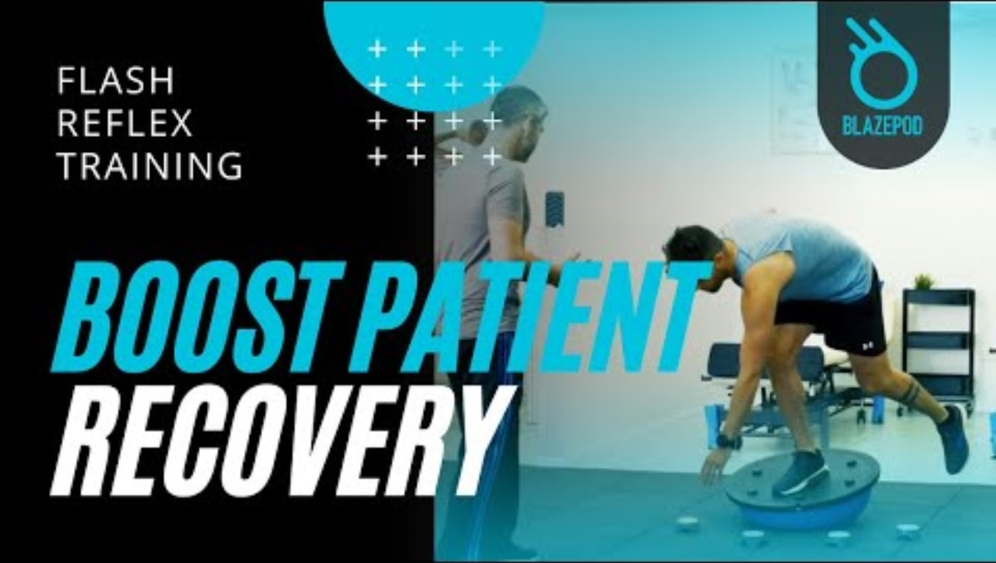
BlazePods
Notes:
Blaze Pods: Targets (working on gait training); balance; distraction during positioning
Also visual processing speed, visuomotor coordination

Slide 12
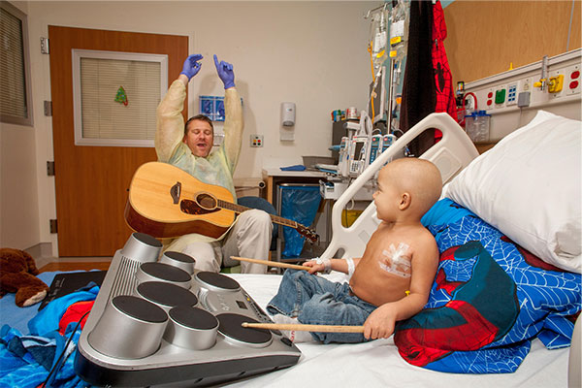

Incorporating Other Therapy Services
Notes:
Our music and art therapists are great at working with us to use their interventions to complement our interventions
Music therapy: for PT they have musical stepping stones for gait training; playing an instrument while maintaining a position; kicking a drum, etc
Art therapy: for PT working on balance, crossing midline, positioning distraction
OT: fine motor, grip strength, vision with field cuts or diplopia

Slide 13

Notes:
We have a great team of facility dogs!
For PT: taking them on a walk, positioning tolerance while engaging with dogs, break time between activities
OT: brushing, throwing a ball, giving treats, positioning for crossing midline or alternating reaching. WBing through elbows and reaching

Slide 14
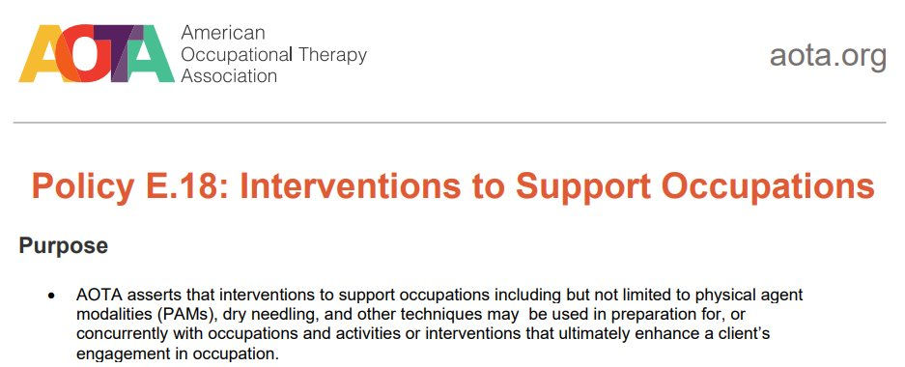
AOTAs stance on dry needling

Slide 15
Dry Needling Precautions
•Cognitive or communication impairments
•Local skin lesions (example: cellulitis, psoriasis, ache)
•Abnormal bleeding tendency (anticoagulant or thrombocytopenia therapy)
•Implants
•Vascular disease
Fear of needles
History of traumatic or spontaneous pneumothorax
Metal allergy
Severe osteoporosis
Area of laminectomy
Scoliosis
Obesity

Slide 16
Dry Needling Contraindications
Patient denies consent
Area over pacemaker with electrical stim
Compromised immune system
Local or systemic infections or active tumor
Pregnancy – 1st Trimester
Post surgery (Must be cleared by surgeon; Relative contraindication)
Autoimmune disease (Relative contraindication)
Controlled anticoagulants (Relative contraindication)

Slide 17
Dry Needling in the Non-traditional population
DN considered a “relatively new treatment” for addressing spasticity (Mohammadpou, 2021)
First case study published in 2007 (Herrero & del Morel) with a 4 y/o child with tetraparesia
Underlying mechanism not entirely understood
Both mechanical and neurophysiological mechanisms hypothesized
Indication that DN paired with Botox results in improved tone control (Kosem, Ata, & Yilmax, 2022)

Slide 18
DN for Hypertonia & Spasticity
DNHS Procedure:
1. Put muscle in a position of submaximal stretch (close to end range but without applying maximal force)
2. Place needle in suspected TrPs (trigger points) while stabilizing treatment area until there is “a significant cessation in the excessive muscular activity” (usually occurs after twitch response)
3. Maintain the position briefly until the neural release appears or contraction ceases
4. Withdraw needle to skin level and then range muscle again to sub-maximal stretch to look for additional TrPs

Slide 19
DN for Hypertonia and Spasticity
Additional DNHS Recommendations:
Wait 7-10 days between treatment series (3-4 sessions each) to allow for complete repair of neuromuscular lesion
Recommend moving in proximal to distal order (due to patterns of pain reference)
Unlike in ortho population, it is discouraged to needle until all twitch responses and TrPs are resolved (would become too painful)
Recommend consideration of synergistic muscles to affected muscle
DN should be followed by neuro re-education

Slide 20
Effects of Dry Needling on Spasticity and Range of Motion- Systematic Review
N = 10 articles
Findings:
3 out of 4 studies found significant decrease in spasticity
2 out of 2 studies found significant improvements in UE ROM
1 out of 1 study found significant improvements in LE ROM
Conclusion: “The findings show strong evidence that the use of dry needling could improve ROM and spasticity and could be useful as an evidence-based physical agent modality to manage spasticity and improve ROM to support functional outcomes.”
(Bynum et al., 2021)

Slide 21
Neuro Case Study - Background
17yo with cytotoxic/metabolic/anoxic brain injury due to polysubstance ingestion
Spasticity increasing rapidly, within weeks developing significant contractures in BUE and BLE
Interventions trialed before DN: Botox, splinting, NMES
DN occurred across five sessions (10/23, 10/25, 10/30, 11/2, & 11/6)
Muscles needled included: biceps, pec minor & major, and lower lats
Seen at rehab follow up and continued to have WFL range and function

Slide 22
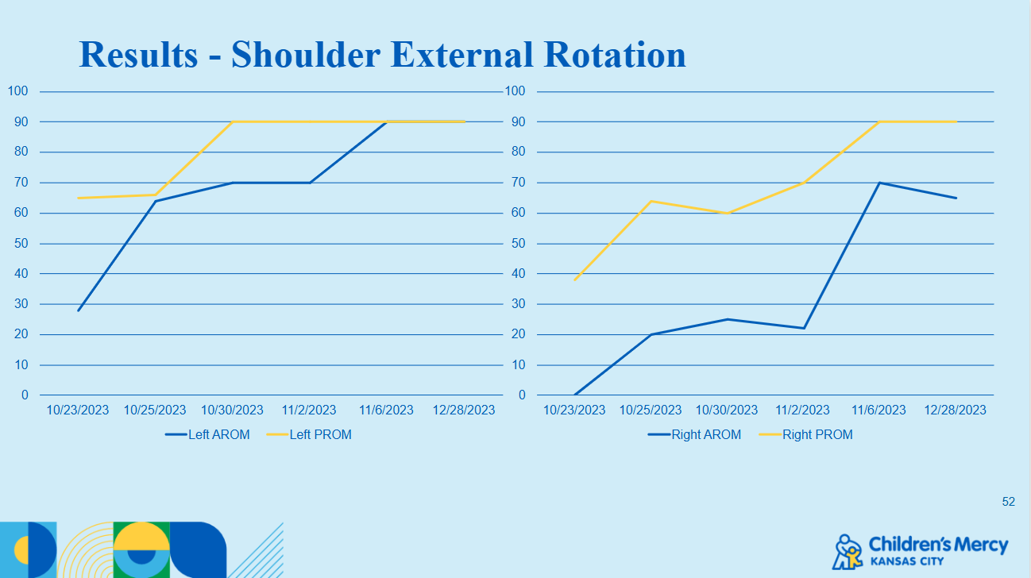

Slide 23
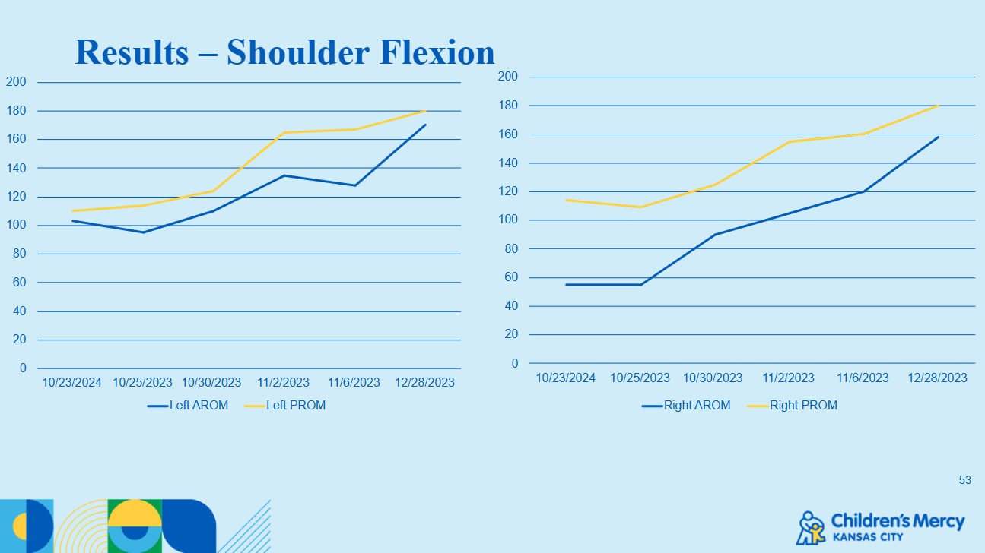

Slide 24
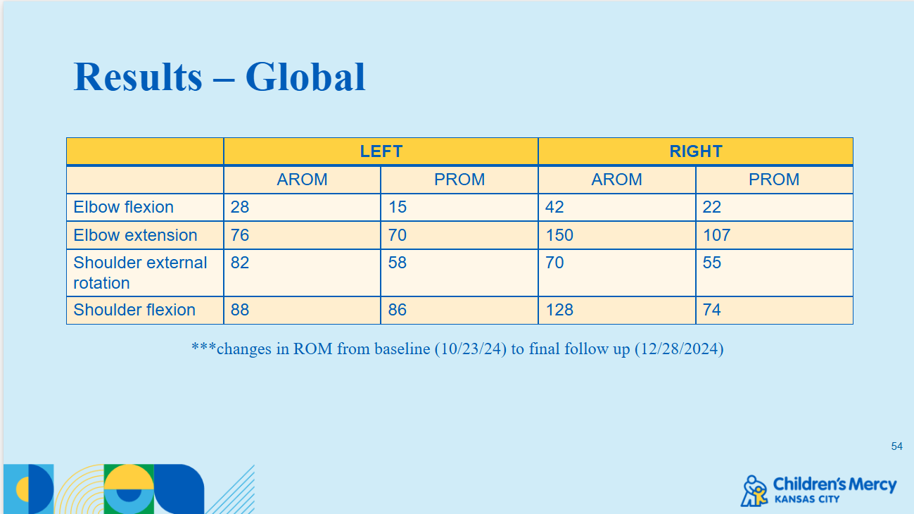

Slide 25
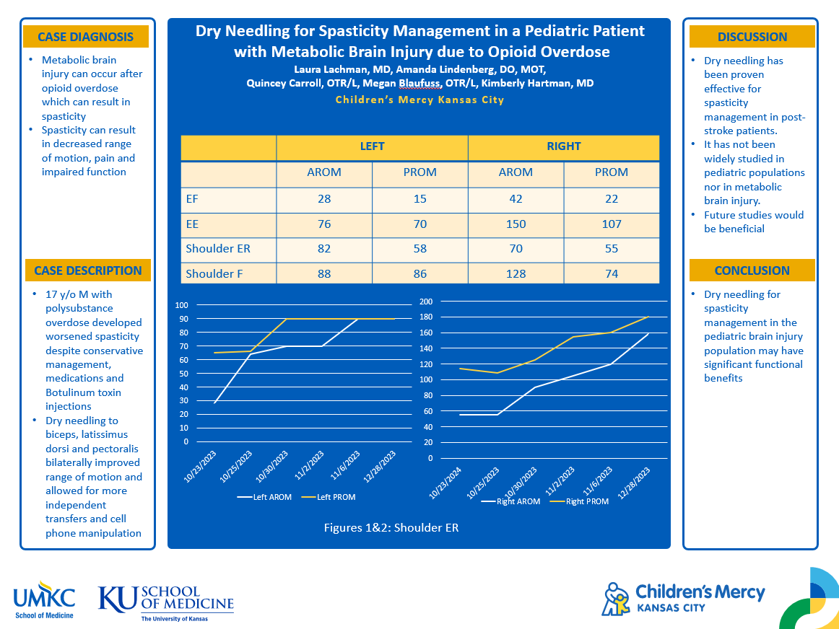

Slide 26
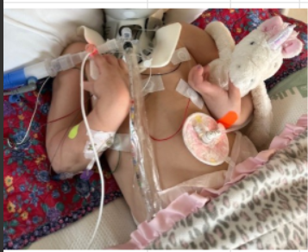
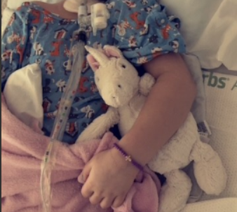
Resting position prior and after DN – no botox
Notes:
**EP could also talk about DN to her gastroc/soleus as additional info but not in depth since it wasn't me, it was David! But only if you think it's helpful

Slide 27
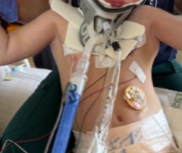
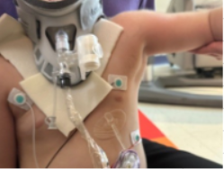
Lat Before
Lat After

Slide 28
Caregiver Education
Notes:
EP will introduce this section

Slide 29
How do we train caregivers?
Early encouragement to participate
Including caregivers in therapy sessions
Practicing handling as often as able and appropriate
The importance of our nursing staff in allowing family to have opportunities for practice outside of therapy sessions.
Notes:
(EP)
Discuss what we can train caregivers in early (prom, positioning with splints, etc) and how that progresses as the patient progresses
Our job is to determine when a skill (bed mobility, transfers, ambulation, etc) is safe enough that a caregiver can be trained and we are "checking off" when they can independently demonstrate safety with the task
Talk about article and how important nursing is to our IPR patient success

Slide 30
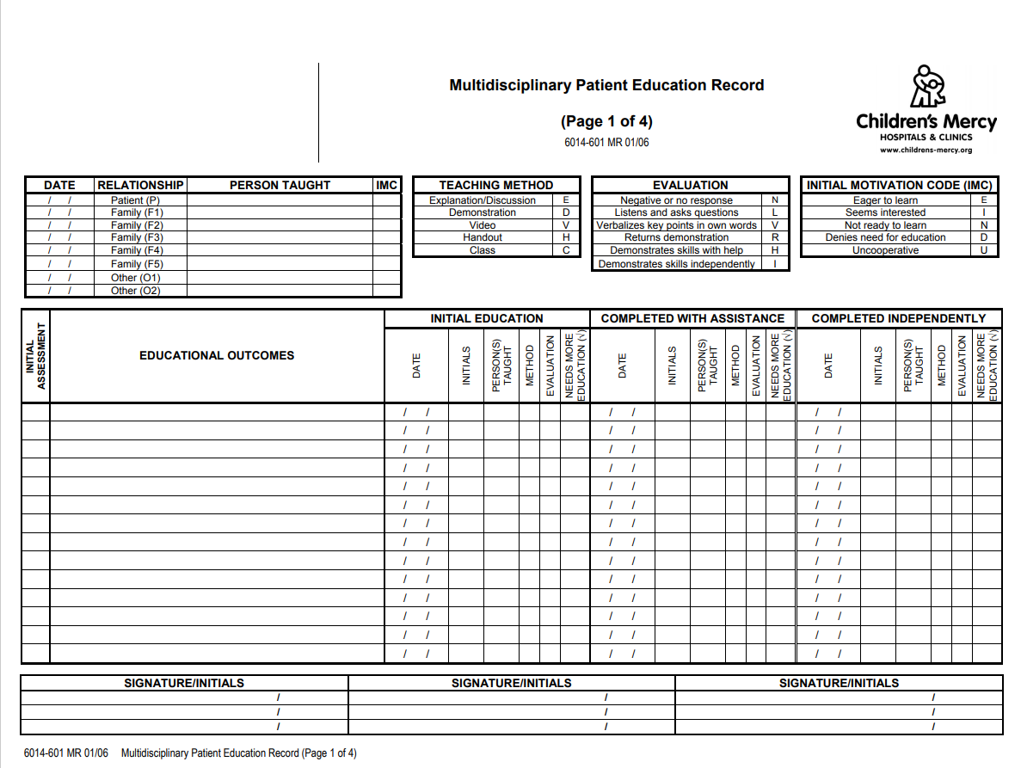
Teaching Sheets
Notes:
(EP)
we use teaching sheets to communicate between disciplines on where the patient and family are in their training progress
Keep these in patient's room

Slide 31
Barriers to Training
Availability of caregivers
Hesitancy to participate
Unclear plan for discharge
Communication
Notes:
(EP)
Caregivers may have to work during typical therapy hours
Try to coordinate specific days/times where they can be present for lots of therapy training at the same time
Caregivers are afraid of doing something wrong which makes them hesitant to try
Encourage frequent practicing and remind them that nursing can always provide assistance outside of therapy times
Some of our patients have challenging social situations that result in questions about discharge location and caregivers
Encourage frequent practicing and remind them that nursing can always provide assistance outside of therapy times
Language or cultural barriers
Use of interpreters (in-person is best for training) and/or bilingual patient guide if available; working within cultural considerations (caretaking done exclusively by female family members, for example)

Slide 32

From Research to Rehab: Supporting Bilingual Clients After TBI
22% of Americans are bilingual
Bilingual Lexical Processing
Language Control
Executive functioning that regulates cross-language competition
Bilinguals rely on executive function for fluent language control
Notes:
(QC)
When asking “what is this object” to a bilingual child after TBI:
Having to think of image, English/Spanish, how to pronounce, choose which is appropriate, produce the word

Slide 33
Therapy Recommendations for a Bilingual Child
Use stronger language or complete assessments in both languages
Use professional interpreters and not family members
Bias or misinterpret “he/she knows it they are just …”
Provide materials ahead of time for interpreters
Check for dialect/region
More accurate representation
Consider assessments may take twice as much time or be strategic with assessment with pertinent testing
Notes:
Important to utilize our interpreters especially with assessments, caregiver education, discharge instructions.
Maybe parents decline but consider that the patient with TBI may perform better if asked in their primary language

Slide 34
Discharge Planning

Slide 35
Family Conference
Family conferences are a regular part of our inpatient rehab program
Typically held near the beginning of an admission to review roles and establish goals for discharge
Occasionally have a second conference close to discharge if needed
Determine estimated discharge date at this meeting
Family is part of the decision-making team
Notes:
(EP and QC)
Family conference is multi-disciplinary in nature (Rehab docs, PT, OT, SLP, Neuropsych, Social Work, Nurse Care Manager) to cover all aspects of patient care
Indications for second conference: delay in family training, change in expected discharge location, review of discharge recommendations/continued services needed
Discharge date is important in establishing a family training timeline

Slide 36
Home Modifications
Our typical discharge disposition is home
Early determination of current home set up to allow as much time as potentially needed to make any necessary modifications
Also consider access to transportation
School and community access and accommodations
Notes:
(EP and QC)
Plan is for home discharge vs adult options
-Ramp, door width, size of bathroom and transfer (can wheelchair walker fit), shower chair size. Most tub shower – how to accommodate if dependent shower needs? Can it fit?
-Where is their bedroom? Do they need supervision (from TBI perspective)? Can they manage their assistive device in the home?
Car transfers
Limited access to transportation as a consideration for discharge planning
We have a teacher who works with the schools to incorporate recommendations made by the team
School reintegration is part of many intensive outpatient therapy provider models

Slide 37
Equipment Needs
Assistive device
Orthotics
Wheelchair
Shower/Bath Chair
Type of bed
Monitoring system
Notes:
(EP and QC)
We try to cast for orthotics and perform seating evals for wheelchairs and bathing equipment during an admission
Have to consider not just home but: School / Community / Play
Shower: lay down In bath? Leckey, tilt in space? Bench or chair?
Bedding: Enclosed, low bed, bed rails?
Monitoring – video/audio?

Slide 38
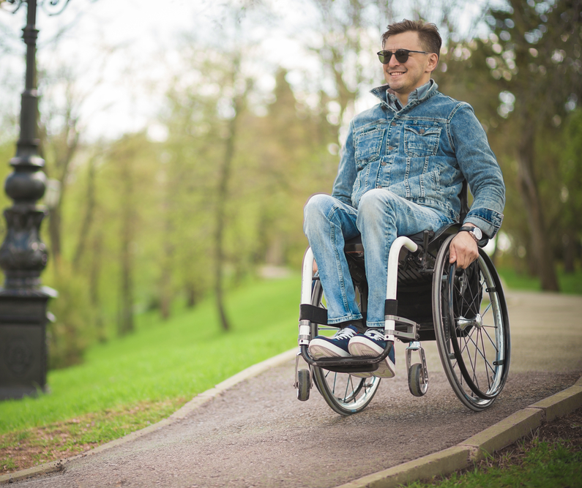
Embrace the Journey: Aging With a Disability
SCI and TBI panel
Shoulders and skin
Car transfers
Isolation
Adaptive Sports
Home Adaptions
Substance Abuse
Reality of returning home
Peer Mentor
Understanding what you need in a wheelchair
Bowel and Bladder
Therapist’s role
Notes:
“With your pts its so important to get them involved, the biggest enemy with SCI or TBI is isolation, most of the world is able bodied – ability360 (adaptive sports/art) “after my accident I discovered kayaking and it changed my life”
“the most important thing you can work with your patients is get them involved as soon as possible
Golf with Barrow
Kayak Ability360
Arizona adaptive water sports
“The whole scope of it doesnt set in until you get home”
Peer mentor
Having someone to talk to who has been through something like this
Sometimes people think they are going to walk out of the hospital – responses vary from people with this mindset**
“Therapists were pretty brutal but way better than coddling them. Throw it at them”
“They told my mom when we were discharging, dont do too much for them, make him do it himself. Dont enable your patients by doing more for them than they can”
“Expose them to their disability for acceptance of their new body”

Slide 39
Discharge Therapy Recommendations
Rehabilitation & Transition Programs
Adaptive equipment & funding (including loan closets)
Financial assistance & grants
Medicaid waivers
Adaptive sport & community program
Supportive group & condition-specific resources
Notes:
(EP and QC)
Day program vs. Outpatient therapies
Insurance considerations when making discharge recommendations
Quincey's handout

Slide 40
Community Outings
Allows patients to understand their "new normal" when out in the community
Can identify areas of function to address prior to discharge
Helps patients and families feel confident being in their community following discharge
Notes:
(EP and QC)
Typical part of the rehab experience
Try to choose a location that is relevant to the patient (salience again!)
Usually 2 therapists and family depending on age and expected assistance level needed in the community
Practicing navigating busy environments, testing endurance and need for wheelchair, bathroom transfers, eating

Slide 41
Ready, Set, Home
Caregivers and patients independently perform cares over a 24-hour period as a "test run" prior to discharge
Helps to identify gaps in training which can be addressed prior to discharge
Notes:
(EP)
Scheduled with patient and caregivers as part of discharge planning
If discharging to multiple households, patient typically needs both caregivers to complete (or if patient needs two caregivers regardless of discharge location)
Patients and caregivers handle all meds, cares, transfers, etc.

Slide 42
Thank you! Questions?

Slide 43
References
Bynum, R., Garcia, O., Herbst, E., Kossa, M., Liou, K., Cowan, A., & Hilton, C. (2021). Effects of dry needling on spasticity and range of motion: A systematic review. American Journal of Occupational Therapy, 75, 7501205030. https://doi.org/10.5014/ajot.2021.041798
Calvo, Sandra & Navarro, Jorge & Herrero, Pablo & B., Raquel & de Diego-Alonso, Cristina & Marijuán, Pedro. (2017). Electroencephalographic Changes After Application of Dry Needling [DNHS © Technique] in Two Patients With Chronic Stroke. MYOPAIN. 23. 1-6. 10.1080/24708593.2017.1291550.
Cleaver, Stefani and Philbin, Mary Kate. (2025). Rancho I-III: A Clinical Perspective [MOOC]. Shirley Ryan AbilityLab Academy. https://ric.litmos.com/course/25826410?ts=639113565661473990
Cruz-Montecinos C, Núñez-Cortés R, Bruna-Melo T, Tapia C, Becerra P, Pavez N, Pérez-Alenda S. Dry needling technique decreases spasticity and improves general functioning in incomplete spinal cord injury: A case report. J Spinal Cord Med. 2020 May;43(3):414-418. doi: 10.1080/10790268.2018.1533316. Epub 2018 Oct 22. PMID: 30346254; PMCID: PMC7241526.
Duman S, Basak T, Adigüzel E, Karakus M. The Relationship Between Care Preparedness and Care Competencies of Caregivers Caring for Individuals With Spinal Cord Injury. Rehabil Nurs. 2026 Jan 12. doi: 10.1097/RNJ.0000000000000529. Epub ahead of print. PMID: 41525502.
Herrero, Pablo & Mayoral, Orlando. (2010). A Case Study Looking at the Effectiveness of Deep Dry Needling for the Management of Hypertonia. Journal of Musculoskeletal Pain. 15. 55-60. 10.1300/J094v15n02_09.
Malfait I, Gijsbers S, Smeets A, Hanssen B, Pick A, Peers K, Schillebeeckx F. Safety of dry needling in stroke patients: a scoping review. Eur J Phys Rehabil Med. 2024 Apr;60(2):225-232. doi: 10.23736/S1973-9087.24.08224-8. Epub 2024 Mar 19. PMID: 38502557; PMCID: PMC11114159.
Mohammadpour F, Ali Oghabian M, Nakhostin Ansari N, Naghdi S, Dommerholt J. Effects of dry needling on post-stroke brain activity and muscle spasticity of the upper limb: a case report. Acupunct Med. 2021 Feb;39(1):69-71. doi: 10.1177/0964528420920294. Epub 2020 Jun 12. PMID: 32529885.
Panahi F, Ebrahimi S, Rojhani-Shirazi Z, Shakibafard A, Hemmati L. Effects of neurorehabilitation with and without dry needling technique on muscle thickness, reflex torque, spasticity and functional performance in chronic ischemic stroke patients with spastic upper extremity muscles: a blinded randomized sham-controlled clinical trial. Disabil Rehabil. 2024 Mar;46(6):1092-1102. doi: 10.1080/09638288.2023.2190168. Epub 2023 Mar 27. PMID: 36970837.

Slide 44
Sánchez-Infante, J., Bravo-Sánchez, A., Esteban-García, P., Jiménez, F., & Abián-Vicén, J. (2022). Changes in Electromyographic Activity of Latent Trigger Points After a Dry Needling Intervention: A Randomized Controlled Trial. Physiotherapy, 117, 72–80. https://doi.org/10.1016/j.physio.2022.09.002
Sánchez-Infante, Jorge, Navarro-Santana, M. J., Bravo-Sánchez, A., Jiménez-Diaz, F., & Abián-Vicén, J. (2021). Is Dry Needling Applied by Physical Therapists Effective for Pain in Musculoskeletal Conditions? A Systematic Review and meta-analysis. Physical Therapy, 101(3). https://doi.org/10.1093/ptj/pzab070
S.B. Snider, H. Shi, Y.G. Bodien, C. Howard, X. Sun, A.J. Golby, K.A. Zimmerman, G. Bertolini, S. Magnoni, V. Dunet, M. Oddo, N.S.N. Graham, E. Mallas, F. Moro, P. Mukherjee, N.R. Temkin, S. Jain, D.J. Sharp, B.L. Edlow, & M.D. Fox, Preservation of anticorrelated brain networks predicts recovery after traumatic brain injury, Proc. Natl. Acad. Sci. U.S.A. 122 (52) e2518159122, https://doi.org/10.1073/pnas.2518159122 (2025).
Sedighimehr N, Zafarshamspour S, Sadeghi M. Effects of dry needling on muscle spasticity of the upper limb in a survivor of traumatic brain injury: a case report. J Med Case Rep. 2022 Jun 14;16(1):237. doi: 10.1186/s13256-022-03408-5. PMID: 35701822; PMCID: PMC9195242.
Simons, D.G and W.C. Stolov. 1976. Microscopic features and transient contraction of palpable bands in canine muscle. American Journal of Physical Medicine. 55(2): 65-88.
Shen Y, Jiang L, Lai J, Hu J, Liang F, Zhang X, Ma F. A comprehensive review of rehabilitation approaches for traumatic brain injury: efficacy and outcomes. Front Neurol. 2025 Jun 13;16:1608645. doi: 10.3389/fneur.2025.1608645. Erratum in: Front Neurol. 2025 Jul 08;16:1651979. doi: 10.3389/fneur.2025.1651979. PMID: 40584523; PMCID: PMC12202449.
Valencia-Chulián R, Heredia-Rizo AM, Moral-Munoz JA, Lucena-Anton D, Luque-Moreno C. Dry needling for the management of spasticity, pain, and range of movement in adults after stroke: A systematic review. Complement Ther Med. 2020 Aug;52:102515. doi: 10.1016/j.ctim.2020.102515. Epub 2020 Jul 16. PMID: 32951759.
Zhang Z, Wang W, Song Y, Zhai T, Zhu Y, Jiang L, Li Q, Jin L, Li K, Feng W. Immediate Effect of Dry Needling at Myofascial Trigger Point on Hand Spasticity in Chronic Post-stroke Patients: A Multicenter Randomized Controlled Trial. Front Neurol. 2021 Oct 29;12:745618. doi: 10.3389/fneur.2021.745618. PMID: 34777214; PMCID: PMC8585994.

Slide 45
