Slide 1



Who Speaks for Me?
Understanding Powers of Attorney, Guardianship, & Alternatives
A Practical Overview of Authority, Rights Retained or Lost, and Common Crisis Mistakes
BIAKS 2026 Annual Brain Injury Professional Conference
Maner Conference Center, Topeka, KS
April 17, 2026
Presenter: Samantha L. Shepherd, J.D.
Managing Attorney

Slide 2

Who Will Speak for Me?
A question many survivors quietly face.
What happens when communication or decision-making becomes difficult?
How can you ensure your voice is still heard?
Imagine waking up in a hospital after a brain injury. You know what you want. You may even know what you need. But the words don’t come out right—or not at all. Decisions are being made around you: medical care, finances, where you’ll live. And the question becomes: Who will speak for me when I can’t?

Slide 3

When a Voice Is Lost, Advocacy Matters!
Brain injury can affect speech, memory, judgment, or stamina.
Loss of Voice
Advocacy protects dignity, safety, and choice.
Loss of Rights

Slide 4

Brain Injury & Decision-Making Capacity
Capacity is NOT all-or-nothing!
01
It can fluctuate day to day.
02
Support may be needed only in certain areas.
03
Planning allows flexibility.
04

Slide 5


What Happens Without Planning?
Decisions may default to courts or institutions.
Family may not automatically have authority.
This may lead to delays in medical care, housing, or finances.

Slide 6




Legal Planning That Speaks for You
Financial POA
Healthcare POA
Advance Directives
Authorizes a trusted individual to manage financial matters on your behalf.
Appoints someone to make medical decisions for you if you’re unable to do so.
Outlines your wishes for medical care and end-of-life decisions in advance.

Slide 7

Guardianship
A Last Resort
  Court appoints a decision-maker
  Individual loses certain rights
  Public court oversight
  Can be costly and time-consuming

Slide 8





Supported
  Decision-Making
Limited
  POAs
Alternatives
  Temporary or Specific Authority
Often Preferred in KS & MO Courts

Slide 9





Family Members
Professional Advocates
Who Are Your People?
Choosing Who Speaks for You
Trusted Friends
Your Choice Matters

Slide 10

Care Needs Beyond Documents
  Daily living support
  System navigation
  Emotional and social well-being
  Ongoing advocacy

Slide 11
Rights Retained & Lost
Right to Make Medical Decisions
  A survivor retains the right to make their own healthcare decisions unless a court appoints a guardian or the person has previously signed a valid healthcare power of attorney that becomes active upon incapacity.
Right to Manage Finances
  Without court intervention, the individual maintains control over bank accounts, property, and contracts. If a guardian/conservator is appointed, financial control may shift — but the court may limit that authority to specific areas.
Right to Vote
  In many states, including Kansas, a person retains the right to vote unless a court specifically removes that right in a guardianship order. Guardianship does not automatically mean loss of voting rights.
Right to Marry, Contract, and Decide Where to Live
  These rights generally remain intact unless specifically restricted by a court. Courts increasingly favor limited guardianships that remove only those rights absolutely necessary for protection.
  Right to Due Process and Legal Representation
  If guardianship or conservatorship is pursued, the individual has the right to notice, to attend the hearing, to object, and to be represented by counsel. Their voice is still legally significant.

Slide 12

GOVERNMENT BENEFITS AS ADVOCACY TOOLS
SSI
Medicaid
HUD
Supplemental Security
Income
Medicaid health coverage
and long-term services
Housing
Benefits provide income, medical care, housing, and support services.
Eligibility often depends on income, assets, and disability status.
Available to eligible individuals in Kansas and Missouri.
For many brain injury survivors, such benefits are lifelines. However, eligibility rules are strict and confusing, and a missed step can mean loss of coverage. Advocacy and planning help survivors access and keep these essential supports.

Slide 13
Special Needs Trusts & the Role of the Trustee
Protection of government benefits
Trustee as advocate for the individual

Slide 14



Care Management Support
Coordinates medical, social, and community services.
Helps navigate SSI, Medicaid, and other benefits.
Especially helpful during transitions or appeals.
Reduces stress for survivors and families.

Slide 15




Common Crisis Mistakes
Waiting Too Long to Address Legal Authority
Assuming Capacity Is “All or Nothing”
Failing to Protect Public Benefits
Spending Down Assets Incorrectly
Not Coordinating the Care Team
Overlooking Long-Term Care Needs
Letting Emotion Drive Permanent Decisions
Not Creating (or Updating) an Estate Plan

Slide 16

How to Start the Conversation
Build the Right Team
Survivor
Family or advocates
Legal and care professionals
Community organizations (like BIAKC)
Put the Person First
Dignity
Autonomy
Respect
Start with Values
Involve Survivors Early

Slide 17


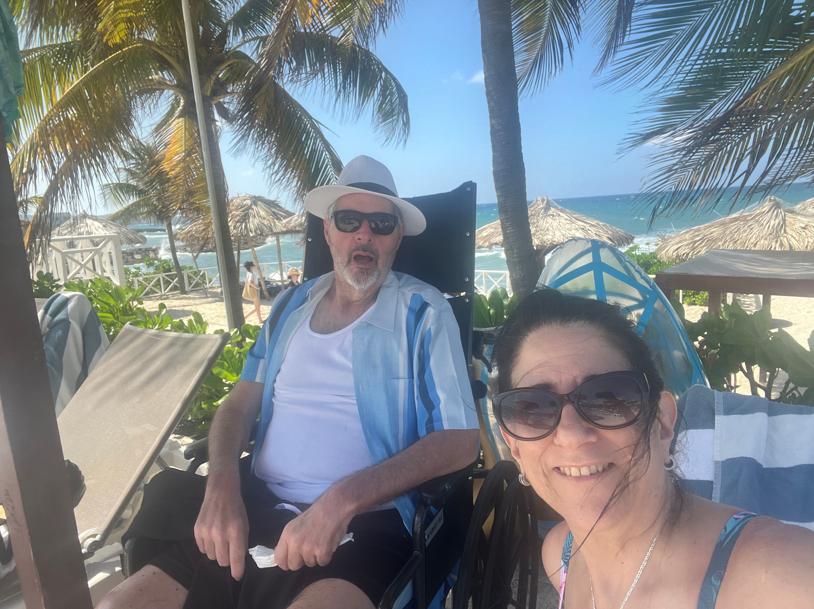
YOUR VOICE MATTERS
Everyone deserves to be heard.
Planning protects your future.
Take one step today.
Call to Action:
You don’t have to do everything today, but you can do something. Start a conversation. Ask a question. Write down what matters to you. Your voice matters—and with the right planning, someone will always be there to speak for you.

Slide 18
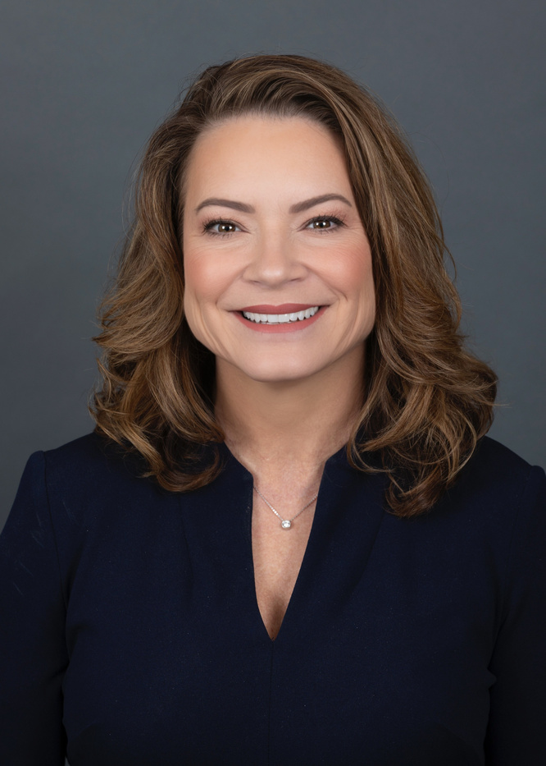





STAY IN TOUCH
Samantha L. Shepherd, J.D., LL.M. CELA
913.333.3533
info@shepherdelderlaw.com
10975 Grandview Drive, Suits 501
Overland Park, KS 66210
www.shepherdelderlaw.com
www.assuredtrustcompany.com

