Slide 1
Growing & Cultivating Advance Directives and ACP
RYAN PFERDEHIRT
Rosemary Flanigan Chair & Vice President of Ethics Services
Center for Practical Bioethics

Slide 2
Objectives
Discuss the ethical challenges that TBIs present for patient autonomy
How goals of care are complicated
Challenging discharge locations,
Discuss how aspects of “self” and “personhood” can further complicate decisions going forward.

Slide 3
Case Example
Mrs. Tutti is a 61 year old female who recently retired and lives with her husband Frank. They are both very physically active and were looking forward to traveling, but recently Mrs. Tutti slip on some ice outside on the sidewalk. The back of her head hit the concrete, causing severe trauma. After several month of rehab, she is slowly recovery. Frank spends all of his time caring for her, but that has caused his health to worsen. He says she is a very different person now and might not be the same person he married.

Slide 4
Another Case Example
Mrs. Adkins is a 77 year old female, who was admitted with a recent head trauma suffered following a fall. She had to have the top of her skull temporarily removed because of the swelling. She is not in the ICU and has told the medical team that she does not want to continue to live in this state of quality of life. She said that when she is given the opportunity, she is going to throw herself out of the hospital bed, intending to die. Her husband has to make a decision regarding placement of a PEG tube. He is not sure if Mrs. Adkins understand her decisions, she is determined to lack decision making capacity, but she is consistent in saying this is not quality of life to her. Mr. Adkins is not sure if she is suffering from the injury or if she truly does not want to continue to live, and thus he should withhold the feeding tube.

Slide 5
Ethical Principles
Autonomy
Beneficence
Nonmaleficence
Justice

Slide 6

Autonomy
&
Beneficence

Slide 7
Respect for Autonomy
Means self-rule.
Belmont Report, “An autonomous person is an individual capable of deliberation about personal goals and of acting under the direction of such deliberation.
Moral decision-making assumes that rational agents are involved in making informed and voluntary decisions.
In health care decisions, our respect for the autonomy of the patient would, in common parlance, imply that the patient has the capacity to act intentionally, with understanding, and without controlling influences that would mitigate against a free and voluntary act.
This principle is the basis for the practice of "informed consent" in the physician/patient transaction regarding health care.”

Slide 8
MAID - Washington Stats
A total of 452 participated in Washington’s Death with Dignity program in 2022.
  • 207 different physicians prescribed the medication.
  • 68 different pharmacists dispensed the medication.
The department received death records for 444 participants and After Death Reporting Forms for 433 participants.
  • 446 participants are known to have died.
    o 363 died after ingesting the medication.
    o 44 died without having ingested the medication.
    o Ingestion status is unknown for the remaining participants.
  Out of the 363 that died after ingesting the medication:
  • 82% were enrolled in hospice care when they ingested the medication.
  • 91% had some form of health insurance.
  • 76% died at home/in a private residence.

Slide 9
Washington Stats (Illness)
Cancer 317 (73%)
Neurodegenerative 34 (8 %)
Respiratory 29 (7 %)
Cardiovascular 25 (6 %)
Other 15 (4 %)
Unknown/Missing 13 (3 %)
Total 433

Slide 10
Washington Stats (Concern)
Loss of autonomy. 358 (83 %)
Financial implications of treatment. 43 (10 %)
Burden on family, friends/caregivers. 254 (59 %)
Less able to engage in activities making life enjoyable. 360 (83%)
Loss of control of bodily functions. 213 (49%)
Inadequate pain control. 199 (46 %)
Loss of dignity. 297 (69%)

Slide 11
Beneficence
The obligation of physician to act for the benefit of the patient and supports a number of moral rules to protect and defend the right of others,
  prevent harm, remove conditions that will cause harm, help persons with disabilities, and rescue persons in danger.
The goal of providing benefit can be applied both to individual patients, and to the good of society as a whole.
  For example, the good health of a particular patient is an appropriate goal of medicine, and the prevention of disease through research and the employment of vaccines is the same goal expanded to the population at large.
Positive requirement
Obligation vs Ideal

Slide 12
Autonomy versus Beneficence
To override the patient’s preference would imply that the medical team is operating under the idea of paternalism, which Beauchamp and Childress (2007) define as, the intentional overriding of one person’s preferences or actions by another person, where the person who overrides justifies this action by appeal to the goal of benefitting or of preventing or mitigating harm to the person whose preferences of actions are overridden (p. 215).
Paternalism comes with some ethical complications because it requires an active use of a difference in power dynamic and creates greater potential for biases.
It can also set a dangerous precedent of the provider ignoring the medical and personal preferences of a patient with capacity.
  It requires personal judgment regarding the meaning of the word “safe & unsafe”, “right & wrong”.

Slide 13
Hard and Soft Paternalism
Soft paternalism is the view that the only conditions under which state paternalism is justified is when it is necessary to determine whether the person being interfered with is acting voluntarily and knowledgeably
Mill’s famous example of the person about to walk across a damaged bridge (language barrier)
  A soft paternalist would justify forcibly preventing him from crossing the bridge in order to determine whether he knows about its condition.
  A hard paternalist says that, at least sometimes, it may be permissible to prevent him from crossing the bridge even if he knows of its condition. We are entitled to prevent voluntary suicide.

Slide 14
Clinical Decision Making
1. The Patient with Capacity
2. Autonomously Executed Advance Directive
3. Substitutive Judgement
4. Best Interests
2 – 4 Require a Surrogate Decision-maker

Slide 15
The Patient with Capacity
Informed Consent
First used, 1957 by attorney Paul G. Gebhard – malpractice case v Stanford
Requires 3 element criteria
  Patient must agree to intervention based on understanding of relevant information
  Must not be controlled by influences
  Must involved intentional giving of permission

Slide 16
Informed Consent
Required by patient;
  Understand, Evaluate, & Reason
Required by provider;
  Diagnosis, Prognosis, Treatment Options, & Recommendation
Ensures pts are aware = protects hospital and physicians from litigation
Ethically – It should be minimum/baseline

Slide 17
Advance Directives and Surrogate Decision Makers
Precedent autonomy
Means of maintaining a patient’s right to autonomy
  A patient’s voice when the patient is voiceless
Advance Directive
  Living will, DPOA, 5 Wishes, etc.
  Does not include POLST/TPOPP

Slide 18
Challenges and Limitations
Living wills cannot cover all conceivable decisions
Questionable pt understanding
Ambiguous terms
  "extraordinary means" and "unnaturally prolonging my life“
Effective use
  Advance Directives and POLST

Slide 19
What if there is not an AD?
Substitutive Judgement
  “Don the mental mantle of the incompetent”
  Surrogate should have familiarity with the patient
  Able to answer, “what would the patient want in this circumstance?”
Best Interest Standard
  Determine the highest probable net benefit among the available options
  Balance benefits, risks, and cost

Slide 20
No DPOA - Who becomes Surrogates?
Appointed Guardian
Husbands, wives, legal partners
Adult children
Parents
Siblings, cousins, aunts, uncles, nephews, nieces
Close and caring friends
(defined by each state laws)

Slide 21
Personhood
What does it mean to be a ”person”?
Ship of Thesus

Slide 22
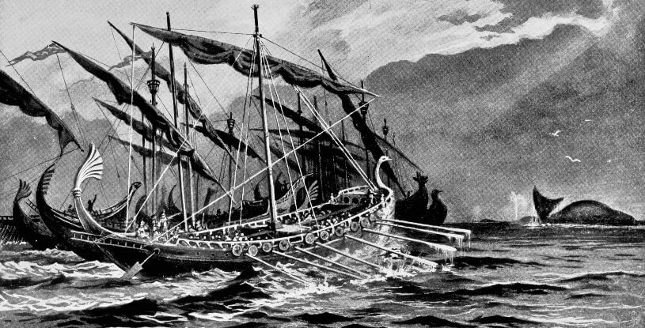
Ship of Theseus
“The ship wherein Theseus and the youth of Athens returned had thirty oars, and was preserved by the Athenians down even to the time of Demetrius Phalereus, for they took away the old planks as they decayed, putting in new and stronger timber in their place, insomuch that this ship became a standing example among the philosophers, for the logical question of things that grow; one side holding that the ship remained the same, and the other contending that it was not the same…over the years, the Athenians replaced each plank in the original ship of Theseus as it decayed, thereby keeping it in good repair. Eventually, there was not a single plank left of the original ship. So, did the Athenians still have one and the same ship that used to belong to Theseus?

Slide 23

Imagine the scenario that human teleportation is possible. Famed scientist Dr. Q says that he has successfully built a machine that can teleport him. He then says he has another machine on Mars and will be able to teleport people to Mars at the speed of light. Dr. Q demonstrates the functioning teleportation machine by teleporting himself to Mars, picking a Martian rock, and teleporting back with the rock as proof. He says the teleporter works by mapping your genetics, breaking you down into individual atoms, and relaying that information to another station across the planet, where then the machine on Mars will reconstruct you atom by atom on the surface of Mars, while the atoms on Earth are deconstructed. This process is repeated for the return journey.
The question then becomes, say you used the transporter, does the same person come out on the other side of the transporter? The person that transports would look exactly like you, talk like you, think like you, and even think that they were you. But are they really you? Imagine something goes wrong with the transporter and the self on Earth is not deconstructed, but instead that self survives and there is another self now on Mars. Who is the real self? How many selves are there? Are there two, one or zero?

Slide 24
Derek Parfit
Developed this thought experiment to demonstrate our limited understanding of what personhood really is.
Parfit believes that the new person that is created on Mars is not the same person that was on Earth.
  a completely new person who only believes themself to be the same self because of memories.
This is what Parfit calls “Relation R”
  meaning that the only reason a new person believes themself to be the same person as a past person is because of a cognitive connection between the two. This means that because both persons seemingly share memories and personality, they both believe themselves to be the same person. But just because two separate persons believe themselves to be the same person, at different times, does not mean they are the same person. Only that they believe themselves to be.

Slide 25
Case Example
The patient is a 36-year-old male, suffering from ESRD, among other ailments, admitted from living in a group home. The patient is known to the hospital staff as being a “problem patient." He has a history of noncompliance and also behavioral issues, including being verbally abusive to family and staff. He suffered a TBI several years ago, which manifests often in violence.
He has been discharged from most other hospitals and health facilities in the area, with them having him sign behavior contracts that he violated. He will not be accepted at any other hospital. Due to his ESRD, he is not able to be discharged to home because he does not have adequate means of transportation for dialysis, and the group home is now declining. No local SNF or other care facility will accept him due to his noncompliance and behavioral issues. The only accepting facility is in Salt Lake City (1000+ miles away). The patient and the family are refusing discharge to Salt Lake City. Social Work has requested ethics support.

Slide 26
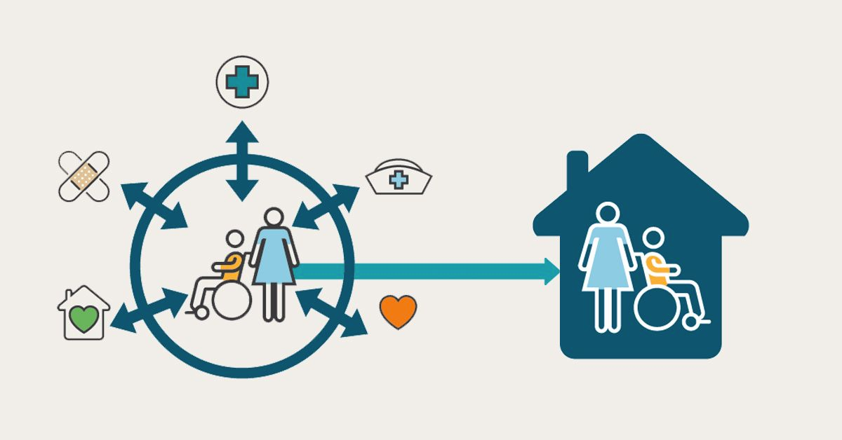
Discharge Planning and Location

Slide 27
Final Takeaways
The value of autonomy and self-determination
Advance directives are not perfect, but they are best we have
TBIs present some unique challenges with autonomy and personhood.

Slide 28
https://faculty.washington.edu/smcohen/320/theseus
Partfit

Slide 29

Questions

