Slide 1
Access Reimagined: Alternative Access for Communication, Learning, Working, and Everyday Life
Abby Azeltine
April 17th, 2026

Slide 2
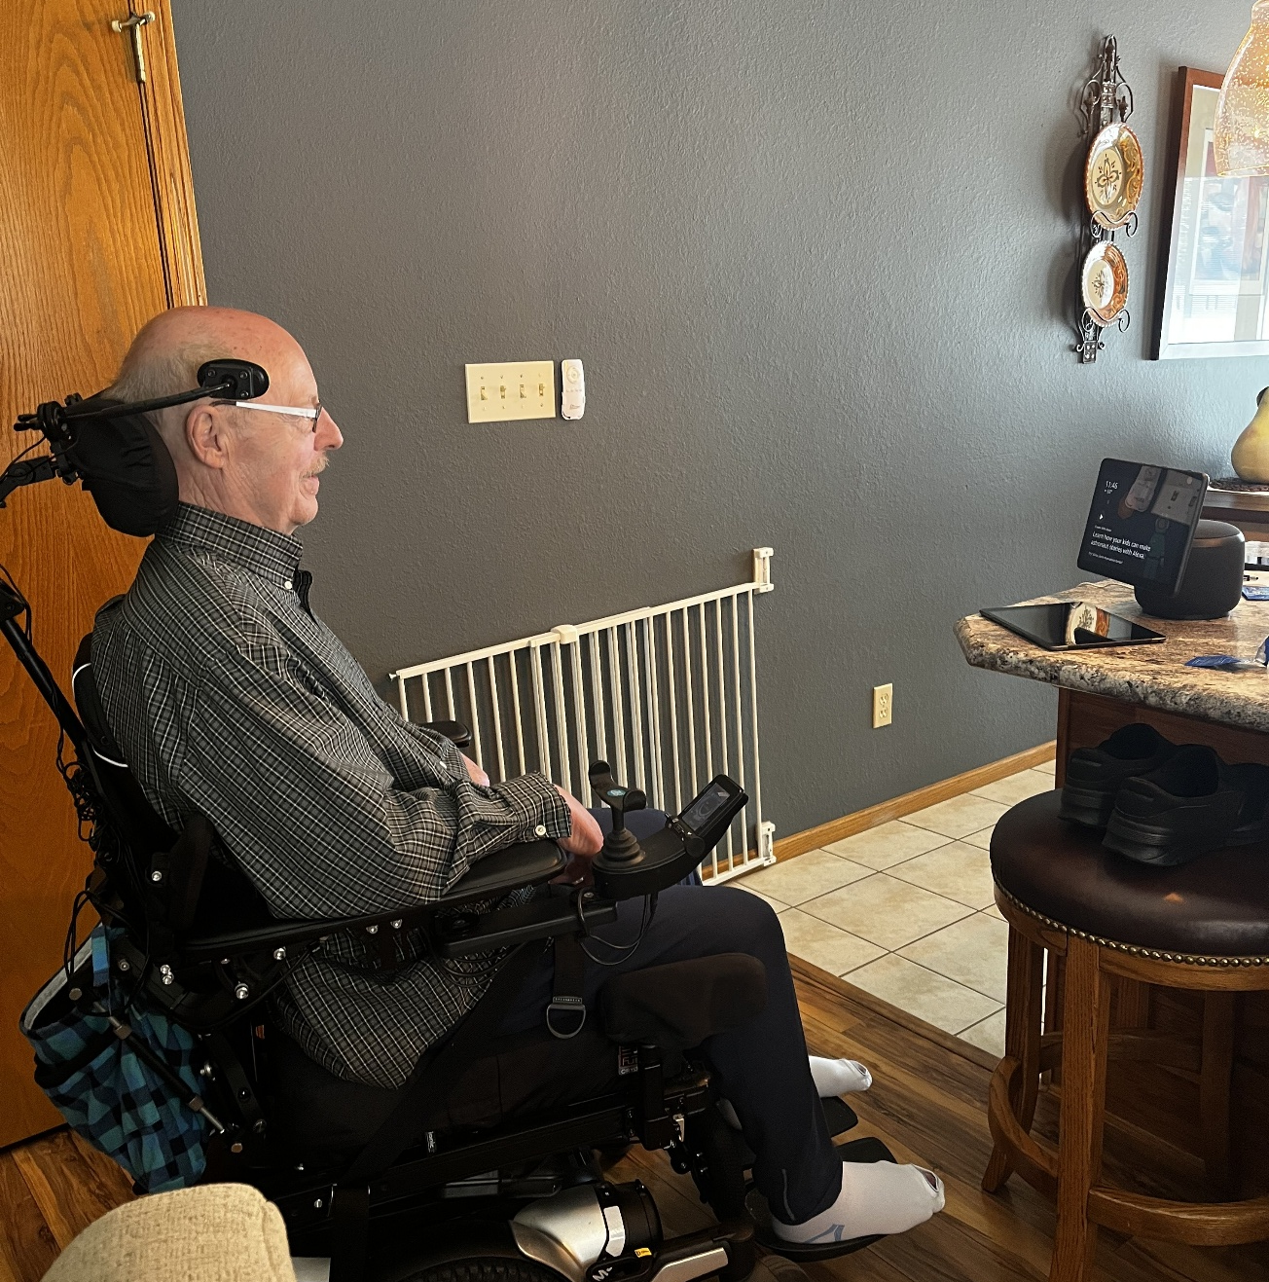
Agenda
1
Clinical Foundations for Alternative Access
2
Mobile and Tablet Access Strategies
3
Computer Access Across Functional Needs
4
Advanced Access: Head, Eye Gaze, and Switches
5
Clinical Application and Resources

Slide 3
Learning Objectives
Identify at least five alternative access methods used by individuals with brain injury.
01
Describe motor, cognitive, visual, and fatigue-related factors that influence access selection.
02
Apply person-centered principles to match alternative access methods to functional goals across daily life activities.
03

Slide 4

Why Alternative Access is Important After Brain Injury
Brain injuries can affect:
      Motor control (weakness, tremors, paralysis)
      Vision or visual processing
      Speech and language
      Cognition, attention, and fatigue
      Coordination and reaction time
(Masel & DeWitt, 2010; Rauchman et al., 2023)

Slide 5
Flexibility
Because brain injury symptoms vary widely and may change over time, access methods must be flexible and customizable.
Access needs may change daily, weekly, or during recovery.

Slide 6
Why Access Must be Flexible
Marcus is recovering from a traumatic brain injury after a car accident. Before his injury, using his phone and computer was automatic. During recovery, fatigue, tremor, and reduced coordination made even simple tasks like texting or selecting an app difficult. What worked one day did not always work the next, showing why alternative access after brain injury must remain flexible and individualized.
Clinical question: What changes first—movement, endurance, cognition, or all three?

Slide 7
Clinical Access Screening
Which movement is reliable?
Which movement is repeatable?
Which causes least fatigue?
Which supports function over time?
Hands → Head → Mouth → Feet → Upper Extremities → Lower Extremities → Mind
(Lange, switch assessment course content, Access to Independence; OccupationalTherapy.com)

Slide 8
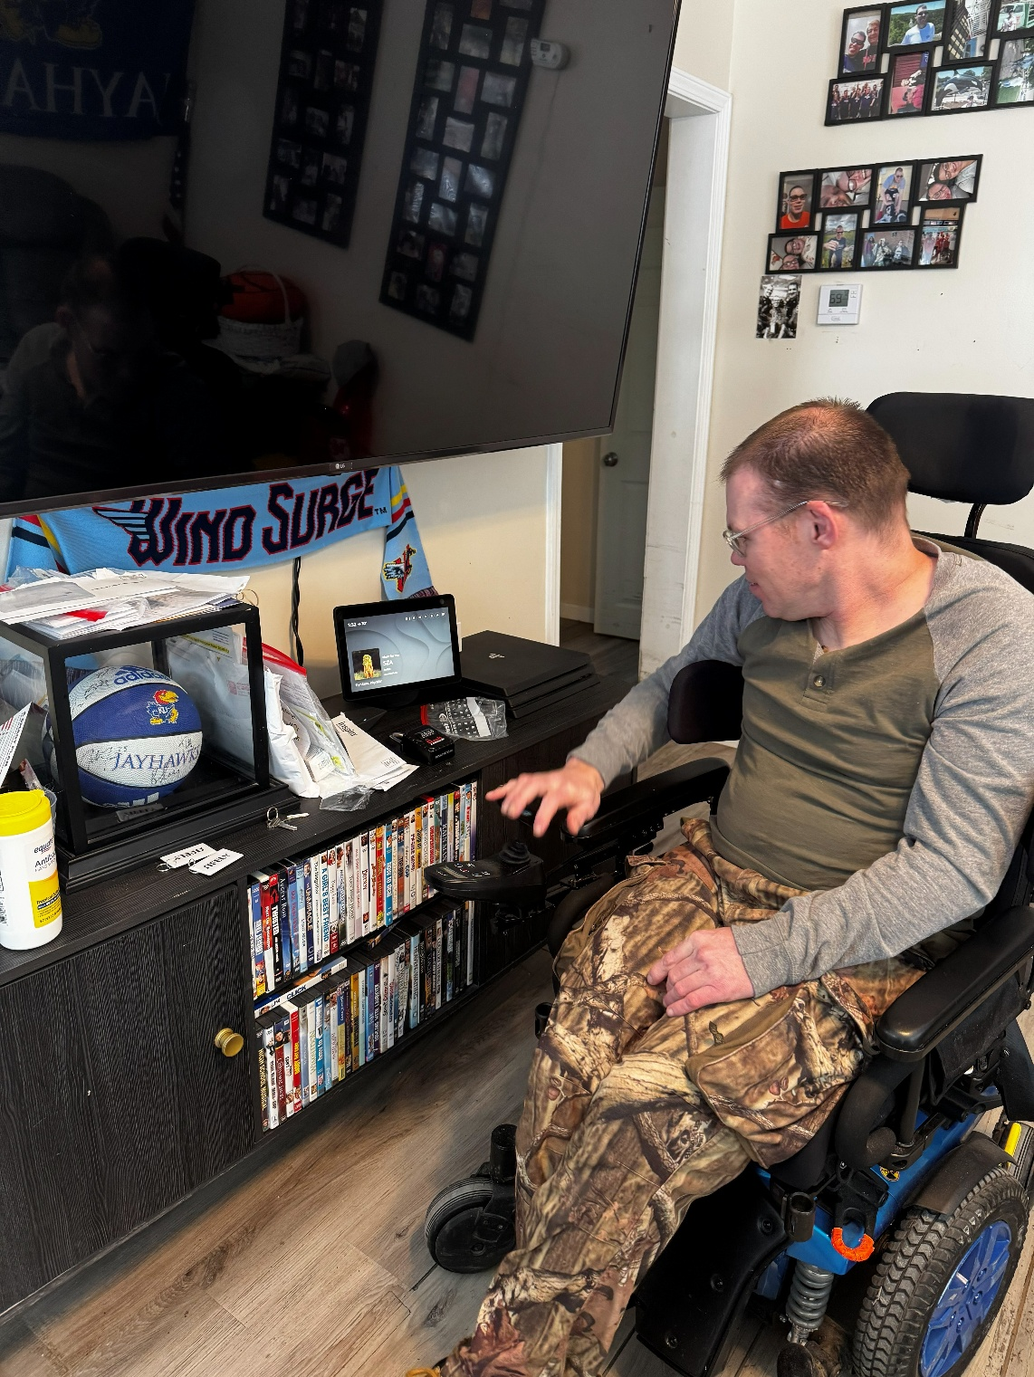
Body Movements to Consider for Access
Hand (down, up, to the side, or grasp)
Finger (tap, squeeze, or up)
Elbow (to the side or down)
Head (to the side)
Mouth (sip and/or puff and tongue)
Chin (down or to the side)
Eyebrow or Eye Blink
Knee (up or to the side)
Foot (down, up, or to the side)
Toe (down, up, or to the side)
Eye Tracking

Slide 9
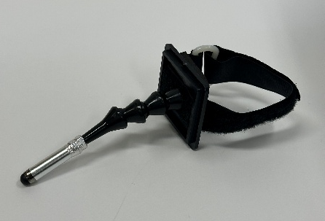
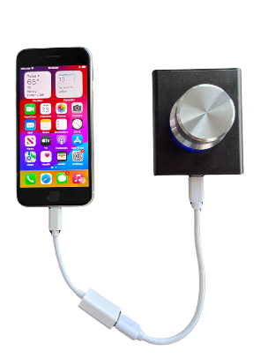
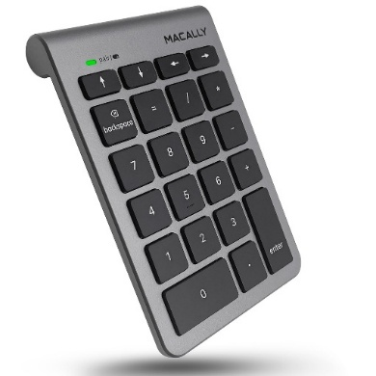
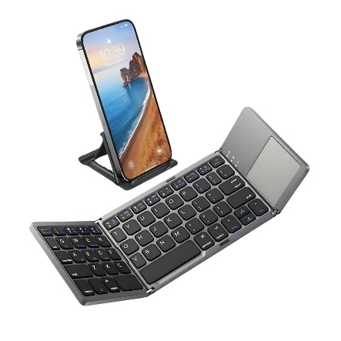
Direct Touch Support
Clinical Need | Example | Key Clinical Note
Weak grasp | NanoNob | reduces grip demand
Reduced finger isolation | Stylus | improves targeting
Fatigue/slower typing | Bluetooth keyboard | reduces touchscreen burden

Slide 10
Tablet and Phone Accessibility
Always trial built-in access before external hardware.
Feature | Helps With | Examples
Voice Control | Hands-free use | Apple Voice Control, Android Voice Access
Shortcuts | Faster, easier tasks | Voice assistants, widgets, favorite contacts, Focus automations
Accessibility Tools | Personalized access | Screen reading, larger text, contrast settings, captions
Source: Apple Accessibility / Android Accessibility

Slide 11
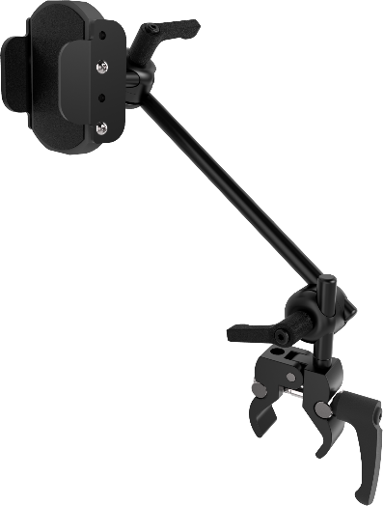
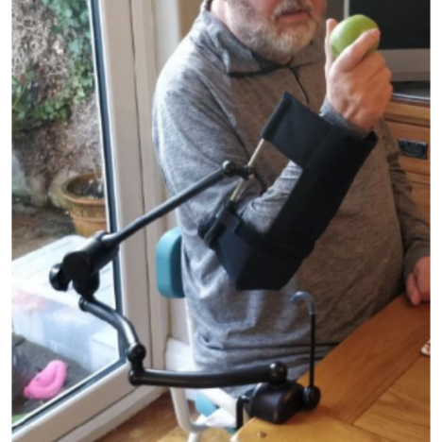
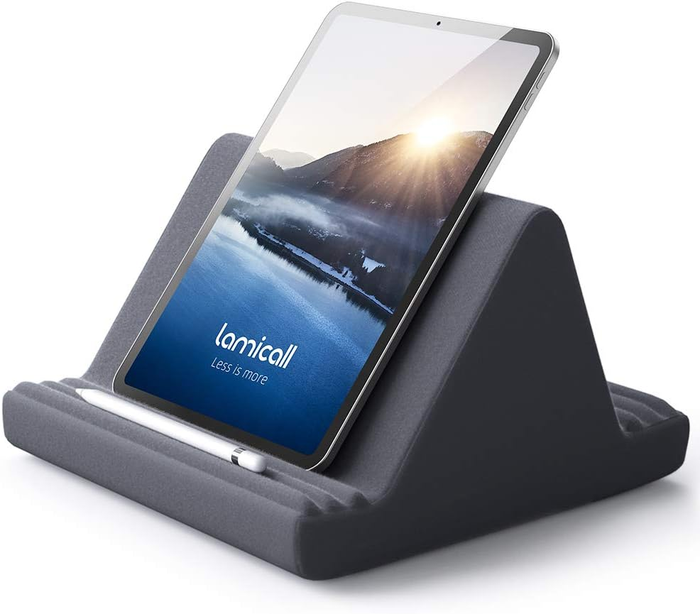
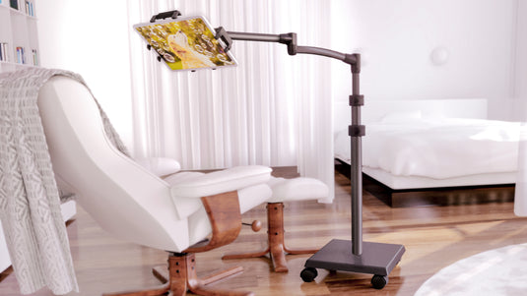
Positioning Often Determines Success
Arm support improves precision
Visual angle reduces fatigue
Poor positioning increases access failure

Slide 12
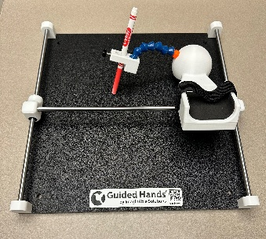
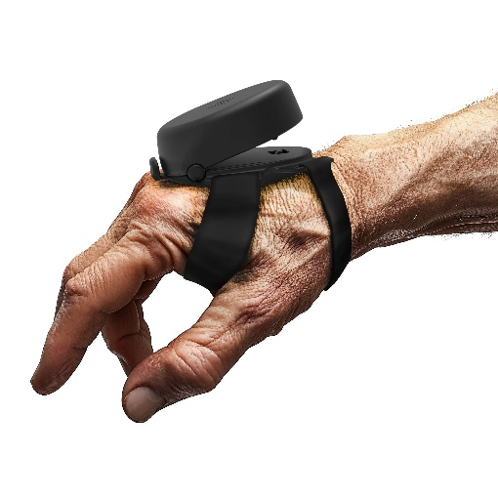
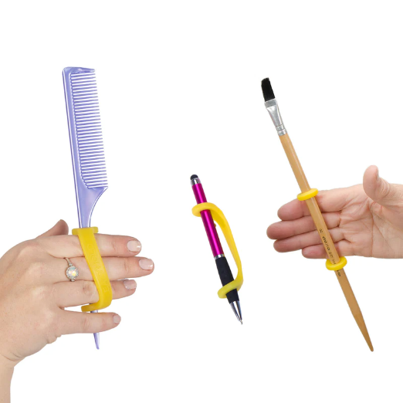
Stabilization Changes Performance
Access Need | Product | Best For
Hand Stabilization | Guided Hands Steadi-3 | Tremor/Ataxia
Controlled Stylus use | Apple Pencil Limitless Stylus | Reduced Precision
Grip Support | Eazy Hold | Weak Grasp

Slide 13
Keyboard Access Categories
Access Need | Access Category | Example | Clinical Consideration
Limited use of one hand | One-handed keyboard | TiPY | Supports full keyboard access when reach is limited to one side
Reduced visual accuracy | High-contrast keyboard | Black and yellow keyboard | Improves key identification and visual targeting
Cognitive or motor challenges | Simplified layout keyboard | Clevy | Larger keys and reduced visual complexity support accuracy

Slide 14
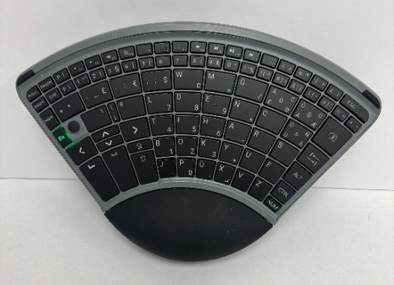
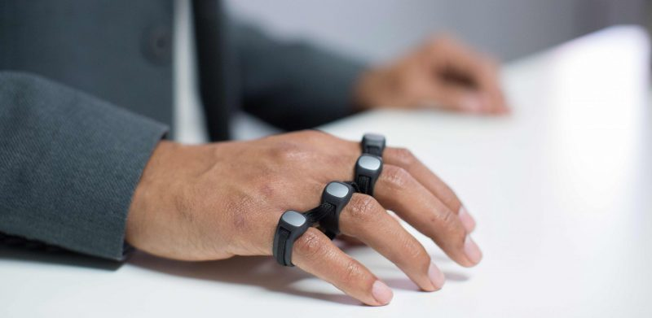
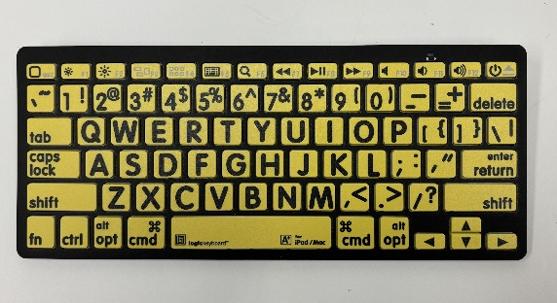
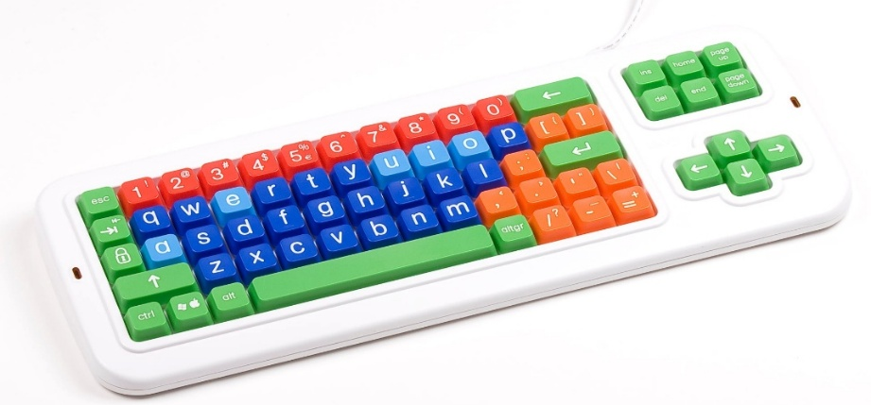
Keyboard Clinical Considerations
The goal is not choosing a product first — it is identifying what makes typing possible with the least effort and greatest consistency.
Match keyboard layout to motor control and endurance
Consider visual processing demands
Reduce unnecessary complexity when cognition is affected

Slide 15
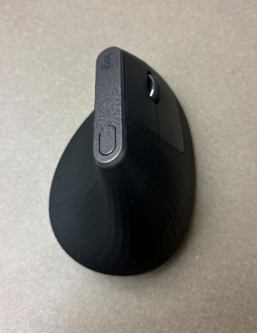
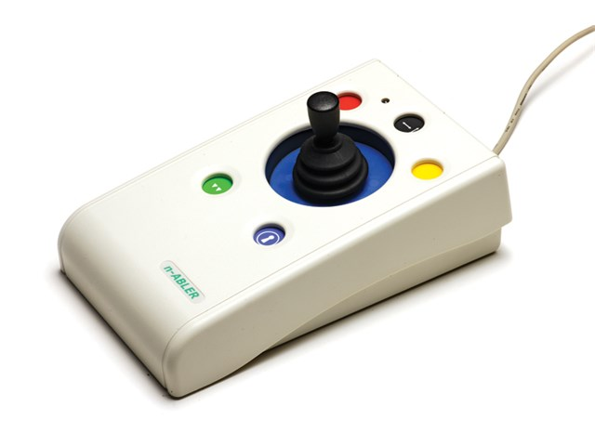
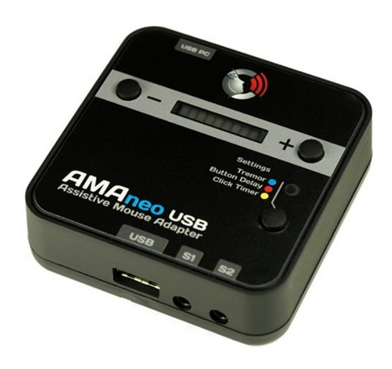
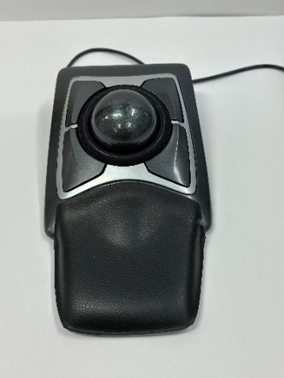
Mouse
Need | Access Type | Clinical Fit
Reduced endurance | vertical mouse | neutral wrist
Reduced movement | trackball | stable cursor
Tremor | joystick/filtering | controlled movement

Slide 16
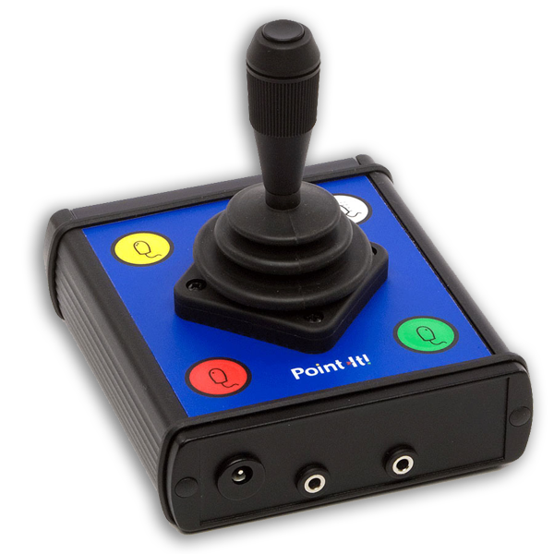
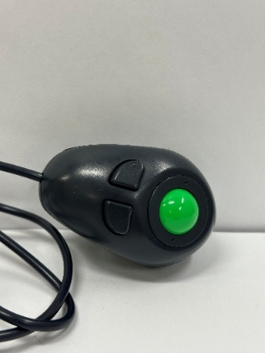
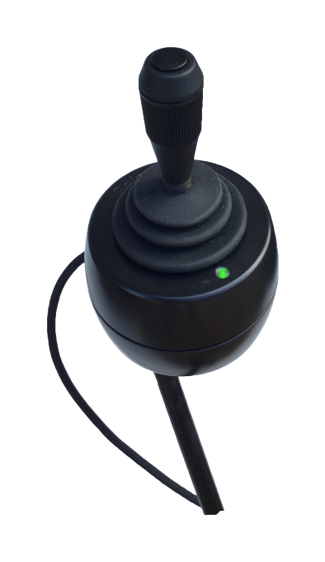
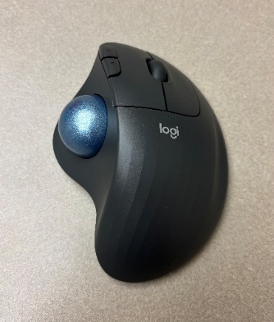
Mouse Clinical Considerations
Selection Depends on :
Range of Motion
Endurance
Cursor Accuracy
Fatigue over time
Always Assess:
Click Accuracy
Drag Ability
Double Click Tolerance
Sustained cursor control
Notes:
A person may move a cursor successfully for 30 seconds but fail after 10 minutes because endurance changes access.

Slide 17
When Hand Access Is Not Reliable
Access Method | Example | Best Functional Fit | Clinical Consideration
Head Control | GlassOuse | Reliable head movement with limited hand use | Requires consistent head control and endurance
Mouth Control | Jouse | Reliable sip, puff, or mouth movement for cursor and click control | Monitor fatigue, oral motor endurance, and positioning
Eye Gaze | Tobii | Minimal physical movement with strong visual attention | Requires visual stability, attention, and sustained gaze control

Slide 18
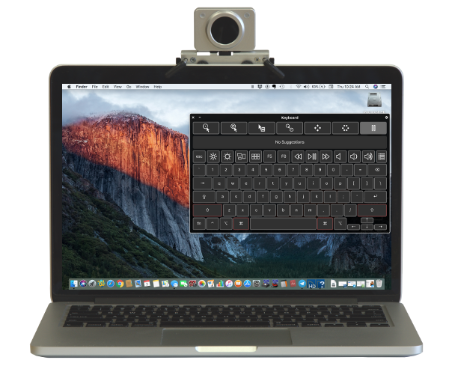
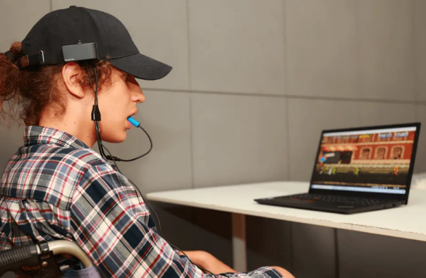
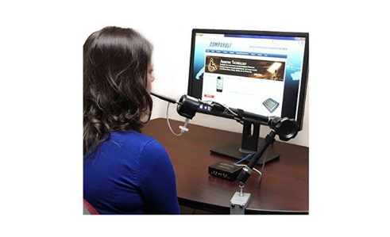
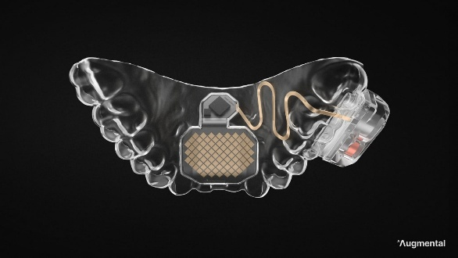
Head and Mouth Control

Slide 19
Clinical Thoughts
The most successful access method is not always the most advanced — it is the one the person can sustain reliably across daily tasks.
Selection depends on endurance, posture, and cognitive load
Accuracy often changes with fatigue
Positioning strongly affects success

Slide 20
Why Eye Gaze Should Not Always be First
Eye gaze can be highly fatiguing, especially for beginners
Fatigue often appears after 15–30 minutes of continuous use
Requires simultaneous:
      visual attention
      motor planning
      sustained fixation
      cognitive effort

Slide 21
Research Findings
New users often show tiredness and exhaustion during initial eye-gaze use (Borgestig et al., 2015)
Performance improves over time, but long-term practice is required (Borgestig et al., 2015)
Eye typing is slower because of eye fatigue and repeated dwell demands (Bafna et al., 2021; Räihä & Ovaska, 2012

Slide 22
Brain Injury and Eye Gaze
Adults with traumatic brain injury demonstrate difficulty with visual search and slower scanning, which can interfere with gaze-based AAC use (Riccardi et al., 2022).
AAC can still improve communication and cognition after acquired brain injury, but access method must match fatigue and cognitive load (Formica et al., 2024).
Clinical reports recommend trialing simpler access methods first before committing to eye gaze when attention and fatigue fluctuate (Fager & Spellman, 2010).

Slide 23
Switch Access: When Small Reliable Movement Can Drive Access
Access Method | Example | Best Clinical Fit | Clinical Consideration
Hand Switch | Hand-activated switch | Reliable finger, hand, or palm activation | Requires repeatable activation with low fatigue
Chin Switch | Chin switch | Limited hand use with consistent chin movement | Positioning is critical for accurate activation
Bluetooth Switch | Blue2 | Wireless access for phone, tablet, or computer | Supports scanning but requires timing control

Slide 24
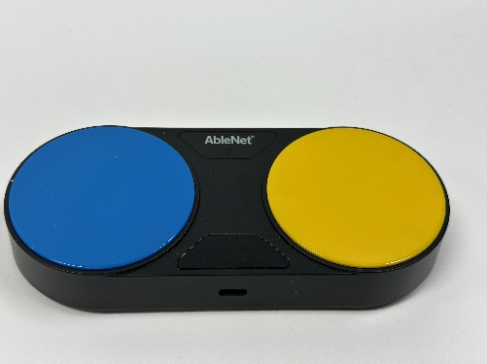
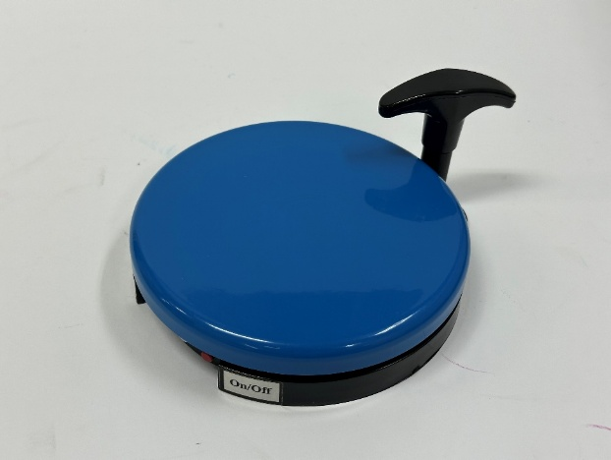
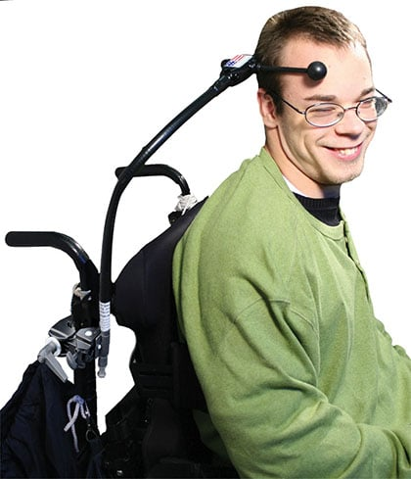
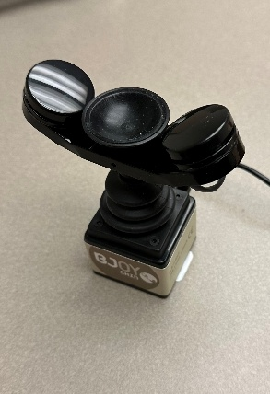
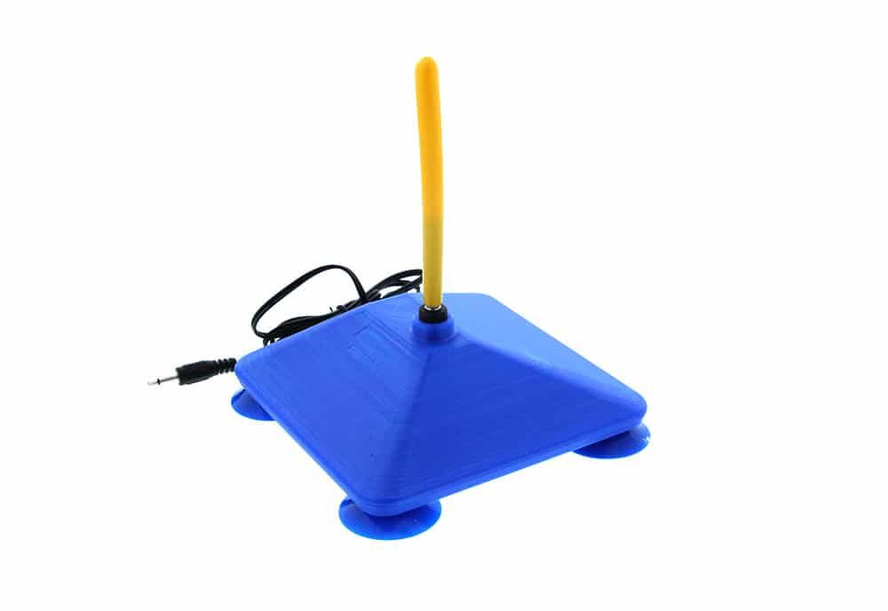
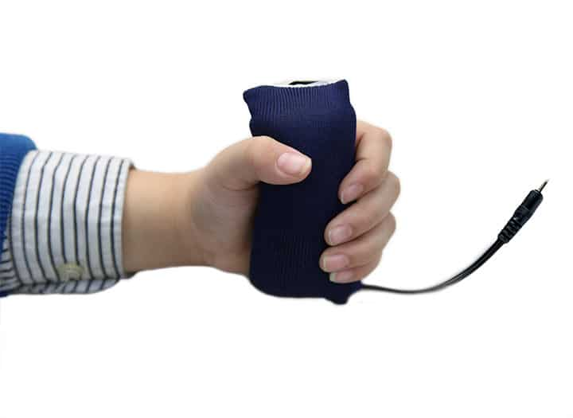
Switches

Slide 25
Switch Access Clinical Thoughts
Small movement can create full device access
Consistency directly affects switch success
Positioning directly affects switch success
Successful switch use depends on choosing the movement that remains most reliable over time, not just the movement that is strongest during evaluation.

Slide 26
Switch Access Requires Clinical Assessment
Reliable movement
Timing
Scanning Tolerance
Endurance
Activation Force

Slide 27
A switch may work perfectly in assessment but fail functionally if timing or fatigue is not considered.

Slide 28
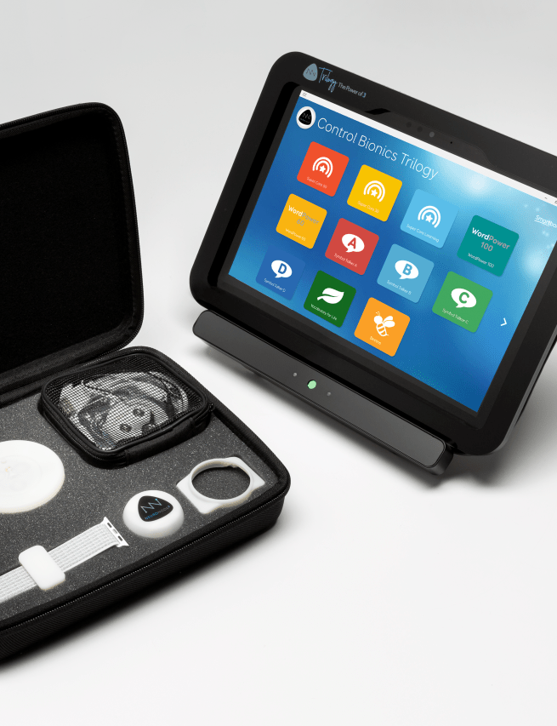
Emerging access options when traditional methods are not sufficient
Control Bionics
Touch
Eye Control
EMG/Spatial Control

Slide 29
Clinical Takeaways
Start with reliable movement
Match access to endurance
Reduce cognitive load
Positioning changes outcomes
Flexibility matters over time

Slide 30
Funding considerations

Slide 31
Assistive Technology for Kansans

Slide 32
Assistive Technology for Kansans: Funding and Mission
Assistive Technology for Kansans is the statewide assistive technology program funded by the Administration for Community Living in the Department of Health and Human Services.
ATK serves people with disabilities and health conditions of all ages across the state.

Slide 33
Assistive Technology for Kansans: Four Core Services
Device Demonstrations: hands-on opportunity to review a range of possible device solutions and compare features with knowledgeable staff.
Device Loan: Individual borrows devices for a few weeks to determine if it meets their needs. Technical assistance on use and care for devices is provided.
ATK-KEE Reuse: Donated high-quality devices are refurbished and given to individuals who need them.
Funding: Provide assistance to determine eligibility for public and private funding options, assist with eligibility paperwork, gather documentation, and help with appeals as needed.

Slide 34
Request to borrow equipment today: www.atkloan.org

Slide 35
Contact your regional AT Access Site
785-672-3125: Western (NKESC, NW - Oakley, SW - Garden City)
785-827-9383: North Central (OCCK, Salina)
316-942-5444: South Central (SKIL, Wichita)
785-551-9708: Northeast (KU, Lawrence)
620-421-6551: Southeast (SKIL, Parsons)

Slide 36
References
Bafna, T., Hansen, J. P., & Raiha, K. (2021). Eye typing performance and fatigue: Effects of dwell time and visual demand. International Journal of Human-Computer Studies, 149, 102605.
Borgestig, M., Sandqvist, J., Parsons, R., Falkmer, T., & Hemmingsson, H. (2015). Eye gaze performance for children with severe physical impairments using gaze-based assistive technology. Journal of Eye Movement Research, 8(4), 1–17
Formica, M., et al. (2024). Augmentative and alternative communication in acquired brain injury rehabilitation: Effects on communication and participation. Brain Injury Rehabilitation Journal.
Kathryn H. Fager, & Megan Spellman (2010). Augmentative and alternative communication for adults with acquired neurologic conditions. In D. R. Beukelman & P. Mirenda (Eds.), Augmentative and Alternative Communication: Supporting Children and Adults with Complex Communication Needs (3rd ed.). Paul H. Brookes Publishing Co..
Lange, M. L. (n.d.). Switch assessment and optimal switch placement [Training/course materials]. Access to Independence / OccupationalTherapy.com.
Masel, B. E., & DeWitt, D. S. (2010). Traumatic brain injury: A disease process, not an event. Journal of Neurotrauma, 27(8), 1529–1540. https://doi.org/10.1089/neu.2010.1358
ProtoArc. (2025, November 28). Thumb vs. (Index/Middle) Finger Trackball: Which One Is Right for You?
Rauchman, S. H., Smith, J. A., & McAllister, T. W. (2023). Traumatic brain injury: Mechanisms, manifestations, and current management. Frontiers in Neuroscience, 17, Article 1090672. https://doi.org/10.3389/fnins.2023.1090672
Räihä, K. J., & Ovaska, S. (2012). An exploratory study of eye typing fundamentals: dwell time, text entry rate, and fatigue. Proceedings of Human-Computer Interaction Research.
Riccardi, E., et al. (2022). Visual attention and scanning deficits following traumatic brain injury: Implications for AAC access. Perspectives of the ASHA Special Interest Groups.

Slide 37
Product/Accessibility Sources
Apple Accessibility
Google Android Accessibility
AbleNet
Steadiwear
ImaginAble Solutions
Logitech
Kensington
ProtoArc
Enabling Devices
Inclusive TLC

