Slide 1
Brain Injury Effects on School-age Students and Impact on Learning
Notes:
NICK
Welcome to our presentation on the effects of BI on school age students and the impact on learning. We are representing the Pediatric and Adolescent Medical Rehabilitation team from Ability KC.

Slide 2
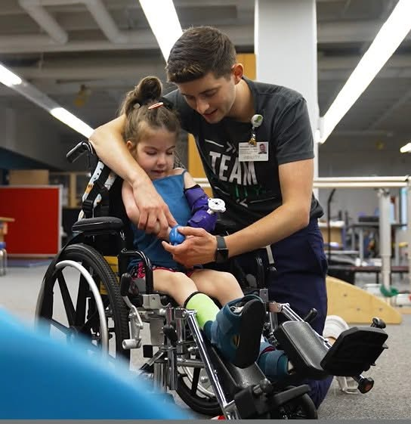
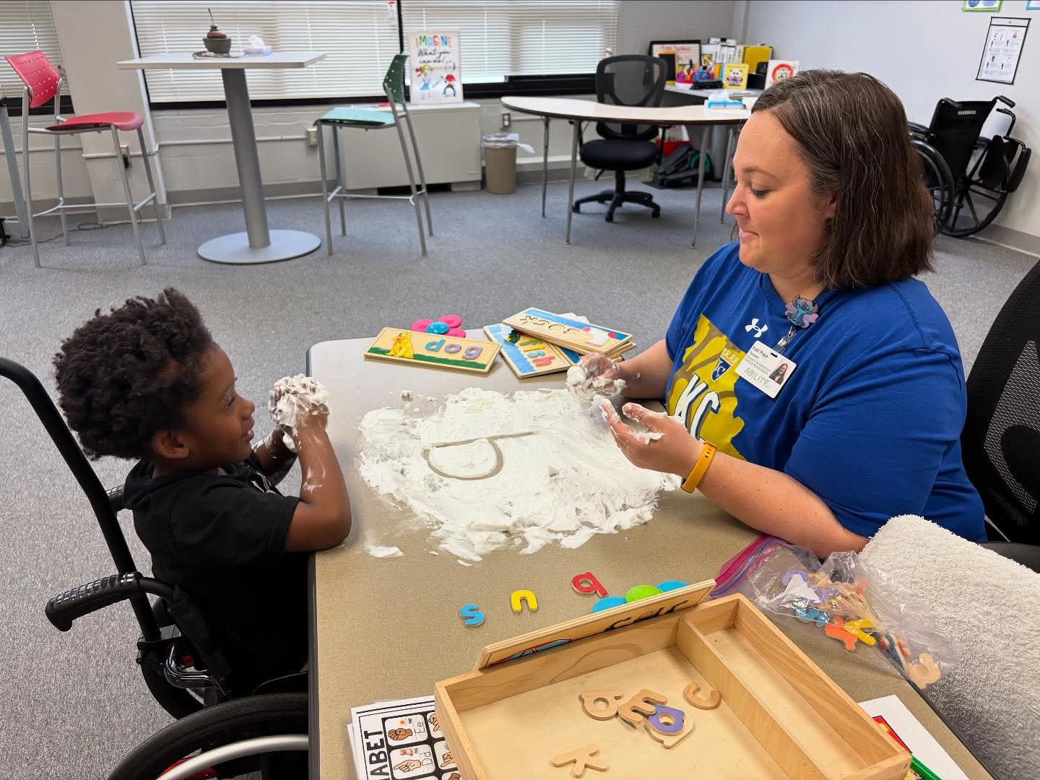
Presenters
Nicholas Guess, OTD, OTR/L
Kelli Pope, B.Ed, B.A.J., School Liaison
(insert photo)
Notes:
NICK and KELLI

Slide 3
Objectives
Understand the continuum of care from hospitalization to school re-entry for a patient with a brain injury
Understand the effects of a brain injury on skills required to be successful in a school setting​
Understand the importance of collaboration between a multi-disciplinary therapy team and school staff for success with re-entry to school​
Understand benefits of partnership in planning for re-entry to the school setting after a brain injury​
Be able to provide recommendations for modifications or adaptations to ensure a successful school re-entry after a brain injury
Notes:
NICK

Slide 4
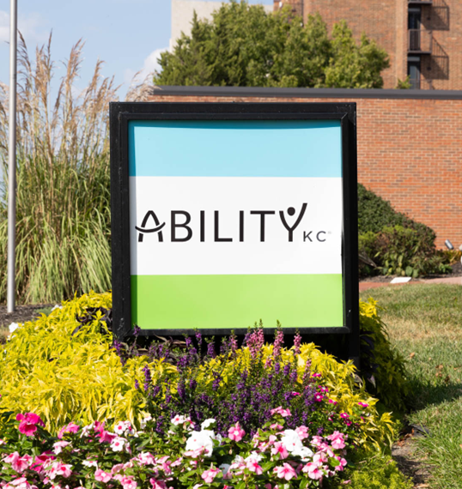
About Ability KC & Brain Injury Program
We serve the Adult and Pediatric populations.
Traditional outpatient therapy and day program.
We offer:
  Episodic Model
  Intensive Schedule
  Interdisciplinary Approach
  Purposeful Individualized Programming
  Collaboration with family and support system throughout services
    Counseling for patients & family members
  Day program patients have additional Value-Added Services available upon qualification
  Over 20% of our Pediatric patients are BI specific
Notes:
NICK
Ability KC is located just outside of downtown Kansas City and serves the greater KC metro, as well as smaller cities/towns across the midwest.
-adult and peds patients
-episodic model of care: intensive bursts of therapy followed by therapeutic breaks and follow-ups
-intensive schedule with therapeutic groups and primary therapy sessions
-prioritize interdisciplinary care, working as a team with other disciplines, as well as value added support staff, such as school liason, nursing, or rehab assistants
-individualized programming provides a time for patients to work on therapeutic activities directed by a licensed therapist, with another team member, essentially providing another time for patients to work on HEP or skill development with specific tasks or skillsets.
-Collaboration with family members, providing family and school conferences, as well as opportunities for counseling, which includes caregivers and patients.
-Value added services could include assistance with school re-entry, receiving accommodations, assistance from nursing, assistance from SW, and other support systems that are providing a value add

Slide 5

Notes:
NICK
This is a mural that we have in our pediatric gym, which we feel like accurately describes the mission of Ability KC. We are passionate about helping kids return to the things that they find meaningful and strive to find creative ways to make that happen.

Slide 6
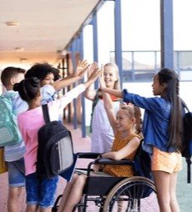
School Aged Students
Over 60% Ability KC patients are considered school aged (K-12)
Public, Private and Homeschool
Families who choose to homeschool are on the rise among the Ability KC pediatric patient population
61.6% of our students return to larger KC Metro School Districts
38.4% return to Rural/Small Districts

Slide 7
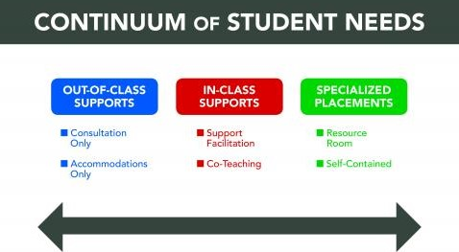
Schools should prioritize Least Restrictive Environment and may require justification to move to more restrictive
Notes:
Information from disciplie specific therapy team members - can be essential in this evaluation process, especially with newly acquired Brain Injuries,
Formalized Testing can be used in schools

Slide 8
Special Education Structure in Kansas
253 districts take part in shared cooperatives
33 districts run independently
Understanding Rights & Special Education Process​
  Can be difficult depending on the level of brain injury acquired and amount of support necessary for success in school. ​
  Many smaller school districts have limited experiences with Special Education and what it can look like within the school environment. ​
    It is important to acknowledge it is not always clear what deficits need to be addressed.​
  IEP vs 504 Plans
As of April 2026, the Kansas City, Kansas Public Schools (KCKPS) is in the final stages of dissolving its long-standing special education cooperative model.
Kansas City, KS: Special Education Transition
Long-standing cooperative model is dissolving
Partner districts transitioning to independent SPED programs
KCKPS moving to a district-only special education structure (2025–2026)
Notes:
Kelli:
Kansas City, Kansas has historically operated under a cooperative model, with KCKPS serving as the host district for multiple districts for more than four decades. As of the 2025–2026 school year, this structure is dissolving. Piper has already transitioned to an independent model, and Bonner Springs–Edwardsville will follow in July 2026.
As a result, KCKPS is shifting to a standalone special education department focused exclusively on students within its district. This transition has real implications for evaluation processes, staffing, service delivery, and how outside medical and therapy partners collaborate with schools.

Slide 9
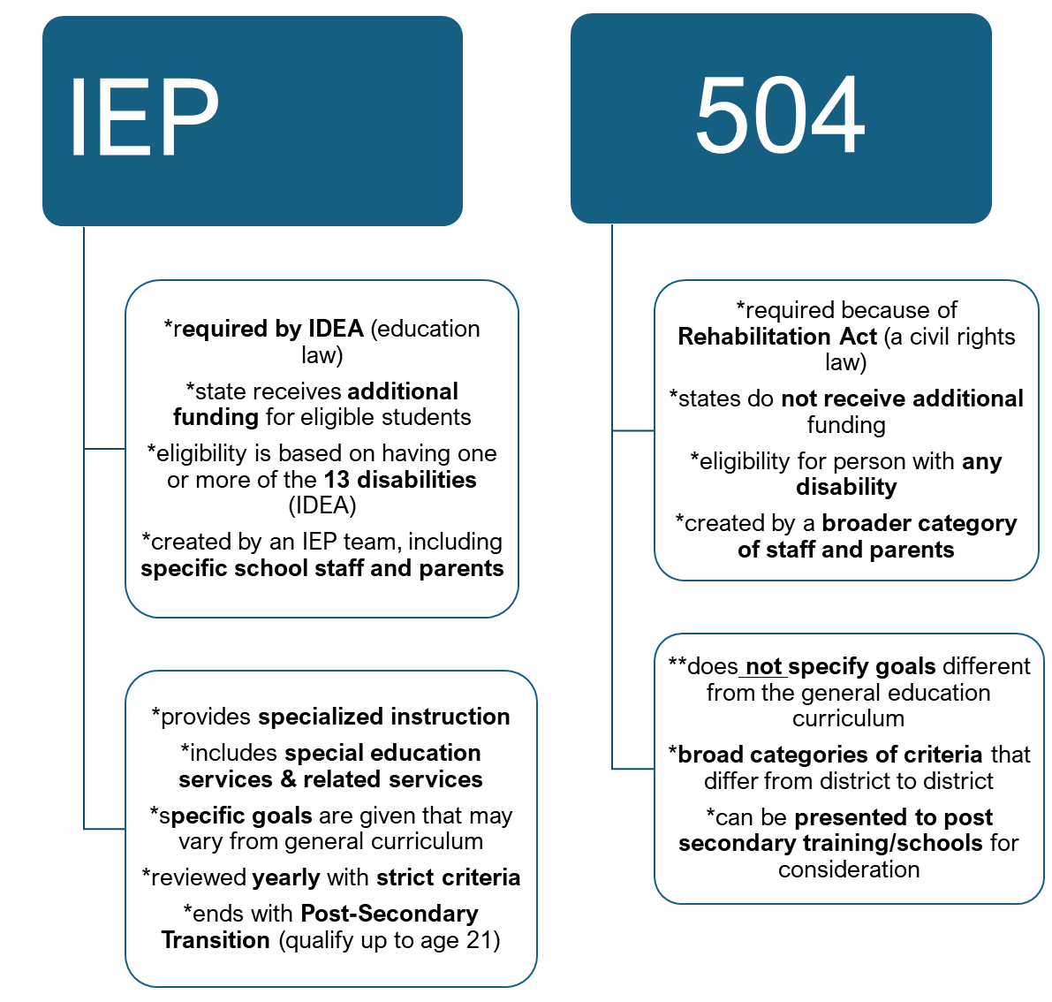
Both
IEP & 504
require an evaluation
available at no cost to the family/student
work to meet the needs of the individual
Includes modifications and accommodations for access to general education curriculum
Notes:
KELLI
Reb Act of 1973- states equal ACCESS to education
IDEA (original law was 1975, when federal funding began, but changed through the years and current IDEA was established in 2004)
Categories:
Autism
Developmental Delay
Intellectual Disability
Emotional Disturbance
Multiple
Deafblindness
Deafness
Hearing Impairment
OHI
Orthopedic impairment
Language disorder
Learning Disability
Visual Impairment
TBI

Slide 10
Discipline specific overview:
Learning in relation to motor skill development
Physical Therapy
  Gross Motor Deficits
  Strength/Endurance
Occupational Therapy
  Vision Deficits
  Fine Motor Control
  ADLs/IADLs
Notes:
NICK
-each discipline is involved in rehab
-working on establishing/restoring skills, specifically considering return to school (strengths/weaknesses and deficits that support/hinder)
-transition back to school when appropriate after developing skills
PT
Can the patient navigate the school environment appropriately?
Can the patient manage stairs? Does the patient have enough endurance to walk from point A to point B?
-looking at overall gross motor skills, safety, and ambulation within the school environment.
-OT could include Visual field deficits, Impaired convergence/divergence and ocular coordination, Strabismus, Diplopia, or Nystagmus, Decreased visual perceptual and/or visual motor skills, and Visual fatigue or sensory overload.
-Additionally, we are looking at those fine motor deficits
-is handwriting effective at school after an injury? Is typing more beneficial?
Does a patient have the fine motor endurance to complete assignments?
And then we are also looking at ADLs and IADLs. What does toileting look like? What does lunchtime and feeding look like? Is a patient able to return to their extracurricular school activities?
These are all common questions that we have frequent conversations about when looking at return to school.

Slide 11
Discipline specific overview:
Speech and Language Therapy
Largest area of crossover within educational setting
Overall cognitive skills & memory
  Short-term, long-term, working memory
  Social/Emotional Learning at the elementary level (re-teaching in the older grades)
  Intelligibility- school’s general viewpoint of SLP scope
    Assistive technology involvement (implementation/training for school)
Notes:
KELLI AND NICK (crossover section)
Additionally OT/SP target attention (including dividing/alternating attention), as well as processing speed, which are both important skills for IADLs, such as school and driving. In relation to school, part of that success really points back to a student's ability to process information accurately and in a timely manner, as well as maintain attention, and divide or alternate attention when required. An example of this may be alternating attention between your notes and speaker or between what your teacher is saying and the screen, so these are really important skills to develop before returning to school to ensure success.

Slide 12
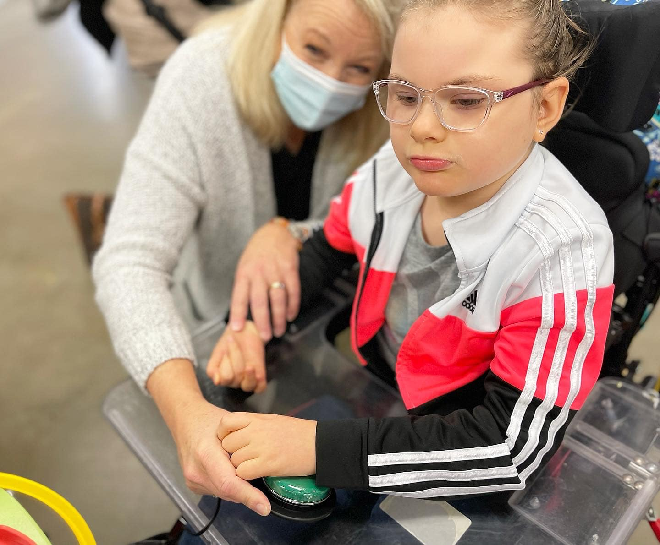
    "Silent Epidemic“
    Learning in relation to communication/cognitive deficits that are more difficult for schools to understand and support
Notes:
Kelli
the importance of observations and shared information/resources to support patients upon re-entry
OUT OF MY MIND (2024 Disney+ movie)- book adaptation from Sharon M Draper's 2010 middle-grade novel about Melody, a non-verbal 6th grader who navigates mainstreem school, it's her internal monologue and is voiced by Jennifer Anniston in the movie. Does a great job!!

Slide 13
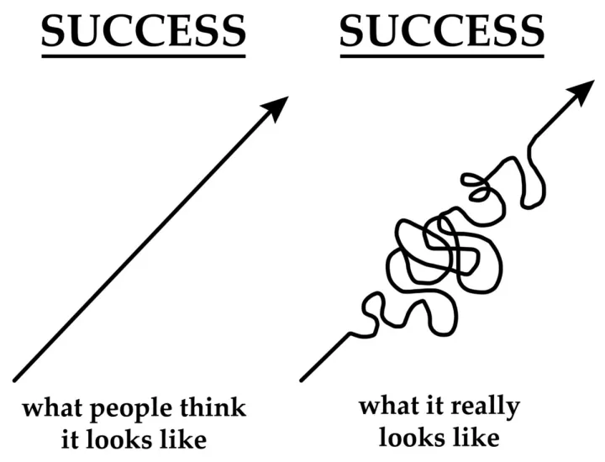
Other Considerations
Path to success is not linear
Recovery may be uneven – skills may plateau or regress, depending on academic demands.
Effects following Brain Injury may present immediately, some may only appear when higher-level skills are expected in later grades.
Ongoing monitoring and support is critical to ensure success within the school environment.
Notes:
NICK
This is something else that we just wanted to touch on-as many of you are aware, recovery from BI isn't always a linear path, it often has regressions and plateus, as well as success. In the school setting, academic demands may be overwhelming for patients.
Patients and/or clinicians, teachers, caregivers may discover deficits that may not have been identified in the beginning, once the patient or student begins completing higher-level work. Deficits such as divided/alternating attention or processing speed can be easily overlooked, until a patient or student is struggling in the classroom.
Ongoing monitoring from therapists, teachers, school support staff, and caregivers is critical to ensuring success. Supports can always be put in place to assist students to be successful.

Slide 14
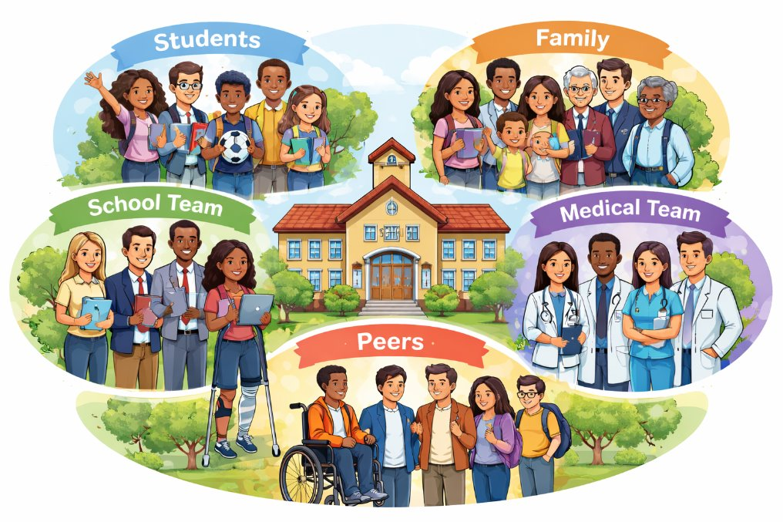
Perspective Matters
Perspectives to consider to shape a successful re-entry
Notes:
Student
Identity & self-awareness shifts
Fatigue, cognitive + emotional changes
Wants normalcy but needs support
Family
Adjusting to uncertainty
Advocacy + communication demands
Protecting vs. promoting independence
School Team
Did they know the student prior
Resources available in district
Deficits/potential for school supports
Medical Team(s)
Social/Peer
Systems
the medical model vs the school model

Slide 15
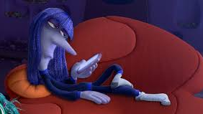
Mental Health
BI recovery adds more depth to youth mental health struggles of today
  Differences between peers
  Decreased engagement in extra-curricular and preferred occupations
  Increased risk of isolation and depression
Schools are increasingly recognizing the mental health needs of today’s youth and can play a critical role in supporting students as they transition back to school following a brain injury.
Notes:
Effects at different ages in school
NICK (first section) AND KELLI (quote)
Mental health is something that obviously impacts all of us, but it can have significant impacts on a patient with a brain injury.
Children and teens already have a lot going in
-puberty
-trying to fit in
-maintaining happiness
-concerns with the future/present
-BI adds a whole different layer to our considerations of mental health.
After a brain injury, many patients are different than they used to be. They may have differences from their peers/friends that didn't used to be differences, that the patient or student is more aware of now.
-decreased engagement in extra-curricular activities or preferred occupations.
-increased risk of isolation and depression.
We always offer counseling to patients at their initial evaluation and encourage it throughout their POC, because we truly believe that anyone could benefit from it, especially when an injury has made significant changes to a person's physical, emotional, and social life.

Slide 16
sample
Timeline of School Re-Entry
EVALUATION DAY
Gradual Re-Entry Begin
Parents sign ROI and initial school contact established
Initial POC decided
  Add in groups, counseling, VA hours as endurance
Discussion of homebound services, if available
Offer school teams to observe therapy sessions
Coordinate school conference
Discussion of POC extension adjustments until a full school re-entry is recommended (with supports)
Enter School at 2-3 days per week (half days)
Adjust POC as needed for school plan
  parents take lead on school conversations
Discharge to school full time
  Potential for outpatient service to continue
Follow-up evaluations
Notes:
KELLI

Slide 17
Transition to Return to School
Plans
Team Connection is KEY
Gradual Re-entry where patients split time between AKC and School
For our High School/Adolescent patients this process can be tricky for a long-term plan
  Graduation requirements, discussions of credits to be forgiven or waived in specific areas of content cross over under the direction of skilled therapists
      PT for PE
      OT for FACS (Home Ec.)
      Lite Group participation cross over with health
  Post-secondary transitions plan that accompany the IEP
  Guardianship/DPOA discussions
A school conference/discussion with school liaison is a way to find the best plan for that patient. The return to school plan and timeline is individualized based on their needs.
Rural, Charter and smaller districts generally need more education on BI specific needs
  38.48% of AKC families live outside of the KC Metro area, where supports are limited
  Staff Trainings or continued education for school districts may need to occur. This is where some of the “extras” of AKC come in
    Experienced Special Education Teacher
    ACCT
Notes:
KELLI

Slide 18
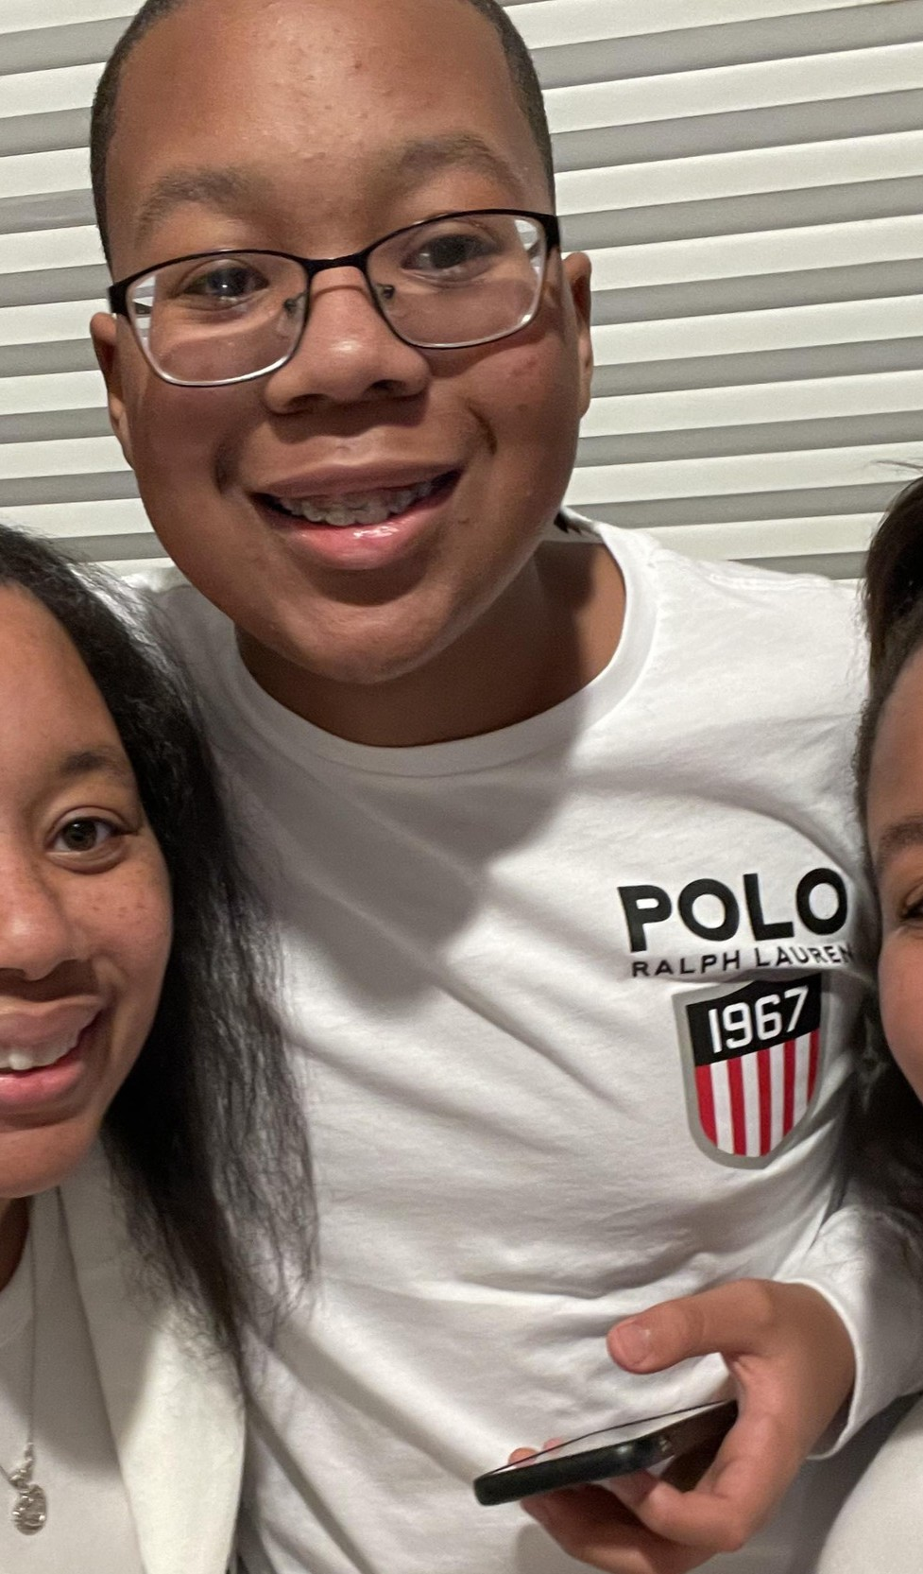
Case Study
Meet Ryan
Children's Mercy Hospital
Nexus Children's Hospital
Ability KC
School Re-Entry
Children's Mercy Hospital
Discharge to Home
Previously healthy,14-year-old male
Diagnosis: Acquired BI after experiencing polymicrobial sinusitis, subdural empyema, and DOC
Attended Nexus Children's Hospital in Houston, TX to complete their brain injury program, before returning to CMH and then referred to Ability KC in October 2023
Received SP, OT, PT, ACCT, FES, Aquatic Therapy, Adaptive gaming
Notes:
NICK
This is Ryan, one of our patients, with an acquired BI. He was a previously healthy 14 year old, who had a severe sinus infection in 2023, leading to polymicrobial sinusitis, subdural empyema, and disorder of consciousness. Ryan initially received care at CMH, followed by a BI program in Texas, specifically focused on disorders of consciousness.
He later returned to CMH, before discharging home and starting services at Ability KC in October 2023. Ryan received SP, OT, PT, ACCT services, FES, Aquatic Therapy, and adaptive gaming group. He has been working on purposeful movement, grasp, functional visual skills, ambulation, swallow, adapted communication, adaptive gaming to name a few things.
Ryan has made significant gains since his initial evaluation, with improved motor planning and purposeful movement, increased visual attention, increased communication, and participation in school/meaningful activities.

Slide 19
Ryan’s Journey continues…
Intensive Bursts:
  34 Weeks – initial POC
  17 weeks
    School Conference-
    Re-Entry at 1 day per week
  31 weeks*
    Updated school plan
  10 Weeks- early discharge due to hospitalization
  Current POC began March 2026
Education of a K-12 SMALL school district on re-entry and how to write IEP goals to encourage participation
Family involvement to allow for consistency/continuation of trained supports
*Current school set up
  2 days per week
  sister is paraprofessional
  daily peer support from friends, classmates and previous team partner
Notes:
KELLI
RB- school impacts slide
INITIAL
Nov 2023 – July 2024
August 2024 – December 2024
January 2025 – September 2025
October – December 2025- was recommended to return to therapy upon discharge/clearance from hospital

Slide 20
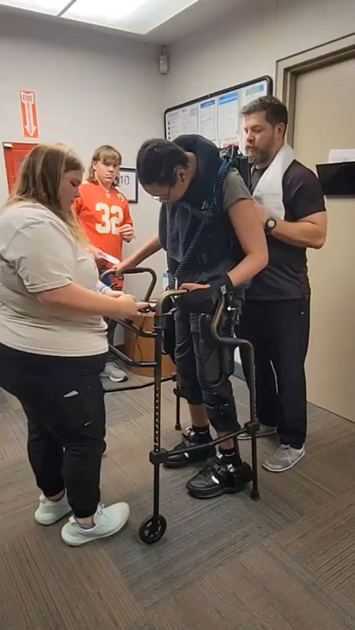
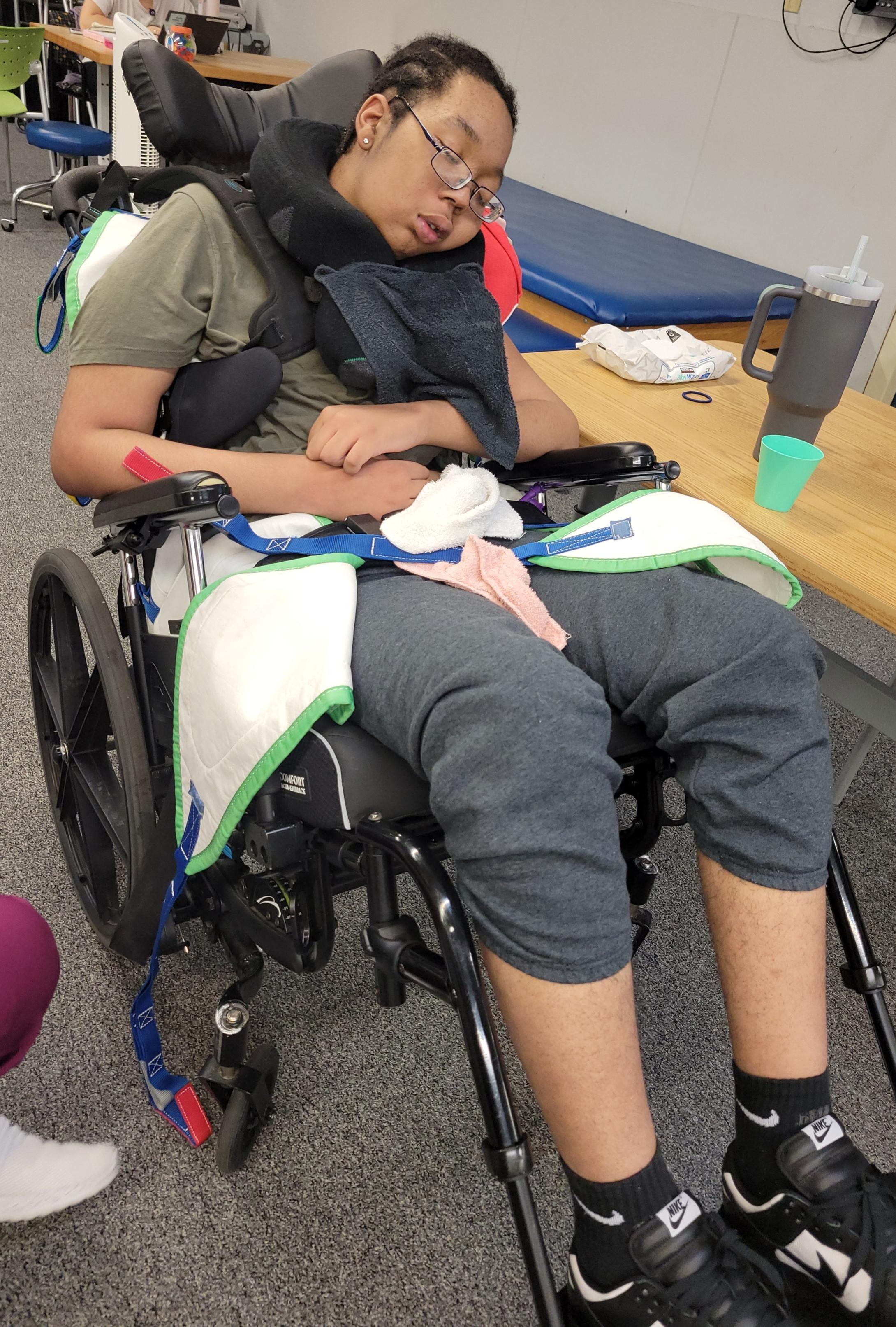
Technology Integration for Ryan

Slide 21
Ryan’s OT Recommendations
Ryan can work on visual attention in midline, as well as sustained visual attention on school related tasks.
He will benefit from breaks in quiet, distraction-free environments with limited visual clutter when needing to focus on process complex tasks.
He also benefits from tasks that are of interest to him to increase visual attention and participation in tasks.
Ryan can also work on any purposeful reach/grasp with school-related tasks. He has begun to show more initiation with purposeful movement using both arms and can use his arms to assist with various school-related tasks as able.
Any social engagement with peers will also be beneficial for Ryan, which will help with motivation, engagement, and participation in school-related and age-appropriate tasks/activities.
Notes:
NICK

Slide 22
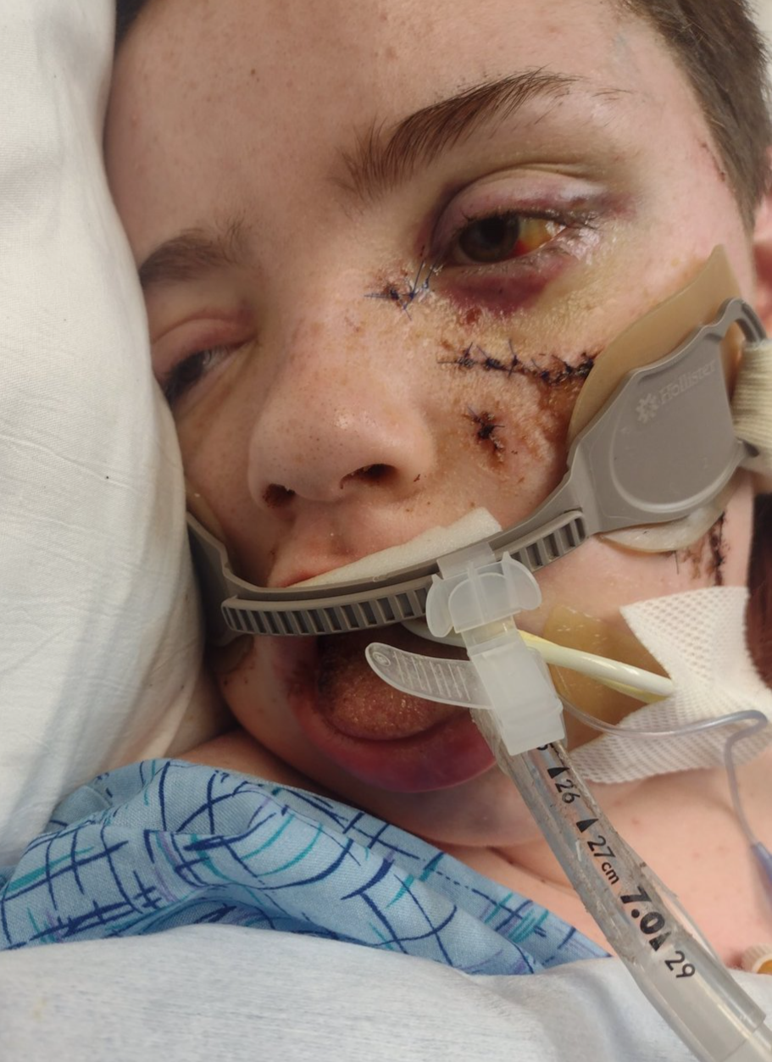
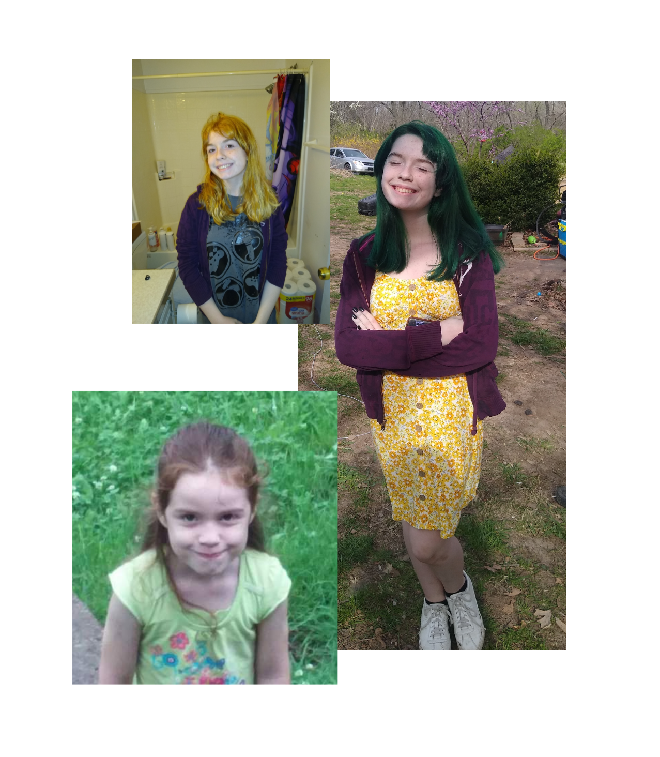
Meet Janey
Previously healthy, 15-year-old female​
Diagnosis: TBI after being struck by an Amtrak train
Received care at CMH before admission to Ability KC in August 2023
Received OT, SP, PT, ACCT, Adaptive Gaming, Lite Group, Transitions Program
Notes:
NICK
This is Janey, another one of our previous patients. She was a previously healthy 15 year old that was struck by an Amtrak train, resulting in a TBI. She received care at CMH before admission to Ability KC in August 2023.
She received OT, SP, PT, ACCT, adaptive gamin group, Lite Group, and participated in our transitions program to foster independence with IADLs and general life skills.
While at Ability KC, Janey worked on ambulation, GMC, FMC, ADLs/IADLs, Language expansion, and feeding. She initially couldn't remember the sequencing and motor planning of many ADLs/IADLs and had difficulty with expressive and expressive language. Janey made an amazing recovery, regaining a lot of those skills and returning to school.
JS- , with intubation at the scene, low GCS, T1-T3transverse process fractures, T6-T8superior endplate fractures consistent with compression fractures, L parietal skull fracture, scattered subarachnoid, retroperitoneal hemorrhage, grade2 splenic injury, open L fib/tib fracture, open L ulnar fracture, L4th and 5th metacarpal fracture, along with multiple facial fractures, tracheostomy w/ self-decannulation

Slide 23
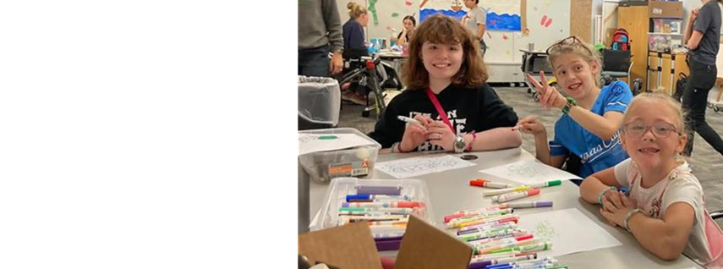
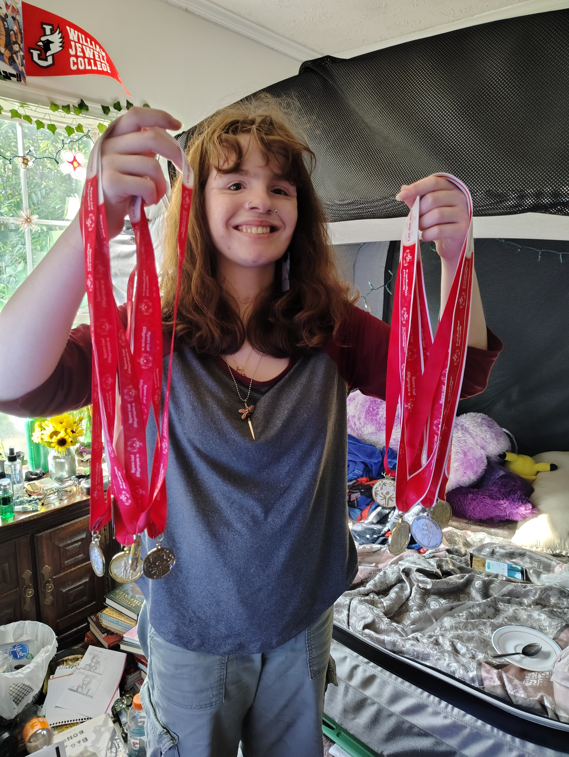
Return to School & Life
August 2023
  began day program at Ability KC for a total LOS 6 months
November 2023
  Initial school contact established
December 2023 - observations
  ACCT/Classroom partnership to support school re-entry, new school placement recommendations from AKC
January 2024
  SCHOOL CONFERENCE
February:
  School Re-entry began two half days per week at school in functional programming
AKC reminded school of ELOS and let them know to work with family on when to transition to full days upon discharge 2/29/2024
Summer 2024- Returned for Adolescent TRANSITIONS Program
Transitions
Special Olympic
GOLD
Notes:
KELLI
For the last 2 years Janey has participated in Special Olympics with 3 golds each time---- 100-meter dash, shot put and long jump
She enjoys the practices prior to competition and has gotten some peers involved in Special Olympics

Slide 24
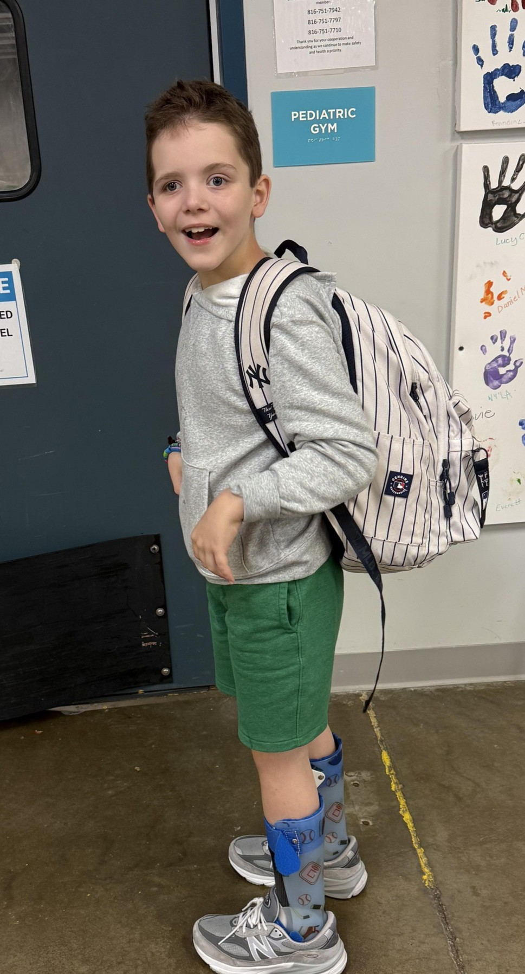
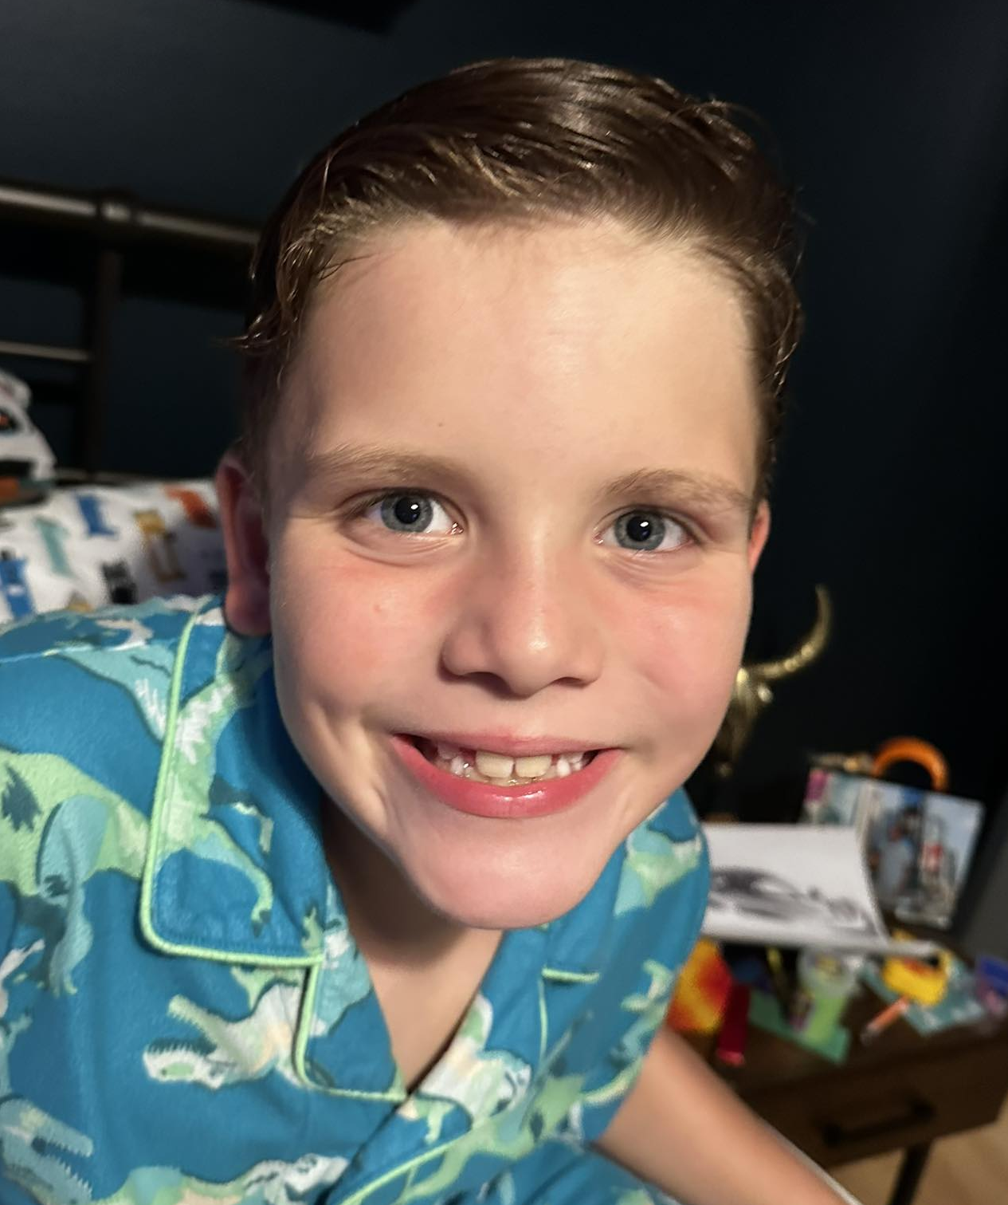
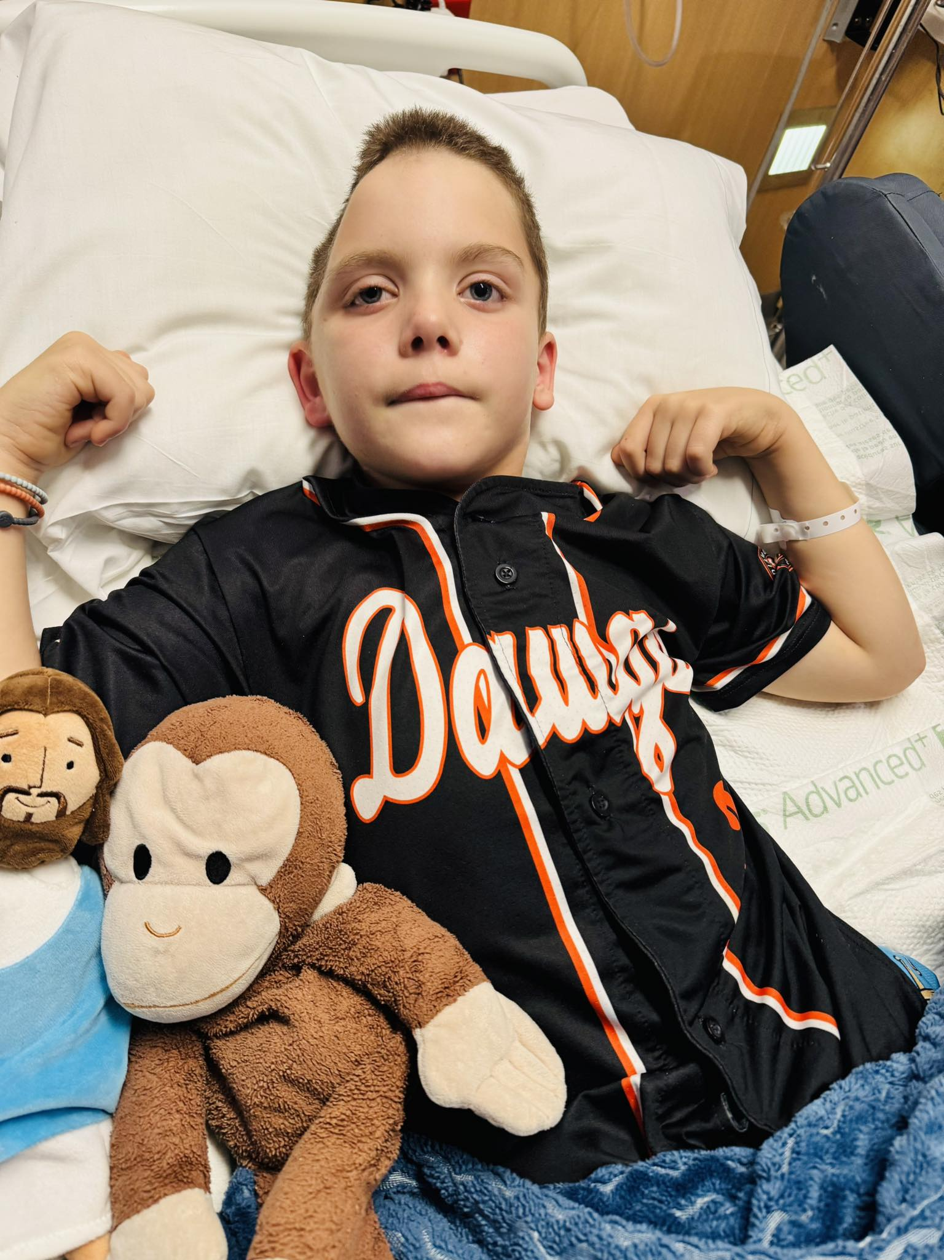
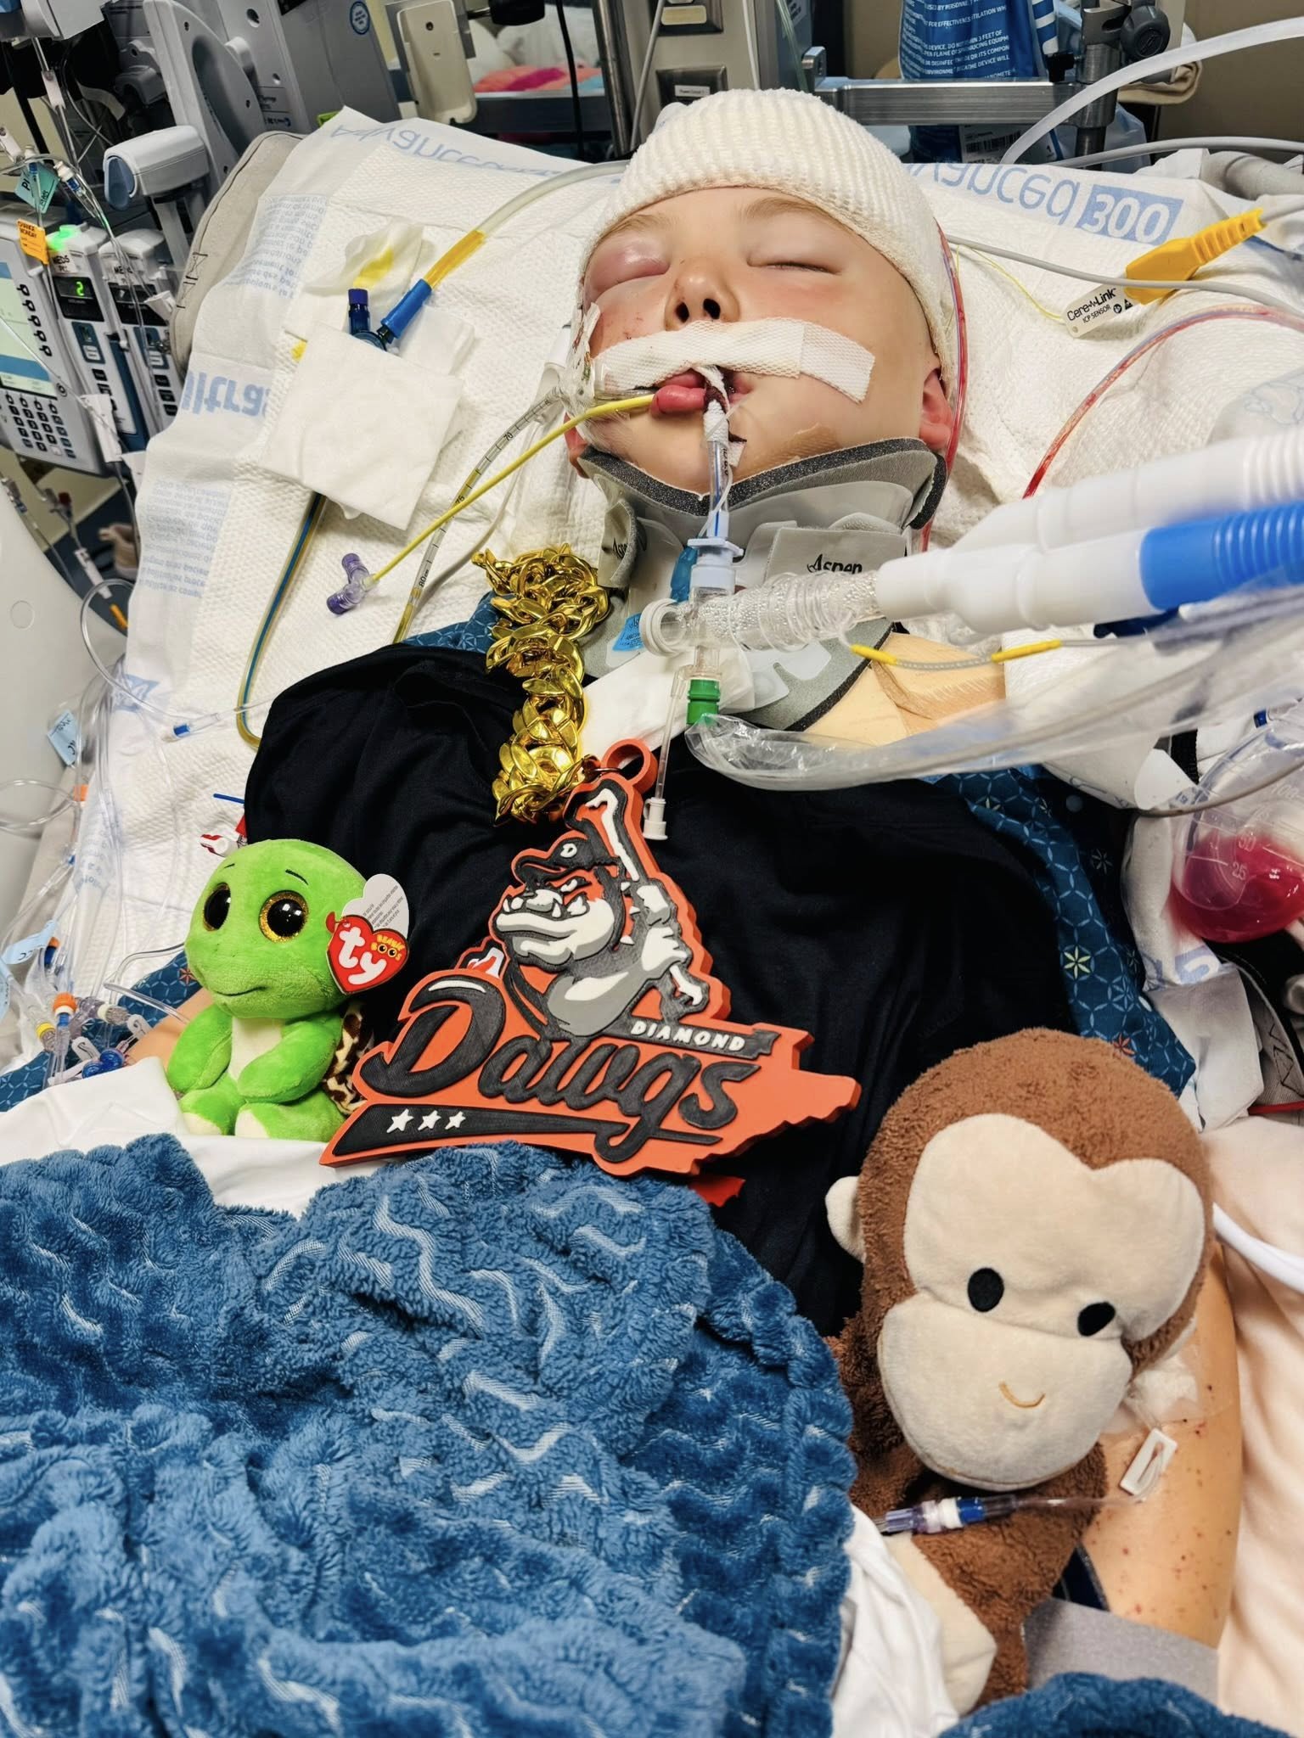
Bentley
Previously healthy, 8 year-old male
Diagnosis: Crush injury with severe TBI after being struck by debris from a tornado while seeking shelter under a bus depot. Initial GCS score of 3.
Received OT, PT, SP, ACCT, Groups, Independent Programming (IP), School/Edu hours & Re-integration Support

Slide 25
Bentley’s School Recommendations
SP recommends assistive technology for (individualized with writing/reading/communicating. Etc).
SP recommends additional time for cognitive processing and task completion. This includes additional response time for in-class questions.
PT recommends assistance be provided when moving from class to class to ensure a safe and timely transition. PT recommends use of a gait belt and CGA for safety.
Program Educator recommends to assess knowledge using multiple-choice instead of open-ended questions
Program Educator recommends to reduce quantity of work required, in favor of quality.
Program Educator recommends regular routines, along with clear & concise directions/expectations (with visual support, when possible) to help minimize avoidance of classroom escape behaviors.
OT recommends reducing visual clutter on work sheets. He has difficulty with figure ground, form constancy, and visual motor speed
Notes:
NICK

Slide 26
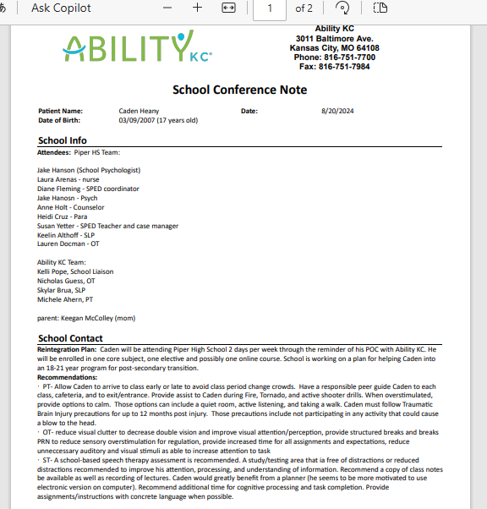
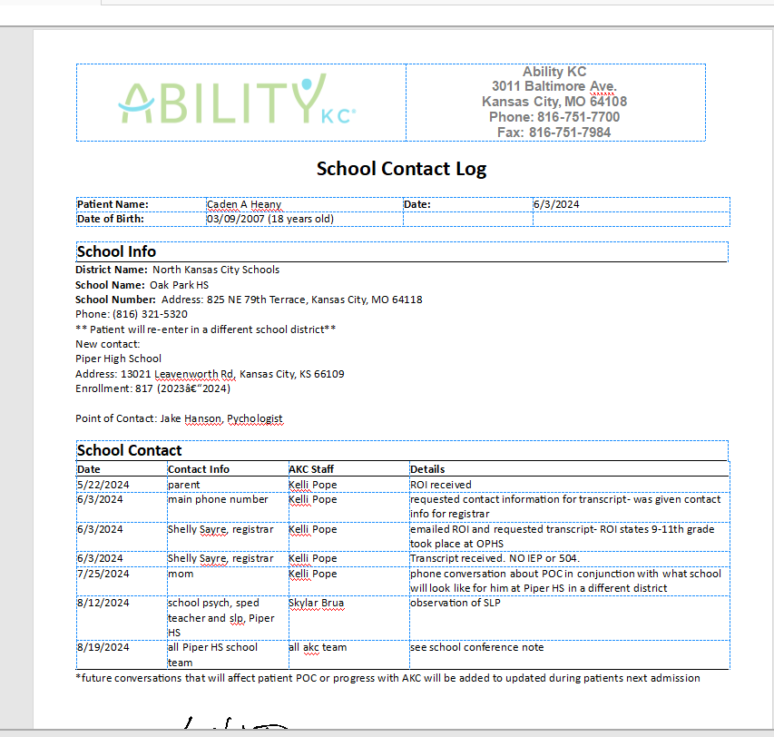
Caden
Previously healthy,17-year-old male
Diagnosis: severe TBI after MVC at high speeds
Received care at CMH before admission to Ability KC in May 2024
Received OT, PT, SP, Adolescent Groups, Lite Group
Notes:
Caden is another one of our patients, a previously healthy 17 year old, who had a severe TBI as a result of a motor vehicle crash at high speeds. Caden initially received care at CMH before admission to Ability KC in May 2024. He received OT, PT, SP, Adolescent groups, and lite group.
Caden had memory deficits, FM deficits, visual deficits w/ double vision and eye misalignment, visual perceptual deficits, visual sensitivity, and deficits related to swallowing, memory, attention, strength/endurance, processing speed, and gait.
Caden made a great recovery as well, with improvements made in all of the areas that I just mentioned. He ended up returning to school and eventually graduating and is now on the BI waiver.
CH- with SDH s/p L craniotomy, cerebral swelling, subclinical seizures, and skull-based fractures with intubation and decannulation
NICK intro, then KELLI

Slide 27
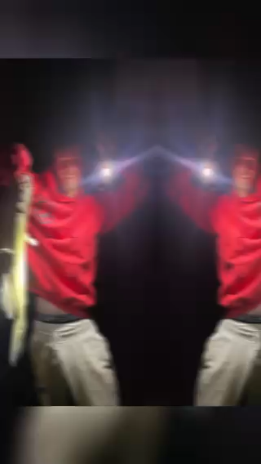
Caden’s Spirit
Ability KC’s partnership with Caden’s Family and High School team has meant so much to Caden’s person journey.
Although Caden still has some struggles with vision, memory, and some cognitive skills, Caden is currently enrolled in a Post-Secondary (18–21-year-old) program through Piper School District & Johnson County Community College. His goal is to earn his Associate’s Degree.
He is currently active on the program’s bowling league and is pursuing assistant coaching positions for little league baseball in Spring 2026.
Notes:
CONCLUSION - KELLI
This is why we do what we do!!!

Slide 28
Questions?

