Slide 1
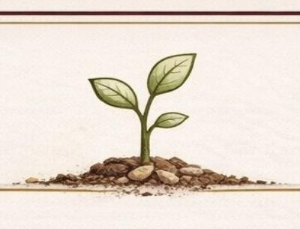
Seeds of Growth
Hope and Healing After Brain Injury
Dr. Cherryl Clark
Author of Hope for the Heart
Traumatic Brain Injury Survivor
DISCLAIMER: Dr. Cherryl Clark is a Traumatic Brain Injury Survivor and inspirational speaker. She is not a medical doctor, therapist, licensed counselor, or psychologist. The information shared is based on personal experience and is intended for inspirational and educational purposes only. It does not constitute medical, psychological, or therapeutic advice.

Slide 2
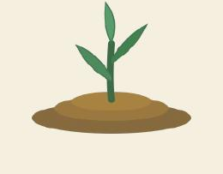
My Journey with Brain Injury
Traumatic brain injury survivor
A life-changing moment
A journey of faith, recovery, and resilience

Slide 3
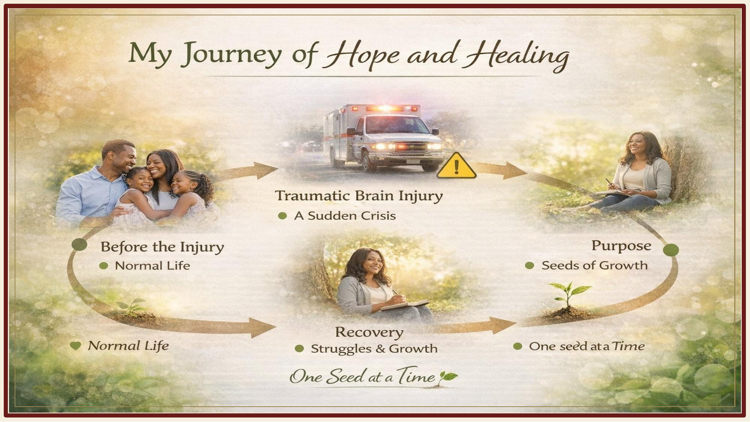

Slide 4
Brain Injury Changes Everything
Brain injury can affect:
Memory
Focus and thinking
Emotions
Energy and fatigue
Daily activities

Slide 5
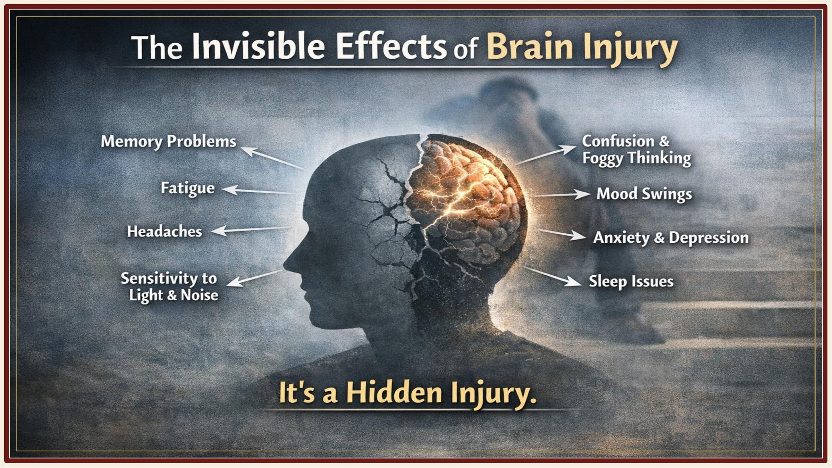

Slide 6
The Invisible Struggle
What survivors often experience:
Cognitive overload
Sensory sensitivity
Emotional changes
Fatigue
Adjusting to a "new normal"

Slide 7
A Turning Point
Learning to Grow Again
Healing doesn't always happen quickly. Growth happens with:
Time
Patience
Support
Faith

Slide 8
Seeds of Growth
What is Seeds of Growth?
A practical approach to healing after brain injury.
Focus areas:
Daily living tools
Emotional and spiritual strength
Community and connection
Encouragement for families

Slide 9
Daily Living Tools
Small tools that help:
Use reminders and calendars
Write things down
Break tasks into smaller steps
Take rest breaks
Use notes or apps for memory
Small tools create big progress

Slide 10
Healing the Heart
Meditation, Prayer and Faith
Scripture Encouragement
Rest and Quiet Moments
Meditative Calming Instrumental Music
Celebrate Your Progress
Give yourself patience and grace

Slide 11
Community and Connection
You are not alone
Support may come from:
Family and friends
Support groups
Mentors and coaches
Sharing your story
Community brings strength

Slide 12
Seeds of Growth
Growth is possible
Healing takes time
Hope remains
One Seed at a Time
Dr. Cherryl Clark

