Slide 1

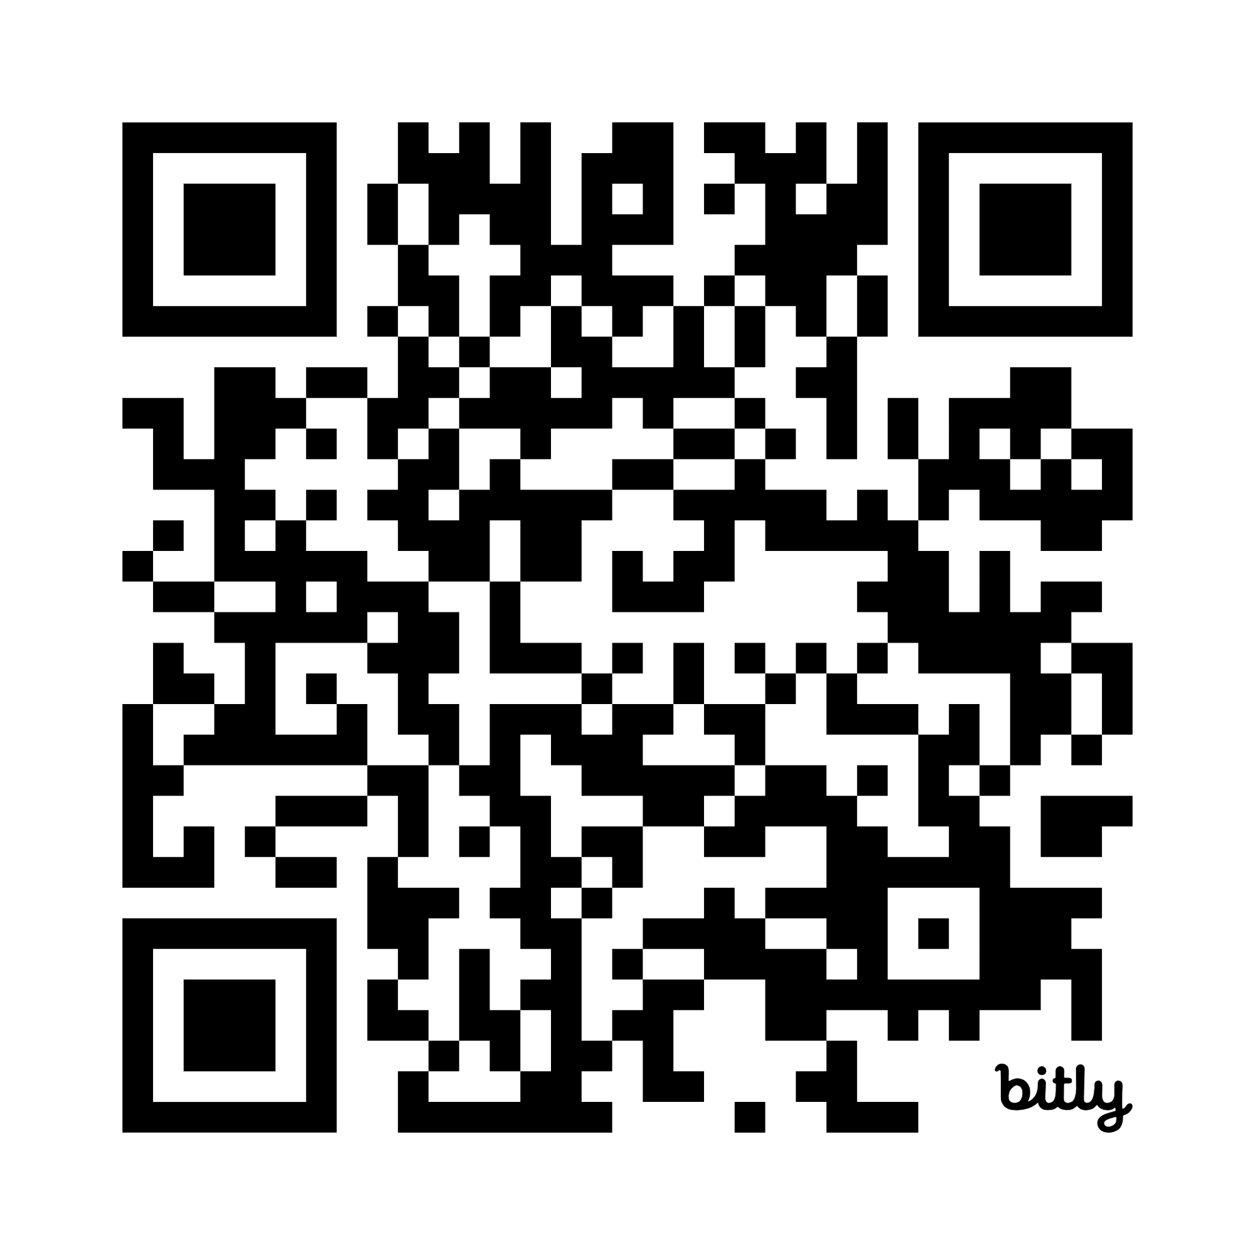
The Family and TBI: A Long Road Ahead
Leif Leaf, Ph.D.

Slide 2
Overview:
Stages in the Brain Injury Journey
Early
Rehab
Home and Community
Long Term Focus/Needs
Impact on Survivors
Impact on the Social System
Partners/Caregivers/Family/Friends
Relationship Challenges
Management Strategies

Slide 3
The Stages:
A Shared Vocabulary
Early Stage: ER, Hospital
Acute Rehab Stage: Inpatient Rehab Center
Home & Community Stage:
Outpatient Rehab
Post Acute Rehab
Residential Rehab
Long Term Stage: Lifelong Living

Slide 4
Early Stage Issues:
Initial Response and Coping
Concerns of Survival and Severity
Acceptance and Readying to Move On
Gathering Info., Networking and Education

Slide 5
Acute Rehab Stage Issues:
Family Joins the Team
Managing Expectations
Maintaining Hope While Looking Forward
Active Discharge Plan
Return to Normalcy: A New Normal

Slide 6

Home and Community Stage
Assessing Needs, Level of Care
Return to Work/School (Voc Rehab, 504/IEP)
Redefining and Readjusting
Family System Changes
Whole Person Needs for Each Family Member

Slide 7

Long Term Stage Focus/Needs
Developing Resources and Support
Medical Management
Lifelong Planning
Medical
Legal
Housing
Aging Well
Survivor and Caregiver Support
Mind Body Health
Productive Activity
This Photo by Unknown Author is licensed under CC BY-SA-NC

Slide 8
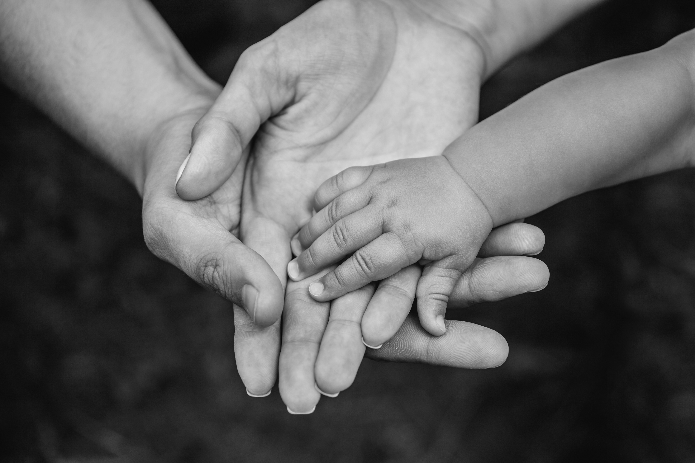

Issues that Affect Relationships: Survivors
Cognitive Changes
Memory, Attention, Problem Solving, Social cues
Emotional Shifts
Irritability, mood swings, depression, anxiety, impulsivity
Personality Changes
Self Centered, Apathetic, Childlike
Social Withdrawal
Feeling Misunderstood, isolated

Slide 9
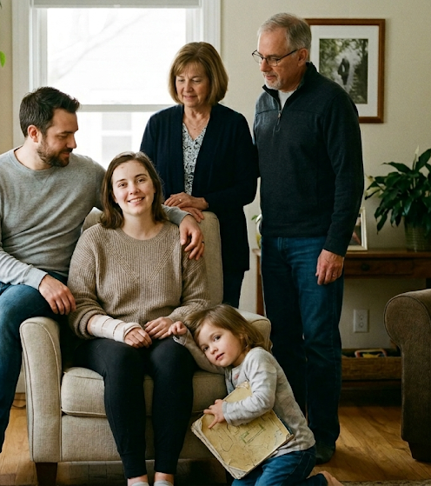
Issues that Affect Relationships: Family
Role Reversal
  Shift from partner to caregiver, new responsibilities/letting go
Emotional Strain
  Stress, Anxiety, Uncertainty about the Future
Loss and Grief
  Mourning the person and dreams they knew pre-injury
Isolation
  Feeling Alone/that friends have disappeared

Slide 10
Relationship Challenges
Communication Breakdown
Fear of Misunderstanding
Inability to express oneself clearly
Loss of Intimacy
Reconnecting Emotionally, Physically
Changes in Sexual Function/Desire

Slide 11
More Relationship Challenges
New Dynamics
Finding New Ways to Have Fun, Quality Time
Marital Challenges
Uncertainty: Neither Partner Knows What to Expect from the Other
Financial Stress
Social Emotional Changes
High Divorce Rate (48%-78%)

Slide 12
Management Strategies
1. Validate Experiences:
Allow each member space to express their unique feelings without judgment
Maintain dignity, value and respect
2. Functional Adaptation:
Help the family unit adjust to daily life after a significant loss and a life-changing event
Physical and mental adaptations and strategies

Slide 13
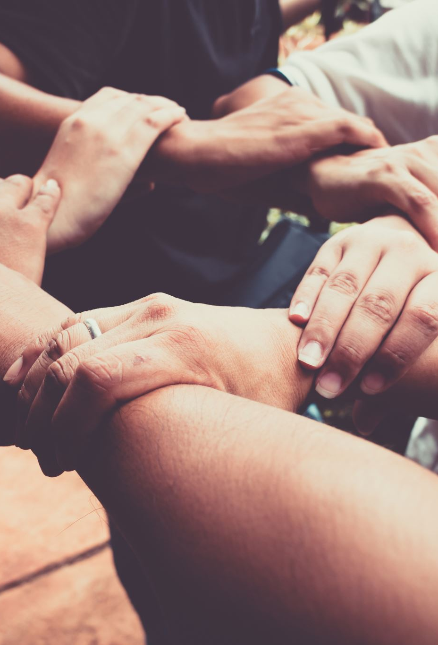
More Management Strategies
3. Build a Supportive Environment:
Support Groups and/or Family Counselling: Fostering a space where members can lean on each other and grow in both knowledge and patience with the changes.
Willingness to try and explore.
4. Spiritual/Social Support: Join a Club, Be active in your religious Community, Foster friendships
5. Maintain Physical/Mental Health: Exercise, Healty Eating, Routine Care, Counselling, Self-Care

Slide 14
More Strategies
6. Developing a Plan: Being able to be proactive and developing a plan to re-establish the family’s unity and direction in key areas. Goals, dreams!!
Routine Family Meetings to share concerns, hopes and plans
  Keep a record for later reference
Visual Family Schedule/Reminders- Calendar, paper, electronic
Plan low stress family activities to grow together
Celebrate small and big successes

Slide 15
Wrap Up
Remember: Life after Brain Injury is different, but worth living and growing together!
Questions?

