Slide 1



Brain Injury Professional Conference
Evolving Landscape of Brain Injury Services and State-funded Initiatives
April 17, 2026
KANSAS

Slide 2

What We Will Cover Today
Home and Community-Based Services (HCBS)
HCBS and the Brain Injury (BI) Waiver
BI Waiver Eligibility/Pathway to the Waiver
MCO and Care Coordination
Person Centeredness
BI Waiver Services and Transition Planning
Growth of the BI Waiver
ACL Traumatic Brain Injury State Partnership
Kansas BI Strategic Plan
Closing and Q&A

Slide 3
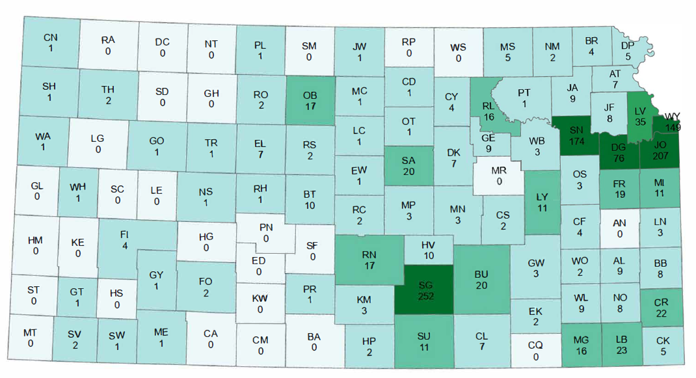
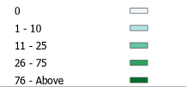

Brain Injury in Kansas
Brain Injury Waiver Participants by County
Slide 3

Slide 4
Brain Injury in Kansas
Average Monthly Cost Per Participant
Slide 4

Slide 5
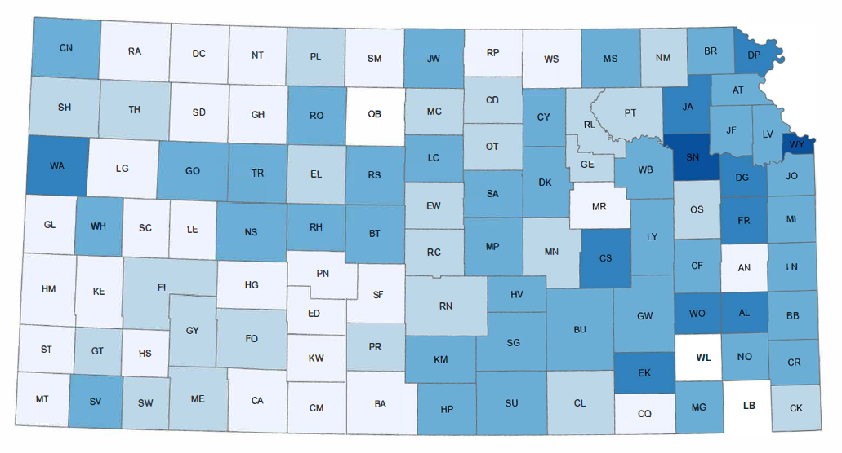
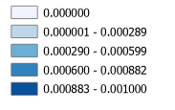
Brain Injury in Kansas
Brain Injury Waiver Participants Per Capita by County
Slide 5

Slide 6

HCBS in Kansas
Purpose
“HCBS ensures that people who receive services and supports through
Medicaid’s HCBS programs have full access to the benefits of community
living and can receive services in the most integrated setting.” ~ CMS
Originally established in 1986, Kansas was the first state in the nation to offer a brain injury-specific waiver program. The BI waiver provides clinically prescribed habilitation/rehabilitation therapy services on a short-term/transitional basis to eligible Kansans following the occurrence of, and treatment for their brain injury. The program offers an alternative to seeking services from more expensive, non-inclusive, institutional settings when negative symptoms of a brain injury rise to the level that the social determinants of health are negatively impacted. Typically, they reach their transition goals between years 2 and 4.
Slide 6

Slide 7

HCBS in Kansas
Purpose
Kansans, both in the community and in institutional settings, who have a brain injury
are given the option to receive the HCBS BI Waiver services in their private home
and community in a cost-efficient manner.
Those actively engaged in the BI Waiver therapies can also use a
comprehensive package of other waiver services, as well as medical services offered by the KanCare health plans through the Managed Care Organizations (MCO). This provides individuals the opportunity to live outside the “crisis” lane and to reintegrate into their families, friends, and communities, thereby improving health outcomes and reducing frequent ER visits, hospitalizations, and placement in long-term care facilities.
Slide 7

Slide 8
BI Waiver Eligibility
Pathway to the Waiver
There are 3 reasonable indicators that the BI Waiver is the best match for the applicant:
1. Has the person been diagnosed with a BI that is not diagnosed as chromosomal, congenital, or degenerative? Can they provide the diagnostic documentation from a qualified medical provider?
2. Is the person wanting to engage in therapies, a requirement of this waiver? Do they have desired outcome goals, even if they are not sure they can meet them?
3. Does the person live in a waiver-approved setting? The BI waiver participant's residential setting is within their family residence, or their privately leased or owned residence, not agency-owned.
Slide 8

Slide 9

BI Waiver Eligibility
Pathway to the Waiver
If the answer is
the BI waiver is the correct eligibility path
Slide 9

Slide 10

BI Waiver Eligibility
Pathway to the Waiver
Entry Point – ADRC (Liberty Healthcare)
Individuals contact the Aging and Disability Resource Center (ADRC)
Receive Options Counseling on available community services
If appropriate, referred for BI Waiver assessment
Slide 10

Slide 11

BI Waiver Eligibility
Pathway to the Waiver
Assessment – Statewide Assessing Entity (Maximus)
Conducts HCBS assessments for BI Waiver eligibility
Reviews functional needs and eligibility criteria
Slide 11

Slide 12

BI Waiver Eligibility
Pathway to the Waiver
Eligibility Review – KDADS
Individual completes MFEI and submits medical
documentation
KDADS reviews and determines program eligibility
Slide 12

Slide 13
BI Waiver Eligibility
Eligibility Criteria
Meet the criteria for placement in a Brain Injury Rehabilitation Facility (BIRF)or hospital, which is determined by completing the BI Medicaid Functional Eligibility Instrument (MFEI) and meeting the level of care criteria for those aged 4 through 64;
Be 0 through 64 years old at the time they complete the eligibility process;
Be a resident of the state of Kansas;
Be financially eligible for Medicaid;
Have an active BI habilitation /rehabilitation needs and want to actively engage in the therapies offered to improve their cognitive, behavioral, communication, physical, vocational, and independent living skills lost because of their brain injury.
Have a documented medical diagnosis of a Traumatic Brain Injury or Acquired Brain Injury (TBI or ABI) that has not also been diagnosed as chromosomal, congenital, or degenerative.
Note: Eligibility for ages 0 through 3 is too young to assess. KDADS will determine eligibility by reviewing the documentation from their medical provider. Paperwork must be provided to the assessing entity or KDADS to determine program eligibility.
Slide 13

Slide 14

BI Waiver Eligibility
Pathway to the Waiver
Final Determination – KDHE (KanCare)
Reviews for Medicaid/Disability eligibility
If approved, assigns waiver start date
Slide 14

Slide 15



BI Waiver Eligibility
Pathway to the Waiver
Enrollment & Notification
Decision shared with participant
Managed Care Organization (MCO) is notified
Slide 15

Slide 16

Waiver Growth
Then & Now
At Inception:
  Served individuals with Traumatic Brain Injury (TBI)
  Eligibility limited to ages 16–64
2020 Update:
  Expanded to include Acquired Brain Injury (ABI)
  Eligibility updated to ages 0–64
  Renamed the Brain Injury (BI) Waiver
  Expanded number of participants with access to rehabilitation and independent living supports
  Resulted in increased enrollment and service utilization
Slide 16

Slide 17
Waiver Growth
Annual Unduplicated Count by Waiver Year
An unduplicated count in the context of waivers (specifically Medicaid 1915(c) Home and Community-Based Services) refers to the total number of unique individuals served within a single waiver year.
Slide 17

Slide 18
Care Coordination
Waiver Professionals
The State of Kansas contracts with three Managed Care Organizations (MCOs) to coordinate HCBS services through the KanCare program. These organizations support participants in achieving health, wellness, and independence through integrated, whole-person care.
Slide 18

Slide 19
Care Coordination
MCOs
The Care Coordinator will meet with the new enrollee in person and complete the service needs assessment and Personal Interest Inventory with them. These are the first steps to creating the Person-Centered Service Plan (PCSP).
Choices: The new enrollee is given a list of BI waiver service providers to reach out to and determine who is the best fit.
Care Coordinators are responsible for assisting the participant in developing, monitoring, and following up on the outcomes of the PCSP, as well as the person’s satisfaction with services.
Slide 19

Slide 20
Person-Centered Care
As professionals, in all waiver service areas, we often learn what works well for those utilizing our services. The word “EXPERT” identifies us as someone with the background and knowledge to help those with a brain injury within the scope of their credentialing.
Participants are the experts in their own lives. Along with their natural supports, they define their goals and direct their care. Our role is to support their choices, respect their autonomy, and provide guidance when needed.
Slide 20

Slide 21
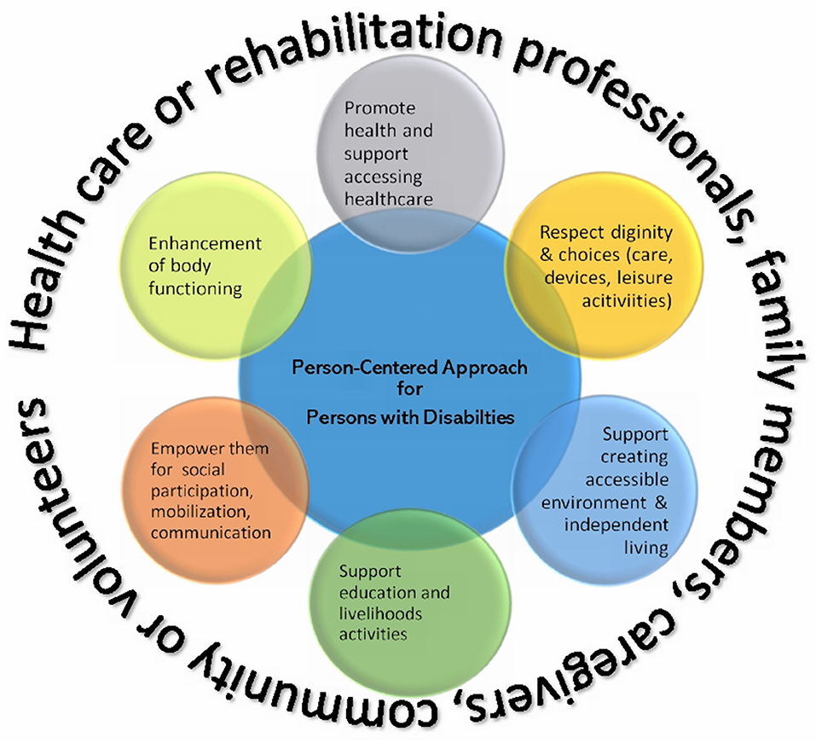
Person-Centered Care
Slide 21

Slide 22

Partnership Opportunities
Charting the LifeCourse
KDADS continues its partnership with The LifeCourse Nexus, Charting the LifeCourse.
The framework is human-centric, meaning the principles are designed to reflect the needs of people.
The key principles were initially developed to drive person-centered change for people with developmental disabilities. This has now been expanded to other populations.
The LifeCourse framework and tools can be applied to everyone and can be used to drive transformational change in practices, organizations, policies, and communities.
Slide 22

Slide 23

Partnership Opportunities
ACL Traumatic BI State Partnership Program
The Traumatic Brain Injury (TBI) State Partnership Program is a federal grant initiative administered by the Administration for Community Living (ACL). Its primary mission is to help states create and strengthen person-centered, culturally competent systems of services and supports for individuals with TBI, their families, and their support networks throughout their lives.
Kansas started this partnership in 2018 at the request of stakeholders to expand opportunities for those in our community living with brain injuries.
Slide 23

Slide 24
Partnership Opportunities
ACL Traumatic BI State Partnership Program Goals
Partnership Activities - identifying and reaching out to new partners, coordinating and aligning activities, information exchange, collaboration on grant activities, and collaboration on activities related to the grant
Planning and Infrastructure – state planning, policy and procedures development, state councils, needs assessment, surveillance, registry, IT systems
Information and Referral and Assistance (I&R/A) – bringing people and services together, answering questions from individuals and families about human service resources, helping people get connected to public benefits, and sharing information about available services like home care and adaptive equipment.
Slide 24

Slide 25
Partnership Opportunities
ACL Traumatic BI State Partnership Program Goals
Screenings - using a standardized procedure, structured interview, or tool to elicit the lifetime history of TBI for an individual. Screening can be used for clinical, research, programmatic, eligibility determination, service delivery, or treatment purposes.
Resource Facilitation – this category of activity could include developing resources such as databases, resource directories, and communication tools to improve service delivery. It could also mean helping through an accessible, holistic, and person-centered process that engages individuals in decision-making about their options, preferences, values, and financial resources and helps connect them with programming, services, and supports they choose.
Trainings, Outreach and Awareness – continuing education for professionals who may work with or provide services for people who have experienced a TBI, training for individuals who have experienced a TBI, public education and awareness, training for caregivers, on-the-job training for agency staff, and cross-training with partnering agencies.
Slide 25

Slide 26
Partnership Opportunities
ACL Grant Outcomes
Development, education, and execution of the professional conference you are attending today.
Continued growth of border state relationships with providers such as Madonna Rehabilitation Hospital and QLI in Nebraska, and Craig Hospital in Colorado, to build upon their evidence-based practices and resources for survivors in Kansas.
Improvements to the BIAKS website to improve accessibility and inclusion of a resource directory.
Slide 26

Slide 27
Partnership Opportunities
ACL Grant Outcomes
Planning for a new series of survivor events, “Survivor and Family Gatherings.” The goal of these is to create four events across the state annually, so we can expand our physical reach by connecting survivors and families in person.
This partnership has allowed Kansas access to technical support from NASHIA and ACL for continued opportunities, goals, and growth in our state.
Slide 27

Slide 28
Strategic Plan
KDADS/BIAKS Goal Categories
Advocacy and Protection
  Goal 1: To enhance the self-advocacy skills of persons with BI.
  Goal 2: Pursue funding opportunities for awareness education.
  Goal 3: Advocate in Legislative and State Agency Systems
  Goal 4: Increase prevention strategies and public education awareness
Social and Recreational Support
  Goal 1: Identify accessible facilities and activities in our communities
  Goal 2: Promote support groups that are inclusive and available statewide
Slide 28

Slide 29
Strategic Plan
KDADS/BIAKS Goal Categories
Independent Living Services
  Goal 1: Promote person-centered, trauma-informed practices to support workforces, communities, and all types of caregivers.
  Goal 2: Enhance caregiver awareness, workforce development, and all aspects of independent living
Employment/Vocational Services
  Goal 1: Working with Vocational Rehabilitation (VR) and educating VR about BI
  Goal 2: Educating the public about the benefits and working with BI
  Goal 3: Self-employment and volunteer opportunities
Slide 29

Slide 30
Strategic Plan
KDADS/BIAKS Goal Categories
Training and Education
  Goal 1: Expand learning opportunities for students, workforces, caregivers, and communities.
  Goal 2: Create alliances with organizations to support community education on BI prevention
  For more information and to participate in the BI Advisory Board or in the implementation of the Kansas Brain Injury Strategic Plan, contact:
  ~Brain Injury Association of Kansas & Greater KC (800) 444-6443 admin@biaks.org OR
~Brain Injury Waiver Program Manager, Kansas Department for Aging and Disability Services, (785) 368-6302 susan.segelquist2@ks.gov
Slide 30

Slide 31
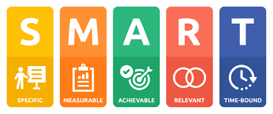
Services & SMART Goals
SMART
The BI waiver supports individuals with functional limitations from their BI and provides community-based services that address SMART goals. This approach transforms vague intentions into actionable plans with clear metrics and deadlines. SMART goals are a structured framework for goal-setting designed to increase the likelihood of success by making objectives:
Slide 31

Slide 32
Services & SMART Goals
Services
Goals and functional limitations may be supported by the following services offered on the waiver. Rehabilitative therapies are a required component of the BI waiver.
Rehabilitation Therapies: Behavior Therapy, Cognitive Rehabilitation, Physical Therapy, Speech-Language Therapy, and Occupational Therapy
Specialized Medical Equipment and Supplies, Home and Environmental Modification Services, Vehicle Modification Services
Slide 32

Slide 33

Services & SMART Goals
Services (continued)
Financial Management Services
Home-Delivered Meals
Medication Reminder Services
Personal Emergency Response System and Installation (PERS)
Personal Care Services (PCS)
Enhanced Care Services (ECS)
Transitional Living Skills (TLS): In-person services to support goals of increasing independence in the home and community
Slide 33

Slide 34
Transition Planning
Transitioning from the BI Waiver
Each person's goals and timelines are unique. On average, we see people reaching the therapy milestones within 2-4 years.
During that time, it is important to identify what happens at the end of the waiver. The participant may seek to close their services, contact an independent living center, or transition to WORKS/Working Healthy, PACE, or another HCBS Waiver for which they meet the criteria.
A minimum of 6 months active participation in therapies is required to be able to determine inability to make progress on the established therapy goals to qualify for a waiver-to-waiver transition and bypass the wait list for that waiver.
Slide 34

Slide 35

Next Steps, Closing and Q&A
Looking Ahead
Building a stronger
service network
Enhancing long‑term
supports
Increasing awareness
and early intervention
Supporting families
and caregivers
Expand provider training
Increase provider network and telehealth
opportunities in rural areas
Strengthen community
partnerships
Improve data collection
Slide 35

Slide 36
Next Steps, Closing and Q&A
Closing Remarks
  Commitment to Partnerships
  Eliminate Barriers
  We Want to Hear From You
Contact:
Susan Segelquist
Brain Injury Program Manager
Susan.Segelquist2@ks.gov
785.368.6302
Slide 36

Slide 37

Next Steps, Closing and Q&A
Q&A
Slide 37

Slide 38

THANK YOU
Thank you for your commitment to improving the lives of Kansans
with brain injuries.

